Slide 1
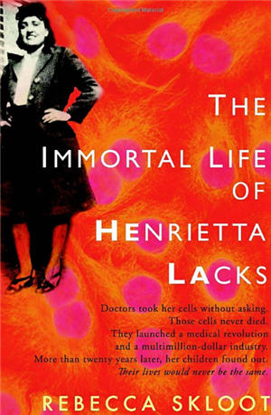

Slide 2
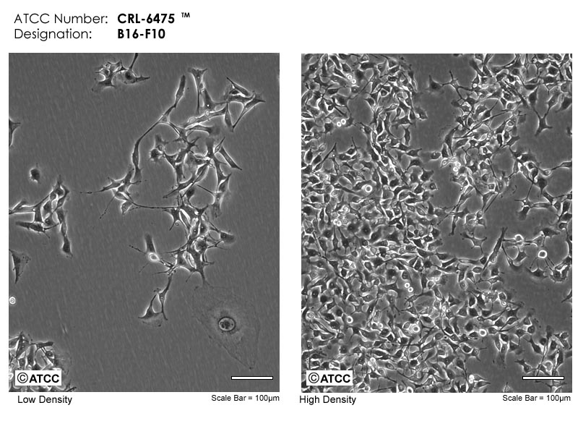

Slide 3
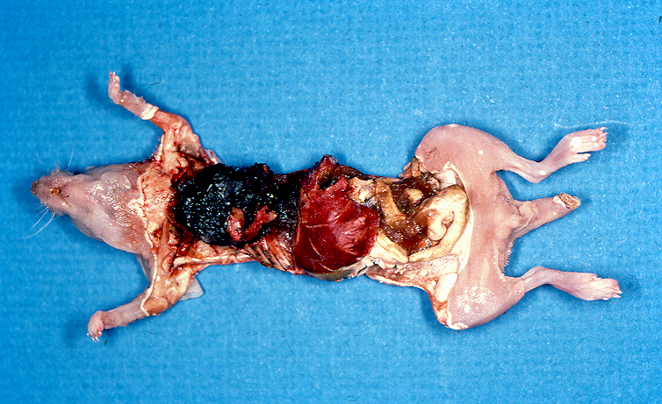
These B16/F10 cells in culture are cancerous!

Slide 4
Cancer cells are different from normal cells
Genetically
Behaviorally
Metabolically

Slide 5
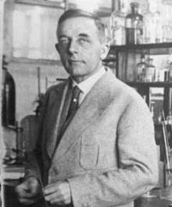
Otto Warburg, 1883 – 1970
Awarded the 1931 Nobel Prize in Physiology and/or Medicine.
The Warburg effect: cancer cells exhibit glucose fermentation even when enough oxygen is present. Since glucose fermentation is much less efficient than respiration, cancer cells consume much more glucose to get the same amount of energy.

Slide 6
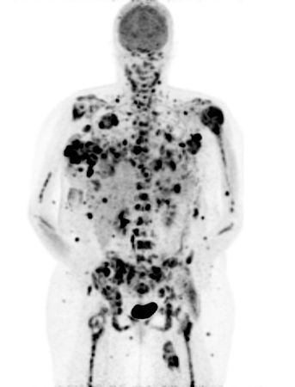
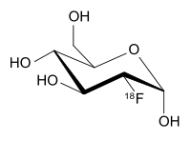

Slide 7
Glucose
Aerobic
Respiration
2 Pyruvate
2 Lactate
2 Acetyl CoA
Oxphos
+ ~30 ATP/glucose
+Oxygen

Slide 8
Glucose
Anaerobic
“Fermentation”
2 Pyruvate
2 Lactate
+ 2 ATP/glucose
2 Acetyl CoA
Oxphos

Slide 9
Glucose
Aerobic
“Fermentation”
The Warburg Effect
TUMOR
MASS
2 Pyruvate
2 Lactate
+ ~30 ATP/glucose
2 Acetyl CoA
Oxphos
+Oxygen

Slide 10
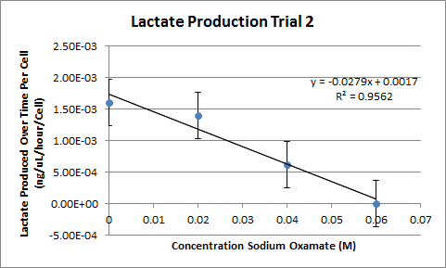

Slide 11
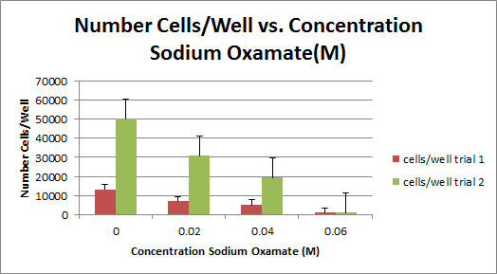

Slide 12
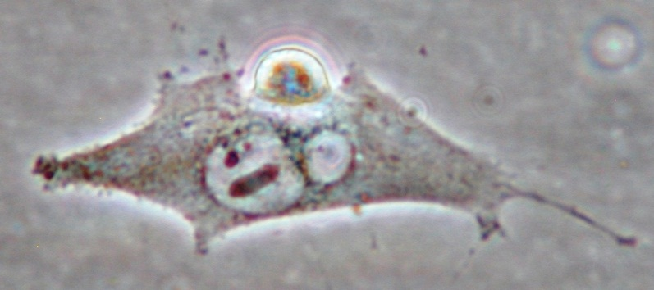
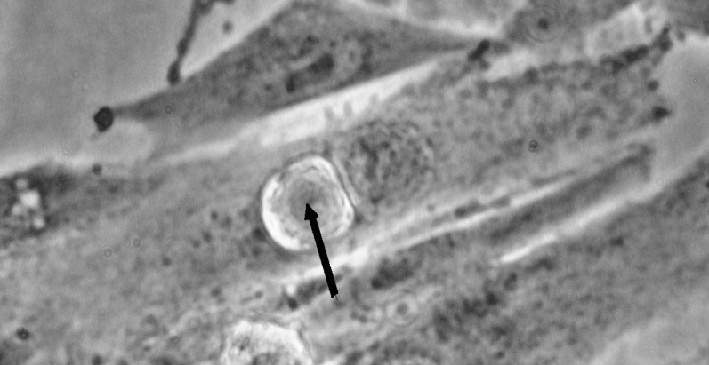
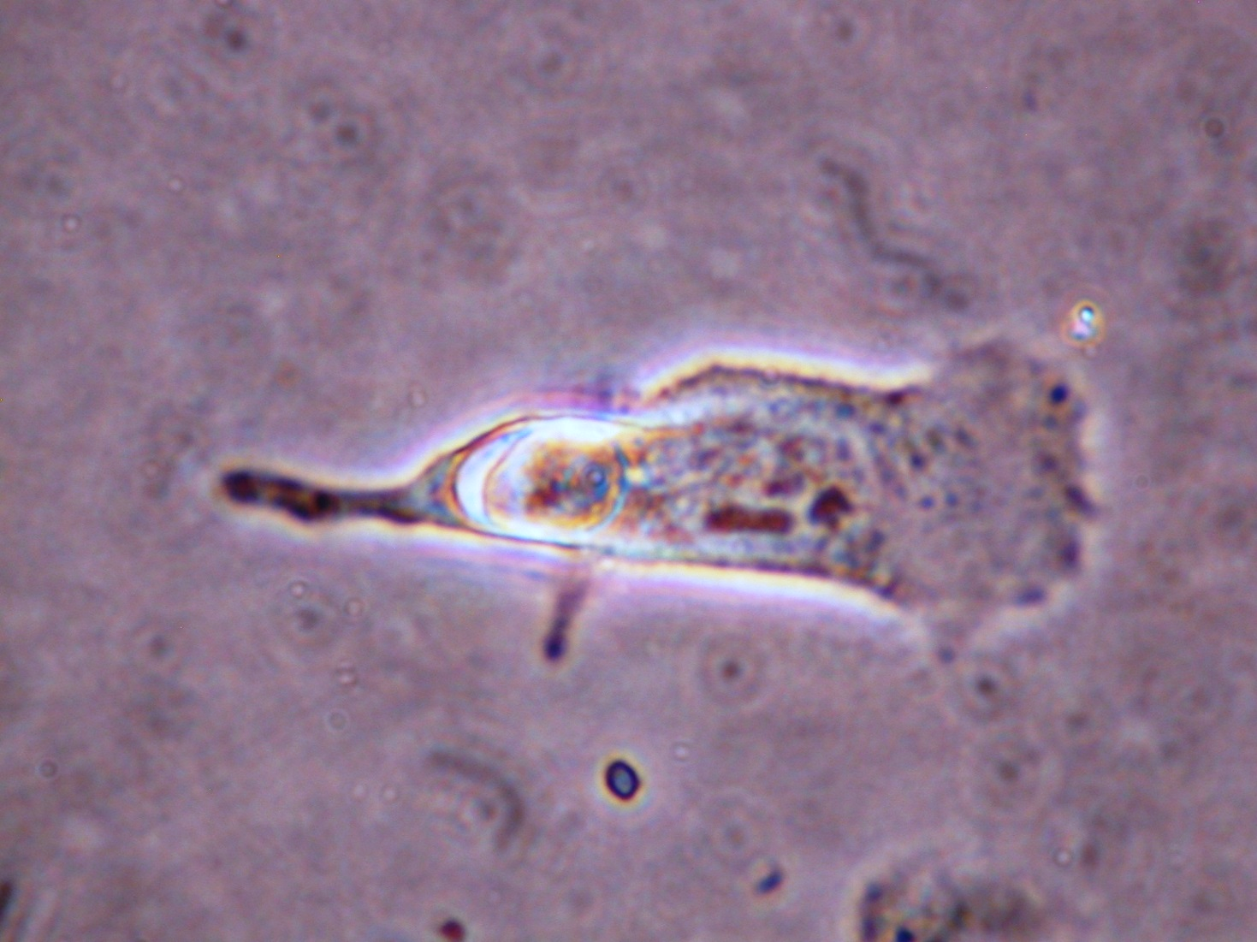
Cannibalism as a source
of fuel for tumor growth?

Slide 13
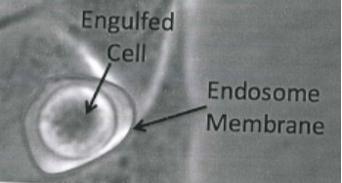

Slide 14
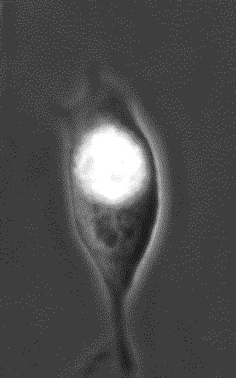
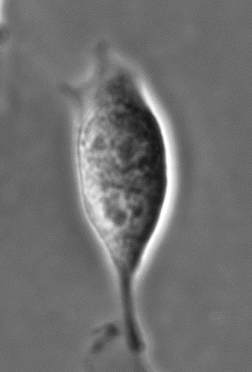

Slide 15
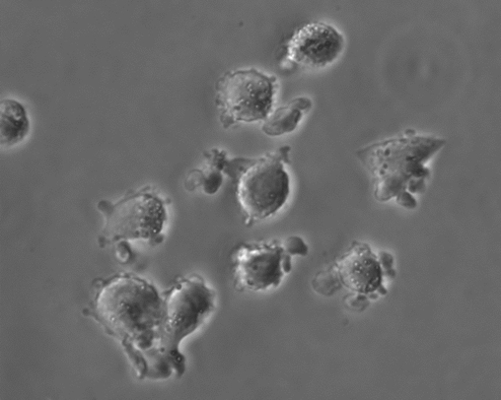
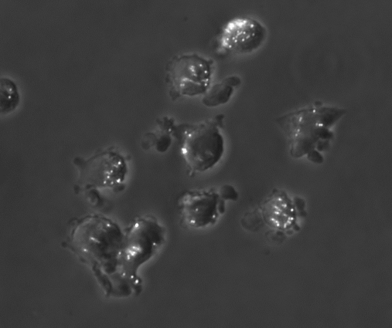
A
B

Slide 16
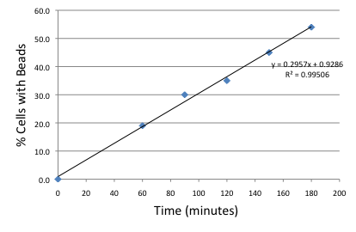

Slide 17
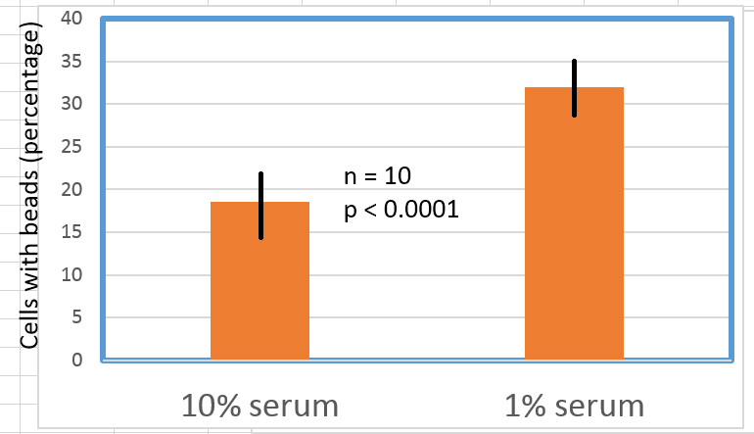

Slide 18
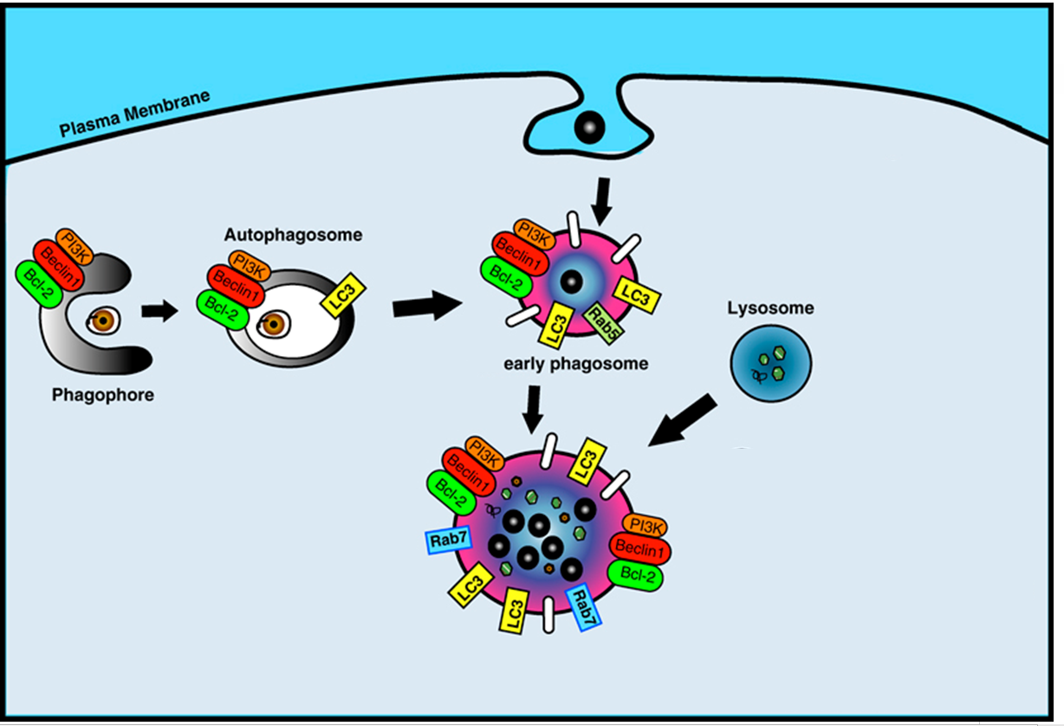

Slide 19
Only uninhibited investigators use inhibitors (Carl Cori, 1947 Nobel Laureate)
Amiloride (inhibition of macropinocytosis)
Hyaluronate (enhancement of macropinocytosis)
3-methyl adenine (inhibition of autophagy)
Rapamycin (enhancement of autophagy)

Slide 20
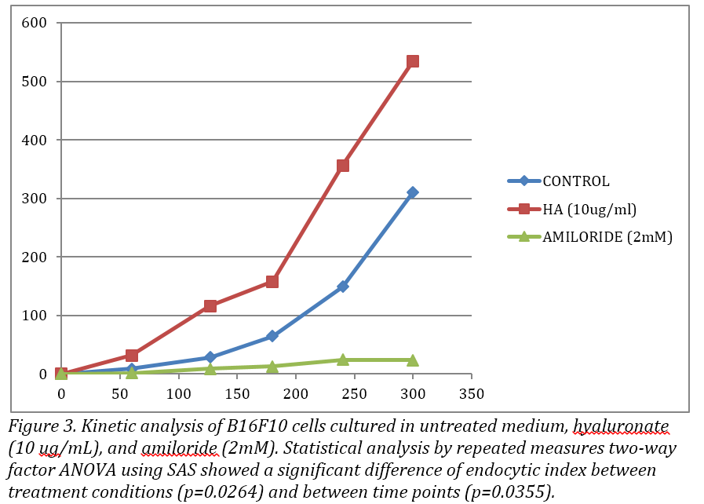

Slide 21
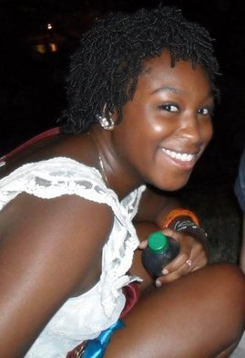
Mary Fakunle, ’12
Rutgers, New Jersey Medical School, ‘18
Shane Swink, ’13
Philadelphia College of Osteopathic Medicine, ‘18
Mariah Johnson, ’14
Lab technician.
Indiana University/Purdue University, Indianapolis
Stacy Blannett, ‘15

