Slide 1
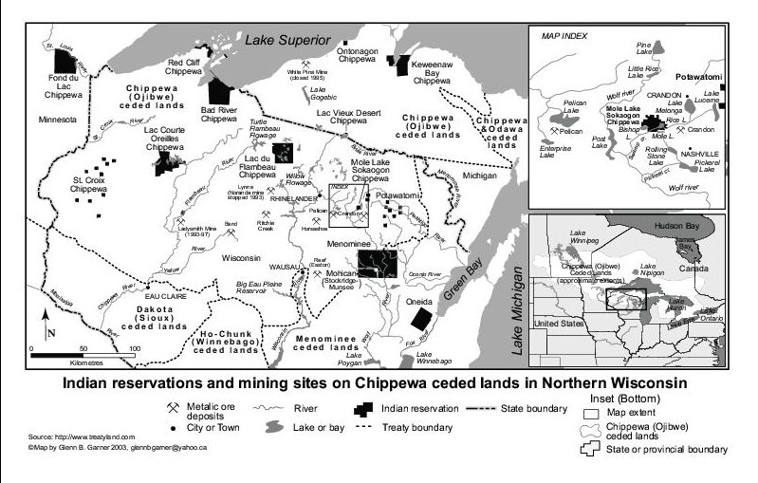
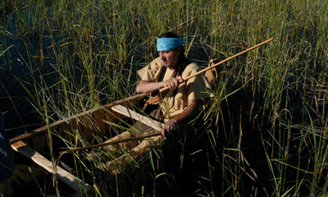
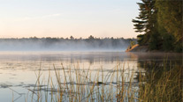
Who are the Ojibwe?
The Story of the Ojibwe (Chippewa) People
The Ojibwe people refer to themselves as the “Anishinaabeg”, meaning true or original people. Others call them “Ojibwe” or “Chippewa”, which means “puckered up” and alludes to moccasins with a puckered seam traditionally worn by the Ojibwe people. The Ojibwe are the largest Indian tribe north of Mexico, and have settled over a wide area (Milwaukee Public Museum 2010:online). They can be found in northern Wisconsin, Minnesota, North Dakota, and Ontario (Pulford1999:23). Although Ojibwe are spread out across a vast amount of land, they feel a constant connection to one another (Pulford 1999:24). They believe strongly in the idea of unity, not only with other Ojibwe, but with the natural world (Ackley).
The Sokaogon Ojibwe of Wisconsin
This poster will focus on the Sokaogon Ojibwe people, who live on a reservation in Forest County, Wisconsin (Nesper 2011:151). The Sokaogon are also known as Lost Tribe, a name given to them after part of the Treaty of 1854, which granted them legal rights to a 12 mile reservation, was lost in a shipwreck (GLITC: 2004). Because this part of the treaty was lost, the Sokaogon did not officially have a reservation until 1939 (Nesper 2011:151).
The reservation where they currently live surrounds Rice Lake, appropriately named for the large amounts of wild rice growing in it. The lake plays an important part in Sokaogon history, culture, and community life. According to their traditional history, the Sokaogon Ojibwe migrated to this location in search of “the food that grows on the water”—wild rice (Nesper 2011:153). The Ojibwe use wild rice for ceremonial, economic, and subsistence purposes (Palmer 1995:23). Harvesting of the rice brings people together and helps to encourage important community connections.
Wild Rice and Zinc-Copper:
A Story of Sokaogon Ojibwe Struggle and Success
Alyssa Bosold , Gettysburg College,
ANTH 223—Indigenous Peoples, the Environment, and the Global Economy
To What Extent Should the Idea of the “Ecologically Noble Savage” be used to Promote Environmental Stewardship and Conservation?
The “Ecologically Noble Savage” is a term used in anthropological discourse. It describes the stereotype that all indigenous people are concerned with the environment and that all indigenous cultures promote stewardship and sustainability (Redford 1991:46). There has been much debate in anthropology centered on the concept of the “ecologically noble savage” and its role in achieving environmental goals. Scholars like Kent Redford argue that the idea of the “ecologically noble savage” romanticizes indigenous people, allowing us to hold them accountable for environmental issues and to avoid taking collective responsibility for complex environmental problems. Furthermore, Redford suggests that the stereotype of the “ecologically noble savage” is incorrect. Indigenous people are a part of modern society and will often destroy the environment in order to improve their lives, just as we do (Redford 1991:48). Others, like Mark Dowie, seem to claim that despite a few examples to the contrary, most indigenous cultures will encourage stewardship, and are “ecologically noble”. He argues that indigenous people should be given the power to take the lead in conservation decision-making (Dowie 2009:247). It seems that both views—seeing indigenous as “ecologically noble” and seeing indigenous as actors in modern society—are valuable in promoting environmental stewardship and conservation.
The story of the Sokaogon Ojibwe is an example where indigenous people are both “ecologically noble” and benefit from modern society. The Ojibwe show us that both ecological indigenous culture and modern development are important aspects of environmental solutions. They help to illustrate a combination of “ecological nobility”, modern development, and cooperative alliances among different members of society that can create successful environmental action.
In some ways, the Ojibwe people are an embodiment of the “ecologically noble savage” ideal. Their culture encourages harmony with nature and their practices require excellent environmental quality. To illustrate, the Ojibwe feel “a…strong spiritual tie between everything on the land and the people” (Ackley). In particular, they feel connected to wild rice, which plays a role in their rituals, and encourages a sense of community. Because wild rice is so sensitive to changing environmental conditions and negative environmental impacts, and because it is such an important part of their culture, the Ojibwe feel that they must protect it (Palmer1995:23).
Although Ojibwe culture encourages the protection of rice and its habitat, this does not mean that indigenous Ojibwe are the only people who should be responsible for rice conservation or that modern institutions should not play a role in protection. In fact, in the Ojibwe’s case, adoption of modern developments and alliance with other environmental interest groups helped to make conservation initiatives a success. The Ojibwe’s revenue from newly developed casinos and gaming enterprises allowed them to hire lawyers to defend their environmental position and to buy land from extractive industries, eventually ending the environmental threat to Wolf River and Rice Lake. The Ojibwe worked closely with other indigenous groups, environmental organizations, tourist groups, sportsmen’s clubs, and the United States Government, developing a broad and advanced network to achieve their conservation goals (Palmer 1995:23). They held ecologically noble intentions, but used the advantages of modern society to help them achieve these objectives. The Ojibwe successfully embraced the idea of the “ecologically noble savage” while acting within a modern context to work toward environmental solutions.
Although this approach worked for the Ojibwe, it may not work in other situations. As Redford suggests, some groups may not be “ecologically noble”, and should not be trusted with conservation decision-making (Redford 1991:48). In other cases, working with modern actors may not be possible or could lead to negative outcomes. It seems that each problem involving indigenous people and the environment is unique, requiring a different solution. We cannot rely entirely on the good environmental intentions of the indigenous or the assets of modern society to save the day in all situations. Instead, we must carefully examine environmental problems on a case by case basis to come up with helpful combinations of both indigenous and modern influences that will create effective and truly sustainable solutions.
Sokaogon Ojibwe reservation land and the proposed mine location are circled in red.
(From the website “The International Development Research Center”)
Indigenous Networks and Connections: Strategic Alliances to Stop Exxon
Alliances between Native Americans, government agencies, non-governmental organizations, and other members of society became instrumental in challenging the mine proposed by Exxon. The groups formed helped to raise awareness about the issue, take legal action and gather important support. Below is a list of organizations that played a role in opposing and preventing mining:
Nii Win Intertribal Council- This is a group of four tribes—the Sokaogon , Menominee, Potawatomi, and Mohican—that used money generated by casinos to challenge the proposed mine.
Wolf Watershed Educational Project- This organization was responsible for bringing Native Americans around the state of Wisconsin to make public speeches against the mine.
Environmental Protection Agency (EPA)-The EPA granted the Sokaogon Ojibwe the right to monitor and regulate water quality on their reservation, allowing the Ojibwe to stop industries from contributing large amounts of water pollution to the Wolf River.
The Town of Nashville- Members of the town of Nashville, who would also live near the proposed mine, joined with the Ojibwe. Together, they opposed the mine and to searched for new economic opportunities to replace the jobs that would have been created by the mining industry.
Northwood Niijii Enterprise Community- This is an alliance between the Menominee Nation, the Lac du Flambeau Tribe, the Sokaogon Ojibwe and members of the towns surrounding their reservations. This group also looked for new economic opportunities to replace mining and to strengthen and stabilize fiscal conditions in the community.
Watershed Alliance to End Environmental Racism (WATER)-This alliance came as a result of Ojibwe opposition to Exxon and helped to promote Native American environmental and political rights.
Information from this section summarized from Native Resistance to Multinational Mining Corporations in Wisconsin, by Al Gedicks- (Gedicks 2001:online)
Ojibwe Man Harvesting Rice; (From the website “Manoomin: Ojibwe Wild Rice”
Threats to Ojibwe Culture and Environment
Overview
In 1976, Exxon Minerals located a zinc-copper deposit in Crandon, Wisconsin, at the headwaters of Wolf River, which runs into Rice Lake (Gedicks 1993:61-62). The company announced a plan to create a mine on the site of this deposit. The proposed mine would have negative environmental impacts for the entire Wolf River watershed. In particular, it would affect the wild rice growing on Rice Lake and threaten the environment, economics, and culture of the Sokaogon Ojibwe (Palmer 1995:23).
Environmental Impacts
The construction of the mine and related facilities would destroy 30 acres of wetlands and produce 60 million tons of material waste. Furthermore, the mine would potentially deplete groundwater sources in the area by using 15 trillion tons of fresh water over its life. Also, 44 million tons of toxic waste (called “tailings”) would be created by the mine. This waste would be stored in underground dumps near the head of Wolf River. Potential leaks could cause contamination of the river and an end to the life within it (Palmer 1995:23).
Impacts on the Sokaogon Way of Life
Wild rice is very sensitive to changes in environmental conditions. If the mine contaminated Mole Lake, or reduced the water within the lake, the Ojibwe’s important wild rice could die off. They would no longer have the staple food in their diet or the significant income made from selling the rice. Furthermore, traditions and ceremonies regarding wild rice would lose their significance (Gedicks 2001:online). For example, wild rice is currently being exchanged to revive the traditional Ojibwe gift-giving economy. Without the wild rice, this traditional economy might cease to exist (Nesper 2011:153).
Results
Thanks to the help of strategic alliances between other native tribes, local people, environmental groups, sporting and tourist industries, lawyers, governmental agencies and money earned from Ojibwe casinos, efforts to stop the proposed mine were successful (Gedicks 1993:78). In 2003, the company’s land was transferred to the Ojibwe bands of Forest County, Wisconsin and the mining project was abandoned (Nesper 2011:159).
Rice Lake; (From the website “Discover Wisconsin”)
Reference Cited
Ackley, Fred
Sokaogon (Mole Lake) Ojibwe, Wisconsin. Electronic document, http://www.ojibwe.org/home/pdf/Ackley_Sokaogan_Econ.pdf, accessed April 27, 2011.
Discover Mediaworks
2011 Discover Wisconsin. Electronic image, http://www.discoverwisconsin.com/Destination.aspx?sdid=1959, accessed May 1, 2011.
Dowie, Mark
2009 Conservation Refugees. Cambridge: MIT Press.
Garland, Sandy
2004 The International Development Research Center. Electronic image, http://www.idrc.ca/IMAGES/books/004/wayofdevelo_196_la_0.jpg, accessed May 1, 2011.
Gedicks, Al
2001 Native Resistance to Multinational Mining Corporations in Wisconsin. Electronic document,
http://www.culturalsurvival.org/ourpublications/csq/article/native-resistance- multinational-mining-corporations-Wisconsin, accessed January 22, 2011.
Gedicks, Al
1993 The New Resource Wars: Native and Environmental Struggles Against Multinational Corporations. Boston: South End Press.
(GLITC) Great Lakes Inter-Tribal Council
2004 Sokaogon Chippewa Community. Electronic document, http://www.glitc.org/pages/scml.html, accessed May 1, 2011.
Great Lakes Indian, Fish, and Wildlife Commission
2011 Manoomin: Ojibwe Wild Rice. Electronic image, http://manoomin.com/Recipes.html, accessed May 1, 2011.
Loew, Patty and James Thannum
2011 After the Storm: Ojibwe Treaty Rights Twenty-Five Years after the Voigt Decision. American Indian Quarterly 35(2):161-184.
Milwaukee Public Museum
2010 Indian Country: Ojibwe History. Electronic document, http://www.mpm.edu/wirp/icw-151.html, accessed April 27, 2011.
Nesper, Larry
2011 Law and Ojibwe Indian “Traditional Cultural Property” in the Organized Resistance to the Crandon Mine in Wisconsin. Law and Social Inquiry 36(1): 151-169.
Palmer, Rose
1995 Exxon vs. Wisconsin’s Chippewa. Earth Island Journal 11(1):23.
Pulford, Mary
1999 Culture Maintenance: An Ojibwe Case Study. Teaching Anthropology: SACC Notes 6(1): 23-32.
Redford, Kent
1991 The Ecologically Noble Savage. Cultural Survival Quarterly 15(1):46-48.
An Unexpected Alliance
From the early 1960’s, sport fishermen and Sokaogon Ojibwe have been in conflict. After Ojibwe successfully contested court orders to restrict tribal commercial fishing rights (granted in an earlier treaty), sport fishermen responded angrily. They threatened Ojibwe who tried to fish with, “logs and rocks blocking their access to boat ramps, nails placed to puncture truck and trailer tires, sand poured in gas tanks, attempted boat swampings, and rifle shots” (Loew and Thannum 2011:63). However, in the 1990’s, in response to the proposed mine, sport fishermen joined with the Ojibwe, “realizing that if…mines were allowed to contaminate rivers…there might be nothing left to argue about “ (Gedicks 2001:online).

