Slide 1
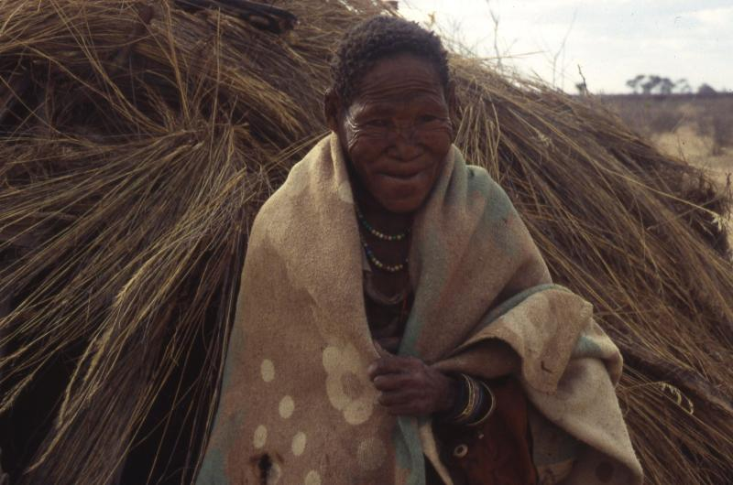
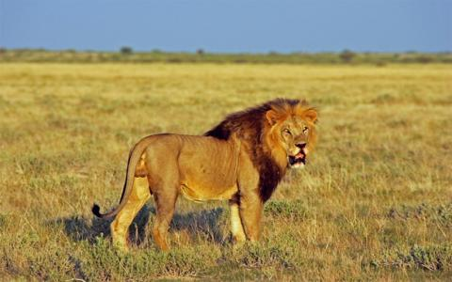
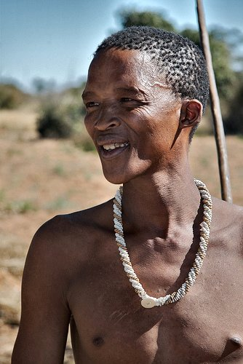
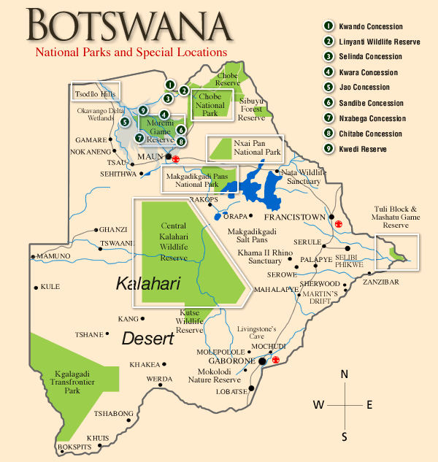
THE ANIMALS OR THE BASARWA: WHY CAN’T BOTSWANA FIND A COMPROMISE? Kate White Gettysburg College ANTH 223-Indigenous Peoples, the Environment, and the Global Economy
THREATS TO THEIR LIVES!!
In 1968, many Basarwa lost land in the Tribal Act. The dominating ethnic group, the Tswana gained much of the land redistributed by the government, but the Basarwa were given the CKGR (Marobela 2010). The, “Central Kalahari Game Reserve (CKGR) was originally set aside in 1961 by colonial authorities to protect Bushman life ways and culture. Approximately the size of Wales, CKGR is the second-largest game reserve in all Africa, whereas the New Xade camp is about the size of an average Texas trailer court,” (Dowie 2009, 142). There is a continuous issue among governments dealing with hunter-gatherer indigenous groups. The idea of no land ownership causes many to lose out on any land at all. So when the Botswana government created the CKGR, the Basarwa were stripped from their homes. Even though the Botswana government has tried to treat the Basarwa with respect initially, there was an increasing amount of harsh treatment towards the Basarwa. Many Basarwa were relocated outside of their land that their ancestors had lived on for thousands of years. This event occurred between 1997 and 2002. The government claimed that the Basarwa were receiving the gifts of ‘development’ and new prosperity, while the wildlife could be saved from extinction. Marobela states that, “those Basarwa who resisted experienced torture and killings, and were forced into open trucks. When relocation ended in 2002, the government capped the borehole, the only source of water for communities residing there,” (Marobela 2010, 140).
The Basarwa did fight back. In the face of other issues threatening their traditional ways of life such as HIV/AIDS. There has been an increasing amount of infection since many Basarwa have been exposed to more ‘development’. The Basarwa formed the group the First People of the Kalahari in 1991 (FPK) and went after the Botswana government in 2002, using the national judicial system (Marobela 2010, 141 DITSHWANELO, 2010). This was all to combat the government who on the, “31st January 2002, the Government of Botswana ceased the provision of basic and essential services to all Basarwa and Bakgalagadi remaining in the CKGR (both Basarwa and Bakgalagadi have lived in the CKGR, although ‘Basarwa’ tends to be understood to include the Bakgalagadi). Immediately after the Government cancelled the services, officials dismantled the existing service infrastructure, such as water tanks, and dumped the community’s water reserves into the ground. Since January 2002 the residents have also been banned from hunting in the Reserve,” (DITSHWANELO, 2010). After four years of struggle in court the UN came in to the picture. “On 10 March 2006 the UN's Committee on the Elimination of Racial Discrimination (CERD) noted its concern at “persistent allegations that [Bushmen] were forcibly removed, through, in particular, such measures as the termination of basic and essential services inside the Reserve, the dismantling of existing infrastructures, the confiscation of livestock, harassment and ill-treatment of some residents by police and wildlife officers, as well as the prohibition of hunting and restrictions on freedom of movement inside the Reserve,” (DITSHWANELO, 2010). The most major threat to the Basarwa is conservation. The Botswana government forcibly removed all the Basarwa from the Kalahari Game Reserve and moved them to the resettlement camps outside the borders of the Reserve. The publicized goals of the government’s actions were to bring the Basarwa out of the ‘stone age’ and into the age of modernity, as well as to protect the, seemingly, diminishing wildlife. The Bawarwa had according to Foreign Ministry spokesman, “outgrown their traditional lifestyle and were killing off the reserve’s animals. That assertion is contradicted by a botwana Department of Wildlife and National Parks study, which reports that the population of all hunted species has doubled over the past decade,” (Dowie 2009, 146). But the government’s actions committed an illegal act according to the constitution. An example of the abuse it told in Roy Sesana’s account, “Sesana describes returning from an extended hunting trip one day to find that government officials had razed his entire village, destroyed his water source, and forced his nine children and two wives into trucks, transporting them like cattle to New Xade. He had no other option but to follow his family, which took him three days on foot. “Being here is like being a prisoner of war,” Sesana says. “If I’d had my way, I would have physically resisted the eviction and would not be here at all.” He truly believes, “they would have killed me had I stayed put,”” (Dowie 2009, 142-143). The Basarwa were able to prosecute the Botswana government, “citing a constitutional provision, and petitioned to have the evicted Bushmen returned to their homeland in the Central Kalahari Game Reserve,” (Dowie 2009, 147). Even against the state, the FPK were able to appeal against the rejected prosecutions, and on, “December 12, 2006, the court ruled two to one that the San had been “wrongfully deprived of their possessions,” their eviction from the CKGR was unlawful and unconstitutional, and they had the right to return to their former settlements in the reserve and to hunt there for their food,” (Dowie 2009, 147). Even though the Basarwa won the court case, they are still being denied the right to hunt on the Kalahari Game Reserve where they live. This limits their capabilities to get food and to eat.
SPEECH MADE BY ROY SESANA, ELECTED LEADER TO REPRESENT THE BASARWA – to the Parliament of Sweden
I am a leader. When I was a boy we did not need leaders and we lived well. Now we need them because our land is being stolen and we must struggle to survive. It doesn’t mean I tell people what to do, it’s the other way around: they tell me what I have to do to help them.
I cannot read. You wanted me to write this speech, so my friends helped, but I cannot read words – I’m sorry! But I do know how to read the land and the animals. All our children could. If they didn’t, they would have all died long ago.
I know many who can read words and many, like me, who can only read the land. Both are important. We are not backward or less intelligent: we live in exactly the same up-to-date year as you. I was going to say we all live under the same stars, but no, they’re different, and there are many more in the Kalahari. The sun and moon are the same.
…
Why am I here? Because my people love their land, and without it we are dying. Many years ago, the president of Botswana said we could live on our ancestral land forever. We never needed anyone to tell us that. Of course we can live where God created us! But the next president said we must move and began forcing us away.
They said we were killing too many animals: but that’s not trie. They say many things which aren’t true. They said we had to move so the government could develop us. The president says unless we change we will perish like the dodo. I didn’t know what a dodo was. But I found out: It was a bird which was wiped out by settlers. The president was right. They are killing us by forcing us off our land. We have been tortured and shot at. They arrested me and beat me.
…
I say what kind of development is it when the people live shorter lives than before? They catch HIV/AIDS. Our children are beaten in school and won’t go there. Some become prostitutes. They are not allowed to hunt. They fight because they are bored and get drunk. They are starting to commit suicide. We never saw that before. It hurts to say this. Is this “development”?
The Basarwa of Botswana
The Basarwa are an egalitarian society living across Southern, Kweneng, Kgatleng, Ghanzi, Kgalagadi, Central and North West Districts of Botswana (DITSHWANELO, 2010). Historically they lived a hunting and gathering lifestyle where they pursued plants, water sources and animals for food. They were nomadic, until in recent decades where they have been forced to live in the confines of the Kalahari Dessert Game Reserve. They lived a lifestyle where they harbored only what they needed for subsistence, and they never remained completely sedentary. In more recent times, some have wanted to begin agricultural lifestyles since they cannot traverse the land like they did before. This is a challenge to their cultural traditions. The Basarwa have been treated in as the lowest ethnic community, and historically have not been given full human rights. But independent Botswana has tried to implement equality measures, and provide the Basarwa with equal opportunities. Unfortunately the Tswana still reign as a dominant class, and they have gained much of the land in the redistribution. The Basarwa have been promised land to live on, but there has been little evidence of this, and now the Basarwa are even being kicked off the Kalahari Game Reserve. While the government has pushed the Basarwa to unify and work together to push for rights, the Basarwa find this difficult since they are traditionally an egalitarian society. Cultural Survival describes how it is difficult for the Basarwa to organize and choose leaders and headman, since this is a foreign concept to them.
The Basarwa were relocated off their ancestral land by the post-independence Botswana government to help bring ‘development’ to the indigenous people and ‘protect’ the wildlife. But underlying reasons for the forced relocation could have been, according to Mark Dowie, in pursuit of diamonds, “Diamonds were suspected because they generate 64 percent of the Botwana’s gross domestic product (GDP). They are the country’s largest export, generating 70 percent of Botswana’s foreign exchange and about 50 percent of government revue. Debswana Diamond Company (Pty) Ltd. is a partnership jointly owned by DeBeers and the government of Botswana. Many government ministers are also on the Bedswana board of directors. In 2001 Debswana sold $2.3 billion of diamonds (almost 30 percent of the world market). However, because diamonds are so widely associated with gunrunning, bloodshed, and genocide, the government may have chosen to publicize a more respectable motive for relocating the Bushmen – wildlife conservation,” (Dowie 2009, 141).
“Ancestral DNA markers that turn up frequently among the San people suggest they are closely related to the ancestry of all humans. We may all be Bushmen. The Bushman’s homeland once ranged from what is now South Africa through Namibia and deep into Botswana and into Angola, Zambia, and Zimbabwe. Bushmen currently number about ninety thousand, and speak an assortment of dialects characterized by click consonants. Their language family is called !Ui. Archaeological data indicate that Bushmen once had a fairly advanced culture dating back over ten thousand years, when early ancestors from the Botswana region migrated to the Waterbery Massif. Rock paintings at Lapala and Goudriver record a life in close harmony with rhinoceros, elephants, and a variety of antelope species resembling the impala, kudu, and eland, all of which still remain in the Kalahari,” (Wells 2003, 54-56; Dowie, 144). In 1965, the Basarwa were forced to change their style of living because a fence was erected to divide Namibia and Botswana. This disrupted the migratory pattern of their nomadic lifestyle. Many Basarwa resorted to becoming more sedentary living in migrant villages. Instead of hunted and gathered food being their main subsistence they now depended on, “Domestic animals, sugar, garden produce, and porridge of ground maize they call “mealie-meal” became their major foods,” (Wells 2003, 54-56; Dowie 2009, 145). The population of Basarwa practicing traditional methods of living in a hunter-gatherer style has dramatically decreased. They travel across the allotted land ‘given’ to them in the Kalahari by the state in small groups in pursuit of water and food sources. They still construct their temporary houses, “made from branches tied together in a semicircle with grass tufts on top, blend into the bush. The men hunt with bows and arrows tipped with poison, the women gather,” (Wells 2003, 54-56; Dowie 2009, 146).
Photo from the website, “Africa Adventure”
Photo from the website, “Carol Ann Bassett”
Photo from the website, “Zanzibar trading”
What solution could solve the issue of conservancy but also gives the Basarwa the ability to carry on a life they have practiced for decades, maintaining cultural traditions?
The only apparent solution would be to form a compromise between indigenous desires and the pursuit to protect flora and fauna. Dowie suggests this in his work, and this is articulated as well by Marabelo, but if management of the wildlife-protected area could be controlled by the Basarwa, and conservation organizations could work with them to help use available technology and resources to be aware of land properties the Basarwa can live in their homelands and work manage the wildlife, since they already no the land very well. The Basarwa have been able to look after the Kalahari Game Reserve for so long, that they should be given the rights to take care of the land they know, and interact with the animals they have respect for. There is a far smaller population of Basarwa who want to live in the reserve than there was before, so why should there be such a pursuit to strike down their livelihoods? To hunt them down like animals, and not treat equal to a human being is an utterly ignorant and colossal human rights tragedy. How to deal with the diamond factor is harder to solve. Botswana’s government obviously wants access to diamond sources because it is such a large part of incoming money flows. Should a whole parcel of land be sacrificed for a chance to part take in an extractive resource industry? This calls into the question how people feel morally. Some would not see such an importance for protecting three thousand people, while other would scream that the Botswana government was imposing cultural genocide. At some point the diamond industry will end and where will the Basarwa be then? More investigation is needed to help solve the adverse effects of the diamond industry.
Photo from the website, “Ngoko”
Bibliography
Bassett, Carol A. "Basarwa woman & grass hut." Carol Ann Bassett: Author & Journalist covering natural resources and traditional cultures. <http://www.carolannbassett.com/gallery/v/botswana/Basarwa+woman+_amp_+grass+hut.jpg.html>. (accessed April 28, 2011).
Dowie, Mark. Conservation refugees: The Hundred-Year Conflict Between Global Conservation and Native Peoples. CambridgeMassachusetts and London, England: MIT Press, 2009.
Marobela, Motsomi N. "The State, Mining and the Community: The Case of Basarwa of the Central Kalahari Game Reserve in Botswana." Labor: Capital and Society. 43, no. 1 (2010): 138-154.
"Basarwa." Zanzibar Trading. <http://www.zanzibar-trading.com/>. (accessed May 05, 2011).
"Central Kalahari Game Reserve." Africa Adventure. <http://www.africa-adventure.com/places/central_kalahari_game_reserve>. (accessed May 03, 2011).
"Ethnic Minorities and Indigenous People." Ditschwanelo: Botswana Centre for Human Rights. <http://www.ditshwanelo.org.bw/ethnic.html>. (accessed April 20, 2011).
"National Parks and Special Locations: Botswana." Return to the Wild: Ngoko Safaris. <http://www.ngoko.com/botswana/bots_locations.htm>. (accessed May 03, 2011).
DITSHWANELO is a human rights group advocating for equal rights for the Basarwa. They are working with them in the ongoing court case against the Government of Botswana.
Go to http://www.ditshwanelo.org.bw/ to learn more.

