Slide 1
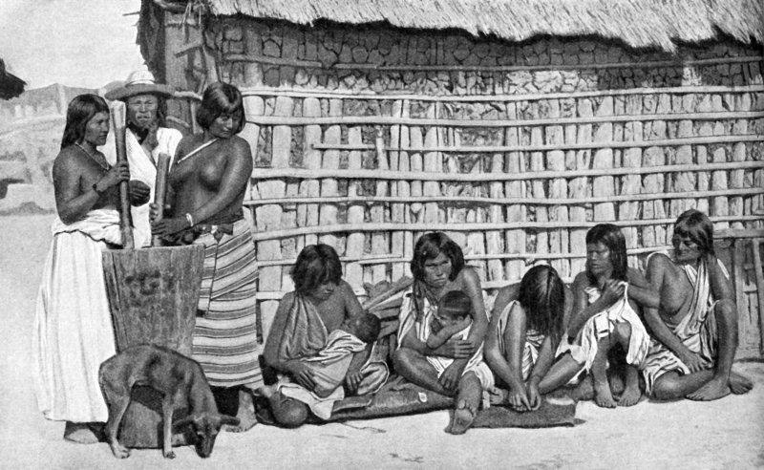
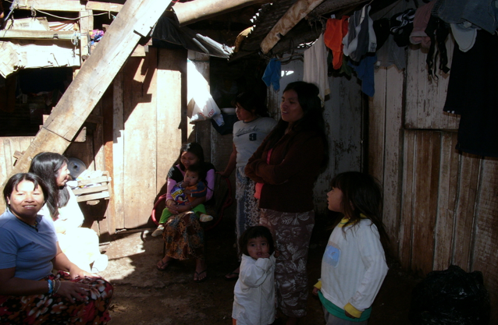
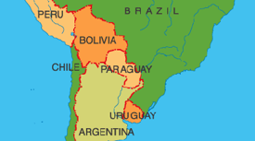
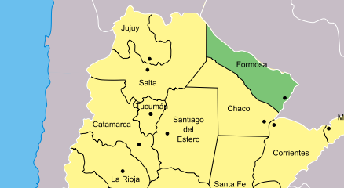
The Gran Chaco Indians of Bañado La Estrella
Formosa Region
Western Paraguay∙ Eastern Bolivia ∙ Northeastern Argentina
Siobhan Tooze –Gettysburg College – Anthropology 223 Indigenous People, the Environment and the Global Economy
Picture from website Probert Encyclopedia, Indians of Gran Chaco in Argentina in 1935.
http://www.probertencyclopaedia.com/photolib/people/Indians%20of%20the%20Gran%20Chaco%20Argentina%20c1935.html
Picture From website Maka Paraguay; family outside of their urban housing 2009.
http://www.genteindigena.org/maka.html
Conceptual Question: “Bañado Estrella presents, Fermosa an anguishing paradox of fishermen and fish dying virtually alongside each other” (Cultural Survival; the deadly paradox of Banado La Estrella). How has this situation occurred?
Urban resettlement and the relocation of the Gran Chaco Indians who live throughout the Bañado La Estrella of Western Paraguay, Eastern Bolivia and Northeastern Argentina, in what is know as the Formosa region,to the impoverished outskirts of the towns along the National Highway 81 has led to the destruction of their traditional ways of life. Relocation forced by human intervention in the area, the development of trades aimed to stimulate the economy of Formosa, the redirection and in some cases damming of the rivers which provide their main food source, and the creation of the two protected areas the Río Pilcomayo National Park and the Formosa National Reservehas left the Gran Chaco people displaced from their food source and in famine and ill health. These new living conditions have most life threateninglyincreased their rates of tuberculosis as well as creating social problems. Their previously strong tribal groups have become socially dismembered by moving from their original homescausing them to loose their traditional ways of live whilst increasing rates of alcoholism, prostitution and other problems related with living in low standard urban communities. However they remain within reasonable reach of their main food source, fish but due to the increasing pollution and lack of indigenous knowledge and resources to transport the indigenous people simply cannot transport or store the quantity of fish they need to survive.
Background of The Indigenous People- The Gran Chaco : The area originally inhabited by theGran Chaco, Bañado La Estrella, a large part of the Formosa Providence,is vast and spans more than 1 million square kilometers across The Formosa region first came into human inhabitation around 6,000 years ago and was settled by various peoples, who peacefully coexisted there. Overtime the collection of indigenous who inhabit this are became known as the Indians of the Gran Chaco. There are over 50 different indigenous groups who share over 17 different languages. The three largest indigenous groups in the area are the Toba, Pilagá, and Wichí, who in only in the past 100 years of national colonial advancement are now in a dismal state of material and cultural impoverishment. The traditional form of sustenance for the Gran Chaco people is the fish that they harvest from the Pilcomayo and Bermejo river and the other tributaries that spread off from this river. They eat a huge variety of “regional fishes such as shads, ox-eyed cackerels, catfish, piranhas, and eels. The sábalo fish stands out as the most abundant and ubiquitous. This fish is a staple and a symbol for the Indians”(Cultural Survival; the deadly paradox of Banado La Estrella). Fish is also believed to be these indigenous people’s favorite food and without it they are unable to survive.
Threats faced by the Gran Chaco: Sadly the Indians of the Gran Chaco face several different issues that compromise their original environment and lands available that they can use.
The introduction of economic schemes by the Argentinean government that has turned the previously minimally used land area into one now over worked with agricultural cultivation, cattle grazing and more in an attempt to stimulate the areas economy. “Wood, textiles and tannery sectors stand among the most saliently developed industries in this province. Some of the industries developed in this country comprise factories devoted to wooden, parquet, and tannine furniture manufacturing, sawmills, coal and wooden didactic toys manufacturing, picking systems, cotton spinning, rice drying and manufacturing, cassava starch manufacturing, corn grinding, dairy farming, cold cuts, and cold meat packing centre's” (Argentina tourism board website).
Pollution from the development of industry and other practices in the area is killing much of the areas wildlife, specifically fish.
The forced relocation of many of the people in the area by the governments economic projects as well as the creation of conservation and reservation areas such as the Río Pilcomayo National Park and the Formosa National Reserve. The areas to which they have been relocated are often dramatically smaller than there home lands and unsuitable for their use, forcing them into urban settings removed from traditional ways of life.
The removal from their main food source leaves them unable to satisfy their dietary requirements, and they lack the knowledge to transport food from their lands “The answer is tragically simple: They do not have the transportation means to travel the average 40 kilometers between their settlements and the Bañado or the river. They also lack the technology to carry and preserve the fish” (Cultural Survival; the deadly paradox of Banado La Estrella).
The Gran Chaco Indians also face the threat of tourism as the government of Argentina seems to be becoming aware of the popularity and attraction of Indigenous people, and have become exploiting the indigenous who remain in this area “Formosa is also known for its large population of indigenous communities, mainly those of Tobas, Wichis and Pilagás native Indians. That is why it is the hosting venue for the “Encounter of Indigenous Peoples of America”, which involves an event gathering indigenous representatives from different kinds of entities”( Argentina tourism board website).
Background on the original homeland- The Bañado La Estrella Area: The Bañado La Estrella is the area of wetlands fed by the Pilcomayoand the Bermejo river is the area of the Formosa region most commonly inhabited by the Gran Chaco Indians. In the heart of this area remains the relics of the regions original landscape, no longer allowed for use by the Gran Chaco due to pollution, cultivation or conservation. “The Bañado La Estrella is not only rich in cultural variation but also in biological diversity. It hosts species from both the neotropics and the temperate southern pampas, including peccaries, tapirs, jaguars, pumas, deer, armadillos, anteaters, maned wolves, cavies, vizcachas, rheas, and guans. Many of the local indigenous people used the Pilcomayo, Bermejo, and Bañado’s resources. The Toba, Pilagá, and Wichí rely heavily on fishing for their subsistence.” (Cultural Survival; the deadly paradox of Banado La Estrella) The location between the two rivers in the area, the Bermejo and Pilcomayp makes the area slightly wetter than the areas surrounding it, making it more subtropical which is a large part of the reason the vegetation and biodiversity is so greatly increased in the area. The rains are also uniform and annual which helps to create some stability in the lagoons and creeks that form throughout the wetlands in which huge numbers of wildlife life.
- Formosa: Formosa is the larger region of land within which Bañado La Estrella lies “Its name stems from the Castilian word “fermoso”, meaning “beautiful”, a term chosen to convey the beauty characterizing the region” ( Argentina tourism board website). It is characterized by a patchwork of savannah grasslands and semi-arid vegetation, with forests lining the riverbanks, which provide the main food source for the inhabitants of the area. Most tragically
The Formosa region is shown above with the corresponding area of South America below, to give the reader a clearer idea of where the region falls.
Picture to the left http://www.greece-map.net/south-america.html
Picture to the Right http://en.wikipedia.org/wiki/Formosa_Province
Help the Gran Chaco are receiving: Most tragically very few people are aware not only of the Gran Chaco Indians and of their plight and struggles against eviction and destruction of their homes. There are a few companies attempting to provide the Gran Chaco people with aid, but they remain a relatively unknown groups in need of help. The most significant source of aid is that given by the long-term UNDP project who began working with the Gran Chaco in 1983 to attempt to stabilize the land lost by the indigenous people as well as to provide them with tools to keep up with the development surrounding them. Fair-trade has recently begun working with an indigenous group to provide them with the opportunity to produce black honey, for which they are given fair and competitive prices unlike the prices and wages they often receive working for the honey farms set up through the government. There was also a CD made by Lyricord in the 1990’s of traditional Gran Chaco music and chanting which returned a percentage of the profits to the peoples the taped to make the music, however the CD was unpopular and is no longer in wide distribution.
.
Bibliography:
2009: Argentinean Tourism board. Fermosa, the green empire
http://www.en.argentina.ar/_en/tourism/C1491-formosa-the-green-empire.php
2009: Indigenous People of The World Collection of Photography
http://www.genteindigena.org/maka.html
Braunstein, Jose. A.
2003 The Deadly Paradox of Banado La Estrella.
Cultural Survival Spring Issue 27:3.
2000: Riveros, Fernando
Electronic Document http://www.fao.org/ag/AGP/AGPC/doc/Bulletin/Granchaco.htm
Solanti Miller, Atossa
1998 Arteries for Global Trade Threaten Amazonia.
Cultural Survival Winter Issue 22:4.

