Slide 1
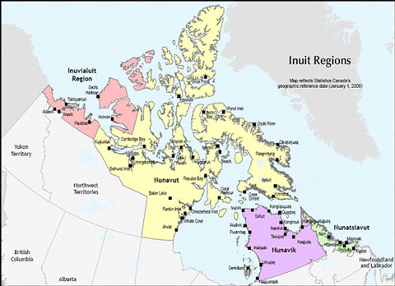
when a dying culture loses its youth:
The struggle to keep Inuit teens alive
Meaghan Sheehan
Gettysburg College
Anth 223 – Indigenous Peoples, the Environment, and the Global Economy
In a survey of Canadian Inuit youth between the ages of 14 and 25,
34% reported an attempted suicide in their lifetime
For 32% of the attempters, the attempt was serious enough to result in injury
20% of respondents reported more than one suicide attempt
In a study of Greenland Inuit between 15 and 30 who died of suicide,
80% had evidence of a personal problem before death
44% had attempted or spoken of suicide previously
90% were intoxicated at the time of suicide
(from “Suicide in Canada”)
(from “Polar Warming”)
(from “Suicide in Canada”)
Background
Threats
The Inuit are an indigenous group inhabiting the Arctic region of Canada and Alaska. They live in a region that not many people could survive in, and have lived there for centuries. There are other Inuit groups in Siberia and Greenland that share a surprising amount of similarities in language, mythology, and lifestyle. Most Inuit in Canada live in communities that are around 200 to 1000+ people. They live a harsh lifestyle, but one that has to work in order for them to survive. Due to the climate, they typically led very isolated lives. Recently, however, the effects of globalization have reached them and they have begun to shift as a society to a more modern lifestyle. At this point in time, the “elders” are ones who grew up living more traditional lives, watching their people make huge lifestyle changes. For the most part, this new lifestyle is accepted by the elders, but they still hold on to their roots and major traditions. There has been a clash between elders and the younger generations who are beginning to resist the traditions of their culture, wanting to further adapt to modern times. The pressure of remaining respectful to their past while also assimilating to the current times has begun to take its toll on the youth of the Inuit groups, and there has been a dramatic increase in suicide amongst teenagers.
(from “Suicide in Canada”)
The types of threats that now face this culture are dangerous. The physical loss is detrimental to the culture because with less people, the less power the people will have in control of their own land. It is especially upsetting, though, because the elders will soon die off, leaving behind no recollection of the traditions that makes their culture so unique. The youth that are attempting to take their own lives are rejecting their traditions, and so the traditions will simply die with the elders. Underlying threats affect the general mental stability of the people. Attempted suicide among the Inuit has caused incredible increases of depression, which then affects many aspects of daily life. Families suffer and become unstable, with missing links within their family as members take their own lives. Poverty increases as hope decreases, and increased accessibility to firearms threatens not only the owner of the weapon but also those around him or her. Alcohol abuse is an increasing threat, as is sexual, physical, and verbal abuse. Delinquent behavior is increasing dramatically, making overall safety of communities very low. The society as a whole is deteriorating on several fronts, making the survival of this culture very unlikely.
(from “Suicide in Canada”)
Conceptual Question
Can this culture be saved from itself?
In this case, a solution is difficult to come by. However, what this culture needs is a serious boost in morale. The youth do not understand the uniqueness of their traditions, due to a lack of experience elsewhere. A general knowledge of the world that they want to be like so much would help them understand the benefits of their own lifestyles. It is unfortunate that globalization has so negatively affected them, as it has to many indigenous cultures. Exposure to drugs and such depression-based conditions spins the issue further out of control, and so both of these would need to be addressed in trying to alleviate this problem. A specific idea could be to provide funding to build a cultural center that can be used to help preserve the Inuit traditions. If enough funding was provided, the Inuit themselves could be hired to build this center, giving them a physical connection to a place that will hopefully later provide them with a cultural connection.
Bibliography:
Polar Warming. Canadian Inuit. Electronic document, http://www.polarwarming.ca/images/canadian_inuit_clip_image001.jpg, accessed May 3, 2011.
Kirmayer, Laurence and Fletcher, Christopher. 1998. “Suicide among the Inuit of Canada,” Suicide in Canada. University of Toronto Press Incorporated.

