Slide 1
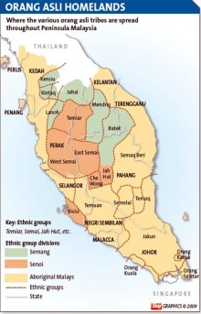
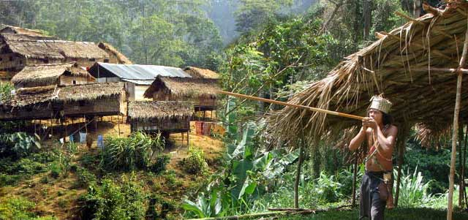
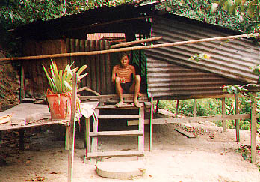
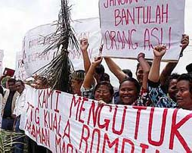
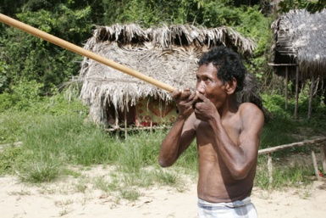
Pushed to the Margins: Orang Asli
Cat Rossi
Gettysburg College
Anth 223
Threats
One of the threats facing Orang Asli began with the Malaysian civil war between the Colonial government and the communist rebels lasting from 1948 to 1960. Many of the rebels operated in the deep forests where the Orang Asli lived, where consequently, they sought help from the Orang Asli. Often times the Orang Asli provided food and labor to the rebels. The Colonial Government became aware of the influence the Orang Asli had in winning the war and they conversely created the post of Adviser on Aborigines. To prevent further help to the rebel army, the Colonial army placed the Orang Asli into poorly created settlement camps. Hundreds of Orang Asli died in the crowded camps from not only physical illness but mental depressive disorders as well.
The greatest threat to Orang Asli identity is their displacement from their traditional homelands. Orang Asli do not have any rights to their lands under the Aboriginal Peoples Act. At any time, the government can take Orang Asli land and are not obliged to pay any compensation- to which Orang Asli have no legal recourse. Most often, Orang Asli communities lose their land to governmental projects such as mining sites, highway and dam projects, housing developments, and various other forms of ‘modernization’. Displacement is so bad, Orang Asli have said if they are ever regarded as nomadic, it’s because the government is constantly forcing them from place to place.
From right after the civil war (1961) Malaysian officials have desired to “integrate” Orang Asli into conventional Malaysian society. With this, the government has attempted to remove them from their remoteness and bring them into the market economy by asserting political control over them. Similarly, they are trying to remove their Orang Asli identity and combine them into the Malay ethnic category.
Orang Asli are in between two conflicting interests, commercial logging and forest conservation. The government blamed the Orang Alsi for the destruction and damage of valuable forest resources quoting, ‘it would be foolhardy to jeopardize the future of a nation by ‘preserving’ a way of life for 50,000 people… when an opportunity, as a result of the Emergency, exists today to start settling them permanently”
Background
The Orang Asli, meaning “original” or “first” peoples, are the indigenous peoples of Peninsular Malaysia. The Orang Asli represent a mere 0.5 percent of the national Malaysian population and are split up into 18 different subgroups, each with varying language and culture. The Orang Asli have varied occupations and lifestyle depending on where the tribe resides. Those who live inland (about 40%) work in forestry living close while those living close to the coast and are mainly fishermen. Many Orang Asli engage in swiddening (hill rice cultivation) as well as hunting and gathering. Similarly, income is earned by trading petai, durian, rattan and resins. Apart from living off the land, a small number live in urban areas and are engaged in salaried jobs. Unlike common perceptions of indigenous people, the Orang Asli do not live in complete isolation and interact in economic transactions between neighboring Malay communities. Even those living in the remote forest exchange their jungle produce for knives, salt, and ax-heads.
Slave raids within Orang Asli communities were common during the 18th and 19th centuries. Many of the slave-raiders were of Malaysian or Batak descent who considered the Orang Asli as savages and jungle beasts. Slave-raiders preferred to take women and children because they were easier to tame and less likely to run off. Typically, all of the adult men in the settlements would be killed off. The slaves that were taken would in turn be sold off to local rulers. The term Sakai, a derogatory term meaning slave, has been used up until recently in Malay language.
Map demonstrating the distribution of Orang Asli homelands
Advocacy
In recent years, younger politicians and bureaucrats have wanted to rid their country of its ignorance and mistreatment towards the Orang Asli and have begun to express their concerns. Two nongovernmental organizations, the Center for Orang Asli Concerns (COAC) and the Orang Asli Association of Peninsular Malaysia (POASM) are working diligently to earn the Orang Asli welfare and rights. In addition, many members of the legal profession have volunteered their time to help Orang Asli in court cases.
Orang Asli Care Campaign-The Malaysian Law Students Alliance created a long term project with the collaboration of the Center for Orang Asli Concerns (COAC) in June of 2009 to aid the Orang Asli. This program collects money to supply them with vital necessities to make their quality of life better as well as bringing attention nationally to their mistreatment. They have put together a self titled advocacy video to promote their cause which can be found on YouTube. The Orang Asli Trail Run- This trail run was created to build awareness and bring monetary aid to the Orang Asli. OA Trail Run creator Karen Loh explains that it is often the assumption that the government is granting the Orang Asli subsidies, however that is not the case. After running through Orang Asli villages, Loh was shocked when she saw that these people were living in complete poverty without running water and electricity. She wanted to give back to the native peoples who throughout history have constantly been taken from.
False Hope: The Aboriginal Peoples Act (1954)
“if [we] are ever regarded as nomadic, it’s because the government is constantly forcing [us] from place to place.”
The Aboriginal Peoples Act of 1954 is unique to the Orang Asli community. It began during the Emergency- the guerilla war fought between the Commonwealth armed forces and the Malayan National Liberation Army- to prevent the communist rebels from seeking help from the Orang Asli. The Act essentially is written treating the Orang Asli as peoples incapable of leading their own lives who are in need of governmental protection to preserve their wellbeing. The Act grants the state authority the right to order any Orang Asli community to leave and stay out of an area, without providing any compensation or assign a new location for the displacement. Essentially the Act rewards the JHEOA (the branch of government concerned with the Orang Asli) the final say in all Orang Asli matters. However, the Act does recognize some rights for the Orang Asli. For example, it claims that no Orang Asli child should be prohibited from an education because they are Orang Asli. It also states that children need permission to attend any religious ceremony from their parent or guardian so they are not to be subjected to any religion against their will.
When will the suppression end?
"Guardians of the Forest" is a documentary on the Orang Asli and their struggle to maintain their ancient ways of life from the pressures of the Malaysian government. The film focuses on an Orang Asli community that is about to be displaced by a giant dam project. It tells the story of the heartbreaking realities Orang Asli face while unveiling struggles which all indigenous peoples are up against. The documentary juxtaposes images of the scenic jungle with the disheartening reality of the poverty and discontent in which the Orang Asli live.
There are also countless ethnographies written about the Orang Asli discussing their struggles.
In an 100+ year struggle to earn a national identity, what steps must be taken by the Orang Asli and their advocates to be recognized and respected as people of Malaysia? Why is the Malaysian government so adamant about deleting their cultural history and “pushing them to the margins?”

