Slide 1
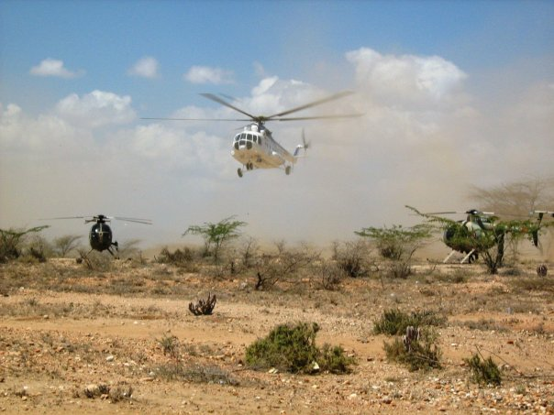
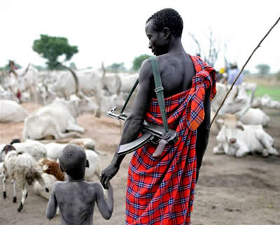
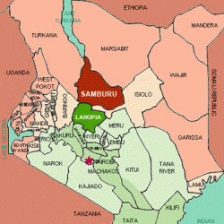
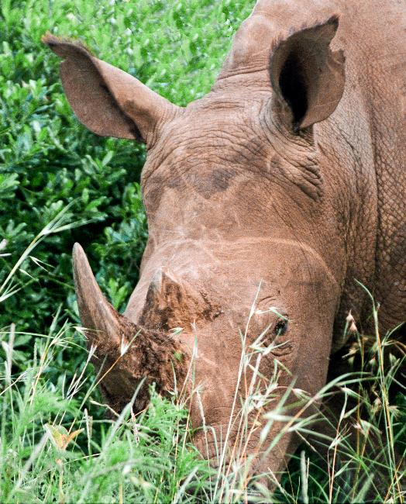
Ryan Patterson Gettysburg College Anthropology 223: Indigenous Peoples, The Environment, and the Global Economy
Conservation, Raiding, and Kenya’s Samburu
Background
The Samburu People of Kenya live in the dry plains and semi-deserts North Central Kenya. They speak the Maa language which is shared by the Maasai. Currently their numbers are around 100,000 (Holtzman 2003). Historically, these people have been dependant on their cattle herds, supplemented by small animals such as goats and sheep. “Through the centuries, the Samburu and their pastoralist neighbors have occasionally raided each other’s cattle to replenish their stocks…” Cultural Survival Quarterly. These raids typically did not end in bloodshed. However, with the influx of guns from surrounding countries and foreign dealers, raids have become increasingly violent triggering a response from the government.
Threats
The Samburu people have faced numerous threats from the government and outside agencies. In February of 2009, reports of abuses by Kenyan police on several Samburu villages surfaced. These stories included instances of death, injury, disability, rape, displacement, terror, impoverishment, hunger, disease, and malnutrition. In response to intertribal violence, police began raiding villages and removing thousands of cattle from the indigenous Samburu. Under the intentions of retrieving stolen cattle, police action carried out by the government has caused violence and left villages without available resources, mainly cattle. Historically, these raids carried out by and against Samburu, were common practice. However, guns from dealers and rebels from other countries have increased the violence associated with this practice. Another problem is that government officials themselves may be instigating intertribal violence. “Mohamed Kuti, member of Parliament for Isiolo District, who last year used his political influence to put 300 government-issued guns into the hands of his Somali and Borana constituents, knowing that they would be used against the Samburu” (Cultural Survival Quarterly). Also, Samburu people were pushed off of their land in November of 2010 in the name of conservation. In this instance, police physically, and in some cases violently, removed 300 families from ancestral homelands. Being labeled as “squatters” in the Kenyan Press, these people were removed so that the African Wildlife Foundation could use it for wildlife preservation. These removals were caught on tape by a British film crew who witnessed clubbing of elders and were themselves detained.
“After the police attack, we women could not eat for three days; we just trembled. My children cried out in their sleep, and I couldn’t sleep at all. We heard a rumor that the police would come again, so we took our children out to the bush at night, hiding. I am more afraid of the police than of the wild animals.” -Village Elder (Cultural Survival Quarterly)
Who’s Helping?
Cultural Survival Quarterly, a Transnational Advocacy Network whose aim is “partnering with indigenous peoples to defend their lands, languages, and cultures”, has raised awareness through their website which tells the stories of Samburu and people faced with similar situations. In response to the AWF’s statement that they were not only providing a conservation area but also would help generate development and sustainable livestock grazing, Cultural Survival wrote a letter asking AWF how these goals would be accomplished when their own organization was partly to blame for displacement of Samburu. After the 2009 police attacks, the advocacy network researched the stories coming out. “We consolidated our findings in a report that we submitted to the Kenyan government, the United Nations, the U.S. State Department, and human rights organizations” (Cultural Survival Quarterly).
Police helicopters carrying out raiding exercises in Kenya
-From the website “Disapora Kenya”
“They are
keenly aware, for instance, of threats to their grazing land
from expanding game parks and large-scale agriculture”
(Holtzman 2003: 138)
A Samburu herder with a boy and his cattle
-From the website “The KenyaSomali Consortium”
Conceptual Question
Does collaboration between indigenous peoples like the Samburu, Conservation Organizations, and Ranchers like the Mayers show agency by the indigenous people or simply manipulation by outside forces?
The Samburu show agency through their cooperation with the Mayer family in the Rift Valley. Funds from Samburu workers go almost entirely to the maintenance and improvement of their cattle herds back home. This unity between ex-ranchers, indigenous peoples, and tourism is not merely manipulation but a symbiotic relationship with both sides benefitting. Also, Samburu have shown agency through the boomerang effect, reaching out to trans-advocacy networks like Cultural Survival in order to popularize their story of police raiding and unfair conservation acts by the AWF. In doing so, they increase their chances of receiving aid and support from outside of Kenya.
Solution?
Samburu and conservation do not have to be at odds with each other. In fact, Samburu and Maasai have worked together to support the private farm called the Mayer’s farm which supports wildlife such as giraffe and zebra. The Mayers originally sold almost all of their 6000 acres when British colonial rule was ending. Instead of selling all of the land, the family decided to keep 250 acres “tucked into its own ecological niche in the rift valley” (Bruner and Kirshenblatt-Gimblett 1994: 441). Cattle from the Maasai are allowed to live in their own area on the farm. Much of the income that is received by the Samburu is used to increase their cattle herds back home. This combination of capital and conservation, indigenous and modern age, could be used by organizations such as the African Wildlife Fund. (Bruner and Kirshenblatt-Gimblett 1994: 441-445)
Map showing the Samburu district
-From the website “Disapora Kenya”
Bibliography
Holtzman, John D.
2003 In a Cup of Tea: Commodities and History among Samburu Pastoralists in Northern Kenya.
American Ethnologist Vol. 30, No. 1: 136-155
http://www.jstor.org/stable/3805213
Bruner, Edward M. and Barbara Kirshenblatt-Gimblett
1994 Maasai on the Lawn: Tourist Realism in East Africa
Cultural Anthropology Vol. 9, No. 4: 435-470
http://www.jstor.org/stable/656384
2010 Samburu Evicted for “Conservation” in Kenya. Cultural Survival Quarterly December, 2010.
http://www.culturalsurvival.org/news/kenya/samburu-evicted-conservation-kenya
Palmer, Paula
2009 When the Police are the Perpetrators. Cultural Survival Quarterly Spring 2010.
http://www.culturalsurvival.org/publications/cultural-survival-quarterly/kenya/when-police-are-perpetrators
2010 Disapora Kenya. Electronic Document.
http://diasporakenyan.se/category/human-rights/samburu-articles/page/2/, accessed May 6th, 2011.
2009 Disapora Kenya. Electronic Document.
http://diasporakenyan.se/2009/11/525/, accessed May 6th, 2011.
The KenyaSomali Consortium. Electronic Document.
http://kenyasomali.blogspot.com/2008_06_29_archive.html
CIA-The World Factbook. Electronic Document
https://www.cia.gov/library/publications/the-world-factbook/photo_gallery/ke/photo_gallery_B1_ke_8.html
How to find out more
Cultural Survival’s report on the police attacks is available at http://www.culturalsurvival.org/news/kenya/cultural-survival-releases-report-human-rights-violations-police-samburu-east-and-isiolo- . This report involved interviews from eyewitnesses and elders as well as responses from NGOs, relief workers, and government officials. The report was written by Paula Palmer and Chris Allan between February 2009 and January 2010. ,
Conservation organizations aim to protect animals like this rhino, and their environments, from destruction.
-From the website “CIA World Factbook”

