Slide 1
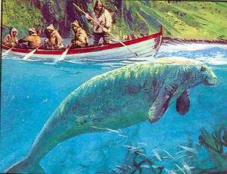
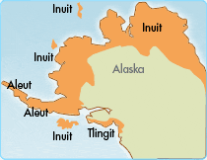
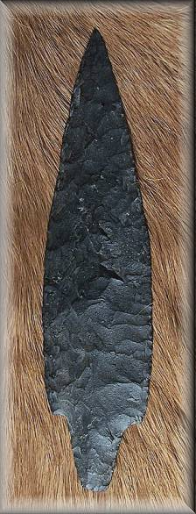
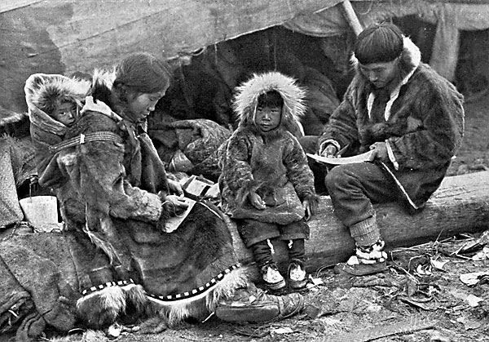
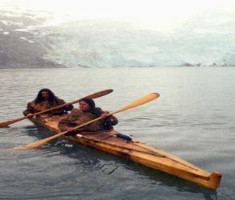
The Aleuts: an Indigenous People in the Labor Forces Felicia Pagán Gettysburg College Anthro 223: Indigenous Peoples, the Environment, and the Global Economy
http://www.mentalfloss.com/wp-content/uploads/2007/11/web-stellerzeekoe.JPG
http://www.learner.org/interactives/historymap/images/aleut.gif
History
The Aleuts are originally from Southwestern Alaska. There are four main group of the Aleutian Islands; from East to West they are the: Fox Islands, Andreanof Islands, Rat Islands and Near Islands. The Native people of that area are known as the Aleuts and they belong to the Eskimo- Aleuts language family. They classify ethnologically as Native North Americans.
In 1741, Alexey IIich Chiricov (Russian navigator) and Vitus Bering (a Danish navigator in the Russian Service) visited the Aleutian Islands but they became in contact with the Russians about a year earlier. The Aleuts first came into contact with the Russians in 1740’s.
Their social classes were separated into three groups: honorable, common people and slaves. Descent was probably matrilineal. The Aleuts shard ideas about wealth and status with the Tlingit and cultural links with the and also maybe with the Siberian. Their typical homes were built underground but they are said to have also lived in longhouses; usually situated on the northern part (Bering Sea) of the island because of the abundant marine resources and driftwood supplies. There economy depended mostly on the harvesting of the fur from the different marine life within their environment. The hunted whales, fox, caribou, sea lions and fish for food. Those animals would also become of interest to the Russians.
They lived near the bay because that is the location of where they could obtain the most abundant sources of sea mammals and materials for the making of their hunting tools. After the overhunting and depletion of the Priblyov herd on the early years of the Russian American Company (1799-1802).
Baranov, manager of the RAC moved up to 200 able- bodied men and their families of those married (availability of different age groups) to two Islands: St. Paul and St. George. There is one village on each island and today those are their predominant settlements. In June 1942, the Japanese occupied the Attu and Kiska Islands in the Aleutians but had to surrender them to the U.S.
Conceptual Questions
What is the history on the heritage and culture of the Aleut people?
Who were the people that went over to the Aleutian Islands and what did they want to gain control over to gain profit?
What did the Aleut people do after seeing that their traditional form of living was being threatened by the Russians? What forms of action did the Aleut resort to in order to maintain and/ or preserve their resources and culture?
Were there other threats that the Aleuts were being threatened with?
How did those threats impact them?
Threats
When the Russians arrived in that area, around 1750, they saw that there were many opportunities for fur trading. They were in search of sea otters, fur seals and foxes. Since then end of the 18th Century the Aleuts were then exploited by the Russian Fur traders for the fur seal pelts (one of three main breeding grounds which they called a rookerie) and they had two more in the USSR.
The Aleuts were being used for the hunting knowledge. The Russians were then taking advantage of the Aleuts environment and took most of their food supply as well as forcing them into slavery.
They depended on fur trading and harvesting for their economic and cultural survival. But they were being faced with problems from the animal protectionist groups. They soon came to realize the pressures from the outside world and so are trying to diversify their island economy. However, the island lacks natural harbors and so diversification is unlikely to occur. They must continue to depend on harvests of the fur seal.
They also experienced exploitation of their natural environment. War- time relocation under the U.S. government act authorizing relocation and internment of civilians and the Aleut fight for the recognition of the wrongs suffering; making sure the descendents stay well presented.
Due to the contact they faced with the Russians, many of them became very ill because of the different sicknesses and diseases and harsh working conditions they were introduced to.
http://www.alaskanartifacts.com/DutchHarbor_Witt_62_c.jpg
http://svr225.stepx.com:3388/eskimo/file/83721.jpg
Bibliography
Microsoft Encarta Online Enyclopedia
2000 Alaska. Electronic document, http://encarta,msn.com http://www.dorjones.net/sitebuilder/images/MichaelLivingstonAlexisBuntenBlackst
First Published on Oct. 28, 2009 Amiq: The Aleut People of the Pribilof Islands, a Culture in Transition. Volume 88, Issue 1. 1983
http://www.culturalsurvival.org/publications/cultural-survival-quarterly/back-issuesoneBay-294x250.jpg
http://www.mentalfloss.com/wp-content/uploads/2007/11/web-stellerzeekoe.JPG
http://www.learner.org/interactives/historymap/images/aleut.gif
http://www.alaskanartifacts.com/DutchHarbor_Witt_62_c.jpg
http://svr225.stepx.com:3388/eskimo/file/83721.jpg
http://www.dorjones.net/sitebuilder/images/MichaelLivingstonAlexisBuntenBlackstoneBay-294x250.jpg

