Slide 1
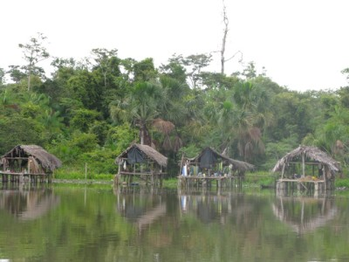
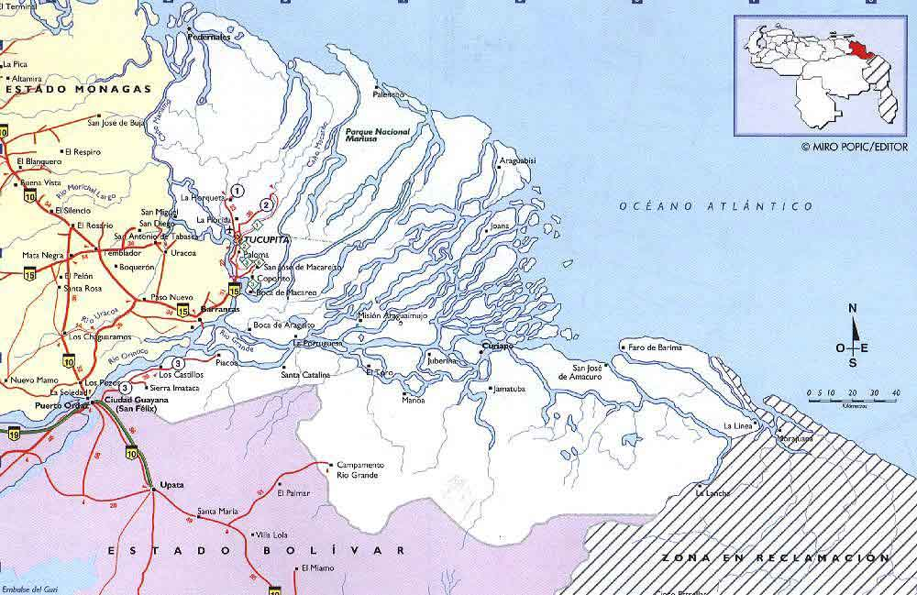
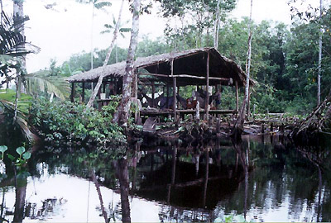
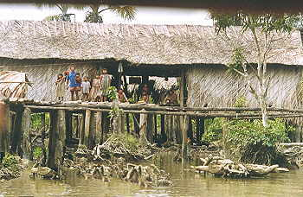
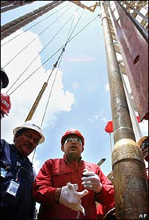
The Orinoco Delta Blues
Ryan Nelson
Gettysburg College
Anth223—Indigenous Peoples, the Environment and the Global Economy
The People of the Canoe
The Warao people have inhabited the Orinoco delta of eastern Venezuela for approximately 7,000 years, well before the Pre-Columbian period, and have been able to maintain a similar lifestyle on the rivers, lands and mangrove swamps that make up the Orinoco Delta into the modern era due to the remoteness and harshness of the terrains they inhabit. The Warao are, by definition, river people (their name translates to People of the Canoe) and maintain a life more reliant upon their relation with the waterways than the land in between them. The homes they build on the water’s edge are designed to withstand seasonal flooding and provide mooring for their canoes. The Warao diet is almost entirely based on aquatic resources, with the exception of the sago they extract from palms trees, as all fauna are classified by their habitat, as subaquatic or subterranean, terrestrial, or aerial (arboreal); of these the Warao are bound by their system of beliefs to avoid killing terrestrial creatures unless absolutely necessary, and therefore rely mainly on the abundances provided in their wetland home.
“Information from this section summarized from Warao Spiritual Ecology”
Think Venezuela: Photos
Think Venezuela: Photos
Full Day Turismo
Think Venezuela: Delta Map
BBC News Images
The Struggle
The Warao people have been engaged in a constant struggle with the incursion of the modern world since the discovery of vast petroleum resources in the area. While the Warao rapidly mobilized to protect their areas through political action the government has turned a blind eye to their pleas, and has for decades permitted oil exploration in the area by foreign groups such as British Petroleum and Conoco Phillips; as well as asserting claims on behalf of the national oil company Petroleos de Venezuela(Oilwatch). Estimates of oil reserves in the Orinoco Oil Belt, mostly above the delta, suggest that as much at 1,300 billion barrels of oil may be extractable (USGS). Since drilling began by-products of the process and crude oil have spilled into the waterways the Warao depend upon, and the interactions between Warao and outsiders has brought about a massive increase in death due to unfamiliar diseases, most notably the Warao have recently seen Cholera epidemics, and the rate of Tuberculosis infection is believed to be unusually high (Briggs). While the Warao can be seen as visibly suffering from disease, they also suffer from the damages of oil in their environment which has led to relocation to urban areas where they live in extreme poverty. The threat only promises to grow, as the rich heavy oil reserves of the Orinoco promise further drilling, and the processing of tar sands for oil extraction threatens to boom in the area as well (Johnson).
Is it possible to drill without causing catastrophic environmental damage, even with the aid of environmental organizations?
Oil firm Conoco Phillips has partnered with Conservation International to analyze the threat of oil work in the Orinoco River Delta, and have cooperated on a Biodiversity Action Plan that hopes to minimize the impact of oil extraction in the area while maintaining the rich aquatic biodiversity that the Warao rely on to survive(Conservation International). The company also plans to contribute to the local people by providing schools and supporting infrastructural development, but does the company school provide any improvement in the Warao life or just destroy their cultural independence? Furthermore, is it possible to drill without causing catastrophic environmental damage, even with the aid of environmental organizations?
In the Media
The struggle of the Warao, and any real analysis of the Orinoco oil situation is difficult to find, perhaps due to the fact that these are thought to be the world’s largest oil deposits in a nation that has a history of hiding truths. I have found one documentary however, an Italian documentary on Hugo Chavez that focuses on the human rights violations within his regime and does shine some light on the situation in the Orinoco. The film is called “ La Minaccia”, meaning “The Threat” and was created by Luca Bellino and Silvia Luzi in 2007. For more, or to order the film visit http://www.laminaccia.com/
The Future
The future looks dire for the Warao, as the scramble for that last great oil resources of the world shows the vast resources sitting just meters below their homeland, it seems that the global interests are aligned with the destruction of the Orinoco Delta. In recent years the Warao have followed the lead of other indigenous groups in branching into the eco-tourism industry, as a last ditch effort of gaining support for the protection of their lands, however given the strength of the forces which they face it seems even this may be a short lived effort (Johnson). While many Warao have already been forced to flee to lives of poverty in the cities those remaining seem to have little hope to evade the devastation of their environment and the eventual death or impoverishment it will reap (Briggs).
Bibliography
BBC News
2009 Associated Press Photo in China in Huge Venezuela Oil Deal, September 17, 2009. Accessed May 6, 2011 at http://newsimg.bbc.co.uk/media/images/42684000/jpg/_42684623_chavez_oil_ap203a.jpg
Bellino, Luca and Luzi, Silvia, dirs.
2007 La Minaccia. Suttvuess Produzioni. Rome
Briggs, Charles L.
2001 Modernity, Cultural Reasoning, and the Institutionalization of Social Inequality: Racializing Death in a Venezuelan Cholera Epidemic in Comparative Studies in Society and History Vol. 43, No. 4, pp. 665-700
Conservation International
2004 Conservation International and Conoco-Phillips Launch ‘Biodiversity Action Plan’ In Venezuela’s Gulf of Paria. June 3, 2004.
Accessed May 6th 2011 at http://www.conservation.org/sites/celb/news/Pages/060304_conocophillips_biodiversity_action_plan.aspx
Full Day Turismo
Photograph. Accessed May 8, 2011 at http://www.fulldayturismo.com/show/pics2_gb.html
Oilwatch
2005 Resistance, Oilwatch Network Bulletin August, Vol. 55.
http://www.think-venezuela.net/english/venezuela_pictures_orinocodelta.htm
Think Venezuela Online Tourism Directory
2002 Photos and Map, Think Venezuela CAV, Accessed May 7, 2011 at
http://www.think-venezuela.net/english/p_delta.htm
USGS
2009 An Estimate of Recoverable Heavy Oil Resources
of the Orinoco Oil Belt, Venezuela. August, Fact Sheet 3028.

