Slide 1
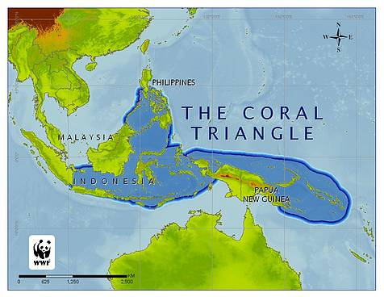
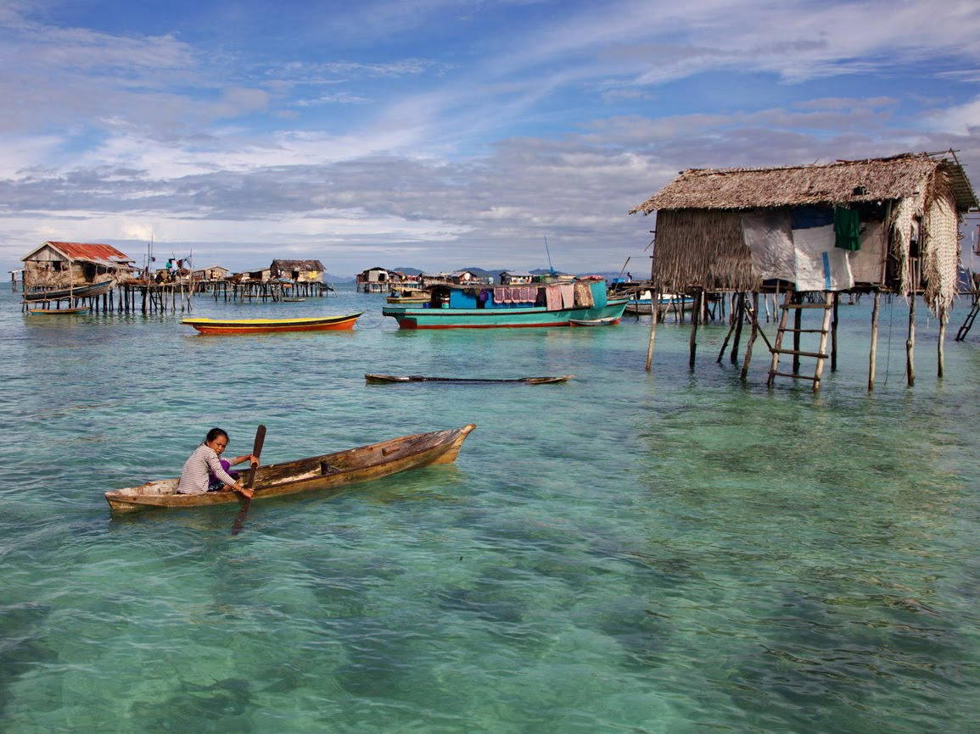
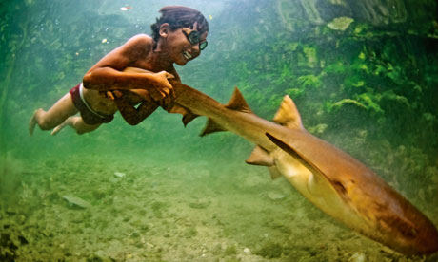
CONCEPTUAL QUESTION
Is community based conservation the best approach for the survival of the Bajau culture and the sustainability of the biologically rich Coral Triangle?
In Mark Dowie’s book, Conservation Refugees, he advocates a departure from the traditional fortress conservation models of the global conservation movement. The theory is - we can’t separate indigenous people from their environment in the name of conservation when those indigenous communities are often the very people who understand how to best interact with the environment in a sustainable way. The Bajau have been roaming the seas of the Coral Triangle for centuries, but in the past few decades, this ecologically valuable environment has been subject to destructive fishing methods that threaten the survival of many of the world’s unique fish and coral species. So, wouldn’t the best method of conservation be to hand it over to the Bajau? Perhaps, but it may be too late for such a simple solution. Here are a few complications:
Today, only a fraction of Bajau actually practice their traditional subsistence methods. Many communities have been resettled and are more concerned with obtaining economic prosperity than with practicing their time-honored traditions of taking from the sea only what is a necessity. Outside development has shifted the approach the Bajau take towards the sea from one of reciprocity to one of profit.
The demands of the global fish trade and the lack of environmental education have increased the rate of unsustainable fishing methods, and without economic assistance the Bajau cannot practice sustainable techniques without experiencing extreme poverty and starvation.
The younger Bajau generation does not necessarily want to be fishermen. Many want to move to the cities and become doctors, lawyers or other professional occupations. We have to be careful of the notion of the “ecologically noble savage” and not assume the Bajau want to remain in their historical lifestyle.
So, what is the best approach? A purely community based model may not be feasible because of the rapid global forces that have already irreversibly altered the traditional Bajau lifestyle. A fortress based conservation model is also not sufficient because it will only push the Bajau further into poverty and may not actually help the environment. Therefore, an organization needs to be formed that will provide economic assistance to the Bajau so that destructive fishing methods can be stopped, and to provide the political support needed to ensure government sponsorship. This is simply a general outline of the potential solution to my question and would require more specific research to propose a realistic strategy. The Bajau, though increasingly removed from their historical environment, still claim a deep love and respect for the sea, and any plan to sustainably conserve the seas they inhabit would definitely require significant involvement from them.
BAJAU SEA NOMADS
Bajau suka laut – The Bajau love the sea
Preston Hartwick
Gettysburg College
Anth 223 – Indigenous Peoples, the Environment, and the Global Economy
BACKGROUND
Often described as “sea gypsies,” the Bajau are a loosely connected group of people inhabiting the Coral Triangle off the southwestern coast of the Philippines and the seas that surround Malaysia and the Indonesian island Sulawesi.
There are around 467,000 Bajau, but only around 10,000 of them still live as sea nomads.
“Bajau” is a term they were given, not one they call themselves. They are mostly organized in small egalitarian kinship groups and have little political structure.
They are expert fishermen, boat makers, free-divers, and sailors.
The Bajau have traditionally lived on lepa-lepa boats, narrow high-prowed vessels around five meters long and 1.5 meters wide, or on stilt villages built on the water. They used to come to land only to trade fish for supplies or to make new boats. Due to resettlement, there are only a few Bajau left who have lived their whole lives at sea.
The governments of the Philippines, Indonesia and Malaysia have tried to resettle the Bajau, mostly in the form of stilt villages. One of these villages, Torosiaje, is located a kilometer out to sea.
They currently make their livelihood selling fish for food consumption or by catching life reef fish for the aquarium trade.
Many Bajau practice a type of animism or folk Islam and may speak a variety of languages from the surrounding areas: Sama-Bajaw languages, Chabacano, Cebuano, Tagalog, Malay, Bahasa Sug, Bahasa Indonesia, English
From the website: WWF
THE CORAL TRIANGLE
The Bajau roam one of the most bio-diverse stretches of ocean in the world, known as the Coral Triangle.
The coral reefs that comprise the Coral Triangle serve as nurseries, feeding grounds and homes for nearly 40% of the world’s reef fish species. This is the highest percentage of coral reef fish diversity in the world.
The Coral Triangle also contains the highest percentage of coral diversity, almost 80% of the world’s coral species are found here.
Around 126 million people depend on the Coral Triangle for their livelihood, and the fish that are exported from this region feed millions more. Other benefits include tourism and export revenue and the buffer of coastal communities from tropical storms.
Scientists estimate that we could lose up to 70% of the planet’s coral reefs within the next 50 years.
The Nature Conservancy has the goal of protecting 15% of the Coral Triangle over the next decade. 2.6% is currently protected.
Bajau stilt village (see works cited)
THREATS TO THE BAJAU
The main threat to the Bajau is the pressure of the fish trade. Forced to compete in an economic system that is relatively new to them, the Bajau often resort to unsustainable or illegal fishing methods, often without being aware of the consequences. Dynamite fishing may catch more fish in the short term, but it destroys the reefs, depleting fish stocks over time. Many Bajau have been killed or maimed while building homemade explosive devices. Cyanide or other poisons are used to capture live reef fish for the aquarium trade, which also kills the reefs that support the ecosystem. The live fish trade is worth more than $800 million a year.
The Bajau are being forced into resettlement, prohibiting them from practicing their traditional lifestyle on the water. In the resettlement village of Tinakin Laut, 75% of the households are below the poverty line. This leads to low education, health and living standards. Fishing is not economically sustainable for these communities. In one survey, no Bajau children said they wanted to become fishermen when they grow up.
There has been an internalization of outsider’s perception of their communities, and many resettled Bajau view those still living on boats as old-fashioned and lower in social status. Economic prosperity is now often the common goal, rather than subsistence fishing. Cultural traditions are disappearing as the younger generations leave life on the sea for land-based occupations.
WORKS CITED
Coral Triangle map: <http://frogandprincess.files.wordpress.com/2009/05/ coraltriangleslick2_163279.jpg>
“Coral Triangle: Protecting the Most Diverse Reefs On Earth.” The Nature Conservancy. 2011. <http://www.nature.org/ourinitiatives/regions/ asiaandthepacific/coraltriangle/overview/index.htm>
Kemkins, Lotte. “Living On Boundaries: The Orang Bajo of Tiankun Laut, Indonesia.” University of Utrecht. 2009. http://igitur-archive.library.uu.nl/student-theses/2010-0303-200346/Kemkens%20Lotte.pdf
Langenheim, Johnny. “The Last of the Sea Nomads.” The Guardian. Sep. 18, 2010. http://www.guardian.co.uk/environment/2010/sep/18/last-sea-nomads
Photograph by James Morgan. <http://james.photoshelter.com/gallery-image/SULAWESI/ G0000msv8l6RdDIc/I0000M88T53krrlY>
Bajau village photograph <http://www.bing.com/images/search?q=bajau+stilt+village&view =detail&id=955C00A8776A304E57F8D5357D457777FEE5C95C&first=0&FORM=IDFRIR>
Waddington, R. (2003), The Bajau. The Peoples of the World Foundation. Retrieved May 6, 2011, from The Peoples of the World Foundation. <http://www.peoplesoftheworld.org/text?people=Bajau>
Bajau boy playing with shark. Photograph by James Morgan
DID YOU KNOW? Bajau fishermen are renowned for their free-diving abilities, plunging to depths of 30 meters or more, often wearing hand-carved wooden goggles and carrying homemade spear guns. In order to dive to greater depths, many young Bajau deliberately rupture their eardrums, causing high rates of deafness in their old age.

