Slide 1
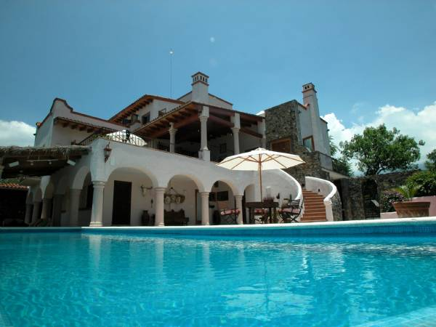
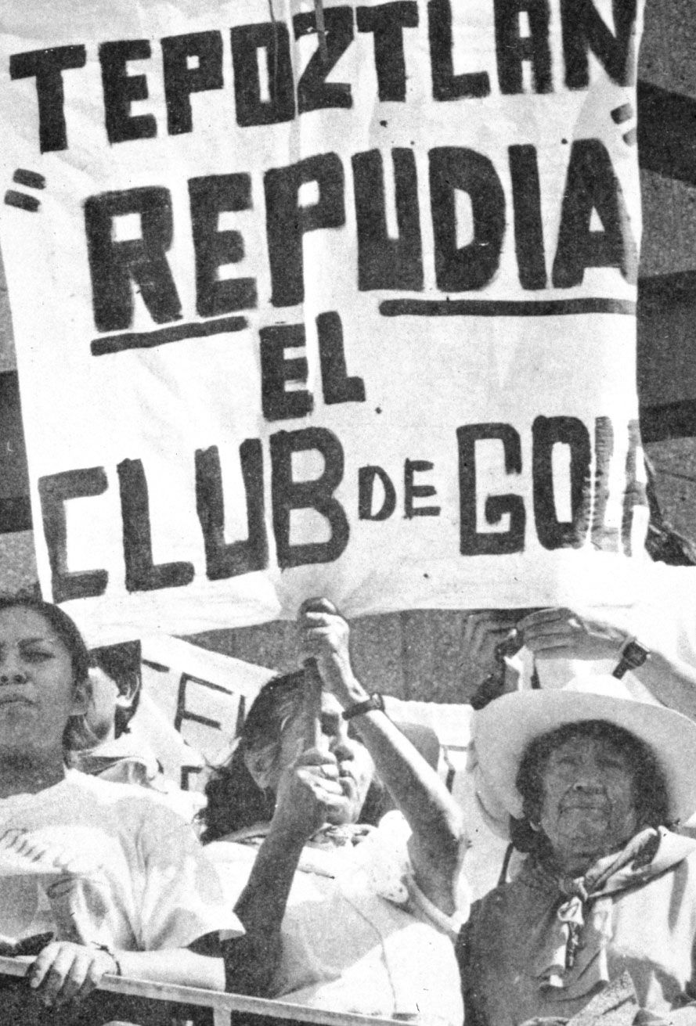
Mexican Golf Course Causes Protests Over Destruction of Precious Water Resources
Nicole Dibble
Gettysburg College
ANTH 223-Indigenous Peoples, the Environment, and the Global Economy
Background Information
The Tepoztecos belong to the indigenous group, the Nahua, of which the Aztecs are a major member. “The language of the Aztecs, Nahua, is spoken by all the Nahua peoples in a variety of dialects.”
Modern Nahua are an agricultural people known for their weaving of cotton and wool. “The social institution of godparenthood (compadrazgo) is widely practiced, and parents and godparents are felt to have strong ties.”
“The Nahua are Roman Catholics, oriented toward the patron saints of their villages as well as the Virgin of Guadalupe and various “Cristos” involved in local legend.”
The Nahua still believe in witchcraft and a variety of pagan or semipagan supernatural creatures. “Pagan religious rituals, except as they relate to witchcraft, are no longer practiced.” (information from this section summarized from “Encyclopædia Britannica”)
Tepotlan in the Mexican state of Morelos is a culturally significant place for those who live there. The city is considered a spiritual center by some because it is believed to be the birthplace of the major Aztec god, Quetzalcoatl. Emiliano Zapata also has ties to the town which increases its relevance to more modern history (Johansen: 266).
The climate in the area is moderate all year long and is advertised to “rarely exceed 85 F in the hottest of the dry season and always come back down at night but rarely below 55 F” (Best Real Estate Planet).
Another travel site stated that, “Tepoztlan is on top of the Tepozteco hill, and it's considered the second most important area in the country for natural "energy", after the pyramids of Teotihuacan” (Attractions).
These praising advertisements for Tepoztlan attract tourists who want to visit a safe, comfortable place which increases demands for construction projects, such as luxury villas and golf courses that might benefit the town economically, but causes serious problems for residents.
The Jack Nicklaus-designed golf course would have consumed five times as much water as Tepotzlan's 28,000 residents use in a day and would have pumped clouds of agrochemicals into the air and water. Deforestation problems would also have occurred (Johansen:266). Even the promise of 13,000 jobs and a vow to plant 16,900 trees could not overcome Tepozteco opposition (G.S., Earth Island).
The jobs promised to Tepoztecans by the were low status labor positions, such as “peons making beds and mowing lawns”. Tepoztecans “foresaw an onslaught of neighbors who would denigrate their culture.” (Wahrhaftig, Las Portadas)
In December, 1995 four armed development supporters killed one person when they fired into a crowd of townspeople. “Ignoring the testimony of scores of witnesses, Morelos state officials arrested three anti-golf activists -- Gerardo Demesa Padilla, Jose Carrillo Conde and Fortino Mendoza Ortiz -- who had not been present during the deadly December gunplay.” (G.S., Earth Island)
Advocacy of Tepoztecos
April 10, 1995: Villagers attempt to protest the developer Grupo KS's plans to build an 18-hole golf course and 800 luxury homes inside the El Tepozteco National Park near Tepoztlan and are attacked by police in the Morelos state in Mexico.
Police opened fire on the protesters, killing one man and wounding several others.
Police attempted to blame villagers for the violence, but their claims were disproven when home videos aired on local news programs showed the police ambushing the protesters and planting weapons on the bodies of the dead and wounded.
“In September 1995, hundred of Morelos state troopers tried -- and failed -- to install a pro-golf course council. The Morelos government has refused to offer any state services to the elected anti-development government in Tepoztlan -- no birth, death or marriage certificates --and the Tepoztecos have responded by refusing to pay state property taxes” (GS, Earth Island).
Following the April 10 police massacre, Grupo KS canceled its golf course resort plans. But the tension between village and state remains, and central to the standoff is the fate of three anti-golf leaders. (information from this section summarized from GS Earth Island)
The traditional Nahua community of Tepoztlán in the state of Morelos, Mexico, unified and succeeded in forcing cancellation of a project in the mid 1990’s. “The project was sponsored by the most powerful of national and international politicians and corporations, to build a luxury subdivision, business park, and golf club on Tepoztecan communal lands.” The use of graffiti and city murals gave Tepoztecos an outlet to express their political opinions. (Wahrhaftig, Talking Walls)
Native Tepoztecos stopped the half-billion dollar golf course/condominium "development" project. “They have said no to the degradation of their environment, no to the expropriation of communal lands, no to the destruction of archaeological sites and no to the underpaid servile sector jobs that have been promised them” (Young).
Conceptual Question
Is a golf course that will bring in tourist revenue worth diverting water from the Tepoztecos?
A golf course is looked at as a place for leisure, even in the United States. A passerby would not typically think about how the golf course manages to stay green or if they did, they would not think that as much water is used is possible for such a small piece of land. It is not fair to the indigenous inhabitants who have connections with the town for generations to worry about their area becoming more arid because much of the water is going towards up keeping a golf course. Tepoztecos do not even like to play golf as they prefer soccer which they see as a real sport while golf is reserved for the elite. Such a proposal to build a golf course in an area so opposed to it is bound to breed discontent causing more problems for the builders and for the Tepoztecos because both sides need to organize and draw support for their causes which causes money. The amount of opposition to the project created a more unified population of Tepoztecos that could influence policy decisions and the appointment of community leaders. The cost of life also became a factor because during some of the protests, some Tepoztecos were shot, killed, or imprisoned for standing up for their right to live on land that can support them.
Quotes
“The newly elected Tepoztlan mayor sneered: ‘We don’t play that sport here,” because, he explained, maintenance of a large golf course “would sap badly needed farming water; pesticides and chemical fertilizer to maintain the grass would pollute the town’s aquifers.’” (Landau 2007).
“’We are Tepoztecos. We are not like other Mexicans, because we know who we are,” one movement leader explained to me, when I asked him why this movement was so successful, where as similar development projects were installed elsewhere with little effective opposition’. (Stolle-McAlister)
Luxury Villa in Tepoztlan (from website “Best Real Estate Planet”)
References Cited
Attractions in Cuernavaca, Mexico: What to do and where to go. Electronic document, http://www.bestday.com/Cuernavaca/Attractions, accessed May 6, 2011.
Best Real Estate Planet.
2008 Secluded Modern Colonial Style Villa In Tepozteco Mountains. Electronic document, http://www.bestrealestateplanet.com/go/en/viewProperty--PropertyID--823--location--North-America--type--Villas----property--Secluded-Modern-Colonial-Style-Villa-In-Tepozteco-Mountains--page.html#images, accessed May 6, 2011.
Encyclopædia Britannica Online
2011 Nahua. Electronic Document, http://www.britannica.com/EBchecked/topic/401786/Nahua, accessed May 6, 2011.
G. S.
1996 Mexico's `Golf War' is not over. Earth Island Journal. Vol. 11, Issue 4. Electronic Document. http://web.ebscohost.com/ehost, accessed May 5, 2011.
Johansen, Bruce E.
2003 Indigenous Peoples and Environmental Issues: An Encyclopedia. Westport, Conn.: Greenwood Press.
Landau, Saul
2007 “WE DON’T PLAY GOLF HERE -- and other stories of globalization” . Electronic document. http://roundworldproductions.com/Site/We_Dont_Play_Golf_Here.html, accessed May 5, 2011.
Stolle-McAllister, John.
Social Movements and Hybrid Cultural Formations: Tepoztlán’s “No Al Golf.” Electronic Document, http://www.maclas.org/journal/essays-xv/essays- xv-stolle-mcallister, accessed May 5, 2011.
Wahrhaftig, Albert L.
Las Portadas de Semillas: Annual State of the Culture Representations in Tepoztlán, Mexico. Electronic document, http://www.sonoma.edu/anthropology/wahrhaftig/stateofculture.html, accessed May 6, 2011.
Wahrhaftig, Albert L.
Talking Walls: The Iconography of Tepoztecan Resistance. Electronic document, http://www.sonoma.edu/anthropology/wahrhaftig/TalkingWalls.html, accessed May 6, 2011.
Young, Elliot 1995 Golf Kills/Tepoztlan Lives. UT Watch (sub) TEX, October/November 1995: Volume 1, Issue #8. Electronic Document,
http://www.utwatch.org/archives/subtex/young2_issue8.html?/archives/subtex/index.html, accessed May 4, 2011.
Film Suggestions
The 2007 film, We Don’t Play Golf Here, examines the confrontation between federal troops and the Tepoztecos over the construction of a golf course and other urbanization projects. An analysis of golf being a sport for the rich and soccer being a sport for the poor takes place in Saul Landau’s film. The film is divided into essay style segments each with a different topic, but interrelated to contaminating the environment. The golf course story is accompanied with a story about toxic chemicals from a Tijuana battery recycling plant and one about how two “ecological peasants” were tortured by Mexican army personnel because they “they tried to stop Boise Cascade from clear cutting forests in Guerrero.” The film is 33 minutes long and provides a good audio and visual aid for high school and college students discussing globalization issues. ( information from this section summarized from Landau 2007)
Protestors against the building of the Golf Club (from the website “Sonoma.edu: Talking Walls”)

