Slide 1
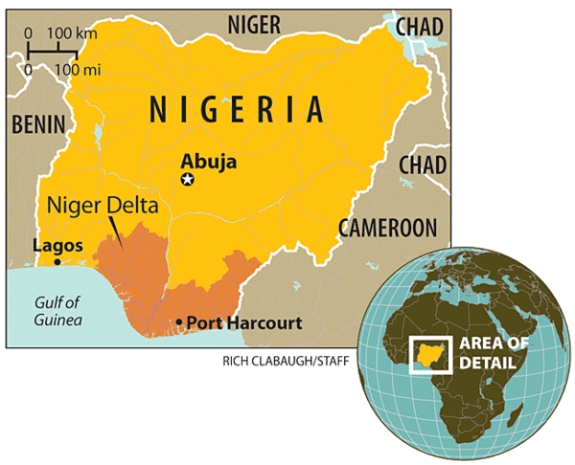
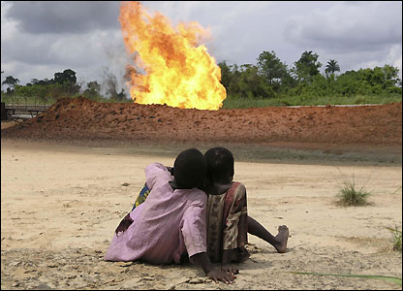
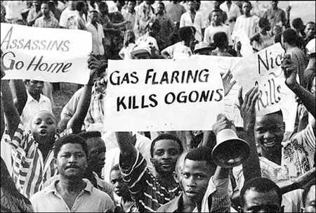
Wastelands, Oil Spills, and the Ogoni: Oh My
Elizabeth Krueger – Gettysburg College - ANTH 223-Indigenous Peoples, the Environment, and the Global Economy
WHO ARE THE OGONI?
The Ogoni are a group of 500,000 indigenous people in the Niger Delta in southern Nigeria. They make their livelihoods traditionally from farming and fishing and have a community-based internal political structure. Since the mid 20th century, they have received international attention due to the damages and human rights violations caused by several multinational oil companies. The oil companies, in conjunction with complications from the Nigerian national government, have allowed large parts of the Ogoni homeland to be ruined. The land has been contaminated not just by oil extraction and pipelines, but also from gas flares that burn 24 hours a day. This not only destroys land and contributes to global warming, but causes many damaging health effects. Shell Oil is the largest foreign oil company present in Nigeria and has extracted oil from the Niger Delta since 1958 as a part of a joint venture with Nigerian National Petroleum Corporation, Elf, and Agip. They account for 50 percent of the country’s oil production and are the company the Ogoni blame for most of the damages. Despite well-voiced opposition to the drilling, the local oil companies continue to undermine local environments and economies without any form of compensation (Johansen 2003:279-281).
Map showing location of Nigeria and the Niger Delta, where the extraction occurs (from the Baldauf article, “Cheers in Nigeria”)
STARTLING STATISTICS
Nigeria generated about 12% of Shell’s oil production worldwide in the late 1990s
1989-1996: The Ogoni suffered an average of 190 oil spills per year (about 319,200 gallons per spill)
1995: Ken Saro-Wiwa and eight Ogoni men were executed by Nigerian government for false murder accusations
By 2000, oil was more than 90% of Nigeria’s export earnings and 80% of government revenue → $20 million per day
1993-2001: more than 2,000 killed, 37 villages destroyed, 30,000 other Ogoni displaced from homes
Sources: (Barnard 1996: 1 and Johansen 2003: 282)
THREATS/ISSUES
Extraction of oil threatens traditional livelihoods, ways of life, and large parts of Ogoni homeland
Gas flares pollute and ruin valuable farmland and contribute to global warming
Gas and oil flares also cause medical problems, such as blindness and skin issues
Acid rain is another byproduct of the flares – it ruins roofs, reduces crop yield and contaminates water and soil
Leaking, rusty oil pipelines cause constant oil spills – these oil spills have turned vast areas of Ogoni land into wastelands
Oil spills are not cleaned up, and continue to contaminate soil and water
Oil companies, such as ChevronTexaco, profit heavily from their operations and the Ogoni receive nothing (Much of oil companies’ profits go to the repressive Nigerian military)
The Nigerian government responds to Ogoni’s peaceful protests with brutal repression – many have been killed, tortured, and displaced from their homes
Sources: (Thomas, Carr and Humphreys 2001:150-170 and Johansen 2003: 282)
Ogoni children watching the constant oil and gas flares (from BBC website “Polluting Nigeria”)
“We either win this war to save our land, or we will be exterminated, because we have nowhere to run to.”
– Ken Saro-Wiwa, MOSOP (African Successes)
ADVOCACY
Existing Ogoni organizations and outside groups joined together to form the Movement for the Survival of the Ogoni People (MOSOP) in 1990. The main organizer of this NGO, Ken Saro-Wiwa,, is an international writer and advocate for the Ogoni. The organization aims to promote democratic awareness, protect cultural rights and practices, and protect the Ogoni environment. The group created the Ogoni Bill of Rights, which summarized the grievances of the Ogoni and made specific requests and demands. It also launched a vigorous campaign to publicize the Ogoni cause and create a support base, both nationally and internationally. It releases a biweekly newspaper and above all, stresses non-violent campaigning techniques (Carr, Douglas and Humphreys 2001: 150-170).
“Thirty billion dollars worth of oil has been taken from the Ogoni region and still there is no electricity, no good water, no good roads. We Ogoni are not against economic development; we believe in it. But we ask that our environment not be destroyed in the process.” – Goodluck Diigbo, President of the Partnership for Indigenous Peoples’ Environment (McIntosh 2003: 1)
Ogoni people protesting oil companies (from the BBC website “Polluting Nigeria”)
REFERENCES CITED
African Successes
2009 Biography of Ken SARO WIWA. Electronic document,
http://www.africansuccess.org/visuFiche.php?id=170&lang=en, accessed May 2, 2011.
Baldauf, Scott
2009 Cheers in Nigeria. Electronic document, http://www.csmonitor.com/World/Africa/2009/0609/p06s07
-woaf.html, accessed May 1, 2011.
Barnard, Gage
1996 Ogoni Battle Shell Oil. Electronic document, http://www.culturalsurvival.org/category/author/barnard
BBC News
2004 In pictures: Polluting Nigeria. Electronic document, Http://news.bbc.co.uk/2/shared/spl/hi/picture_gallery/04/africa_polluting_nigeria/html/1.stm, accessed May 1, 2011
Johansen, Bruce E
2003 Indigenous Peoples & Environmental Issues. Wesport: Greenwood Press. Pp 279-290.
McIntosh, Ian
2003 Ogoni Leader Speaks Out at UN Permanent Forum on Indigenous Issues. Electronic document,
http://www.culturalsurvival.org/category/author/ian-mcintosh, accessed May 1, 2011.
Thomas, Alan, with Susan Carr and David Humphreys
2001 Environmental Policies and NGO Influence. New York: Routledge Press. Pp 150-170.
CONCEPTUAL QUESTION
The case of the Ogoni is not an isolated incident -
Indigenous peoples throughout the world have faced problems with oil companies and the devastating effects of oil extraction on local economies and environments. Is there a way for oil extraction to continue without producing all of the negative side effects? Can indigenous peoples and oil companies ever come together to effectively find a solution? This is an extremely important issue, as demonstrated by our studies in this class, which can be seen in the book Savages and the film Crude (among others). It is clear the Ogoni are not against economic development, but more research outside of this case study on the Ogoni is needed to determine a feasible answer to this probing question.

