Slide 1
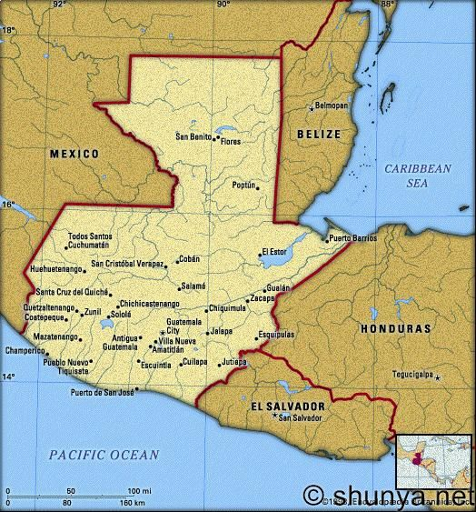
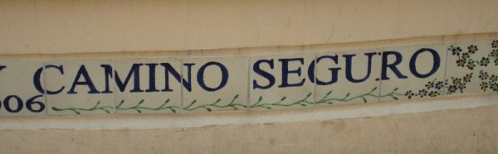
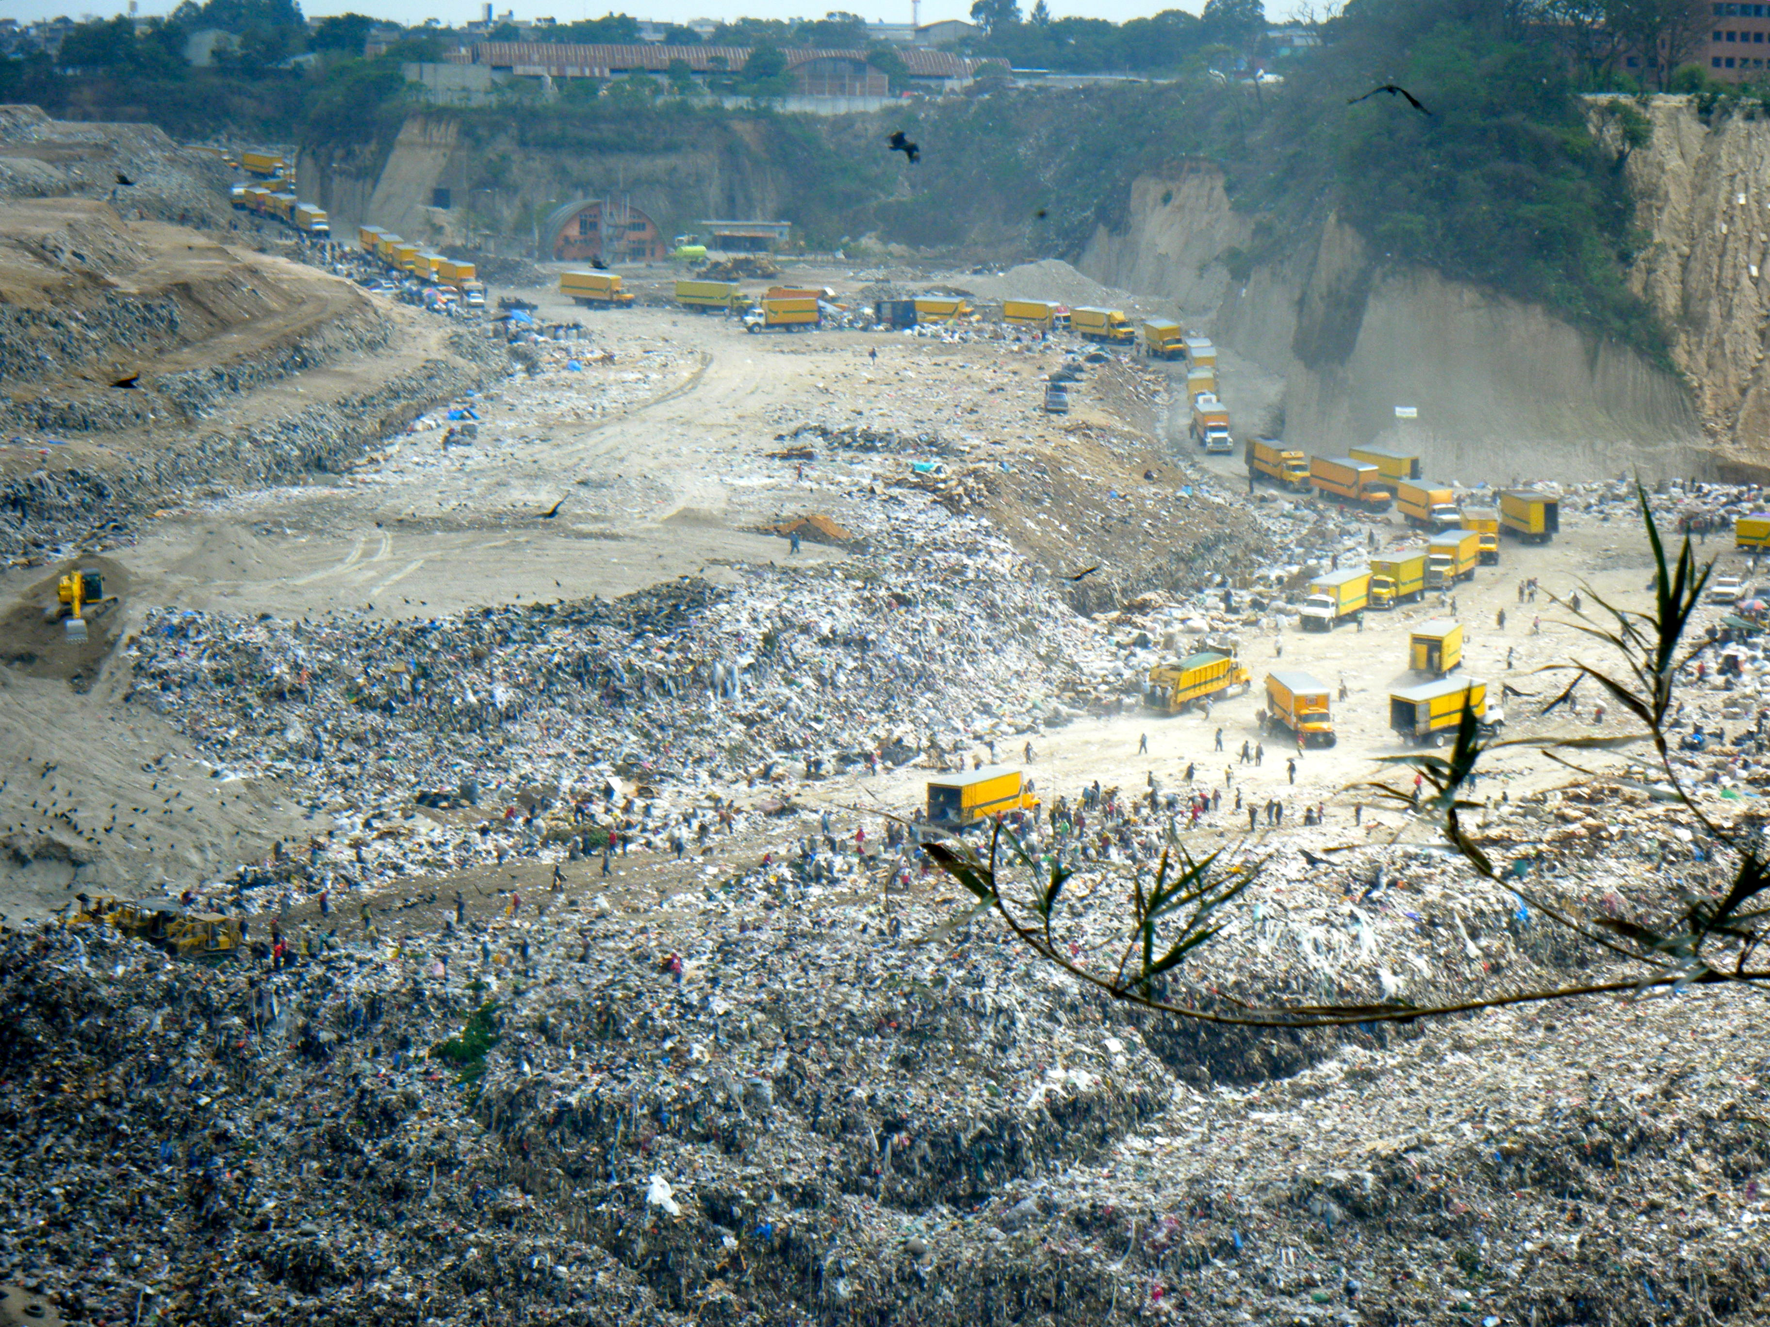
The Landless Maya of Guatemala Bridget Kelsea—Gettysburg College Anth 223—Indigenous Peoples, the Environment, and the Global Economy
Background: The Indigenous Maya of Guatemala
The ancient Mayan Civilization flourished throughout Guatemala, Southern Mexico, and Belize from approximately 900 BC to 400 AD. They are remembered for their complex systems of hieroglyphic writing, calendar making, mathematics, architecture, artwork, and especially their agricultural methods and spiritual connection to the land (Culbert 1993).
Many of the ancient Mayan agricultural techniques and rituals have been preserved in current day Mayan populations. The Mayan myth of Quetzalcoatl, the maize god who brings a single grain of corn to the Mayan villagers, symbolizes the religious importance of maintaining a reciprocal relationship between the commoners and their deities. Fertile crops ensure Mayan survival, and therefore, land is highly preserved and worshipped (Culbert 1993).
Today 60% of Guatemala’s 11 million inhabitants identify with one of the nearly 30 different Mayan language groups of Guatemala’s western highlands (Stonich 2001).
Threats: Coloniality, Civil War and Displacement
Since the onset of the sixteenth century colonial conquest, Guatemala’s indigenous Mayans have been marginalized, displaced, oppressed, enslaved, silenced, raped, and murdered. By 1780, colonial rule had left the Mayan population depleted to only 10% of what it once was. Independence in 1820 only shifted corruption from the hands of the Spanish to a small elite Ladino class (Cojtí-Cuxil 1996: 19-25).
Liberal reforms in the late 19th century enabled despotic governments to abolish cherished communal landholdings and imposed harsh labor laws. Vagrancy laws required males to perform between 100-150 days of unpaid labor per year to the state as a way to “incorporate” the Mayan savages into modern society by breaking down their ancient land and labor systems (Manz 2004: 46-48).
By the 1940s, the vagrancy laws were abolished, and democratically elected President Jacobo Arbenz instigated land reform to alter the unequal distribution of wealth. By the mid-twentieth century, 1% of the Guatemalan population controlled 65% of land, leaving 40% of the rural Guatemalan population landless (Stonich 2001).
Seen as a communist threat, President Jacobo Arbenz was overthrown in a CIA backed Coup d’etat in 1954. The consequential presidential appointment of General Carlos Castillo-Armas sparked a 36-year civil war in Guatemala between the Ladino elite and indigenous Mayan populations who were viewed as communist guerrilla conspirers. The national army’s scorched earth tactics, widespread torture and violation left thousands of Mayans weakened and silenced and resulted in more than 200,000 disappearances (London and London 2007: 7).
The gruesome Guatemalan civil war led to the displacement of 500,000 to one million Mayans who were forced to leave the sacred land their ancestors had tended in hopes of survival (Comisión para el Esclarecimiento Histórico 1999). 16% of surviving Mayans settled in oppressive army-controlled model villages, 12% fled to the urban areas, 8% went into hiding and tens of thousands crossed the border to Mexico (Internal Displacement Monitoring Centre 2003).
(From the website, “world map now”)
(From the book, We Were Taught to Plant Corn Not to Kill, by Tax’a Leon and Douglas London)
What Can You Do?
With the help of Camino Seguro (a non-government organization founded eleven years ago), six hundred children have been given the opportunity to escape the borders of the basurero. Within a safe and caring environment, Camino Seguro provides a comprehensive and integrated program that fosters hope, good health, educational achievement, self-sufficiency, self-esteem and confidence. The primary focus is to create opportunities and dignity through the power of education (Safe Passage 2011). Having volunteered with Camino Seguro for six months over the past two years, I have been able to see first hand the effects of the 36-year civil war and the way that these Mayan survivors have persevered.
Can aid organizations accommodate the needs of indigenous people without imposing their own ideals and assumptions?
Beginning in 1983, displaced peasants were encouraged to return to their ancestral lands (Manz 2004). While this effort was embraced by many, others, including the guajeros that we see still living in the Guatemala City garbage dump today, have chosen to remain in the locations that they had fled to. One might wonder why these people would prefer to continue living in a garbage dump when given the opportunity to return to their rural lands.
Perhaps their new homes in the basurero provide a sense of community, or stability. Perhaps their old lands were plagued with memories of loss and terror. Perhaps these indigenous Maya no longer want to remain living on the fringe of society and would prefer to integrate with urban life.
The key here is for non-state actors to understand their role as an outsider in many indigenous struggles. Instead of pushing our own notions of “progress” and “indigenous rights,” we need to step back and ask the Mayans what they would like to see in their own future.
Displacement to Urban Centers:
The Guatemala City Garbage Dump
Of the 12% of Mayan survivors that fled to urban areas after being pushed off their rural land, hundreds found refuge in the Guatemala City Garbage Dump (basurero). Unable to find jobs based on their inability to speak Spanish and their lack of basic labor skills, many Mayans brought their families to live and work in the basurero (Iwerks and Glad 2006).
Located in a natural ravine, the Guatemala City garbage dump (the largest and most dangerous landfill in Central America) is 35 acres (12 football fields) long and 180-280 feet deep. About 600 tons, 1/3 of the entire country’s garbage, is dumped in the basurero everyday (Iwerks and Glad 2006). The waste is not monitored and contains hospital waste, biohazardous material, dead animals from the zoo, and human corpses.
Today more than 2500 workers (guajeros) do a service to their government by removing up to 500 tons of recyclable goods everyday from the landfill that would otherwise overflow. In return, they earn meager wages of up to $2 US per day and are forced to purchase identification cards to even enter the premises (Iwerks and Glad 2006).
The guajeros live in gang-controlled slums surrounding the basurero and live off the food they find in the dump. Many have never left their small communities for they are seen as unsanitary, uneducated beggars who do not understand the “modern” world. Nevertheless, most claim that they are better off in the dump for they are able to eat what they find in the basurero and are safe from government violence.
Works Cited
Cojtí-Cuxil, Demetrio
1996 The Politics of Maya Revindication. In Maya Cultural Activism in Guatemala. Edward F. Fischer and R. McKenna Brown, eds. Pp
19-51. Austin Texas: University of Texas Press.
Comisión para el Esclarecimiento Histórico
1999 Guatemala Memoria del Silencio: Conclusions and Recommendations. Guatemala City: United Nations Office for Project Services.
Culbert, T. Patrick
1993 Maya Civilization. Washington DC: Smithsonian Books.
Internal Displacement Monitoring Centre
Guatemala Poplulation Figures and Profile. Electric Document, http://www.internal-displacement.org/idmc/website/countries.nsf/,
accessed May 3, 2011
Iwerks, Leslie and Mike Glad, dirs
2006 Recycled Life. 38 mm. AllGlad, Inc.
London, Taxa Leon and Douglas Stuart London.
2007 We Were Taught To Plant Corn Not To Kill: Secrets Behind the Silence of the Mayan People. United States: Back Up Books Human
Medical Rights Press.
Manz, Beatriz
2004 Paradise in Ashes: A Guatemalan Journey of Courage, Terror, and Hope. Berkeley: University of California Press.
Safe Passage
2011[1997] Camino Seguro. Electronic Document, http://www.safepassage.org, accessed May 2, 2011.
Stonich, Susan C. ed.
2001 Endangered Peoples of the World: Endangered Peoples of Latin America: struggles to survive and thrive. London: Greenwood Press.
World Map Now
2011 Guatemala Map. Electric Document, http://www.worldmapnow.com/images/ 2011/01/Guatemala-Map-1.jpg, accessed May 3.
Photo taken by Bridget Kelsea 2009

