Slide 1
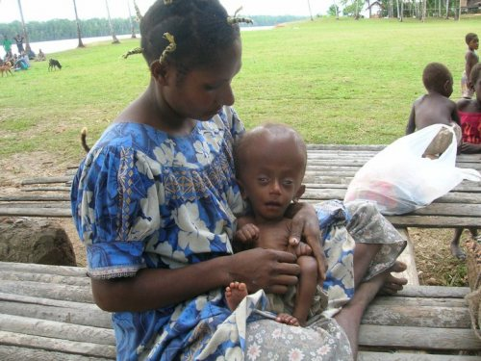
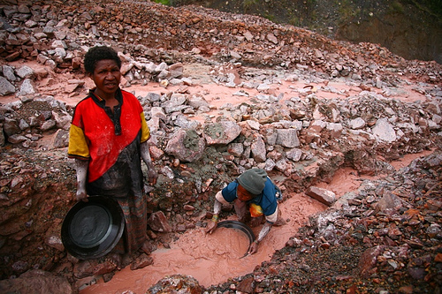
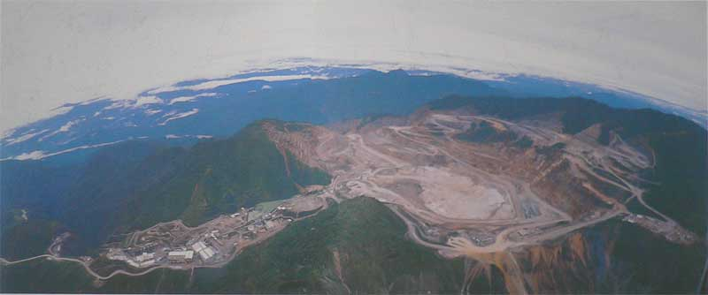
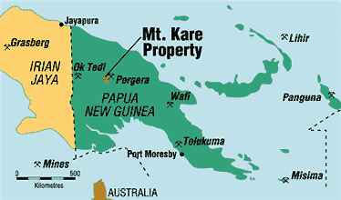
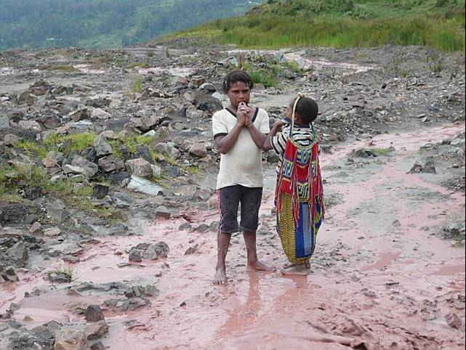
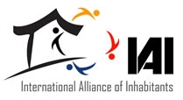
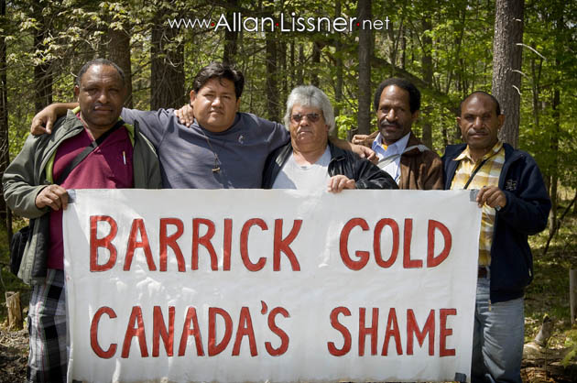
Mine Destruction in Papua New Guinea Highlands
By: Lauren Dunne
Anthropology 223
May 2011
This is a devastating image of a baby born with a serious birth defect do to the mineral run off in the Ok Tedi River
Harrowing photographs a grim reminder of the dangers of mine waste. in Worldpress.com [database online]. [cited May 4, 2011 Available from http://ramumine.wordpress.com/2010/08/30/harrowing-photographs-a-grim-reminder-of-the-dangers-of-mine-waste/.
Porgera Mine: An example of Mountain Top Mining, where there is no resources left after the mine is created. Allan Lissner. EVENT: Mining (in)justice: At home and abroad. in Praxis Pictures [database online]. Available from http://allan.lissner.net/event-mining-injustice-at-home-and-abroad/.
This photo represents the helpless men who pan for gold in the Ok Tedi River because they can no longer farm. Their land has been taken away from the transnational companies, who have left them with no resources or land to live on.
Howden, Erland. Pollution, porgera gold mine. in Yahoo [database online]. February 2008Available from http://www.flickr.com/photos/erlandh/2311803574/.
Map of Papua New Guinea: The Central Highlands, Porgera and Ok Tedi Mines.
Papua new guinea. in Madison Minerals Inc. [database online]. 2004 [cited May 2, 2011 Available from http://www.madisonminerals.com/html/projects_Kare.htm.
Response of International Community: The International Alliance of Inhabitants is an organization that publicizes the struggles of the indigenous people, in hope that more awareness will come from the publicity (International Alliance of Inhabitants 2010). In an article they published about the police hostility and killings due to the mine, it informs the general public about what is happening. In this particular instance, it is a report about Amnesty International and how their efforts to persecute the responsible parties (the government and the police) for the outbreak in violence will be hopefully be felt in the Highlands. The corporations’ mission is to help all instances of “world eviction” in which people are forced to leave their native lands and they dedicate their website to documents and proclamations that occur on an international level about what is happening in our world (International Alliance of Inhabitants 2010). This group is essential in their campaign to prevent eviction from indigenous lands.
Another group that helps the horrible circumstances of the Huli people is the WaterAid program in Papua New Guinea, which focuses on finding clean water sources for the people in the highlands (WaterAid 2010). The importance of bringing clean water to people living on this river comes from the fact that people rely on the river water to survive, but the water is so contaminated from the mineral runoff that they can no longer use it as a source (WaterAid 2010). With the help of WaterAid, the situation in the highlands is somewhat more bearable for the people, because they have the most important resource available.
Transnationalism: The overarching question applicable to the Huli people is: What are the cultural implications of transnational companies and how do they influence each culture through changing the modes of resource distribution and land use? This question is relevant to Kane’s book, Savages, which also focuses on indigenous land that is slowly being destroyed because of international oil companies that are devastating the Amazon Rainforest (Kane 1996). In comparison, the people of the Amazon won an important lawsuit, which gave them a great deal of money to clean the crude out of the land, and restore their traditional ways of life (Kane 1996). In the Papua New Guinea situation, the land cannot be repaired because of the damage, and therefore life will forever be marked by the impact of these momentous gold mines. In order to answer this question, it’s important to look at how the culture of the indigenous people has already changed due to the violent mining culture that has produced so much negativity and hopelessness for the people experiencing the horrors of globalization in the context of these brutal transnational industries. In Savages, Kane helps us understand that even though many people consider indigenous as a primitive culture, in reality indigenous are often the best stewards of the land because of their local knowledge. This is also evident in the book, “Conservation Refugees” where Dowie concludes that often times, and the indigenous are more prepared to manage their own lands (Dowie 2011). Unfortunately, in the case of the Huli people, the greed of the transnational corporations are in control and they leave the indigenous with no agency in deciding who controls the land. At this point, I think this question clearly can be answered with the knowledge that the indigenous cultures of the Central highlands have been significantly changed through globalization and not in a positive way.
Papua New Guinea Indigenous People V. Barrick Gold:The indigenous people living near the Porgera Mine are fighting for their freedom against Barrick Gold, a Canadian company that has seemingly destroyed all life near the mine. In an article published by the Workers World, the leader of the local indigenous people is speaking out about the project (Catalinotto 2009). This is significant in giving the indigenous an international voice, and helping others see how devastating the situation is. The article quotes:
Tulin was in New York this May attending a United Nations Permanent Forum on Indigenous Issues. He spoke for the Akali Tange Association, which represents around 10,000 Indigenous “landowners” in the mine area. Two decades ago, Tulin became the first secretary general of the Mine and Allied Workers Union, which at that time represented as many as 3,000 miners and construction workers at the Porgera mine” (Catalinotto 2009).
This quote gives hope to the Indigenous community in stopping this project and restoring the Porgera community, as well as recognizing the worldwide problem with transnational corporations that are destroying land all over the world in extractive industries. Overall, though this is a depressing situation, Tulin is a useful advocate in the situation and this issue is popularly known because of advocates like him.
Two Children standing in the runoff of the Ok Tedi River
Allan Lissner. EVENT: Mining (in)justice: At home and abroad. in Praxis Pictures [database online]. Available from http://allan.lissner.net/event-mining-injustice-at-home-and-abroad/.
The Mining Culture and the Threats they pose to Indigenous People:
There are many significant implications of the large mines of Ok Tedi and Porgera, which have devastated all aspects of life for the indigenouslliving in the central highlands of Papua New Guinea. Because of the large resource deposits in the highlands, huge transnational corporations have taken control of the mines, leaving the indigenous people with no agency or means of production, since their land has been destroyed (Jorgensen 2006). The history of this colonial movement extends back to post World War II, when the Papua Government became independent and essentially needed money to support their new independence (Jorgensen 2006). Along with the severe environmental consequences of mining, people have been displaced and forced into prostitution to support their families.
In the devastating field of mining, the indigenous people have no choice but to adapt to the new way of life through finding jobs that accommodate their needs (Ballard and Banks 2003). For example, many of the men stand in the Ok Tedi River all day, panning for minerals such as gold, which could significantly increase their economic situation, yet the risk is great (Jorgensen 2006). This job is very dangerous because of the possibility of a rockslide, which could cause fatalities. Also, mining sometimes requires men to leave their indigenous hillsides to work at sites along the river that have not already been exploited, which isolates and neglects the needs of the women and children (Ballard and Banks 2003). Because of this, many women resort to prostitution with the foreign mine workers to support their families. Unfortunately this has contributed to the circulation of HIV Aids, where many women and men are now infected with the disease and have no means of getting any health care. As you can see from this cycle, the mining industry has devastated the norms of agricultural life, and forced the indigenous culture to change in irreversible ways.
Overall, it is obvious that the Huli people of the highlands of Papua New Guinea are facing the threats of an epidemic (HIV), displacement, and governmental persecution and neglect through supporting the large transnational corporations. These threats are all caused by the environmental devastation that has destroyed the land through mountain top mining, mineral runoff in the water, as well as taking over indigenous land. In studying these threats, the implications could cause cultural extinction in the future if the indigenous population cannot find ways to overcome these problems caused by globalization.
Picture of the general sentiment for indigenous population
Confront barrick gold. Toronto, Canada, Available from http://www.solidarityresponse.net/tag/papua-new-guinea/.
Complete Bibliography:
Ballard, Chris, and Glenn Banks. 2003. "RESOURCE WARS: The Anthropology of Mining." Annual Review of Anthropology 32, no. 1: 287-313. Academic Search Premier, EBSCOhost (accessed May 3, 2011).
Dowie, Mark. 2011. Conservation Refugees: The Hundred-Year Conflict Between Global Conservation and Native Peoples. Cambridge, Mass.: MIT Press.
International Alliance of Indigenous People. Victims of police violence and forced evictions near papua new guinean gold mine. Great Britain, May 3, 2011.
Jorgensen, Dan. 2006. Hinterland history: The ok tedi mine and its cultural consequences in telefolmin. The Contemporary Pacific 18 (2): 233-63.
Kane, Joe. 1996 Savages. New York: Knopf : Distributed by Random House.

