Slide 1
Discussion Question Drawing on the book, brainstorm with your group and make a list of all social practices that evidence and reinforce gender inequality. ►Go through each practice and discuss whether the book adequately describes the local logic, or complex cultural reasoning, behind this practice. Do you understand it well after reading this book, or are you still confused as to why the Minianka and so many other Africans do this? ►Have you ever studied this issue in another class, or been exposed to it in some other way?

Slide 2
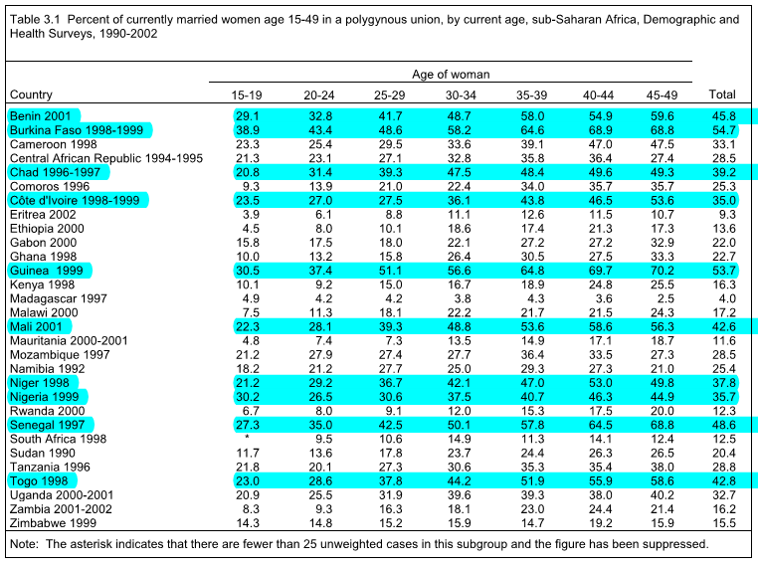

Slide 3
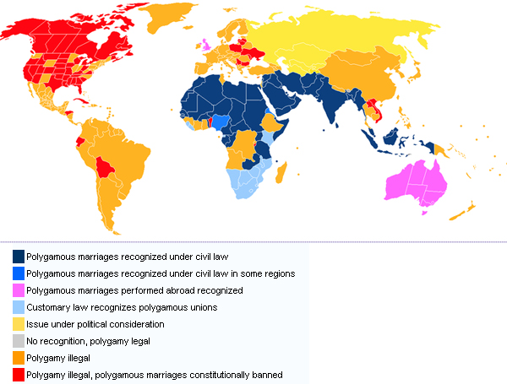

Slide 4
