Slide 1
It is estimated that over 50 per cent of the African population do not have access to modern health facilities and more than 60 per cent of people in rural areas have no access to primary healthcare.
many African countries will have just
one health worker per 1,000 people (the
European average is one per 100)

Slide 2
WHO figures show that North America
accounts for only 10% of the global
burden of disease, yet has 37% of the
world's health workers. Both countries
together spend 30% of the world's financial
expenditure for health.
In contrast, Africa, which suffers
more than 24% of the global burden of
diseases, has access to only 3% of health
workers and less than 1% of the world's
financial resources.

Slide 3
More than half of the estimated 536,000 maternal deaths worldwide occurred in sub-Saharan Africa, and 13 out of 14 countries with maternal mortality rates of at least 1,000 are in
the region.
The adult lifetime risk of maternal death is highest in Africa (1 in 26), while developed countries had the smallest lifetime risk (1 in 7,300).

Slide 4
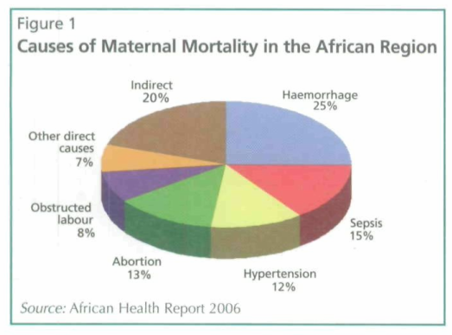

Slide 5
Children in sub-Saharan Africa face the gravest challenges for survival. Africa accounts for 44 per cent of global under-five Mortality. The number of children that die before the age of 5 for every
1000 births, remains staggeringly high at 172 deaths in sub-Saharan Africa compared with just 6 in the high-income
countries
It has been estimated that out of the 60 countries worldwide, which contribute 94 per cent of child mortality, 37 are in the African region

Slide 6
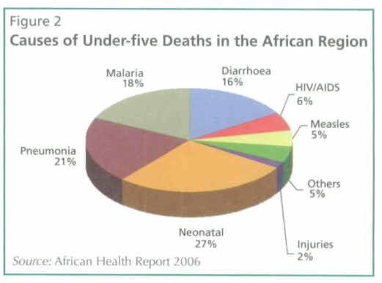

Slide 7
