Slide 1

Cyber Security Fundamentals
With slide design by Microsoft’s AI.

Slide 2
AAA
Authentication
Authorization
Accounting
Notes:
Authentication – confirming a person’s or device’s identity.
Authorization – keeping track of what users have permission to access which resources.
Accounting – maintaining logs of who accesses which resources

Slide 3

Hacker Motivation
What motivates people to circumvent security?

Slide 4
Hacker Motivation
What motivates people to circumvent security?
Financial Gain
Hacktivism
Revenge
Curiosity, Challenge
Espionage
Thrill-Seeking
Profitable Criminal Enterprise
Social Recognition
From: https://brandefense.io/blog/drps/cyberattacks-what-motivates-hackers/

Slide 5
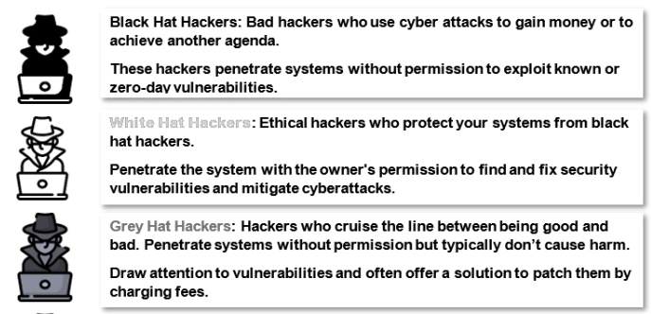
Hacker Hats
https://sectigostore.com/blog/different-types-of-hackers-hats-explained/

Slide 6
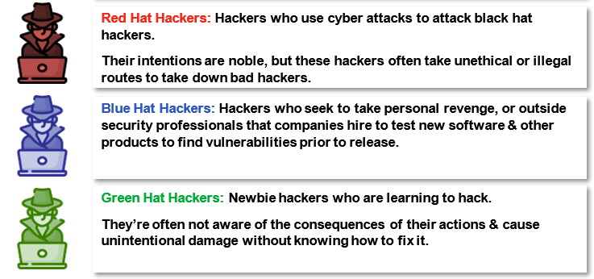
Hacker Hats
https://sectigostore.com/blog/different-types-of-hackers-hats-explained/

Slide 7
AI for Slide Design
Are the formats distracting?
Positives and Negatives?
Notes:
Inconsistent across slides and sessions
Hard to get back to the original other than undo

Slide 8
Five Principles to Follow and One to Avoid
Defense in Depth
Least Privilege
Separation of Duties
Security by Design
KISS
Security by Obscurity

Slide 9
Symmetric Key Cryptography
Alice is talking to Bob secretly.
Both Alice and Bob know an algorithm for encrypting
Both Alice and Bob know secret information (key) to decipher the code

Slide 10
Caesar Cipher C(4)
Plain
Cipher
Plain
Cipher
Example: https://www.simonsingh.net/The_Black_Chamber/caesar.html

Slide 11
Substitution Cipher
Plain
Cipher
Plain
Cipher

Slide 12
Substitution Cipher (key)
Plain
Cipher
Plain
Cipher

Slide 13
The Vigenere Table
Plain
cipher
keyword

Slide 14
Cracking the Code with Frequencies
Cracking Tool:
https://www.simonsingh.net/The_Black_Chamber/vigenere_cracking_tool.html
Letter Frequencies:
https://www.simonsingh.net/The_Black_Chamber/letterfrequencies.html

