Slide 1

Cyber Security Fundamentals
With slide design by Microsoft’s AI.

Slide 2
Security Controls
Physical
Administrative
Technical

Slide 3
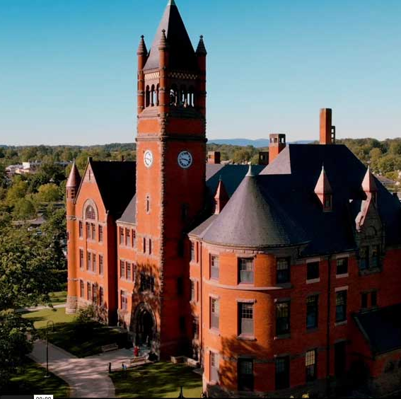
Securing Glatfelter Hall
24 Hour Access
Classrooms
Computer Labs
Lounges
Offices
Bell Tower

Slide 4
Securing Glatfelter: Tools
Physical
Door
Locks/keys
Lights/power
Administrative
Access policy
Campus Safety
Fire drills
Entry logs
User policies
Password policy
Technical
Cameras
Alarms
Passwords
Cable locks
Key entry (RFID)

Slide 5
Layers of Security
Human
Perimeter (physical)
Network Security
Endpoint Security
Application Security
Data Security
Assets

Slide 6
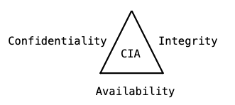
CIA Triad
Notes:
Confidentiality: preventing access to unauthorized users
Integrity: assuring assets are not corrupted or tampered with
Availability: allowing access to authorized users

Slide 7
C, I, or A?
Passwords C,I
Web sites A
Encryption C,I
Doors A
Device Registration C
Network Firewalls C,I
Anti-phishing training I
Intrusion Detection C
Keys C,I
Backups I,A
Digital Signatures I
Email A
Logs C, I

Slide 8
CIA Tradeoffs
Confidentiality vs. Availability
Integrity vs. Availability
Confidentiality vs. Integrity
Notes:
Confidentiality v. Availability: keeping out unauthorized users could also keep out authorized users.
Integrity v Availability: Checks to make sure changes are valid could slow down performance so affect availability
Confidentiality v Integrity:

Slide 9
AAA
Authentication
Authorization
Accounting
Notes:
Authentication – confirming a person’s or device’s identity.
Authorization – keeping track of what users have permission to access which resources.
Accounting – maintaining logs of who accesses which resources

Slide 10
Hacker Motivation

Slide 11
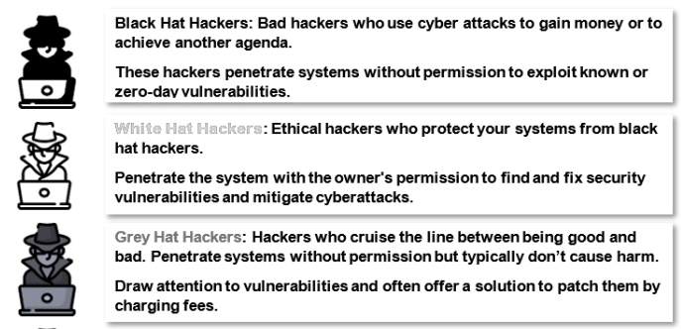
Hacker Hats
https://sectigostore.com/blog/different-types-of-hackers-hats-explained/

Slide 12
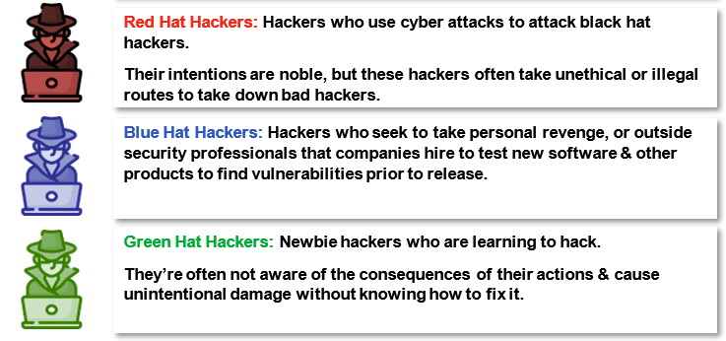
Hacker Hats
https://sectigostore.com/blog/different-types-of-hackers-hats-explained/

Slide 13
AI for Slide Design
Were the formats distracting?
Positives and Negatives:
Notes:
Inconsistent acress slides and sessions
Hard to get back to the original other than undo

