Slide 1
Violins, Saxophones, and Tuvan Throat Singers: The Physics of Musical Instruments
Maryland Symphony Orchestra
Adult Lecture Series
January 26, 2022
Hagerstown Community College

Slide 2
Outline
Musical Acoustics
Basic physics of sound and vibration
Harmonics
Violins
Saxophones
The voice
Other topics of interest?

Slide 3
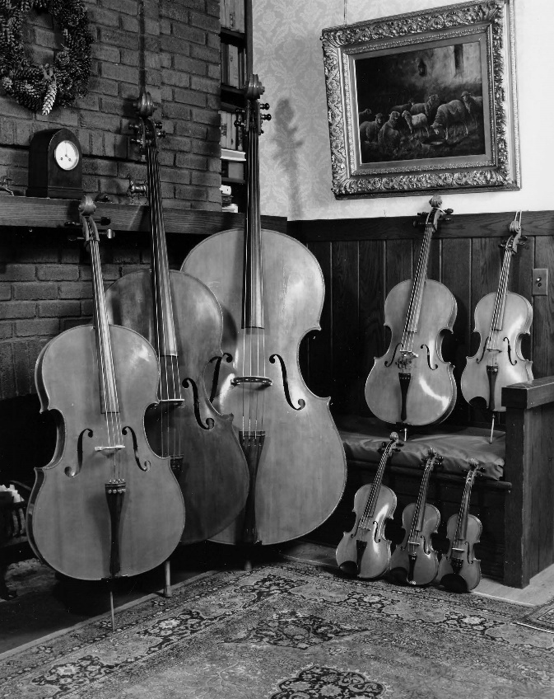
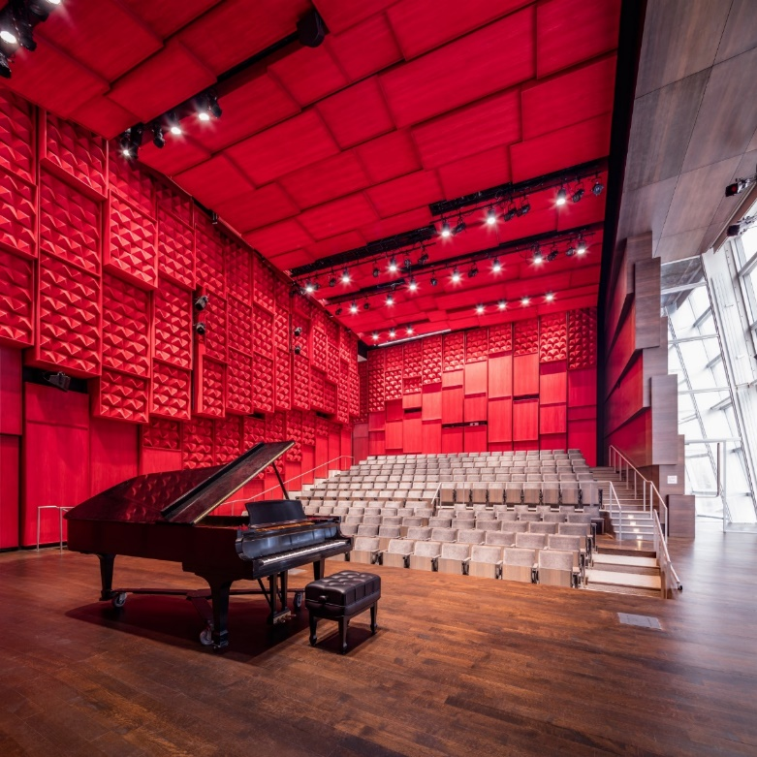
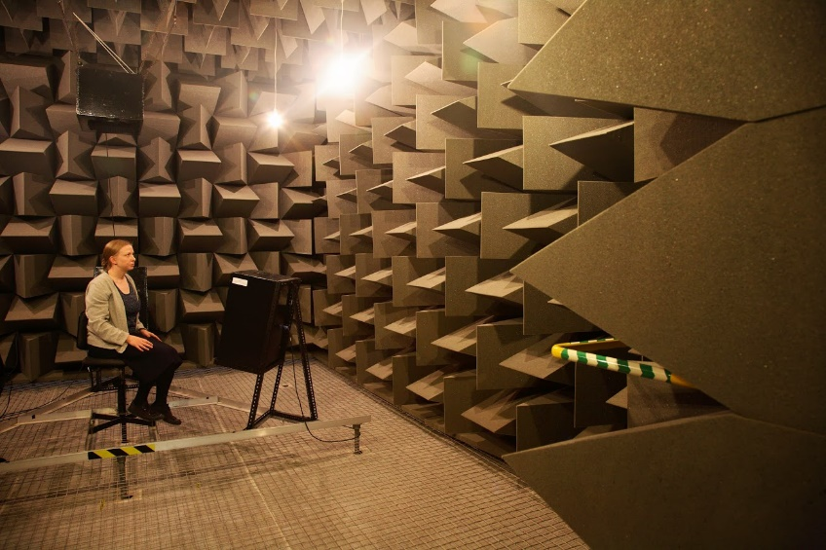
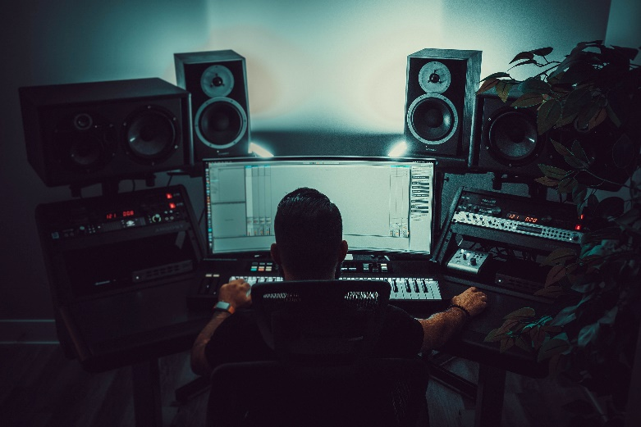
Musical Acoustics
Carleen Hutchins’s Octet
Voxman Music Hall U. Iowa
Anechoic Chamber, U. Salford
Photo by Troy T on Unsplash

Slide 4
Variety of Musical Sounds
What instruments do you hear?
Sample 1
Sample 2
Sample 3
Why do instruments playing the same note sound different?
Notes:
Carmen MacRae – How long Has this been going on?
David Liebman – Por Toda a minha Vida of Unknown Jobim
Anat Cohen – J Blues

Slide 5
Adjectives to describe timbre…

Slide 6
Adjectives to describe timbre…
Warm
Lush
Brilliant
Rough
Edgy
Smooth
Breathy
Pure
Light
Bright
Dark
Round
Sizzle
Airy

Slide 7
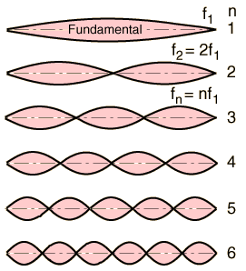
Harmonics (overtones)
Vibrating objects vibrate in many modes at once
Real sound waves have many frequencies
overtones ringing on piano
Flexible string: modes form a harmonic series
f_{n} = n f₁ , where n=1, 2, 3,…
f₁ is called the fundamental
f₂ – f_{n} are called the overtones
String
Harmonics
1st Octave
Octave + P5
2nd Octave
2nd Octave + M3
2nd Octave + P5

Slide 8
Harmonics (overtones)
Every periodic wave can be made by adding sine waves that form a harmonic series
Joseph Fourier (1768-1830) French mathematician
Sine waves
Our ears hear all of these sine wave at once:
Pitch is from the fundamental of the series $f_{1}$.
Timbre is from the combination of harmonics.

Slide 9
Tonal Recipe – Frequency Spectrum

Slide 10
Violins
String vibrates (bowed or plucked)
Bridge transmits vibration to body of violin
Body of violin resonates
Sound leaves body travels to your ear!
http://www.phys.unsw.edu.au/jw/violintro.html

Slide 11
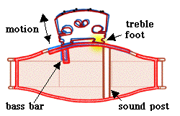
Violins
Sound depends on complex vibration of string
filtered by
The complex resonance (vibration) response of the body

Slide 12
String, bridge, body…
Harmonic series of string is filtered by bridge and body resonances.
Plot of the strength of each harmonic from the string.
Plot of the frequency response of different violin bodies. C. Hutchins

Slide 13
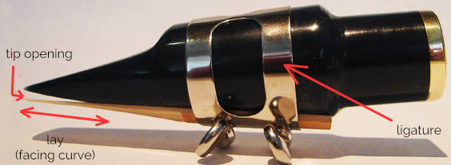
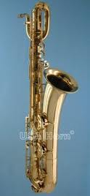
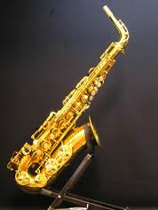
Saxophones
Reed vibrates as air enters mouthpiece
Air column resonates with harmonic modes like waves on a string

Slide 14
Instruments
Source of the vibration
Produces the sound energy with characteristic sound determined by vibration modes
Resonant cavity
Helps radiate the sound energy
Filters the source vibration (colors timbre)
Cavity geometry determines pitch in wind instruments
Quiz: What is the source of vibration and what is the resonant cavity for the violin? For the saxophone? For the voice?

Slide 15
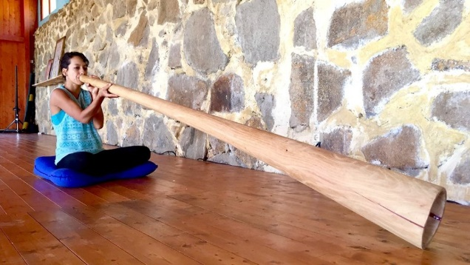
Resonance
Physical system responds strongly to input of energy at natural frequency (frequencies).

Slide 16
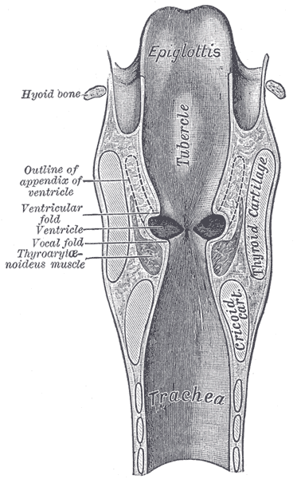
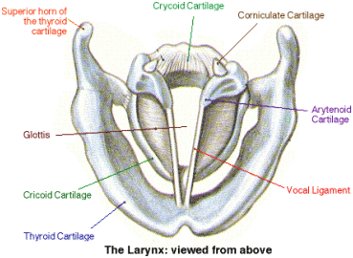
The Voice
Vocal cords are the source of vibration
Muscle tension and air speed affect vibration frequency
Harmonic series from vocal cords fills the vocal tract
http://www.ohsu.edu/xd/health/services/ent/services/nw-clinic-for-voice-and-swallowing/anatomy.cfm

Slide 17
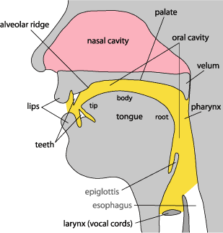
The Voice
Vocal tract resonates
Altering tongue, teeth change cavity resonance frequencies
http://www.indiana.edu/~hlw/PhonUnits/vowels.html

Slide 18
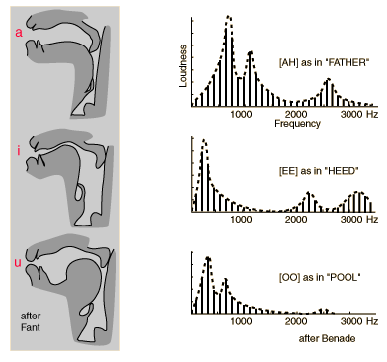
Vowels and Timbre
Vocal tract “filters” harmonic series from vocal cords
Spectrum analyzer:
Spectroid, Audacity..
http://hyperphysics.phy-astr.gsu.edu/hbase/music/vowel.html

Slide 19
Vowels and Timbre
Broad resonances that shape the harmonic series are called formants
Different Formant frequencies produce different vowel sounds
Spectrum Analysis
http://hyperphysics.phy-astr.gsu.edu/hbase/music/vowel.html

Slide 20
Overtone Singing: Extreme Formant Control
Throat Singers of Tuva
Typically sing a low pitch so lots of harmonics, then alter vocal tract to produce a very narrow, strong formant that the singer moves over different harmonics. Result is a low drone pitch with a high whistle that moves on top.
Different styles: https://www.alashensemble.com/about_tts.htm
Xray images of vocal tract during performance.
https://www.youtube.com/watch?v=a-qb1opYnvk
Great demonstration of Overtone signing technique
https://www.youtube.com/watch?v=vC9Qh709gas
Same performer in MRI machine!
https://www.youtube.com/watch?v=YIUvX7hebBA
Article on Overtone singing https://elifesciences.org/articles/50476

Slide 21
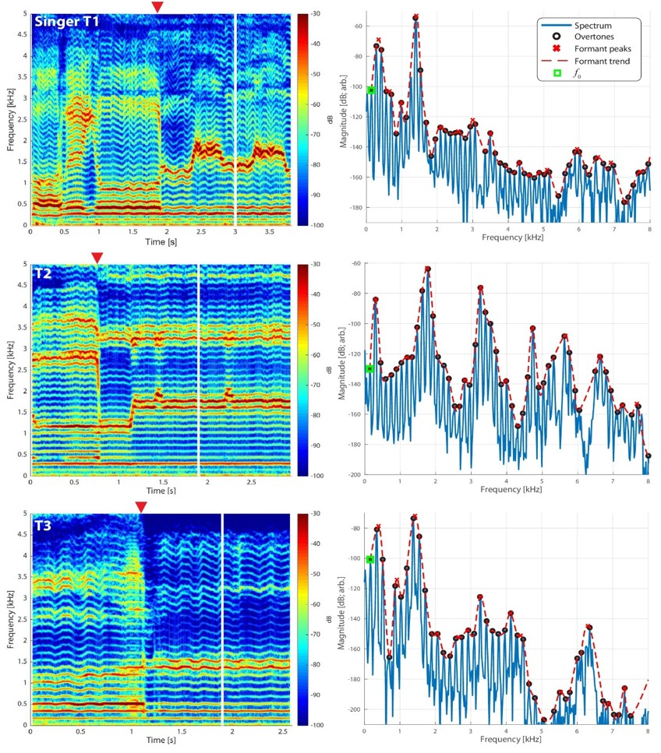
Spectrogram: Frequency spectrum versus time.
Frequency spectrum at the time of the red triangle on spectrogram.
From https://elifesciences.org/articles/50476
A very sharp formant can isolate different harmonics.
By moving the frequency of the formant, the “whistle note” changes pitches.

Slide 22
Why do instruments playing the same note sound different?
Different harmonics in the sound color the timbre
What have we left out?

Slide 23
Why do instruments playing the same note sound different?
Different harmonics in the sound color the timbre
Attack, sustain, decay
Phrasing
Voice incredibly versatile, especially at controlling harmonics (e.g., vowel sounds).

Slide 24
Questions and Discussion
References and Websites
Musical Acoustics by Donald E. Hall (Brooks/Cole, Thomas Publishing, 2002)
The science of sound by Thomas D. Rossing (Addison-Wesley Pub. Co., 1990)
Fourier Synthesizer Applet
https://phet.colorado.edu/sims/html/fourier-making-waves/latest/fourier-making-waves_en.html
Tuvan throat singing – xray movies
https://www.youtube.com/watch?v=a-qb1opYnvk

Slide 27
Sound waves
Variation in air pressure (and air density)
Amplitude (size of pressure variation)
Frequency (repetition rate)
cycles/sec or Hertz (Hz)
Humans hear from ~20Hz to ~20,000Hz
Wavelength (~17m to 17mm)
Wave speed (344 m/s = 770mph)

Slide 28
Sound Characteristics
Characteristic Physical quantity
Loudness wave amplitude
Pitch wave frequency
Timbre harmonics or overtones
It’s actually more complicated than this, but we’ll start here.
Let’s measure some sound waves…

Slide 29
An example: Harmonic Series of A₂
Harmonic | frequency f(Hz) | Equal Temp. f(Hz) | Note | interval in scale | Overtone
1 | 110 | 110 | A₂ | 1
2 | 220 | 220 | A₃ | 1 | 1
3 | 330 | 329.6 | E₄ | ~P5 | 2
4 | 440 | 440 | A₄ | 1 | 3
5 | 550 | 554.4 | C#₅ | ~M3 | 4
6 | 660 | 659.3 | E₅ | ~P5 | 5
7 | 770 | 784.0 | G₅ | ~~m7 | 6
8 | 880 | 880 | A₅ | 1 | 7

Slide 30
Wind Instruments
Vibration of lips, reed, edgetone can produce any frequency or even noise (all frequencies)
Resonant cavity has strong resonance which forces vibration source to a certain frequency (pitch)

Slide 31
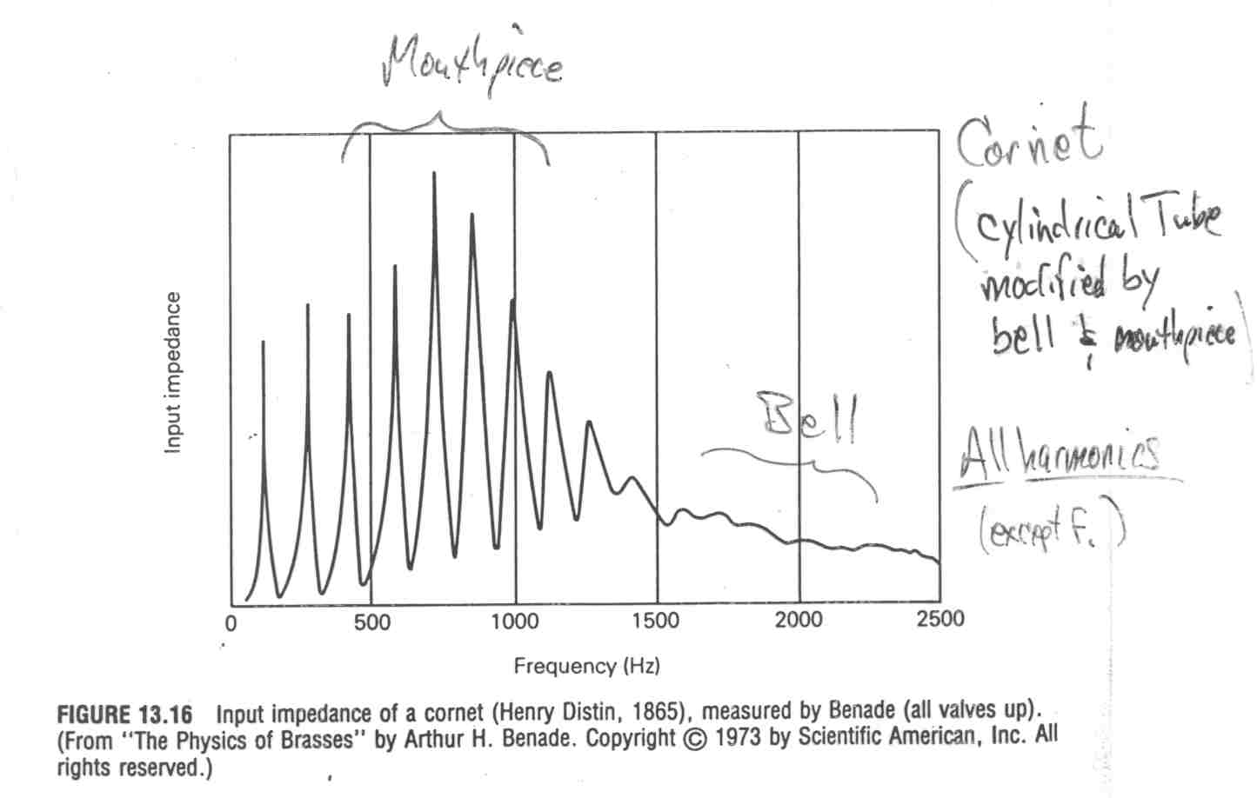
Resonance Examples
Trumpet
From Musical Acoustics, Hall 2002.

Slide 32
Resonance Examples
Clarinet
From Musical Acoustics, Hall 2002.

Slide 33
Resonance Examples
Bassoon
From Musical Acoustics, Hall 2002.

Slide 34
Voice
Vibration of vocal cords create sound wave rich in harmonics
Vary pitch by varying tension in vocal cords
Vocal tract resonates with three main broad resonances called formants
Unlike like wind instruments vocal tract resonances are not strong enough to force vocal cords to a definite pitch
Vary vowel sound (timbre) by varying shape of vocal tract (changes resonant frequencies) !!Incredibly versatile!!
Fourier Analysis

Slide 35
Notes and Intonation
How do you vary the note you are playing on your instrument?
How do you vary the intonation?
Are there instruments on which you can not vary intonation?

Slide 36
References and websites
Musical Acoustics by Donald E. Hall (Brooks/Cole, Thomas Publishing, 2002)
The science of sound by Thomas D. Rossing (Addison-Wesley Pub. Co., 1990)
Fourier Synthesizer Applet http://www.phy.ntnu.edu.tw/ntnujava/index.php?topic=17
Tuvan throat singing – xray movies http://www.sciam.com/article.cfm?articleID=000C5ABE-B135-1CBC-B4A8809EC588EEDF&pageNumber=1&catID=9 (or google “scientific american tuvan”)

