Slide 1
Parity-Violating Neutron Spin Rotation Measurements at NIST
ISINN-21
Alushta, UK May 20-25, 2013

Slide 2
Neutron Spin Rotation (NSR) Collaboration
    W.M. Snow¹, E. Anderson¹, L. Barron-Palos², C.D. Bass³, T.D. Bass³, B.E. Crawford⁴, C. Crawford⁵ , W. Fox¹, J. Fry¹, K. Gan⁶, C. Haddock¹, B.R. Heckel⁷, D. Luo¹, M. Maldonado-Velazquez², R. Malone⁴, D. M. Markoff ⁸, A.M. Micherdzinska⁹, H.P. Mumm¹⁰, J.S. Nico¹⁰, A.K. Opper⁹, S. Penn ¹¹, S. Santra¹², M.G. Sarsour¹³, S. van Sciver¹⁴, E. I. Sharapov ¹⁵, H.E. Swanson ⁷ , S. B. Walbridge ¹, H. Yan ¹, and V. Zhumabekova ¹⁶
    Indiana University / CEEM ¹
    Universidad Nacional Autonoma de Mexico ²
    Thomas Jefferson National Accelerator Facility ³
    Gettysburg College ⁴
    University of Kentucky ⁵
    University of Winnipeg ⁶
    University of Washington⁷
    North Carolina Central University ⁸
    The George Washington University ⁹
    National Institute of Standards and Technology ¹⁰
    Hobart and William Smith College ¹¹
    Bhabha Atomic Research Centre ¹²
    Georgia State University ¹³
    Florida State University¹⁴
    Joint Institute for Nuclear Research ¹⁵
    Al-Farabi Kazakh National University ¹⁶
    Support: NSF, NIST, DOE, CONACYT, BARC

Slide 3
N-N Weak Interaction
strong ~1 fm
weak ~0.01 fm
HWI mediated by W± and Zº but
short range (~0.01 fm) << size of nucleon (~1 fm)
…yet responsible for parity violating effects in
N-N interactions, nuclear decay, atomic structure, anapole moments
Weak/strong ~10⁻⁶
Use parity violation to isolate Weak contribution

Slide 4
Meson Exchange
N
N
~1/100 fm range
~1 fm
π, ρ, ω
PC
PV
N
N
Weak NN force
Strong NN force
DDH model – exchange of 3 lightest mesons, leads to six coupling constants
f_{π} , h_{ρ}⁰ , h_{ρ}¹ , h_{ρ}² ,h_{ω}⁰ , h_{ω}¹
Different experiments sensitive to different linear combinations

Slide 5
Parity Violating Spin Rotation
Acquired phase shift is a function of index of refraction
Index of refraction depends on forward scattering amplitude, which includes PNC term (polarized neutrons, unpolarized target)
Two helicity states acquire different phases → rotation angle.

Slide 6
φ_{PNC} for Transversely Polarized Neutrons
y
x
z
_
Detector
+
Polarizer
Analyzer

Slide 7
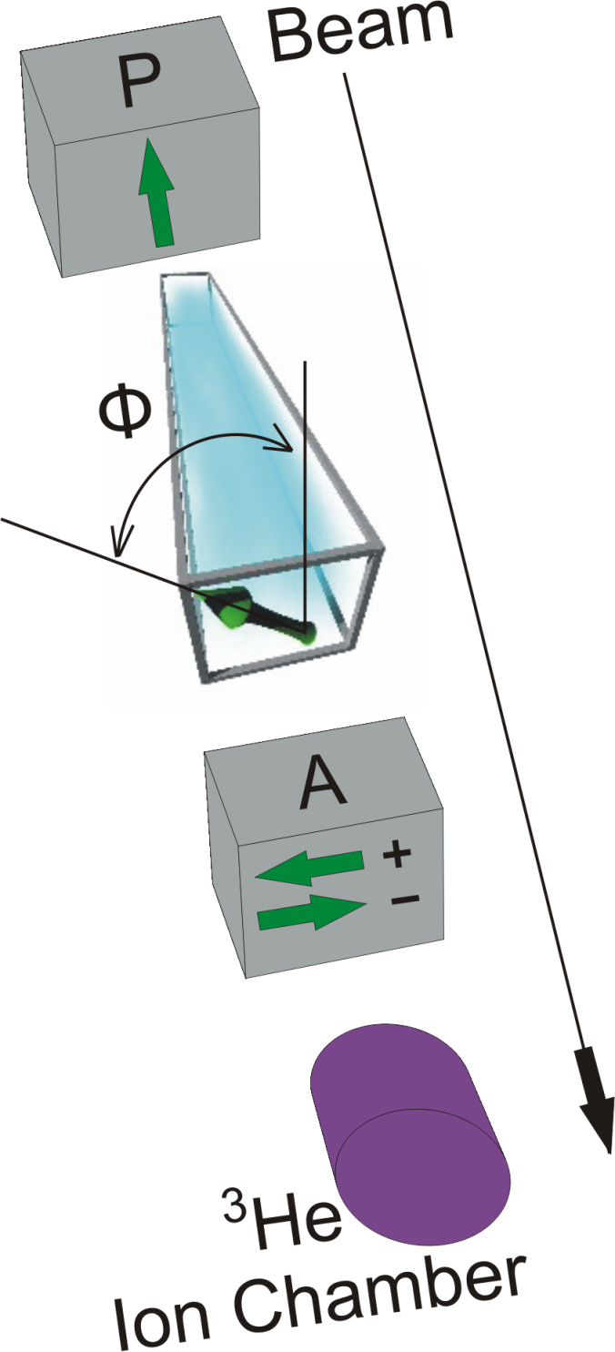
Expected Size:
Experimental challenge
  Reducing
  effectively canceling what is left
  controlling noise
  controlling other systematics

Slide 8
Canceling φ_{PC}
Output Coil /
Polarization
Analyzer
Supermirror
Polarizer
Target Chamber
(Upstream)
Target Chamber
(Downstream)
Ion
Chamber
Pi-Coil
side view
^{up}φ_{PC}
−^{up}φ_{PC}
^{dn}φ_{PC} − ^{up}φ_{PC}
chamber full
Neutron
Beam
+ φ_{PNC}
− φ_{PNC}
− φ_{PNC}
φ_{BKG} − φ_{PNC}
B
− φ
+ φ
Vertical field of “Pi-coil” reverses rotation angle
Detector sensitive to φ_{BKG} − φ_{PNC}
φ_{BKG}= ^{dn}φ_{PC}- ^{up}φ_{PC}~0

Slide 9
Canceling φ_{PC} – Side-by-side experiments
Output Coil /
Polarization
Analyzer
Supermirror
Polarizer
Target Chamber
(Upstream)
Target Chamber
(Downstream)
Ion
Chamber
Pi-Coil
top view
^{up}φ_{PC}
−^{up}φ_{PC}
^{dn}φ_{PC} − ^{up}φ_{PC}
chamber full
Neutron
Beam
+ φ_{PNC}
− φ_{PNC}
− φ_{PNC}
φ_{BKG} − φ_{PNC}
^{up}φ_{PC}
−^{up}φ_{PC}
^{dn}φ_{PC} − ^{up}φ_{PC}
chamber full
+ φ_{PNC}
φ_{BKG} + φ_{PNC}
φ_{BKG}= ^{dn}φ_{PC}- ^{up}φ_{PC} is insensitive to target location
Change target locations
Double subtraction isolates φ_{PNC} and reduces effects of reactor fluctuations

Slide 10
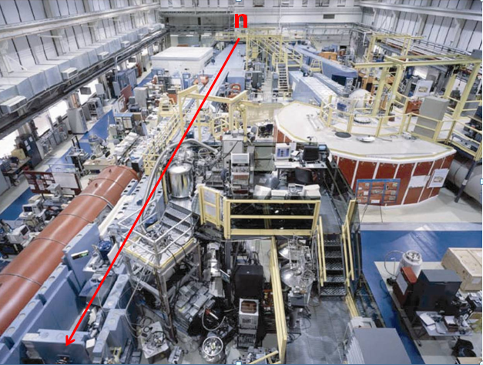
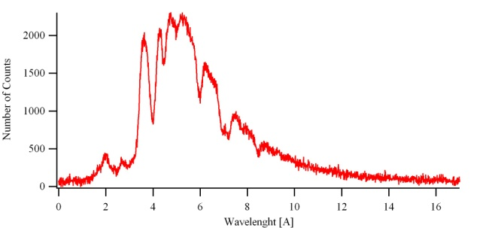
Cold Neutron Guide hall at NCNR
n
⁵⁸Ni guide θ_{c}=2.1 mrad/A (m=1.2)
NG-6 Polychromatic beam
Reactor 20 MW (fission neutrons)
Moderation D₂O
Thermal neutrons
Moderation LH
Main measurement – 3 reactor cycles January – May 2008, Systematic studies – 1 reactor cycle June 2008.
Cold neutrons
T=20K
slide courtesy A. Micherdzinska

Slide 11
Spin Rotation Apparatus
Measures the horizontal component of neutron spin for a vertically-polarized beam
+y
motion-control
system
room-temperature
magnetic shields
cryogenic
magnetic shield
+x
pi-coil
ion chamber
+z
input coil
output
coil
supermirror
polarizer
input guides
supermirror
analyzer
liquid helium targets
output guide
cryostat
100microGauss in target region
float glass waveguides θ_{c}=1.2mrad/Å (m=0.68)
Be filter -> spectrum above 4Å limits under rotation by pi-coil

Slide 12
Rotation Angle Asymmetry
pi-coil
input coil
output
coil
input guides
Polarizer
Analyzer
Output coil rotates vertical spin by +90º or -90º (1 Hz)
Vertical super-mirror analyzer analyzes component due to rotation

Slide 13
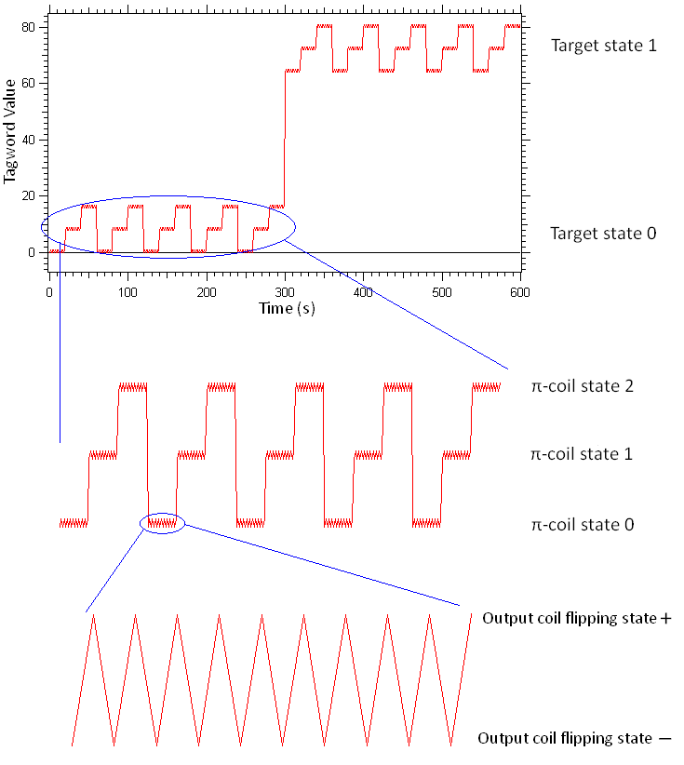
Data sequence
n
A spin rotation angle is determined from each pair of output coil states (+, −).
Reversing the π-coil current cancels any neutron spin rotations from stray fields outside the coil.
Π-coil (−, 0, +) state is repeated five times to form a 300-s target sequence.
The liquid helium is then drained and filled in the complementary state in 300–350 s, and the previous sequence is repeated to form a target cycle.
slide courtesy A. Micherdzinska

Slide 14
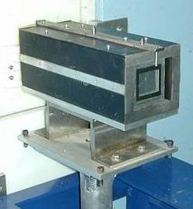
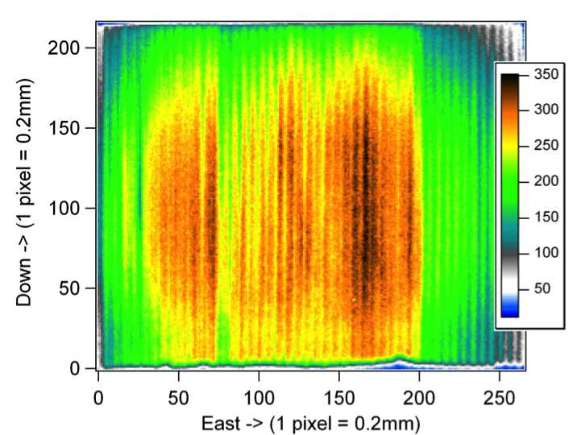
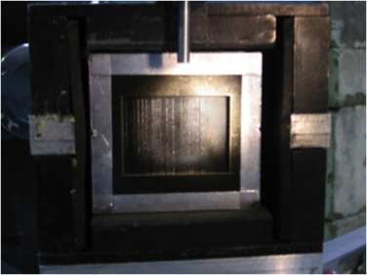
Polarizing Super Mirror
Polarized beam
unpolarized beam
B
spin-dependent scattering from magnetized mirrors
Alternating layers of magnetic surface (cobalt) and absorptive layer (titanium and gadolinium); 1mm separation;
Placed in 300 G permanent box.
Typical polarization: 98%; transmission: 25%
14 mrad
4.5cmX5.5cm
slide courtesy A. Micherdzinska

Slide 15
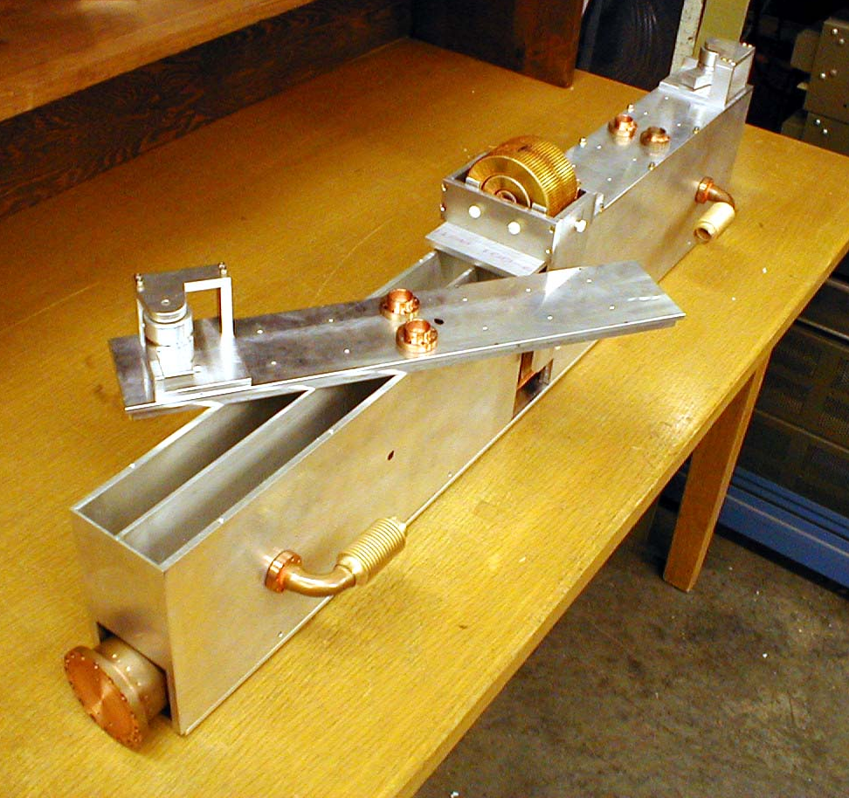
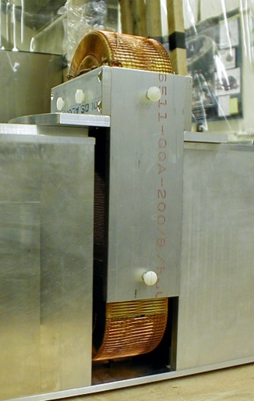
Target Chamber
pi-coil
Separate Left and Right chambers upstream and downstream of pi-coil
C.D. Bass NIM A 612 (2009) 69-82

Slide 16
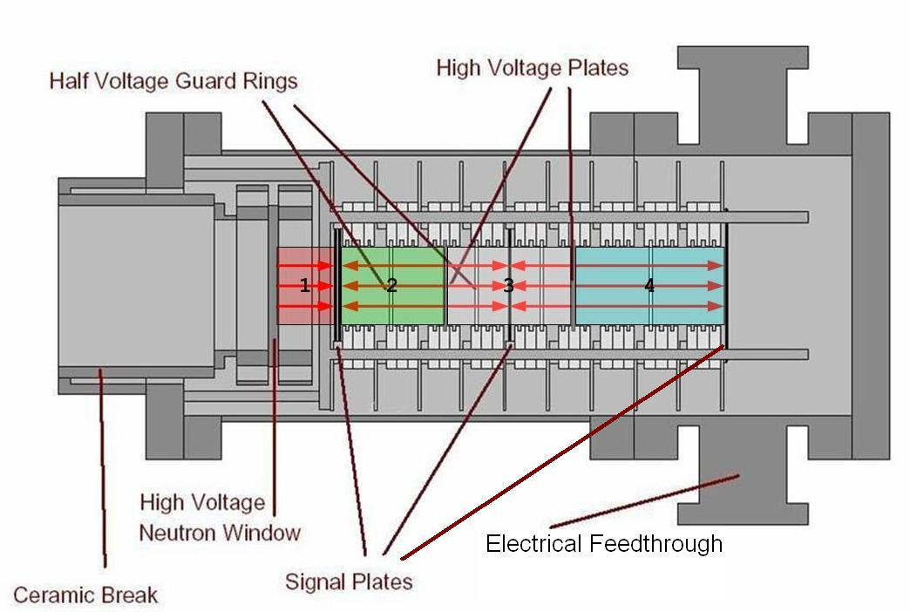
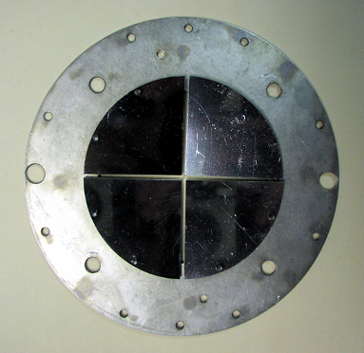
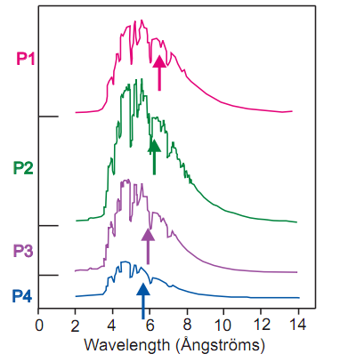
Segmented ³He ionization chamber
n
charge collection plates are divided into 4 quadrants (3" diam) separated L/R and U/D beam
³He and Ar gas mixture
Neutrons detected through n+³He → ³H+¹H
High voltage and grounded charge-collecting plates produce a current proportional to the neutron flux
4 Detection Regions along beam axis - velocity separation (1/v absorption)
S.D.Penn et al. [NIM A457 332-37 (2001)]

Slide 17
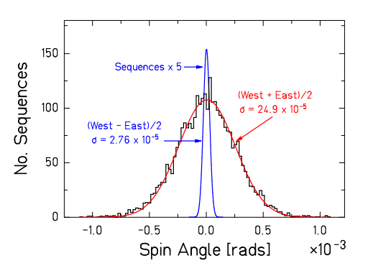
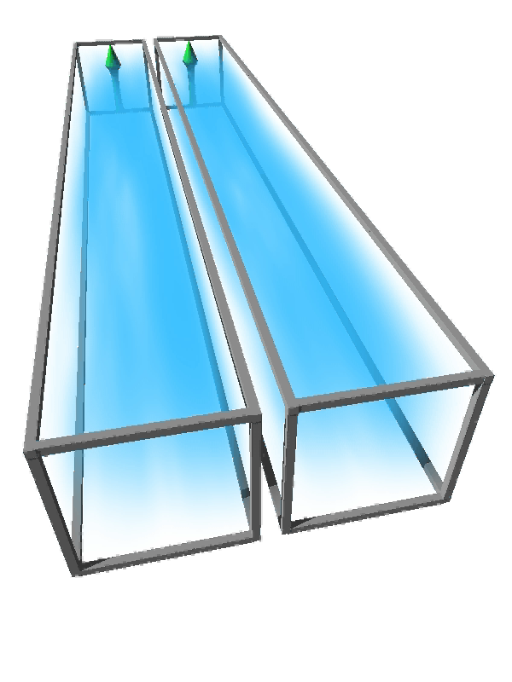
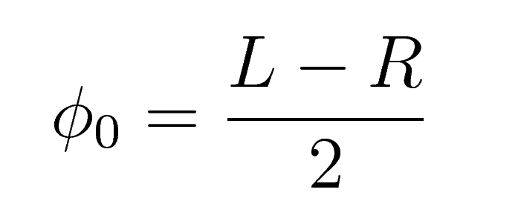
Reactor Noise Suppression
L
R
Large noise from beam intensity fluctuations is suppressed
Width of LEFT-RIGHT difference of spin rotation angles is consistent with √N neutron counting statistics noise to ~10% accuracy

Slide 18
Systematic Effects
Diamagnetism of LHe | ΔB/B ≈ 6E-8 | 2E-9 rad/m
Optical potential of LHe | ~ 10 neV | 3E-9 rad/m
Shift in neutron energy spectrum | Δ L ≈ 0.01 mm | 8E-9 rad/m
Small angle scattering |  | 2E-8 rad/m
Change in neutron paths due to refraction/reflection |  | 3E-10 rad/m
Polarimeter nonuniformity |  | 1E-8 rad/m
B amplification |  | < 4E-8 rad/m
B gradient amplification |  | < 3E-8 rad/m
PA/target nonuniformity |  | < 6E-8 rad/m
TOTAL estimated systematic effect |  | 1.4E-7 rad/m
Calculated
Measured
Simulations used to investigate small angle scattering and B-field gradients

Slide 19
Small-angle scattering
Target positions
Wave guides
detector
Upstream-downstream subtraction is incomplete
  Energy loss for scattered neutrons + different paths in target region
  (up stream scatters travel farther at lower energy)
  path length of scattered neutrons is different
  (up stream scatters spend longer time in target region)
  different detector solid angles from target positions
  (fewer scattered neutron reach detector from up target)

Slide 20
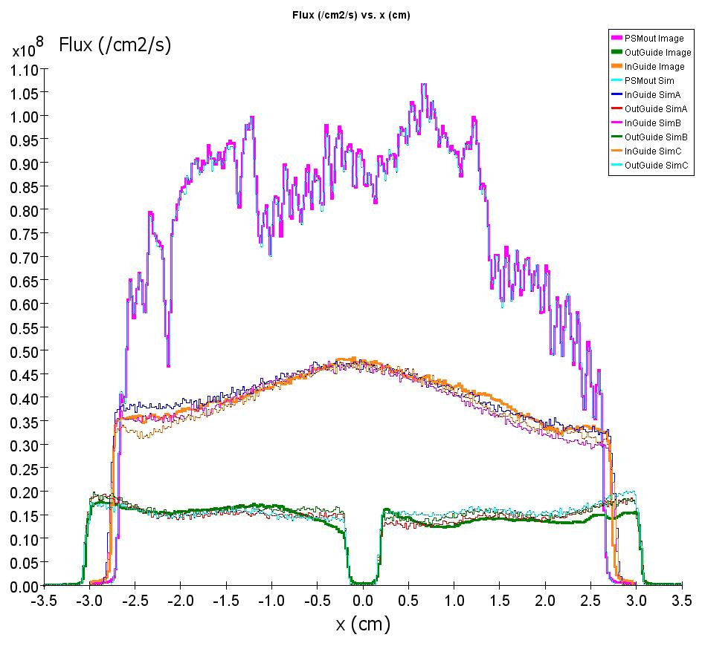
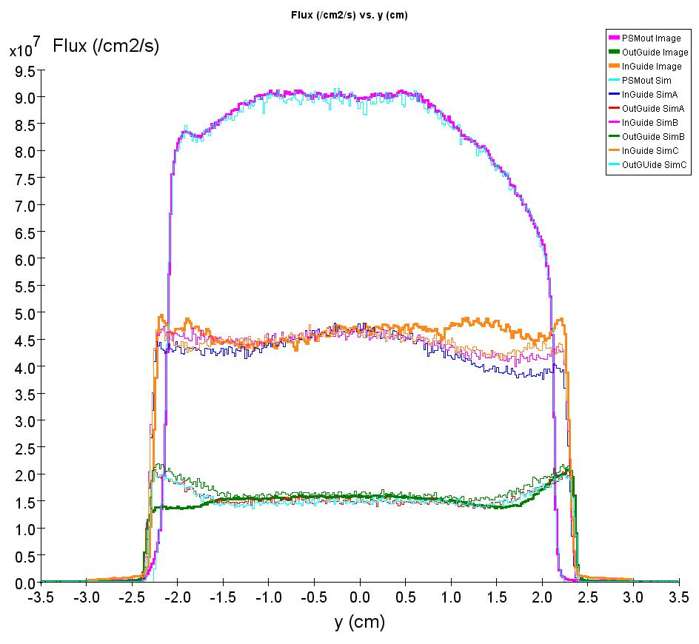
Simulations
Monte-Carlo neutron transport
  Phase space of polarizing super mirror as input
  allow reflections from waveguides, scattering from Al windows, air gaps
  small angle scattering in liquid He target
  calculate PC rotation
  study effect of target position, alignment, B-field gradients, changes in energy and path length

Slide 21
Systematic Effects
Diamagnetism of LHe | ΔB/B ≈ 6E-8 | 2E-9 rad/m
Optical potential of LHe | ~ 10 neV | 3E-9 rad/m
Shift in neutron energy spectrum | Δ L ≈ 0.01 mm | 8E-9 rad/m
Small angle scattering |  | 2E-8 rad/m
Change in neutron paths due to refraction/reflection |  | 3E-10 rad/m
Polarimeter nonuniformity |  | 1E-8 rad/m
B amplification |  | < 4E-8 rad/m
B gradient amplification |  | < 3E-8 rad/m
PA/target nonuniformity |  | < 6E-8 rad/m
TOTAL estimated systematic effect |  | 1.4E-7 rad/m
Calculated
Measured

Slide 22
Results
Artificially high magnetic field 10mG
  implies <4x10⁻⁸ rad/m systematic
Artificially high magnetic gradient +7mG to -7mG
implies <3x10⁻⁸ rad/m systematic

Slide 23
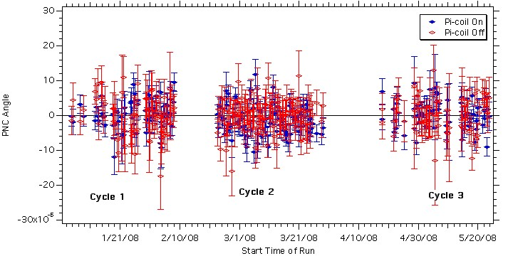
Results
pi-coil ON runs measure φ_{PNC}
pi-coil OFF runs should be zero if no systematics

Slide 24
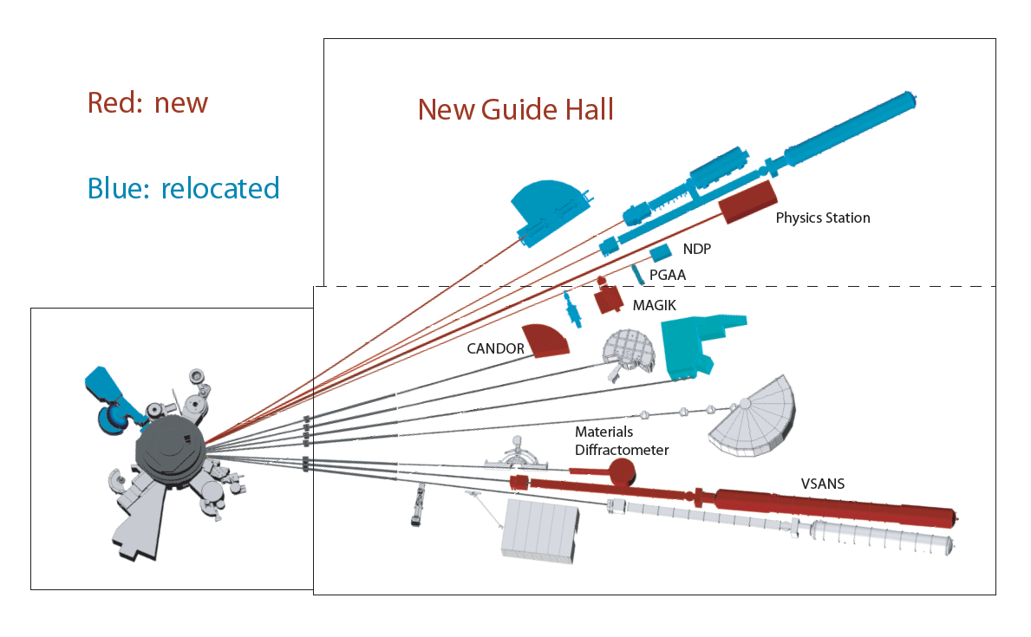
NIST Guide Hall Expansion Project
NGC beam – larger area, higher flux, more divergent beam
~X20 increase in polarized slow neutron flux in spin rotation apparatus(!)
Spin rotation stat precision of <2E-7 rad/m in a 5 week cycle is possible
slide courtesy M. Snow

Slide 25
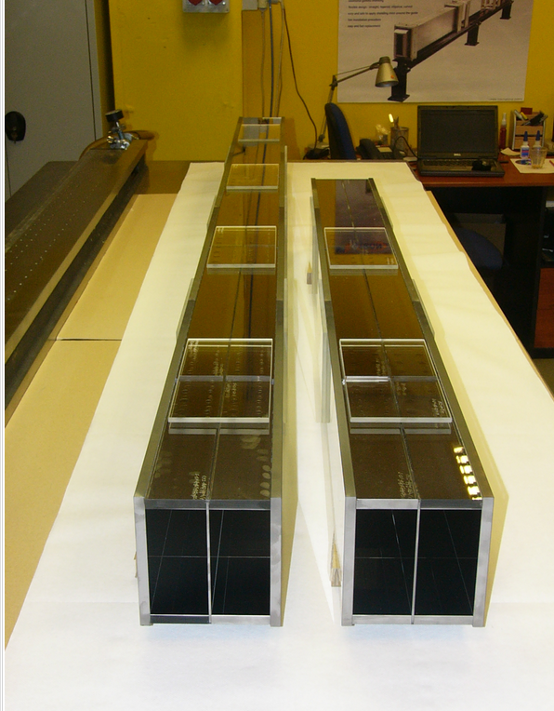
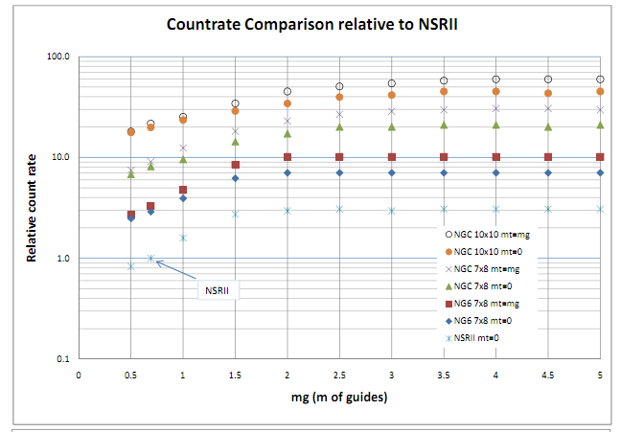
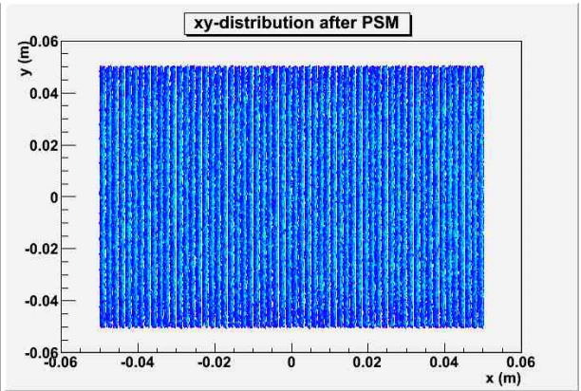
Apparatus Improvements
New 10cmX10cm supermirror polarizer/analyzer pair (on order)
61 vanes with Fe/Si supermirror (m=2.5)
Non-magnetic Supermirror (m=2) waveguides
Enlarged target chambers, ion chamber
Decreased heat load and He re-liquidification to reduced down time
Improved liquid He pumping

Slide 26
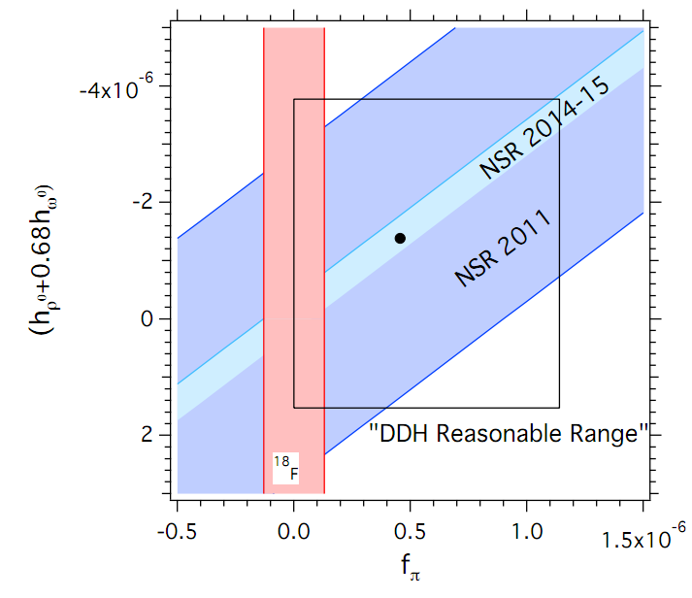
Conclusions
In addition to helping constrain hadronic weak coupling constants, recent analysis demonstrates that the result also places the most stringent limit to date on new parity-odd long-range sub-eV interactions (WISPs) Phys. Rev. Lett. 110, 082003 (2013)
Upcoming experiment on new NGC beam at NIST promises to improve precision to the 2x10⁻⁷ rad/m level.

Slide 31
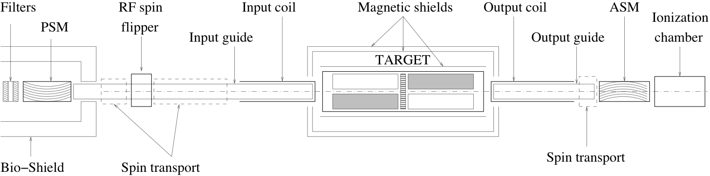
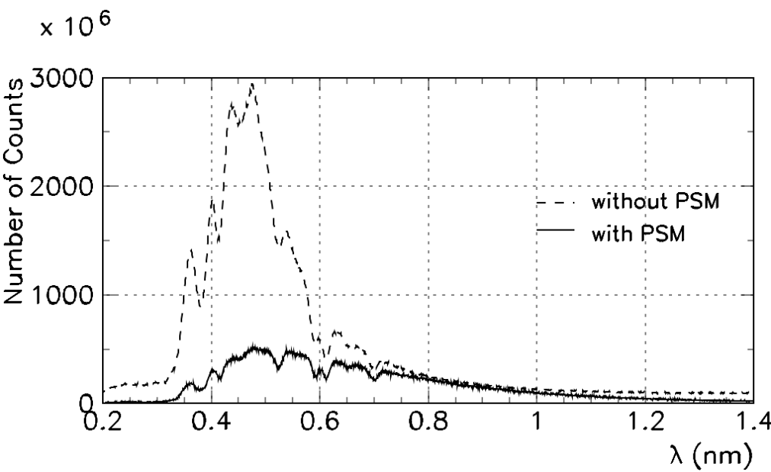
Before real measurement we need to understand beam
and apparatus behavior – systematic check of beam and apparatus behavior
n
Beam intensity distribution as I(λ) / chopper – TOF, ionisation chamber
A. Micherdzinska CUA, 03/02/2011

Slide 32
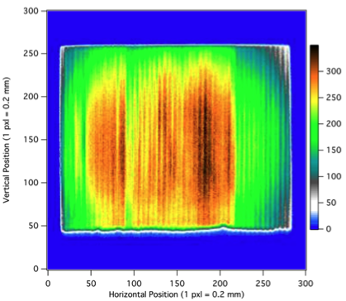
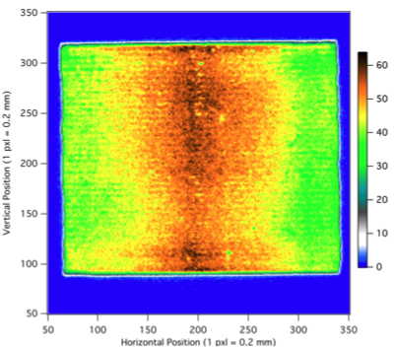
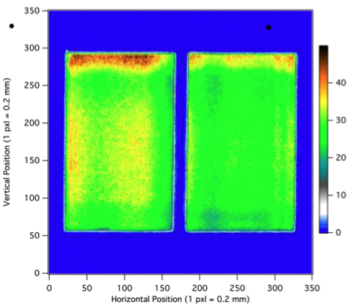
Before real measurement we need to understand beam
and apparatus behavior – systematic check of beam and apparatus behavior
n
Beam intensity distribution as I(x,y) / image plate
A. Micherdzinska CUA, 03/02/2011

Slide 33
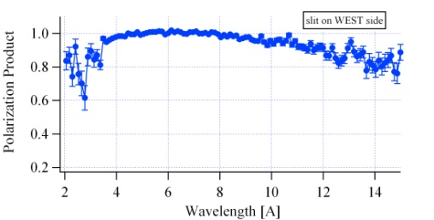
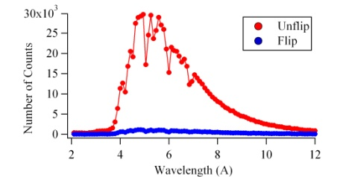
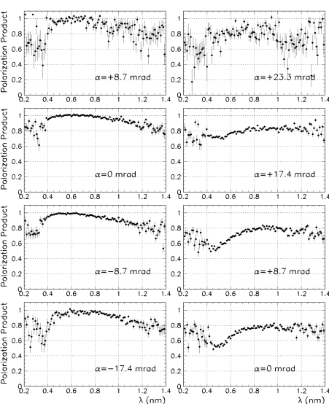
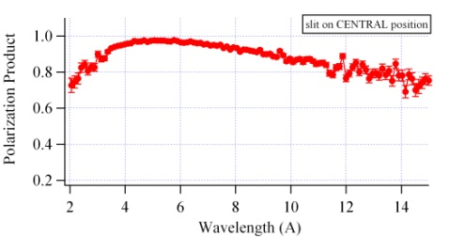
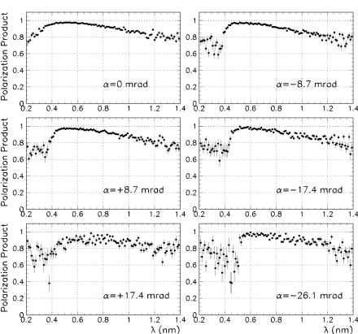
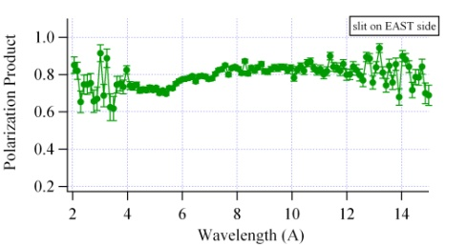
Before real measurement we need to understand beam
and apparatus behavior – systematic check of beam and apparatus behavior
n
PA=(U-F)/(sU+F)
U- Unflip; F- flip
s – spin-flip efficiency (s=0.95 ± 0.05)
Polarization product (PA) as a f(λ) /PSM, ASM, chopper – TOF
A. Micherdzinska CUA, 03/02/2011

Slide 34
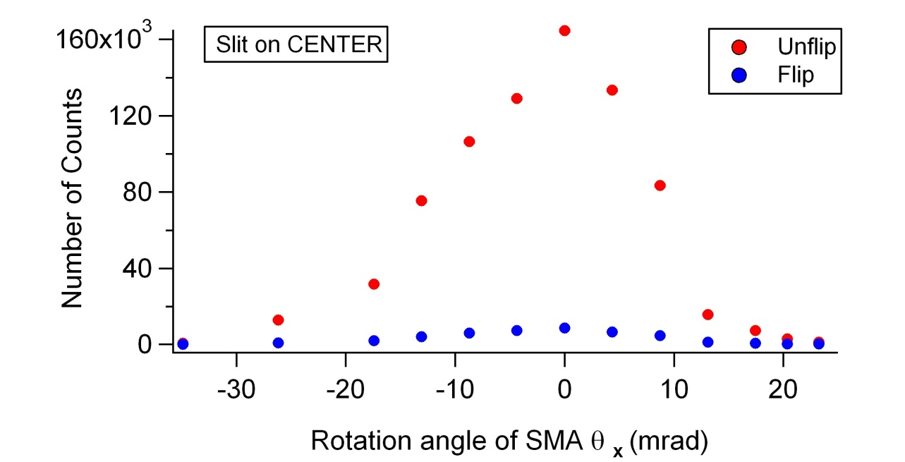
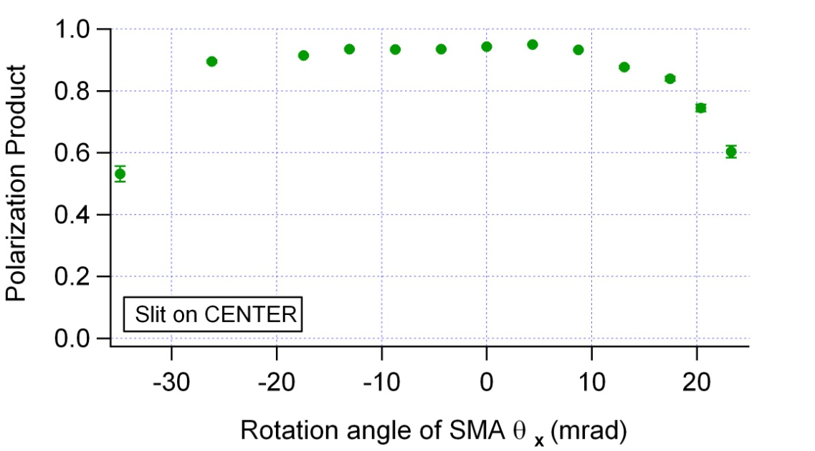
PA as a function of angle
n
Input coil
ASM
-
0
+
For 5mm slit in the
CENTRAL position
PA does not change with angle
A. Micherdzinska CUA, 03/02/2011

Slide 35
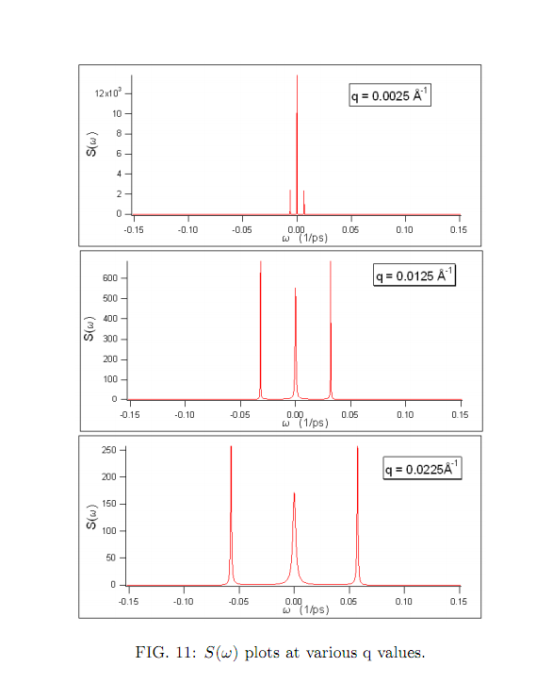
Small Angle Scattering in liquid ⁴He
cross section ~ Dynamic structure factor S(q,ω)
for q<0.1 (1/Å), S(q,ω) found from hydrodynamic properties of liquid
Measured σ(E) used to determine if scattering takes place
Central peak from quasi-elastic scattering from diffusive motion of liquid
side peaks from single phonon scattering

Slide 36
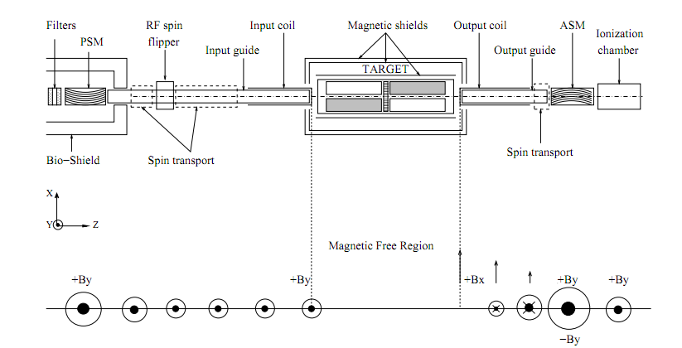

Slide 38
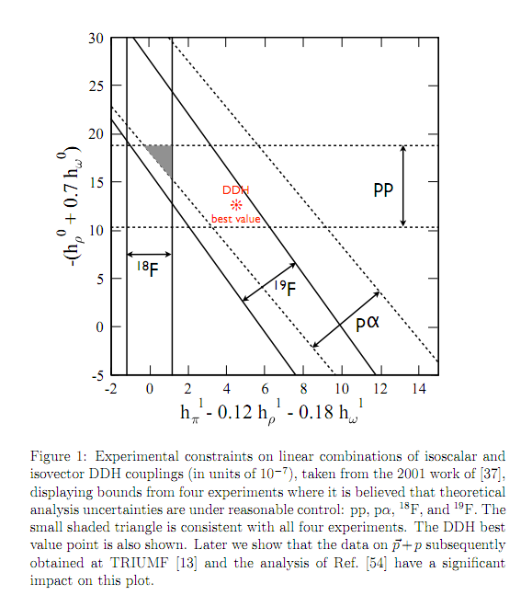
Haxton and Holstein, arXiv:1303.4132v2 [nucl-th] 21 Mar 2013

Slide 39
