Slide 1

Model of the gamma ray-induced out-gassing in the nn-experiment at YAGUAR
B. Crawford for DIANNA
May 26, 2009

Slide 2
  Δa_{CSB} = (a_{pp} – a_{nn})
  Use Δa_{CSB} to test theory.
  But the magnitude and sign of Δa_{CSB} are uncertain!
n-scattering at YAGUAR
a_{pp} = (-17.3 ± 0.8) fm
a_{nn} = (-18.5 ± 0.3) fm (π-d capture, n-d breakup)
a_{nn} = (-16.27 ± 0.40) fm (n-d breakup)
  Nagels et al. NUCL. PHY B 147 (1979) 189.
  Howell et al. PHYS LETT B 444 (1998) 252.
  González Trotter et al. PHYS REV LETT 83 (1999) 3788.
  Huhn et al. PHYS REV C 63 (2001) 014003.
Notes:
Ann has been measured via final state interaction neutron-deuteron breakup at specific energies ranging between 13 and 25 MeV, with a current experiment underway at 19MeV using both the geometries
Anp agrees for these two experiments – this is a fascinating time for those studying few body physics and 3 nucleon forces.

Slide 3
n-scattering at YAGUAR
• Experimental goal
Make the first direct measurement of a_{nn} (related to the strength of attraction between two neutrons) to a precision of 3%
• Motivation
a_{nn} measurements disagree within experimental uncertainty
a_{nn} ’s lack of precision does not constrain theory
Notes:
Ann has been measured via final state interaction neutron-deuteron breakup at specific energies ranging between 13 and 25 MeV, with a current experiment underway at 19MeV using both the geometries
Anp agrees for these two experiments – this is a fascinating time for those studying few body physics and 3 nucleon forces.

Slide 4
n-scattering at YAGUAR
Pulsed reactor with high instantaneous flux
Annular design with open through-channel (nn-cavity)
90% enriched ²³⁵U-salt/water solution
Energy per pulse – 30 MJ
Pulse duration – 0.9 ms
Fluency – 1.7x10¹⁵ /cm²
Flux – 0.8x10¹⁸ /cm²/s
Neutron density – 1x10¹³ /cm³
Notes:
Ann has been measured via final state interaction neutron-deuteron breakup at specific energies ranging between 13 and 25 MeV, with a current experiment underway at 19MeV using both the geometries
Anp agrees for these two experiments – this is a fascinating time for those studying few body physics and 3 nucleon forces.

Slide 5
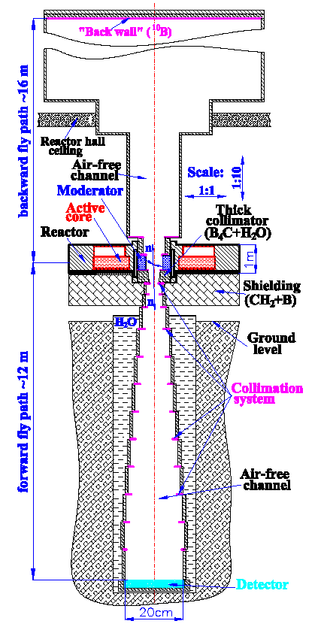
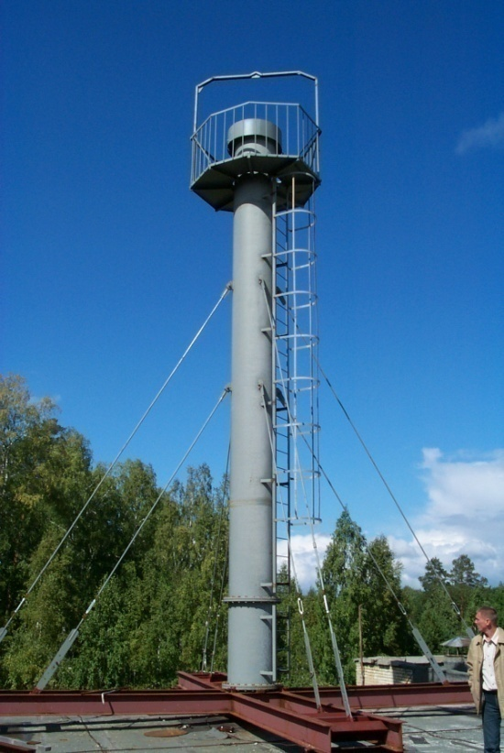
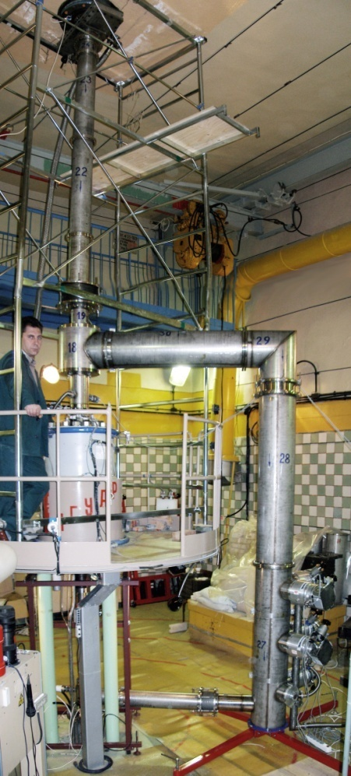
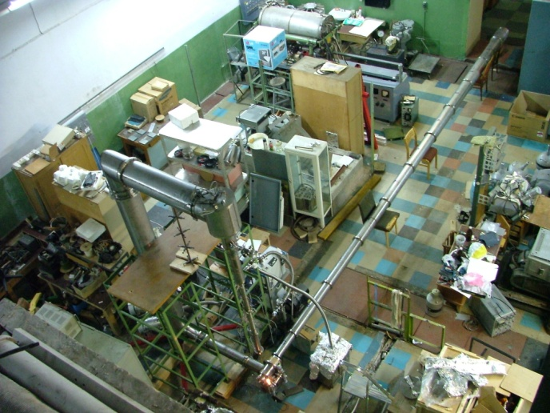
Notes:
Pause here – NEUTRON GAS

Slide 6
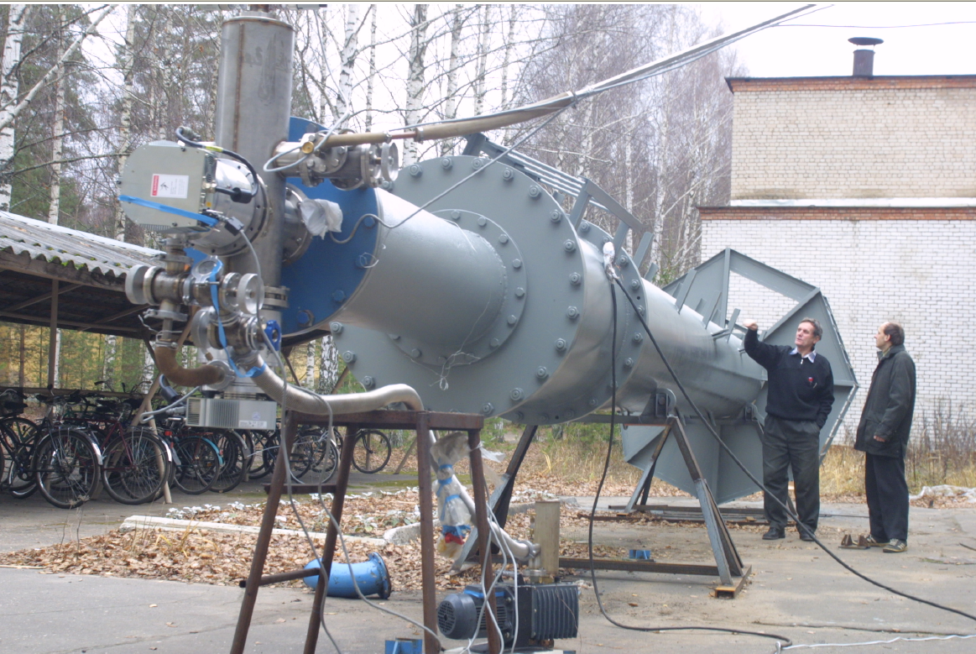
Vacuum testing of upper section of neutron channel.

Slide 7
n-scattering at YAGUAR
a_{nn} determined from detector counts
Expect N_{D} ~ 150 counts/pulse
~10 pulses achieves required statistics
Sharapov, ISINN-13 Report E3-2006-7, p. 130

Slide 8
Monte Carlo modeling of neutron background
Neutron speed | Source of background | Number of neutrons per pulse
Fast (>0.5eV) | Initial and delayed | ~10
Thermal (<0.5eV) | Back wall | ~10
 | Collimators/walls | <10
 | Residual gas | P(H₂)~10⁻⁷ <1 P(N₂)~10⁻⁶ <1
 | Total | 20—40
A. Yu. Muzichka, et al., Nucl. Phys. A 789 (2007)

Slide 9
n-scattering at YAGUAR
Notes:
Ann has been measured via final state interaction neutron-deuteron breakup at specific energies ranging between 13 and 25 MeV, with a current experiment underway at 19MeV using both the geometries
Anp agrees for these two experiments – this is a fascinating time for those studying few body physics and 3 nucleon forces.

Slide 10
n-scattering at YAGUAR
n-n measurement
Notes:
Ann has been measured via final state interaction neutron-deuteron breakup at specific energies ranging between 13 and 25 MeV, with a current experiment underway at 19MeV using both the geometries
Anp agrees for these two experiments – this is a fascinating time for those studying few body physics and 3 nucleon forces.

Slide 11
n-scattering at YAGUAR
n-n measurement
(Poor) fit shown here is Maxwellian x ε
Notes:
Ann has been measured via final state interaction neutron-deuteron breakup at specific energies ranging between 13 and 25 MeV, with a current experiment underway at 19MeV using both the geometries
Anp agrees for these two experiments – this is a fascinating time for those studying few body physics and 3 nucleon forces.

Slide 12
n-scattering at YAGUAR
n-n measurement
(Poor) fit shown here is Maxwellian x ε
Detector count rate
N ~ x40 too high
Notes:
Ann has been measured via final state interaction neutron-deuteron breakup at specific energies ranging between 13 and 25 MeV, with a current experiment underway at 19MeV using both the geometries
Anp agrees for these two experiments – this is a fascinating time for those studying few body physics and 3 nucleon forces.

Slide 13
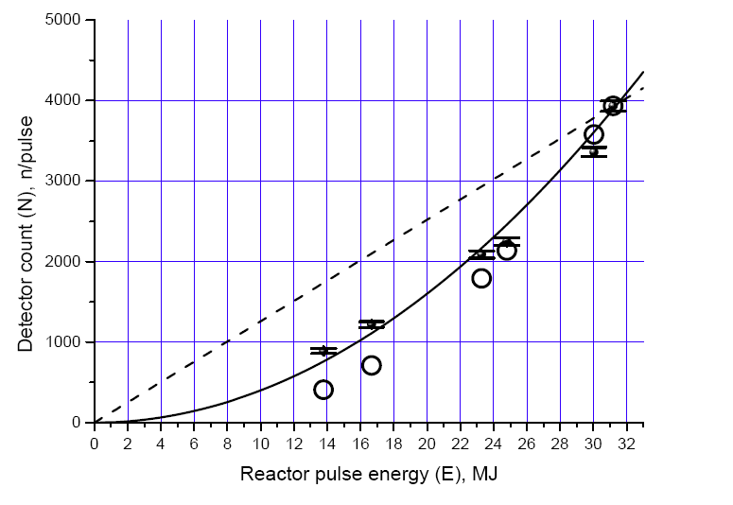
n-scattering at YAGUAR
Not wall background
N ~ E²
The n’s “target” varies with reactor power

Slide 14
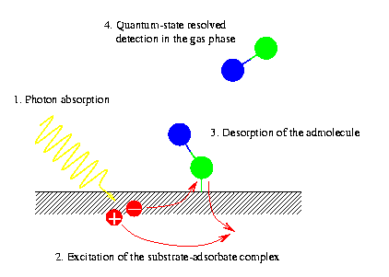
n-scattering at YAGUAR
Radiation Induced Desorption of H₂ or H₂O
Explains N ~ E²
Image courtesy of Arno Shindlmayr, Universitat Paderborn
Notes:
Photon hits moderator or Al wall, causes electron emission. That emission or later absorption of the photoelectron can desorb neutral atoms from a chamber surface. Desorption depends on the photon energy, the intensity, angle of incidence.

Slide 15
n-scattering at YAGUAR
nn data fit well by Maxwellian x ε x σ_{n}
σ_{n} (E) for H₂
Notes:
Ann has been measured via final state interaction neutron-deuteron breakup at specific energies ranging between 13 and 25 MeV, with a current experiment underway at 19MeV using both the geometries
Anp agrees for these two experiments – this is a fascinating time for those studying few body physics and 3 nucleon forces.

Slide 16
n-scattering at YAGUAR
nn data fit well by Maxwellian x ε x σ_{n}
σ_{n} (E) for H₂O
Notes:
Ann has been measured via final state interaction neutron-deuteron breakup at specific energies ranging between 13 and 25 MeV, with a current experiment underway at 19MeV using both the geometries
Anp agrees for these two experiments – this is a fascinating time for those studying few body physics and 3 nucleon forces.

Slide 17
n-scattering at YAGUAR
Desorption rate
unbaked Al
Dobrozemsky, NIM 118 (1974) 1 - 37

Slide 18
n-scattering at YAGUAR

Slide 19
n-scattering at YAGUAR
Desorption induced by photons, electrons, ions is an ongoing research effort
Characterized by desorption yield, η (molecules/particle)
Values span many orders of magnitude
  Particle
  Energy
  Material
  Angle of incidence
  Surface treatment (polishing, baking, irradiating, coatings…)
Notes:
Ann has been measured via final state interaction neutron-deuteron breakup at specific energies ranging between 13 and 25 MeV, with a current experiment underway at 19MeV using both the geometries
Anp agrees for these two experiments – this is a fascinating time for those studying few body physics and 3 nucleon forces.

Slide 20
n-scattering at YAGUAR
Implied value from nn measurement

Slide 21
n-scattering at YAGUAR
Molvic et al., desorption yield ~ electronic energy loss in layer near surface
K⁺ ions on Stainless steel
  68-1000keV
  80-88º from normal
Molvic, PRL 98 (2007) 1 - 4
Notes:
Ann has been measured via final state interaction neutron-deuteron breakup at specific energies ranging between 13 and 25 MeV, with a current experiment underway at 19MeV using both the geometries
Anp agrees for these two experiments – this is a fascinating time for those studying few body physics and 3 nucleon forces.

Slide 22
n-scattering at YAGUAR
A simple Model to relate desorption yield to energy deposit
  Treat each point along ion trajectory as an e⁻ source
  Uniform energy deposit along ion track
  Exponential conversion of energy deposit to number of desorbed molecules with respect to depth in target, z=Rcos(θ)
θ
R
z
Notes:
Ann has been measured via final state interaction neutron-deuteron breakup at specific energies ranging between 13 and 25 MeV, with a current experiment underway at 19MeV using both the geometries
Anp agrees for these two experiments – this is a fascinating time for those studying few body physics and 3 nucleon forces.

Slide 23
n-scattering at YAGUAR
972keV K+ ions in Stainless Steel
  η(90º)=15,000 [Molvic]
  Range 3914 eV/Ang [TRIM]
λ=750Ang
At z=λ desrob 9500 molecules
797keV electronic energy loss
84eV/molecule
Energy Deposit in YAGUAR…
Data: Molvic, PRL 98 (2007) 1 – 4
Bieniosek, PR ST-AB 10 (2007) 1—5
Notes:
Ann has been measured via final state interaction neutron-deuteron breakup at specific energies ranging between 13 and 25 MeV, with a current experiment underway at 19MeV using both the geometries
Anp agrees for these two experiments – this is a fascinating time for those studying few body physics and 3 nucleon forces.

Slide 24
n-scattering at YAGUAR
GEANT4 simulation of gamma/electron transport
  Gammas incident on 2-mm thick Al slab
  Detect energy deposit in 0.1-μm thick slabs per incident gamma
z
Notes:
Ann has been measured via final state interaction neutron-deuteron breakup at specific energies ranging between 13 and 25 MeV, with a current experiment underway at 19MeV using both the geometries
Anp agrees for these two experiments – this is a fascinating time for those studying few body physics and 3 nucleon forces.

Slide 25
n-scattering at YAGUAR
Assume λ_{Al} ~ λ_{SS}to 2 λ_{SS}
Energy deposit per gamma in last 750-1500Ang Al in YAGUAR
  0.3—0.7 eV/γ
  Desorption yield for H₂ from Al in YAGUAR if baked
    η~0.004 – 0.008
    Correcting by factor of ~10 for baked vs. unbaked*
    η~0.04 – 0.08
    Result from nn-experiment unbaked Al
    η~0.03
*A.G. Mathewson, CERN-ISR-VA/76-5 (1976)
Notes:
Ann has been measured via final state interaction neutron-deuteron breakup at specific energies ranging between 13 and 25 MeV, with a current experiment underway at 19MeV using both the geometries
Anp agrees for these two experiments – this is a fascinating time for those studying few body physics and 3 nucleon forces.

Slide 26
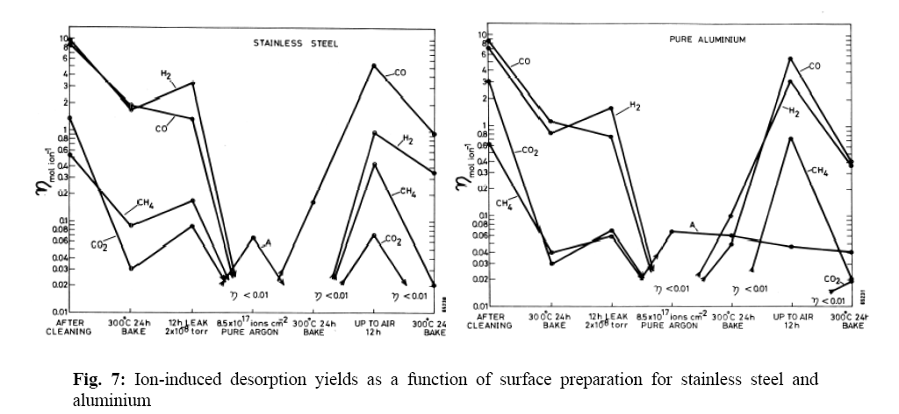
n-scattering at YAGUAR
Effect of baking stainless steel and Al (~ 6x improvement)
Irradiation by Ar ions, 10¹⁸ /cm² (> 100x improvement)
baking
Ar ions
Mathewson, CERN-ISR-VA/76-5 (1976)
Notes:
Ann has been measured via final state interaction neutron-deuteron breakup at specific energies ranging between 13 and 25 MeV, with a current experiment underway at 19MeV using both the geometries
Anp agrees for these two experiments – this is a fascinating time for those studying few body physics and 3 nucleon forces.

Slide 27
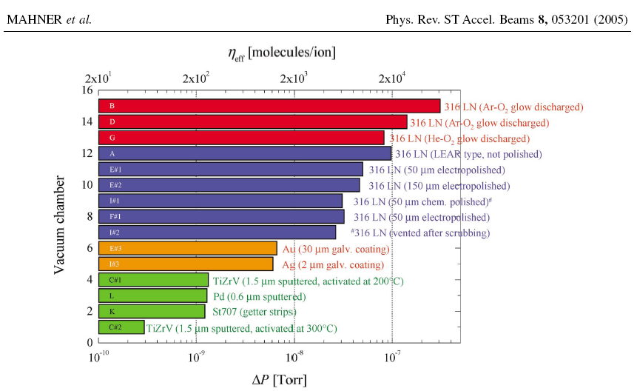
n-scattering at YAGUAR
Signal to noise in current experiment 1:40
Need to reduce desorption by ~400
New coatings suggest improvements of greater than 300!
Mahner, PR ST-AB 8 (2005) 1—9
Notes:
Ann has been measured via final state interaction neutron-deuteron breakup at specific energies ranging between 13 and 25 MeV, with a current experiment underway at 19MeV using both the geometries
Anp agrees for these two experiments – this is a fascinating time for those studying few body physics and 3 nucleon forces.

Slide 28
n-scattering at YAGUAR
Conclusion
Initial nn measurements imply radiation-induced desorption of H₂ and/or H₂O in nn-collision cavity.
Model relating electronic energy deposit along depth in target to desorption yield approximates recent results of K⁺ ions in stainless steel.
Results from this model are consistent with implied desorption from nn experiment.
Notes:
Ann has been measured via final state interaction neutron-deuteron breakup at specific energies ranging between 13 and 25 MeV, with a current experiment underway at 19MeV using both the geometries
Anp agrees for these two experiments – this is a fascinating time for those studying few body physics and 3 nucleon forces.

Slide 32
n-scattering at YAGUAR
Possibility of fitting combination of
Maxwellian*σ(nH₂) and Maxwellian
Assume 20% from
desorbed H₂
Notes:
Ann has been measured via final state interaction neutron-deuteron breakup at specific energies ranging between 13 and 25 MeV, with a current experiment underway at 19MeV using both the geometries
Anp agrees for these two experiments – this is a fascinating time for those studying few body physics and 3 nucleon forces.

Slide 33
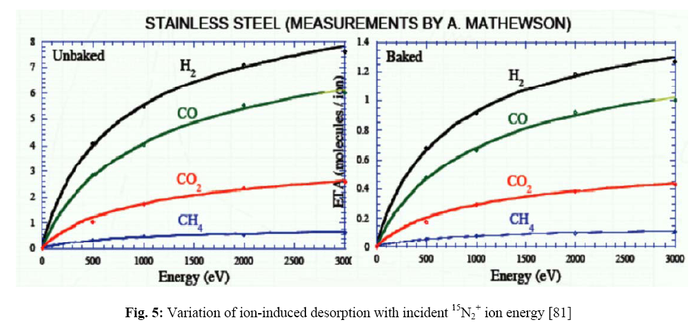
n-scattering at YAGUAR
Effect of baking stainless steel (~ 6x improvement)
Mathewson, CERN-ISR-VA/76-5 (1976)
Notes:
Ann has been measured via final state interaction neutron-deuteron breakup at specific energies ranging between 13 and 25 MeV, with a current experiment underway at 19MeV using both the geometries
Anp agrees for these two experiments – this is a fascinating time for those studying few body physics and 3 nucleon forces.

Slide 35
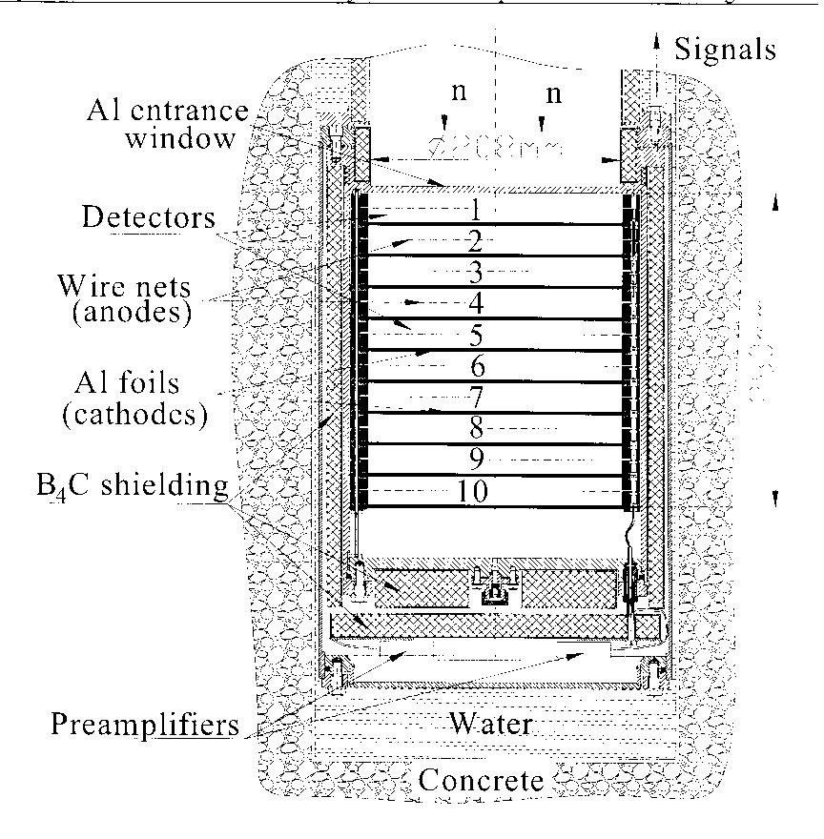
n-scattering at YAGUAR
³He detector with 375 mTorr
for n-⁴He measurements
³He detector with 375 Torr
for n-n measurements
Notes:
Ann has been measured via final state interaction neutron-deuteron breakup at specific energies ranging between 13 and 25 MeV, with a current experiment underway at 19MeV using both the geometries
Anp agrees for these two experiments – this is a fascinating time for those studying few body physics and 3 nucleon forces.

Slide 36
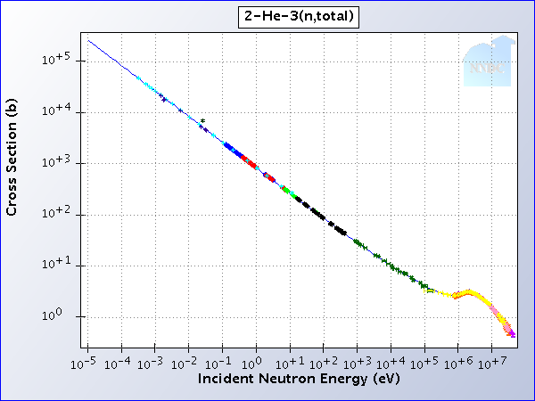
n-scattering at YAGUAR
³He detector with 375 mTorr
for n-⁴He measurements
detector efficiency goes as 1/v
National Nuclear Data Center, Brookhaven National Lab
Notes:
Ann has been measured via final state interaction neutron-deuteron breakup at specific energies ranging between 13 and 25 MeV, with a current experiment underway at 19MeV using both the geometries
Anp agrees for these two experiments – this is a fascinating time for those studying few body physics and 3 nucleon forces.

Slide 37
n-scattering at YAGUAR
³He detector with 375 mTorr
for n-⁴He measurements
³He detector with 375 Torr
for n-n measurements
detector efficiency goes as 1/v
Notes:
Ann has been measured via final state interaction neutron-deuteron breakup at specific energies ranging between 13 and 25 MeV, with a current experiment underway at 19MeV using both the geometries
Anp agrees for these two experiments – this is a fascinating time for those studying few body physics and 3 nucleon forces.

Slide 38
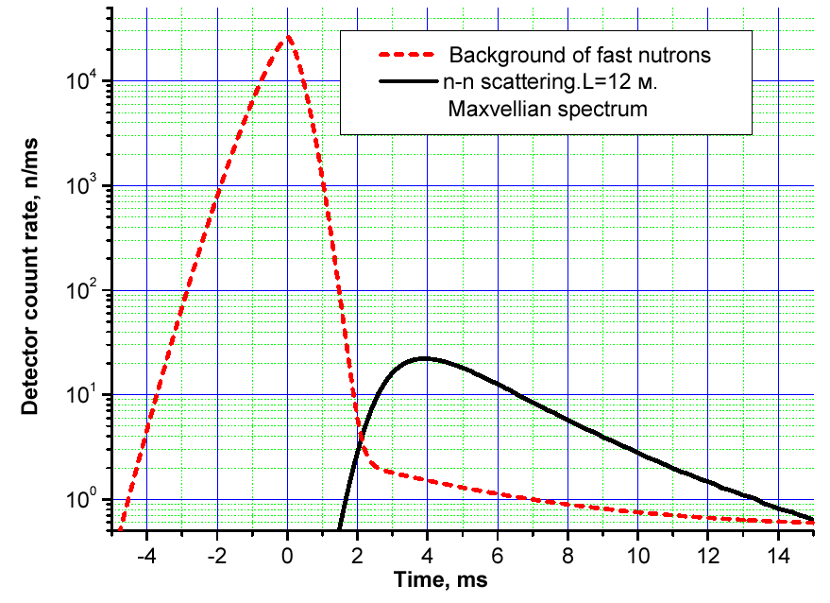
Fast vs. Thermal TOF spectra

Slide 39
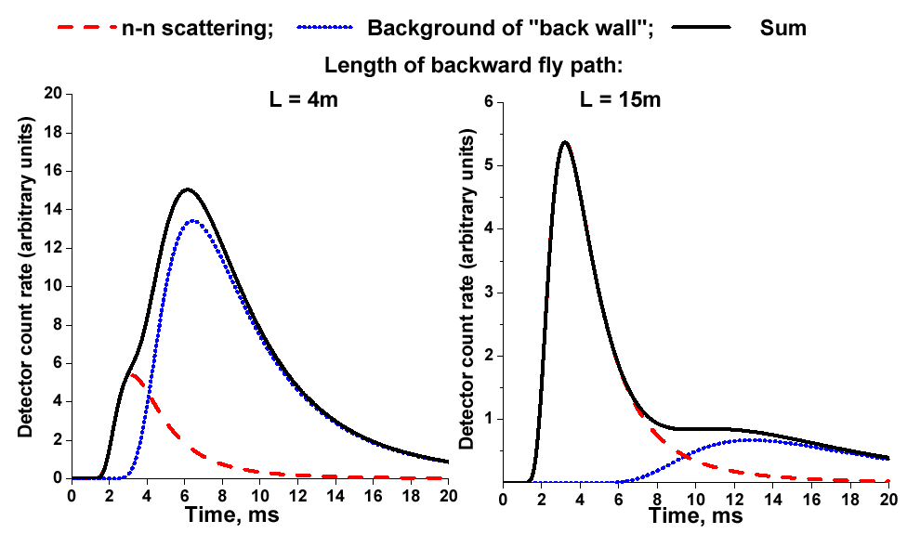
“Back Wall” Background

Slide 40
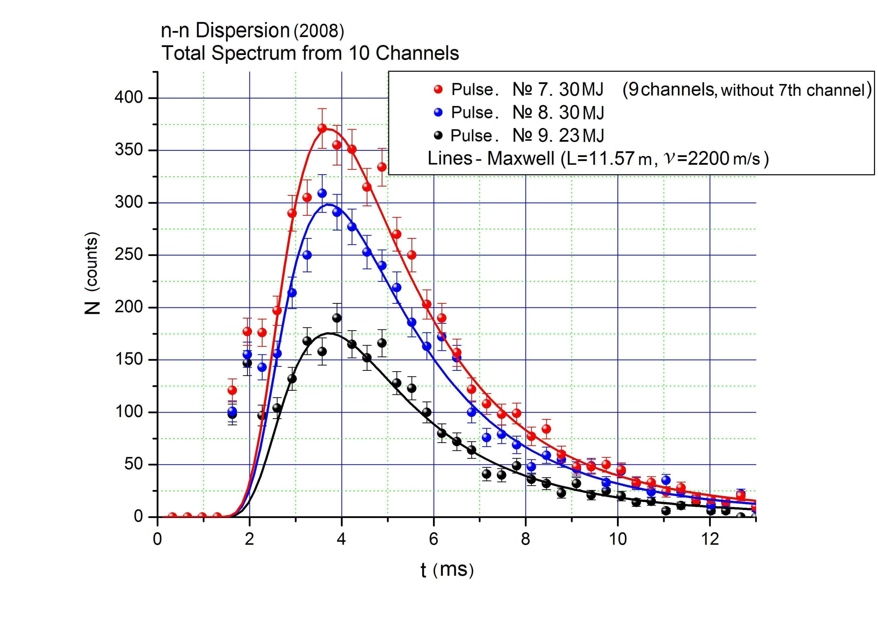

Slide 41
n-scattering at YAGUAR
• Computer modeling
Characteristics of neutron field
  Detector count rate sensitivity to neutron field characteristics
  Neutron background experiment
Notes:
Ann has been measured via final state interaction neutron-deuteron breakup at specific energies ranging between 13 and 25 MeV, with a current experiment underway at 19MeV using both the geometries
Anp agrees for these two experiments – this is a fascinating time for those studying few body physics and 3 nucleon forces.

Slide 42
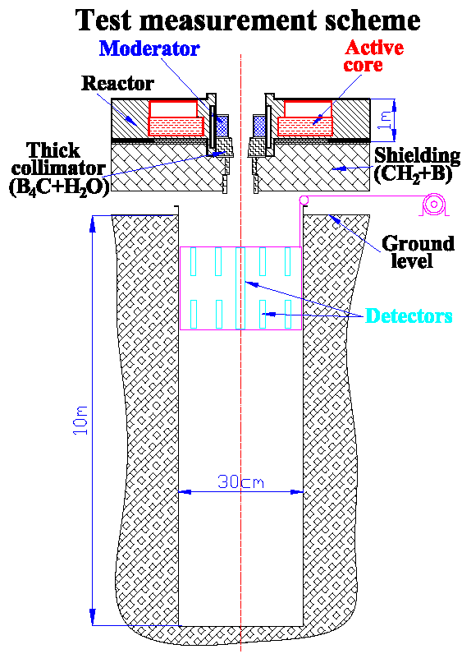
Background Modeling Tests
Neutron flux measured as a function of depth in underground channel.
Neutron flux modeled with MCNPX
Thermal neutron flux agrees with model (³He ion. detectors)
Fast neutron flux also agrees with modeling

Slide 43
n-scattering at YAGUAR
Notes:
Ann has been measured via final state interaction neutron-deuteron breakup at specific energies ranging between 13 and 25 MeV, with a current experiment underway at 19MeV using both the geometries
Anp agrees for these two experiments – this is a fascinating time for those studying few body physics and 3 nucleon forces.

Slide 44
n-scattering at YAGUAR
Notes:
Ann has been measured via final state interaction neutron-deuteron breakup at specific energies ranging between 13 and 25 MeV, with a current experiment underway at 19MeV using both the geometries
Anp agrees for these two experiments – this is a fascinating time for those studying few body physics and 3 nucleon forces.

Slide 45
n-scattering at YAGUAR
Notes:
Ann has been measured via final state interaction neutron-deuteron breakup at specific energies ranging between 13 and 25 MeV, with a current experiment underway at 19MeV using both the geometries
Anp agrees for these two experiments – this is a fascinating time for those studying few body physics and 3 nucleon forces.

Slide 46
n-scattering at YAGUAR
Notes:
Ann has been measured via final state interaction neutron-deuteron breakup at specific energies ranging between 13 and 25 MeV, with a current experiment underway at 19MeV using both the geometries
Anp agrees for these two experiments – this is a fascinating time for those studying few body physics and 3 nucleon forces.

Slide 47
n-scattering at YAGUAR
Radiation-induced desorption?
Image courtesy of Arno Shindlmayr, Universitat Paderborn
Notes:
Photon hits moderator or Al wall, causes electron emission. That emission or later absorption of the photoelectron can desorb neutral atoms from a chamber surface. Desorption depends on the photon energy, the intensity, angle of incidence.

Slide 48
n-scattering at YAGUAR
Radiation-induced desorption?
Image courtesy of Arno Shindlmayr, Universitat Paderborn
Notes:
Photon hits moderator or Al wall, causes electron emission. That emission or later absorption of the photoelectron can desorb neutral atoms from a chamber surface. Desorption depends on the photon energy, the intensity, angle of incidence.

Slide 49
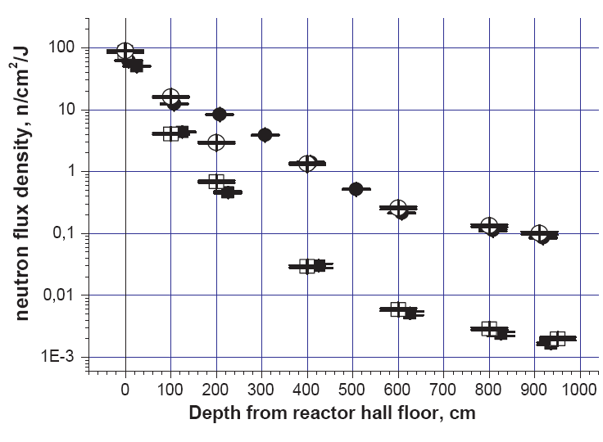
Thermal Neutron vs. depth
Open circles = measured
Closed circles = modeled

Slide 50
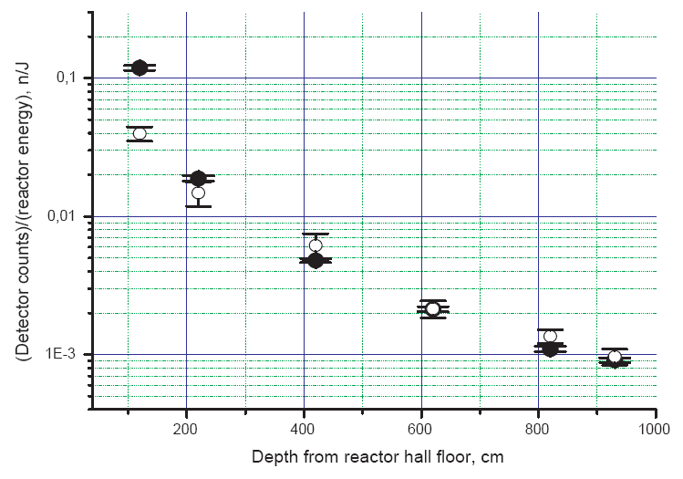
Fast Neutrons vs. depth
Open circles = measured
Closed circles = modeled

Slide 51
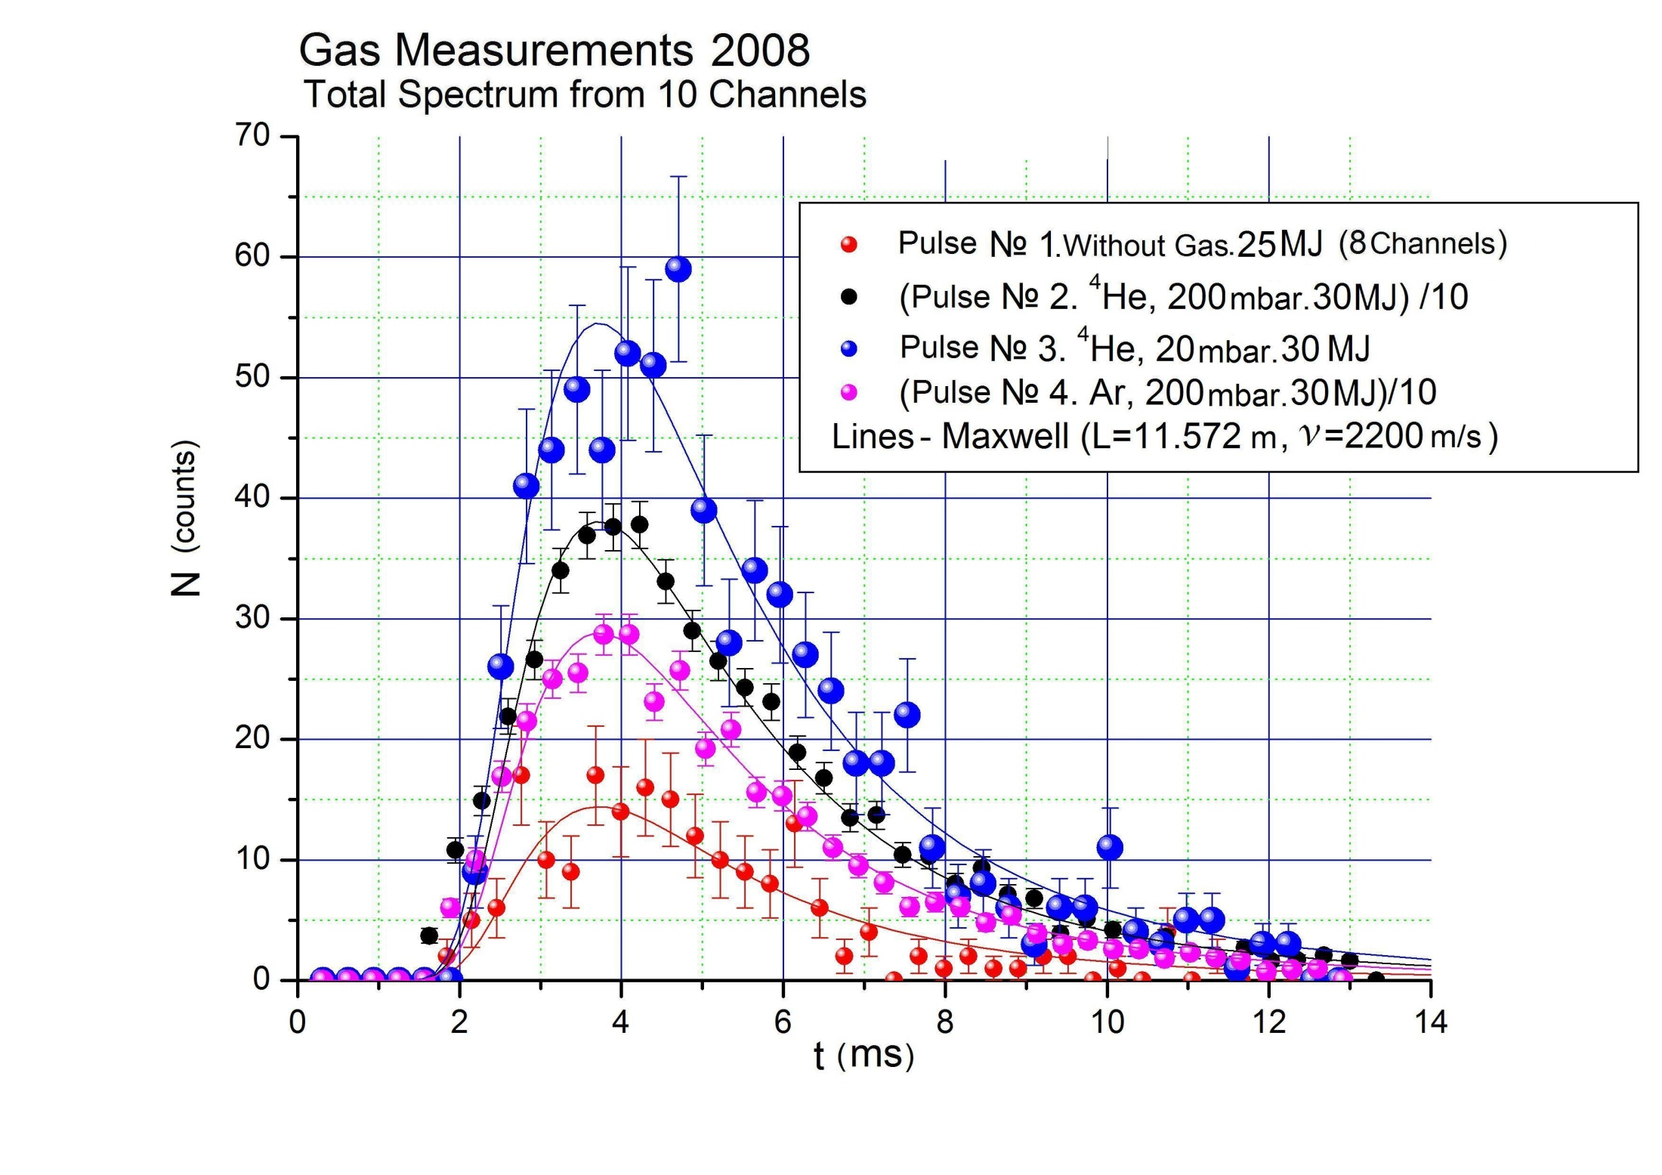

Slide 52
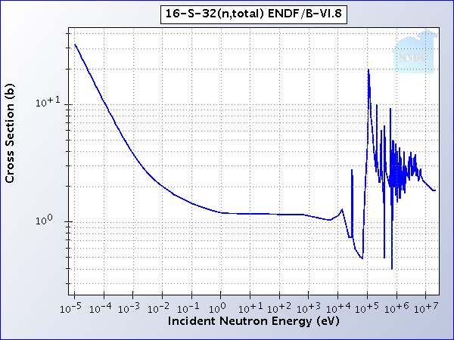
n-scattering at YAGUAR
Sulfur outgassing?
Image courtesy of Arno Shindlmayr, Universitat Paderborn
Notes:
Photon hits moderator or Al wall, causes electron emission. That emission or later absorption of the photoelectron can desorb neutral atoms from a chamber surface. Desorption depends on the photon energy, the intensity, angle of incidence.

