Slide 1
Neutron Spin Rotation Measurements by the NSR Collaboration
DNP 2014
Hawaii October, 2014

Slide 2
Neutron Spin Rotation (NSR) Collaboration
    W.M. Snow¹, E. Anderson¹, L. Barron-Palos², C.D. Bass³, T.D. Bass³, B.E. Crawford⁴, C. Crawford⁵ , W. Fox¹, J. Fry¹, K. Gan⁶, C. Haddock¹, B.R. Heckel⁷, D. Luo¹, M. Maldonado-Velazquez², R. Malone⁴, D. M. Markoff ⁸, A.M. Micherdzinska⁹, H.P. Mumm¹⁰, J.S. Nico¹⁰, A.K. Opper⁹, S. Penn ¹¹, S. Santra¹², M.G. Sarsour¹³, S. van Sciver¹⁴, E. I. Sharapov ¹⁵, H.E. Swanson ⁷ , S. B. Walbridge ¹, H. Yan ¹, and V. Zhumabekova ¹⁶
    Indiana University / CEEM ¹
    Universidad Nacional Autonoma de Mexico ²
    Thomas Jefferson National Accelerator Facility ³
    Gettysburg College ⁴
    University of Kentucky ⁵
    University of Winnipeg ⁶
    University of Washington⁷
    North Carolina Central University ⁸
    The George Washington University ⁹
    National Institute of Standards and Technology ¹⁰
    Hobart and William Smith College ¹¹
    Bhabha Atomic Research Centre ¹²
    Georgia State University ¹³
    Florida State University¹⁴
    Joint Institute for Nuclear Research ¹⁵
    Al-Farabi Kazakh National University ¹⁶
    Support: NSF, NIST, DOE, CONACYT, BARC

Slide 3
N-N Weak Interaction
strong ~1 fm
weak ~0.01 fm
HWI mediated by W± and Zº but
short range (~0.01 fm) << size of nucleon (~1 fm)
…yet responsible for parity violating effects in
N-N interactions, nuclear decay, atomic structure, anapole moments
Weak/strong ~10⁻⁶
Use parity violation to isolate Weak contribution

Slide 4
Meson Exchange
N
N
~1/100 fm range
~1 fm
π, ρ, ω
PC
PV
N
N
Weak NN force
Strong NN force
DDH model – exchange of 3 lightest mesons, leads to six coupling constants
f_{π} , h_{ρ}⁰ , h_{ρ}¹ , h_{ρ}² ,h_{ω}⁰ , h_{ω}¹
Different experiments sensitive to different linear combinations

Slide 5
Parity Violating Spin Rotation
Acquired phase shift is a function of index of refraction
Index of refraction depends on forward scattering amplitude, which includes PNC term (polarized neutrons, unpolarized target)
Two helicity states acquire different phases → rotation angle.

Slide 6
φ_{PNC} for Transversely Polarized Neutrons
y
x
z
_
Detector
+
Polarizer, P
Analyzer, A

Slide 7
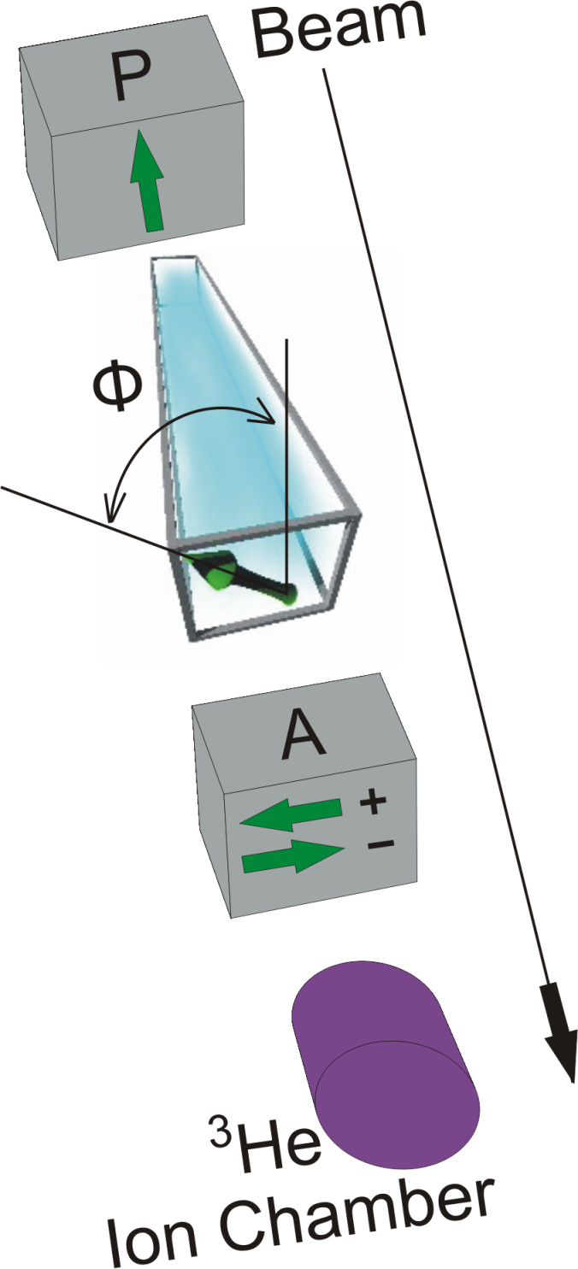
Expected Size:
Experimental challenges
  Reducing
  effectively canceling what is left
  controlling noise
  controlling other systematics

Slide 8
Canceling φ_{PC}
Output Coil /
Polarization
Analyzer
Supermirror
Polarizer
Target Chamber
(Upstream)
Target Chamber
(Downstream)
Ion
Chamber
Pi-Coil
side view
^{up}φ_{PC}
−^{up}φ_{PC}
^{dn}φ_{PC} − ^{up}φ_{PC}
Neutron
Beam
chamber full
chamber empty
+ φ_{PNC}
− φ_{PNC}
− φ_{PNC}
φ_{BKG} − φ_{PNC}
B
− φ
+ φ
Vertical field of “π-coil” reverses rotation angle
φ_{BKG}= ^{dn}φ_{PC}- ^{up}φ_{PC}~0
Detector sensitive to φ_{BKG} − φ_{PNC}

Slide 9
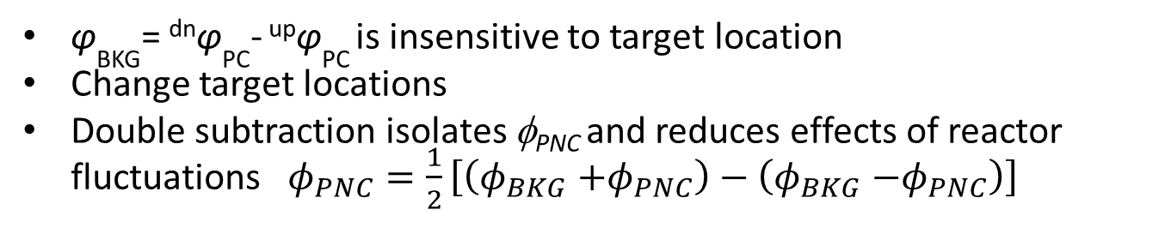
Canceling φ_{PC} – Side-by-side experiments
Output Coil /
Polarization
Analyzer
Supermirror
Polarizer
Target Chamber
(Upstream)
Target Chamber
(Downstream)
Ion
Chamber
Pi-Coil
top view
^{up}φ_{PC}
−^{up}φ_{PC}
^{dn}φ_{PC} − ^{up}φ_{PC}
Neutron
Beam
chamber full
chamber empty
+ φ_{PNC}
− φ_{PNC}
− φ_{PNC}
φ_{BKG} − φ_{PNC}
^{up}φ_{PC}
−^{up}φ_{PC}
^{dn}φ_{PC} − ^{up}φ_{PC}
chamber empty
chamber full
+ φ_{PNC}
φ_{BKG} + φ_{PNC}
φ_{BKG}= ^{dn}φ_{PC}- ^{up}φ_{PC} is insensitive to target location
Change target locations
Double subtraction isolates φ_{PNC} and reduces effects of reactor fluctuations $φ_{PNC}=\frac{1}{2}\left[\left(φ_{BKG}{+φ}_{PNC}\right)−\left(φ_{BKG}{−φ}_{PNC}\right)\right]$

Slide 10
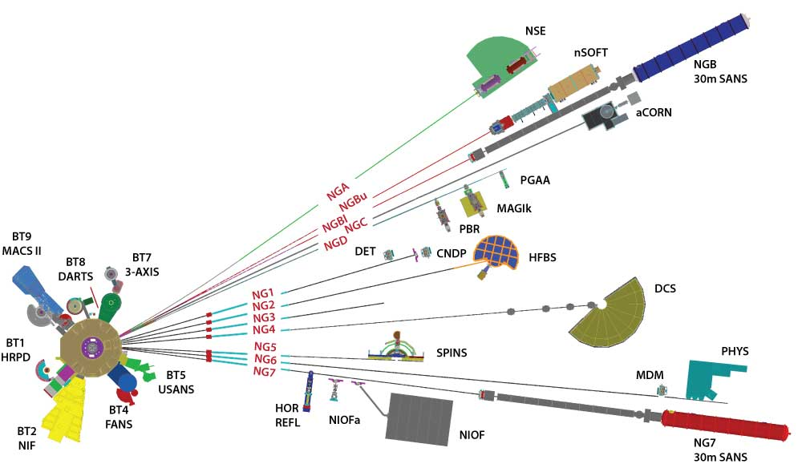
NIST Center for Neutron Research
Reactor 20 MW (fission neutrons)
Moderation D₂O
Moderation LH
Thermal neutrons
Cold neutrons
T=20K

Slide 11
Spin Rotation Apparatus
Measures the horizontal component of neutron spin for a vertically-polarized beam
+y
motion-control
system
room-temperature
magnetic shields
cryogenic
magnetic shield
+x
pi-coil
ion chamber
+z
input coil
output
coil
supermirror
polarizer
input guides
supermirror
analyzer
liquid helium targets
output guide
cryostat
100microGauss 10microGauss in target region
float glass waveguides (m=0.68) super-mirror guides (m=2)
5cmX5cm NG6 10cmX10cm NGC
4.5E8/cm²/s NG6 2.5E9/cm²/s NGC
Be filter cuts spectrum <4Å to limit under rotation by pi-coil

Slide 12
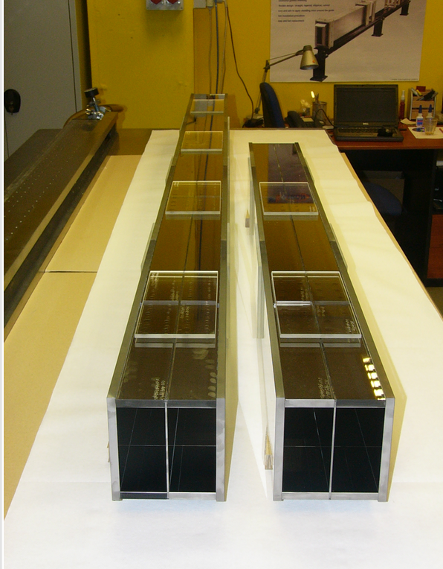
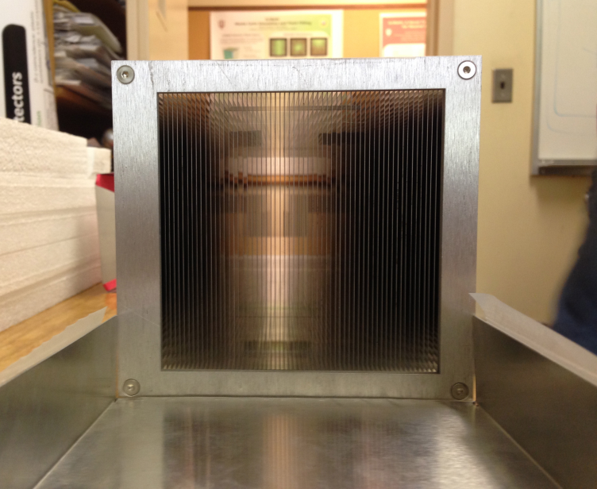
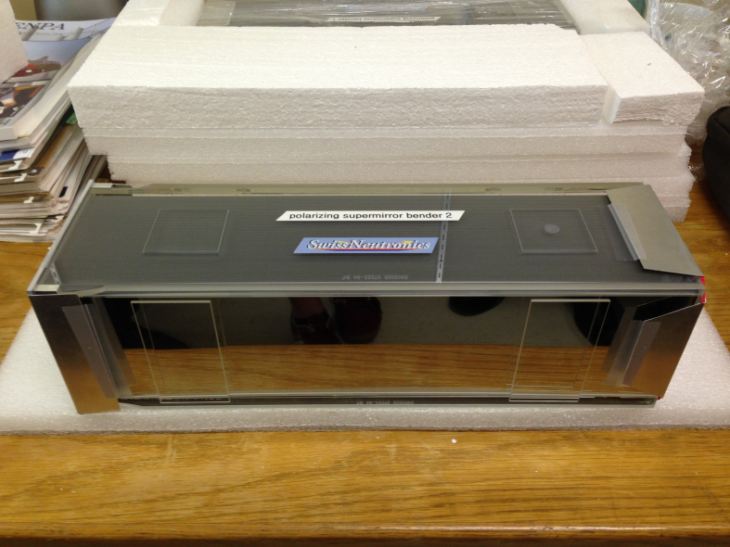
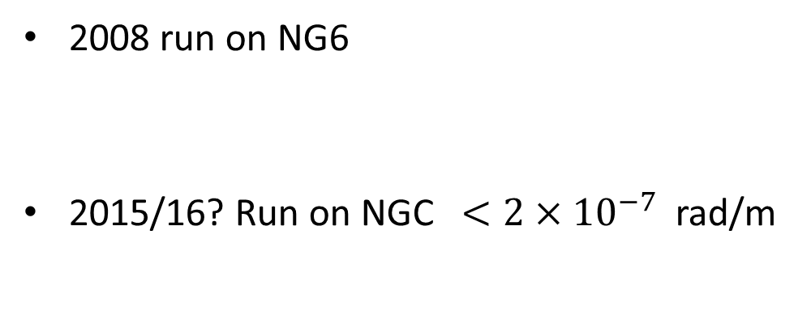
Parity-Violation Results/Plans
2008 run on NG6
2015/16? Run on NGC $<2×{10}^{−7}$ rad/m

Slide 13
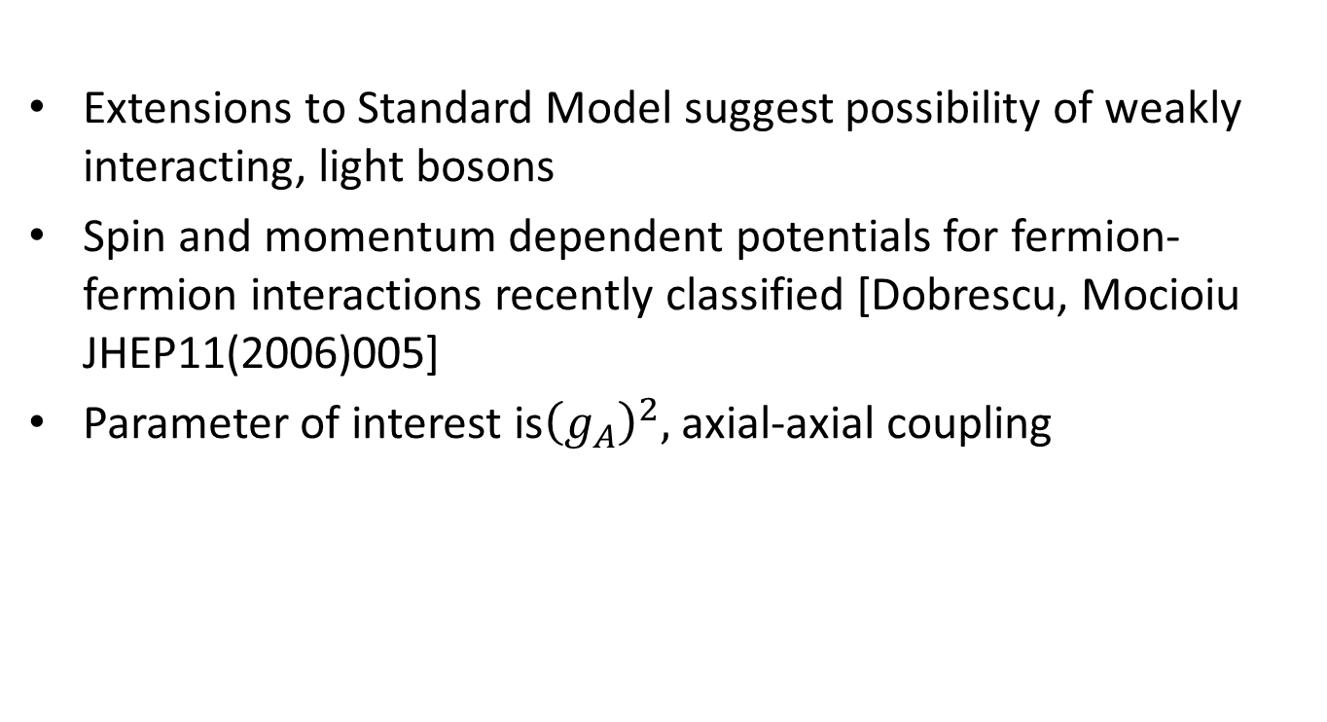
5th force Long-Range Interactions
Extensions to Standard Model suggest possibility of weakly interacting, light bosons
Spin and momentum dependent potentials for fermion-fermion interactions recently classified [Dobrescu, Mocioiu JHEP11(2006)005]
Parameter of interest is${\left(g_{A}\right)}^{2},$ axial-axial coupling
v
r

Slide 14
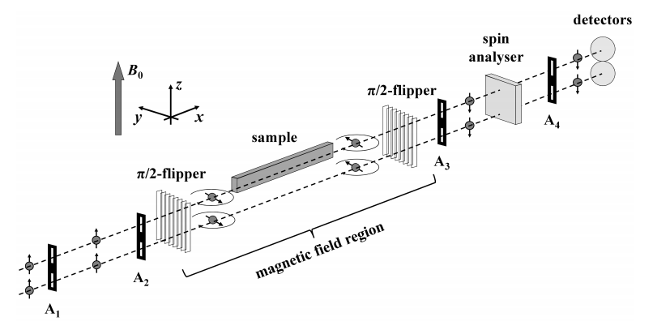
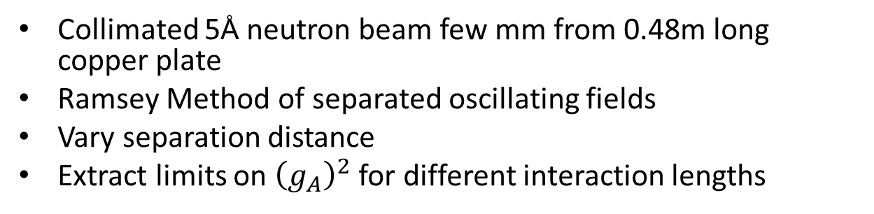
2012 PSI results
Collimated 5Å neutron beam few mm from 0.48m long copper plate
Ramsey Method of separated oscillating fields
Vary separation distance
Extract limits on ${\left(g_{A}\right)}^{2}$ for different interaction lengths
M. Piegsa and Pignol , Phys. Rev. Lett. 108, 181801(2012)

Slide 15
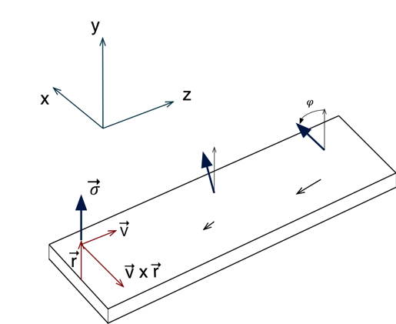
NSR Experiment
Use full 10cmX10cm beam
Vertical spin tips forward/backward
Sandwich high/low density materials → net rotation
Slab separation ~1mm
X
X
X
X
X
v
X
X
X
X
X
X
X
X
X
X
X
X
X
X
X

Slide 16
NSR Neutron Polarimeter
(Side View)
magnetic shields
Segmented
³He ionization
chamber
target (70 cm)
AFP spin
flipper
supermirror
polarizer (45 cm)
supermirror
polarization analyzer
(45 cm)
input coil
output coil
non-magnetic SM input guide (125 cm)
pi/2 turner
non-magnetic SM output guide (200 cm)
B_{x}
B_{y}
~5 G
~100 μG
~5 G
~2 G
Application of a vertical B-field gradient causes output guide field to rotate by ±90° before reaching the vertical analyzer field.
Slide from IU PhD student, Chris Haddock

Slide 17
Expected Sensitivity at LANSCE FP-12 and NIST
Neutron spin rotation apparatus is designed for a 10cm x 10cm beam.
Pulsed operation at LANSCE provides a useful handle on systematics since the effect is speed independent while the primary systematic depends on neutron speed.
At LANSCE: < 1 week 4x10⁻⁷rad/m
At NIST: < 1 week 1x10⁻⁷rad/m
MC simulation connecting experimental spin rotation sensitivity and physics sensitivity on g_{A} compared to existing limits.

Slide 18
Status
Supermirror Waveguides
  Testing (October 2014 at LENS)
Input/Output coils (construction beginning)
Supermirror polarizer and analyzer
  Testing (October 2014 at LENS)
Room temperature targets (design complete, construction starting winter 2014)
Pi-coil (design nearing completion)
RF Spin Flipper (built and tested)
Ion chamber
  Testing (October 2014 at LENS)
Liquid helium targets
  Cyrostat
  Target and He pump design/testing in progress
  Tested
Helium re-liquifier commissions with equivalent heat load
Data Acquisition - Minor Upgrade in progress

Slide 19
Conclusions
The NSR collaboration set new limit on parity-violating spin rotation in the n-⁴He interaction of <9x10⁻⁷ rad/m
New apparatus on NGC beam of NCNR will achieve <2x10⁻⁷ rad/m to further constrain N-N weak couplings.
New apparatus on FP12 of LANSCE (Fall 2015) will reduce limits on axial-vector coupling, (g_{A})², of exotic spin-1 light boson by 2—3 orders of magnitude.
Above results for g_{A} in combination with recent limits on g_{V} will further reduce limits on parity-violating coupling g_{A}g_{V} set by previous n-⁴He spin rotation measurements.
Upgraded apparatus nearing completion ready for
  Fall 2015 5th force experiment on FP12 at LANSCE
  2016 n-4He parity-violating experiment on NGC at NCNR

Slide 22
Backup slides

Slide 23
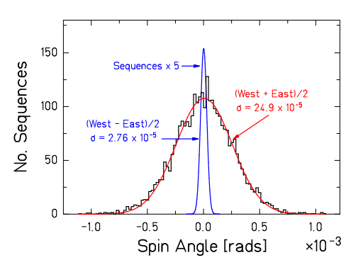
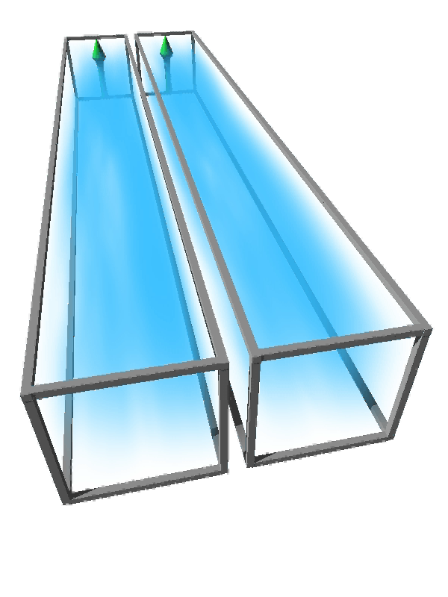
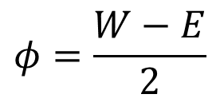
Reactor Noise Suppression
E
W
Large noise from beam intensity fluctuations is suppressed
Width of East-West difference of spin rotation angles is consistent with √N neutron counting statistics noise to ~10% accuracy
$$φ=\frac{W−E}{2}$$

Slide 24
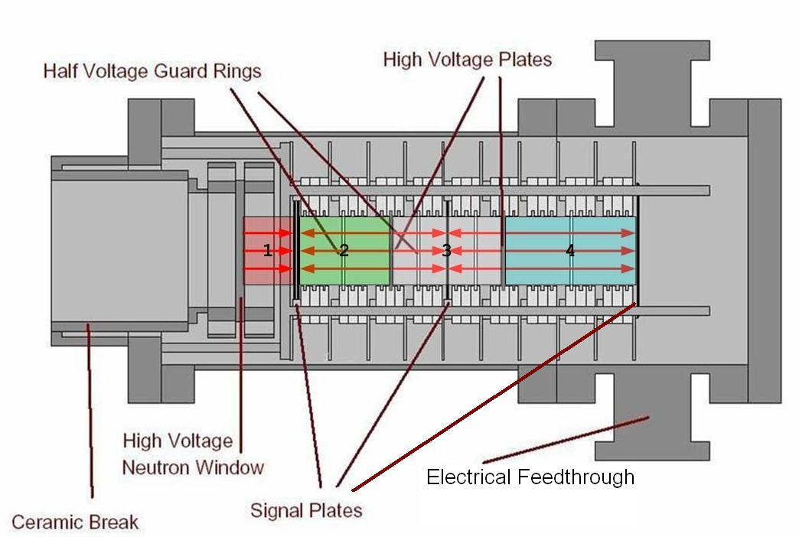
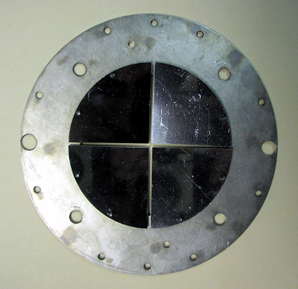
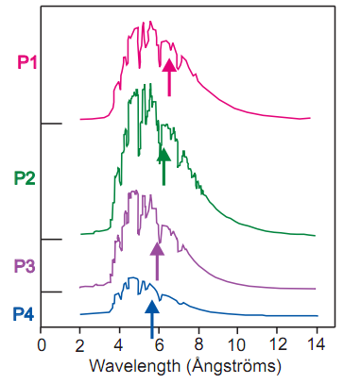
Segmented ³He ionization chamber
n
charge collection plates are divided into 4 quadrants (3“ 7.5” diam) separated L/R and U/D beam
³He and Ar gas mixture
Neutrons detected through n+³He → ³H+¹H
High voltage and grounded charge-collecting plates produce a current proportional to the neutron flux
4 Detection Regions along beam axis - velocity separation (1/v absorption)
S.D.Penn et al. [NIM A457 332-37 (2001)]

Slide 25
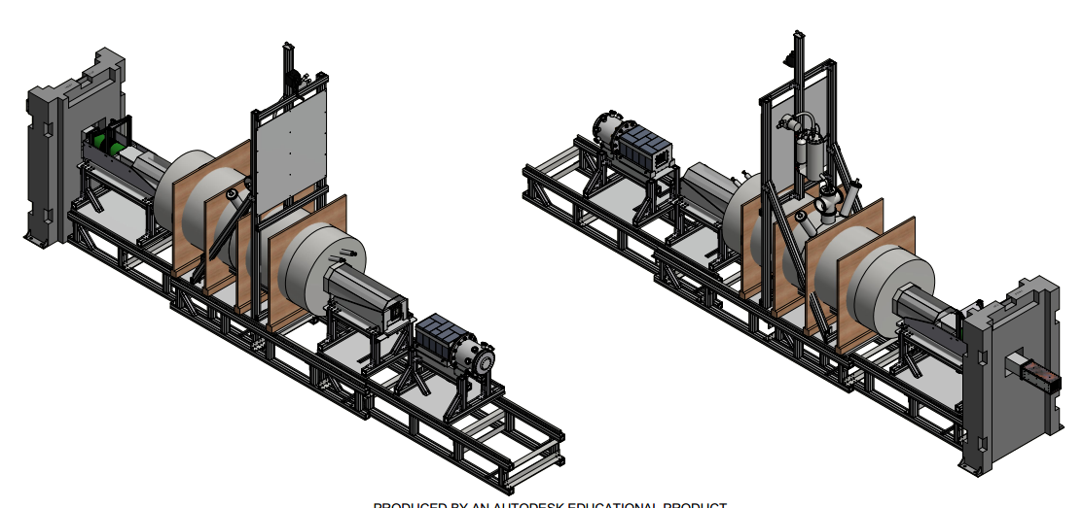

Slide 26
Outline
Experiment 1: Parity-violating spin rotation → hadronic weak coupling constants
NSR apparatus
Controlling systematic errors
Experiment 2: Parity-conserving spin rotation → exotic long-range interactions
Status of upgrades/current run

Slide 27
Systematic Effects
Diamagnetism of LHe | ΔB/B ≈ 6E-8 | 2E-9 rad/m
Optical potential of LHe | ~ 10 neV | 3E-9 rad/m
Shift in neutron energy spectrum | Δ L ≈ 0.01 mm | 8E-9 rad/m
Small angle scattering |  | 2E-8 rad/m
Change in neutron paths due to refraction/reflection |  | 3E-10 rad/m
Polarimeter nonuniformity |  | 1E-8 rad/m
B amplification |  | < 4E-8 rad/m
B gradient amplification |  | < 3E-8 rad/m
PA/target nonuniformity |  | < 6E-8 rad/m
TOTAL estimated systematic effect |  | 1.4E-7 rad/m
Calculated
Measured
2008 on NG6
Simulations used to investigate small angle scattering and B-field gradients
Artificially enhanced B-fields and gradients used to experimentally place limits
Ion detector + pi-coil OFF data used to measure ambient magnetic field

Slide 28
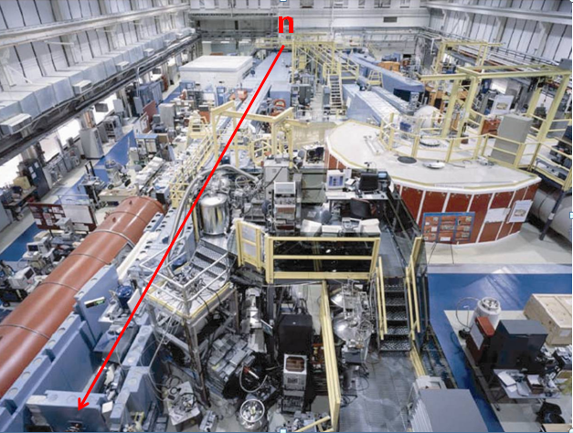
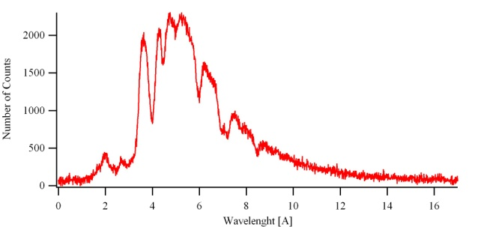
Cold Neutron Guide hall at NCNR
n
⁵⁸Ni guide θ_{c}=2.1 mrad/A (m=1.2)
NG-6 Polychromatic beam
Reactor 20 MW (fission neutrons)
Moderation D₂O
Thermal neutrons
Moderation LH
Main measurement – 3 reactor cycles January – May 2008, Systematic studies – 1 reactor cycle June 2008.
Cold neutrons
T=20K
slide courtesy A. Micherdzinska

Slide 29
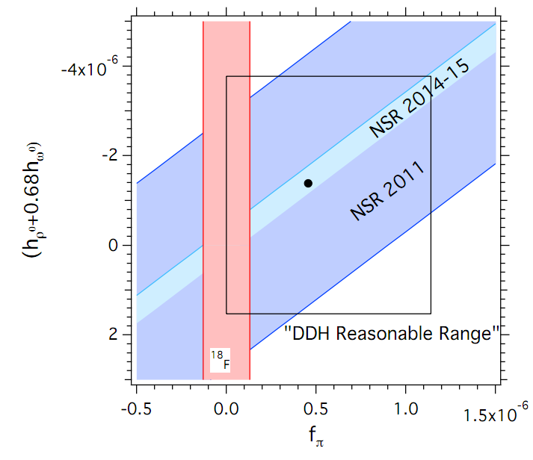
Conclusions
In addition to helping constrain hadronic weak coupling constants, recent analysis demonstrates that the result also places the most stringent limit to date on new parity-odd long-range sub-eV interactions (WISPs) Phys. Rev. Lett. 110, 082003 (2013)
Upcoming experiment on new NGC beam at NIST promises to improve precision to the 2x10⁻⁷ rad/m level.

Slide 34
Results
Artificially high magnetic field 10mG
  implies <4x10⁻⁸ rad/m systematic
Artificially high magnetic gradient +7mG to -7mG
implies <3x10⁻⁸ rad/m systematic

Slide 35
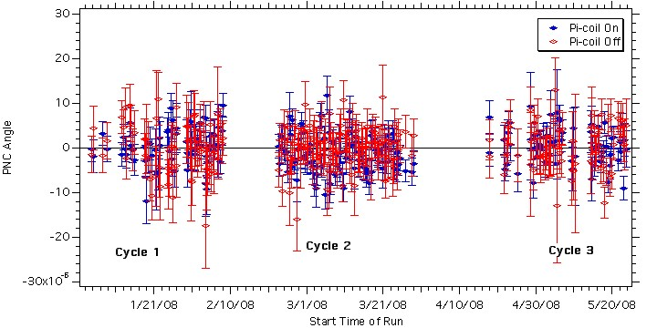
Results
pi-coil ON runs measure φ_{PNC}
pi-coil OFF runs should be zero if no systematics

Slide 36
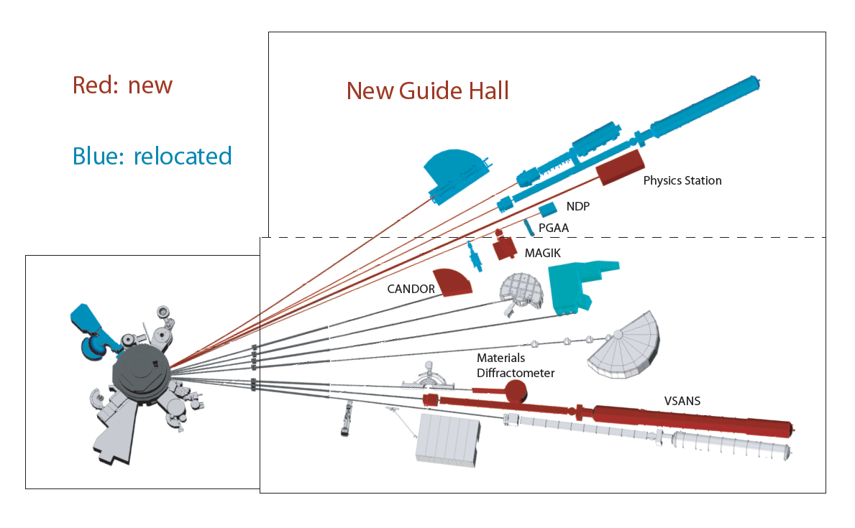
NIST Guide Hall Expansion Project
NGC beam – larger area, higher flux, more divergent beam
~X20 increase in polarized slow neutron flux in spin rotation apparatus(!)
Spin rotation stat precision of <2E-7 rad/m in a 5 week cycle is possible
slide courtesy M. Snow

Slide 37
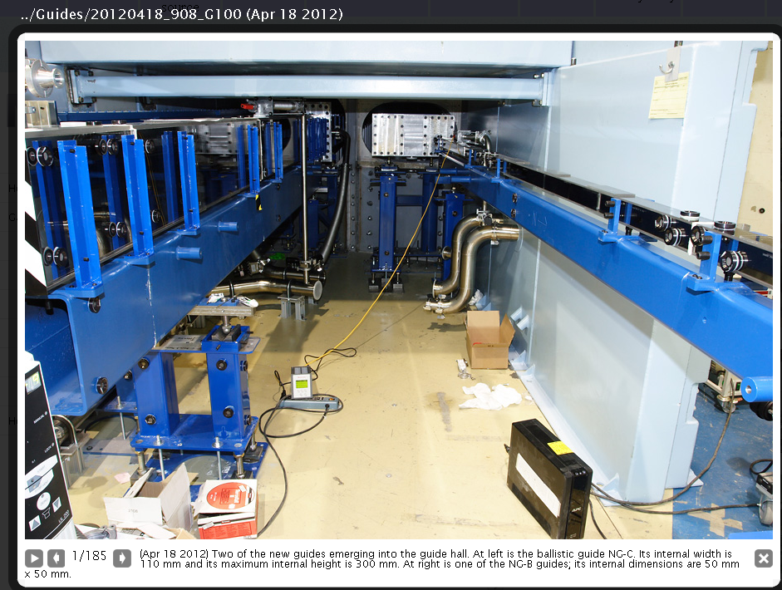
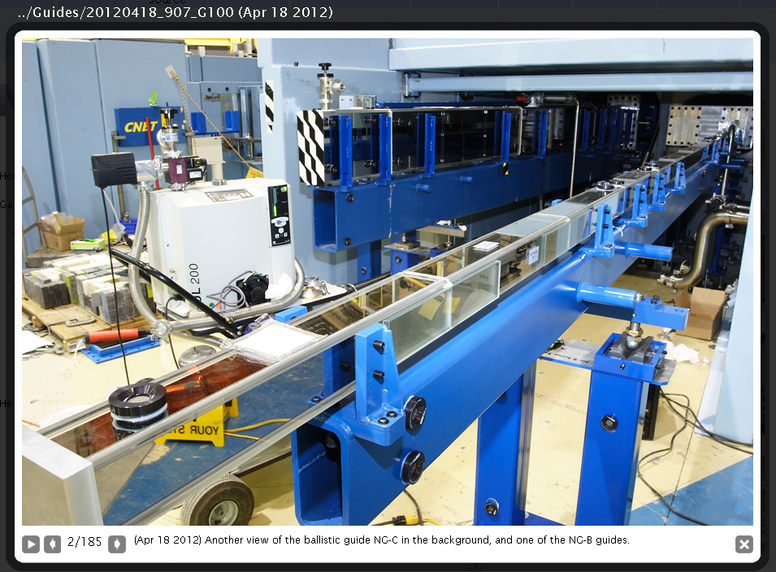

Slide 38
Rotation Angle Asymmetry
pi-coil
input coil
output
coil
input guides
Polarizer
Analyzer
Output coil rotates vertical spin by +90º or -90º (1 Hz)
Vertical super-mirror analyzer analyzes component due to rotation

Slide 39
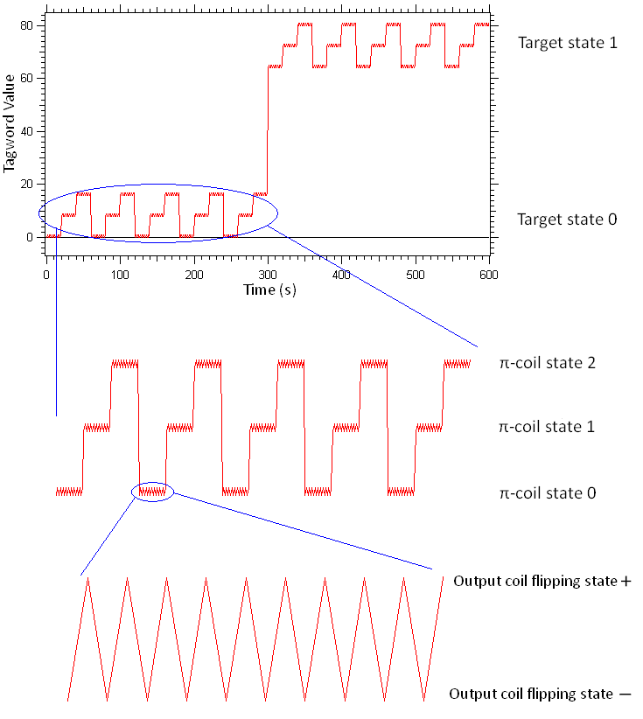
Data sequence
n
A spin rotation angle is determined from each pair of output coil states (+, −).
Reversing the π-coil current cancels any neutron spin rotations from stray fields outside the coil.
Π-coil (−, 0, +) state is repeated five times to form a 300-s target sequence.
The liquid helium is then drained and filled in the complementary state in 300–350 s, and the previous sequence is repeated to form a target cycle.
slide courtesy A. Micherdzinska

Slide 40
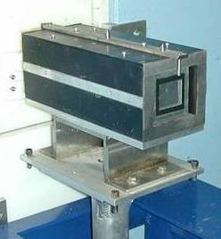
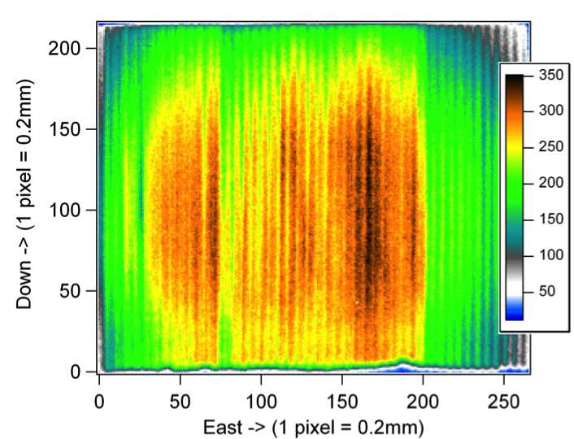
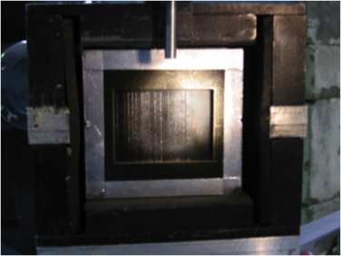
Polarizing Super Mirror
Polarized beam
unpolarized beam
B
spin-dependent scattering from magnetized mirrors
Alternating layers of magnetic surface (cobalt) and absorptive layer (titanium and gadolinium); 1mm separation;
Placed in 300 G permanent box.
Typical polarization: 98%; transmission: 25%
14 mrad
4.5cmX5.5cm
slide courtesy A. Micherdzinska

Slide 41
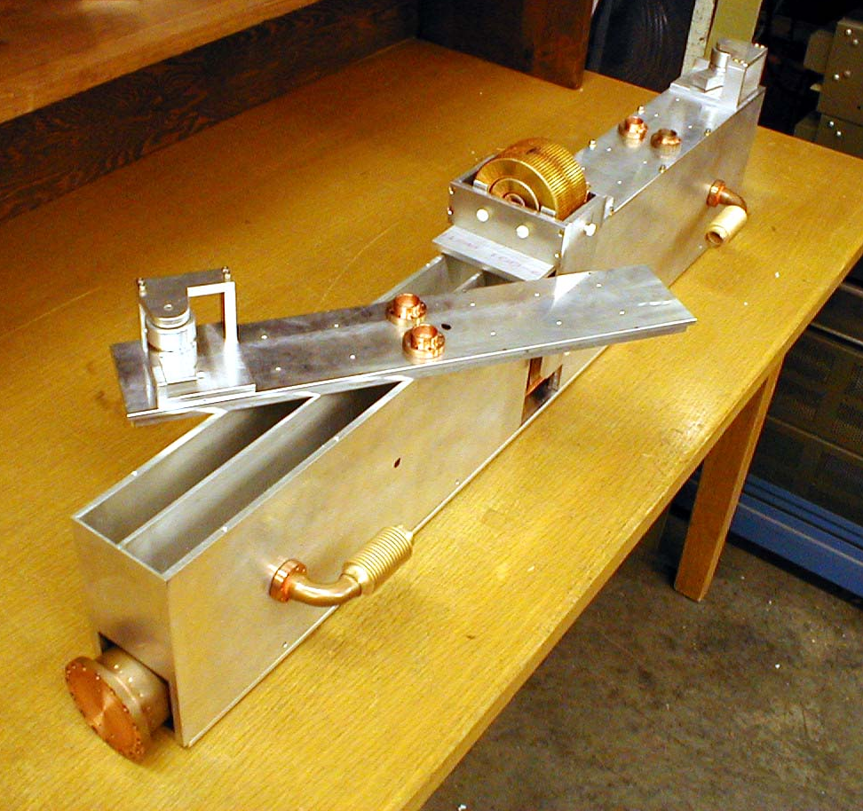
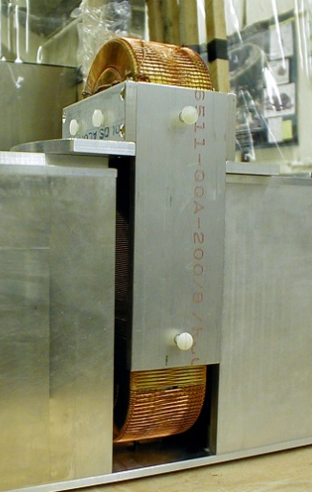
Target Chamber
pi-coil
Separate Left and Right chambers upstream and downstream of pi-coil
C.D. Bass NIM A 612 (2009) 69-82

Slide 42
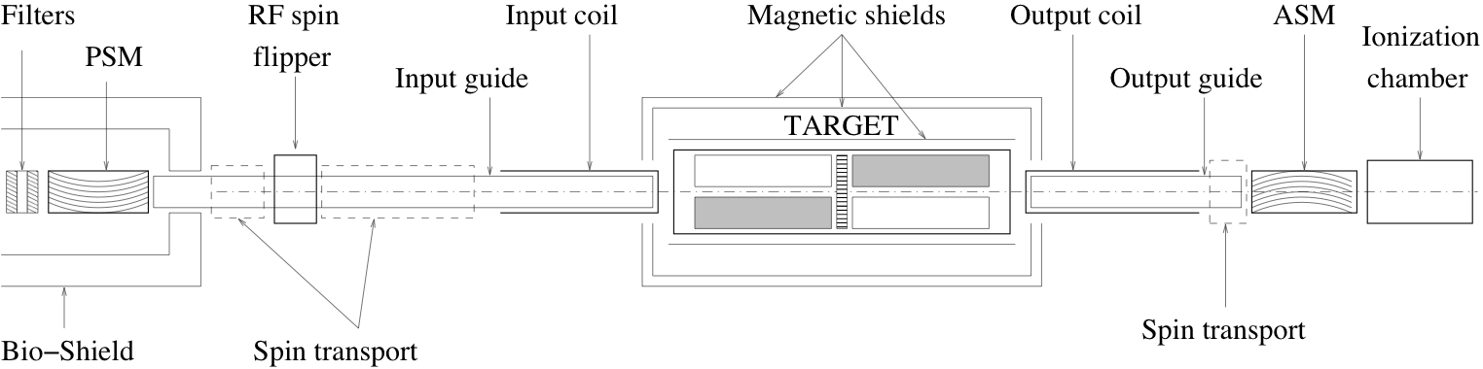
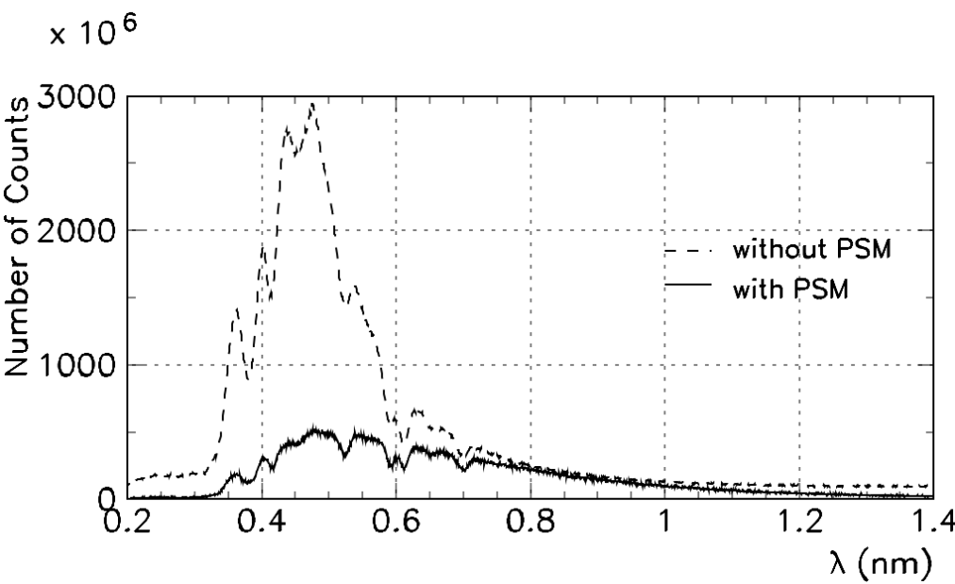
Before real measurement we need to understand beam
and apparatus behavior – systematic check of beam and apparatus behavior
n
Beam intensity distribution as I(λ) / chopper – TOF, ionisation chamber
A. Micherdzinska CUA, 03/02/2011

Slide 43
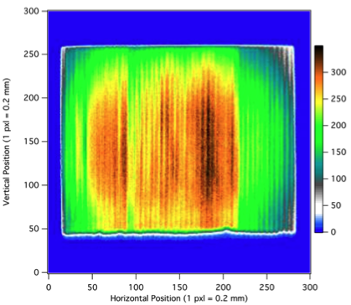
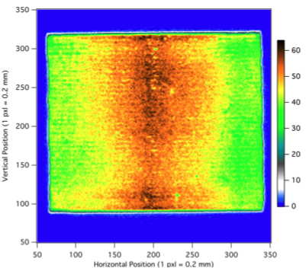
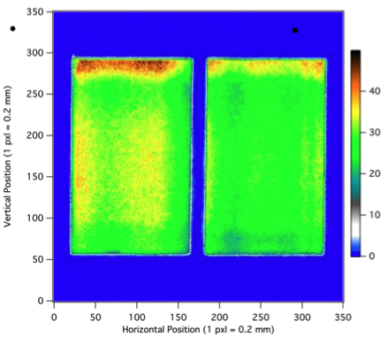
Before real measurement we need to understand beam
and apparatus behavior – systematic check of beam and apparatus behavior
n
Beam intensity distribution as I(x,y) / image plate
A. Micherdzinska CUA, 03/02/2011

Slide 44
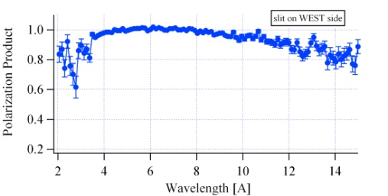
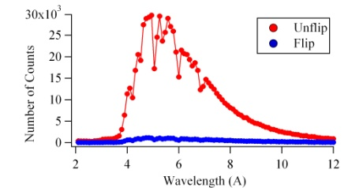
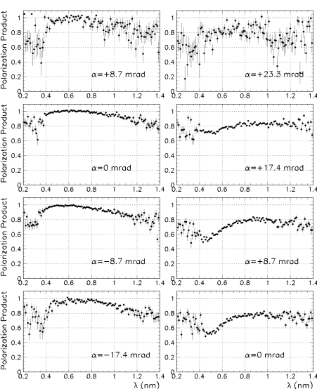
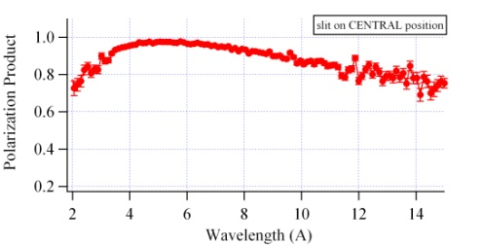
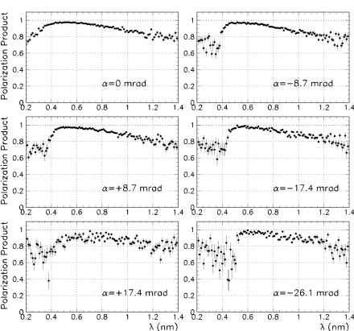
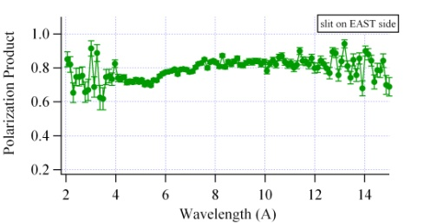
Before real measurement we need to understand beam
and apparatus behavior – systematic check of beam and apparatus behavior
n
PA=(U-F)/(sU+F)
U- Unflip; F- flip
s – spin-flip efficiency (s=0.95 ± 0.05)
Polarization product (PA) as a f(λ) /PSM, ASM, chopper – TOF
A. Micherdzinska CUA, 03/02/2011

Slide 45
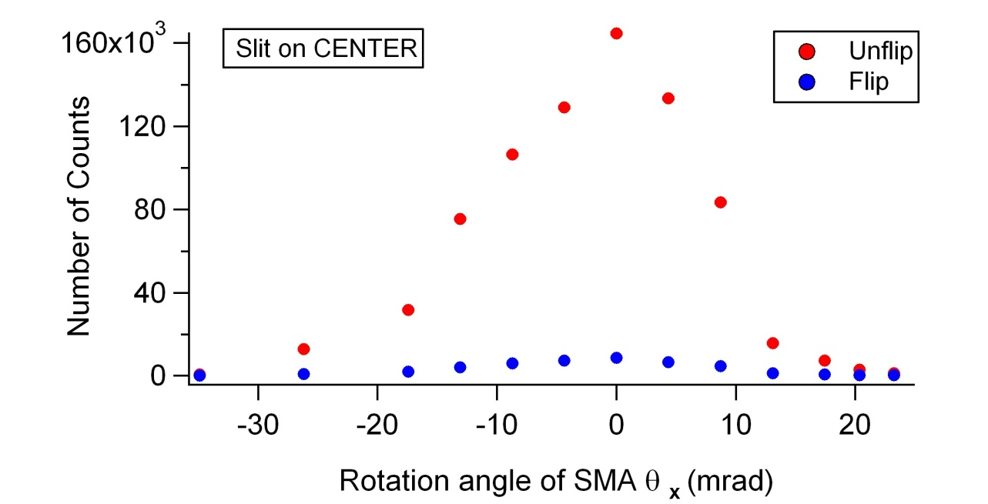
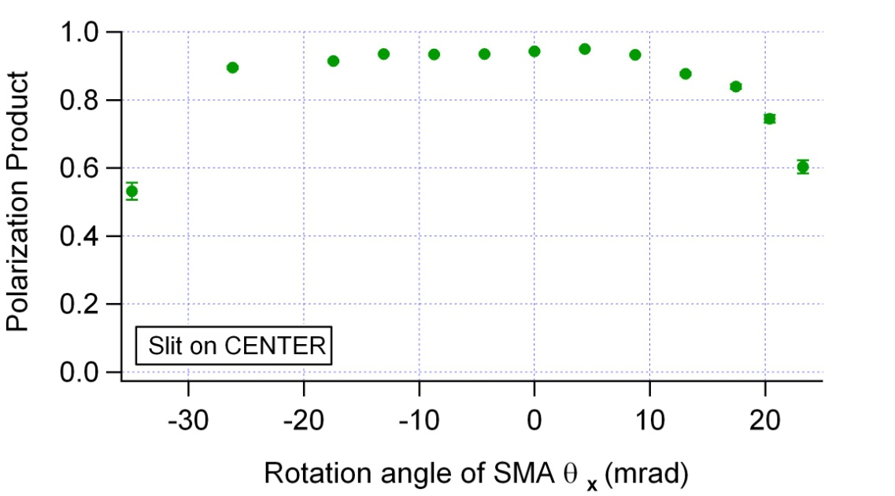
PA as a function of angle
n
Input coil
ASM
-
0
+
For 5mm slit in the
CENTRAL position
PA does not change with angle
A. Micherdzinska CUA, 03/02/2011

Slide 46
Small-angle scattering
Target positions
Wave guides
detector
Upstream-downstream subtraction is incomplete
  Energy loss for scattered neutrons + different paths in target region
  (up stream scatters travel farther at lower energy)
  path length of scattered neutrons is different
  (up stream scatters spend longer time in target region)
  different detector solid angles from target positions
  (fewer scattered neutron reach detector from up target)

Slide 47
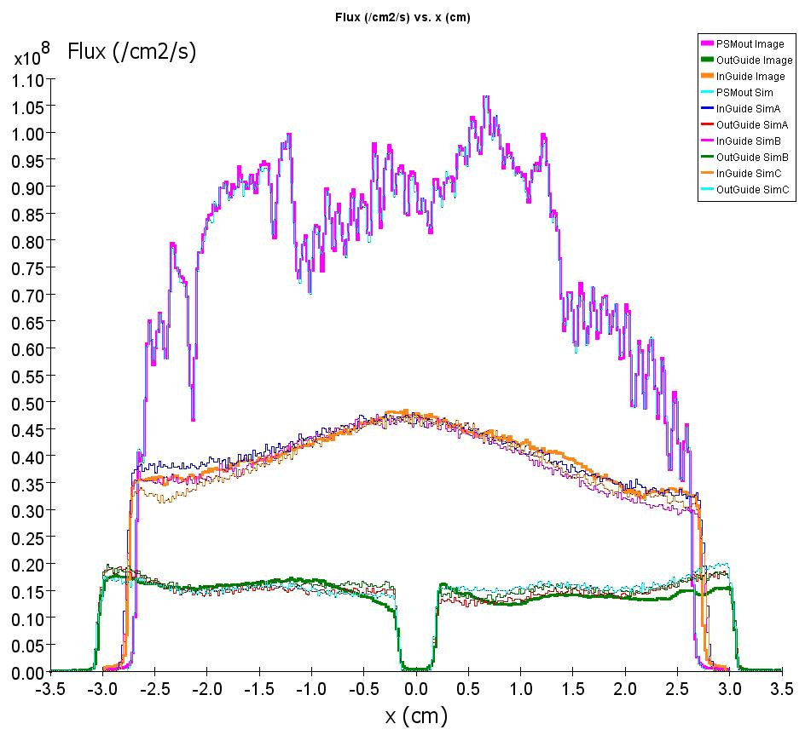
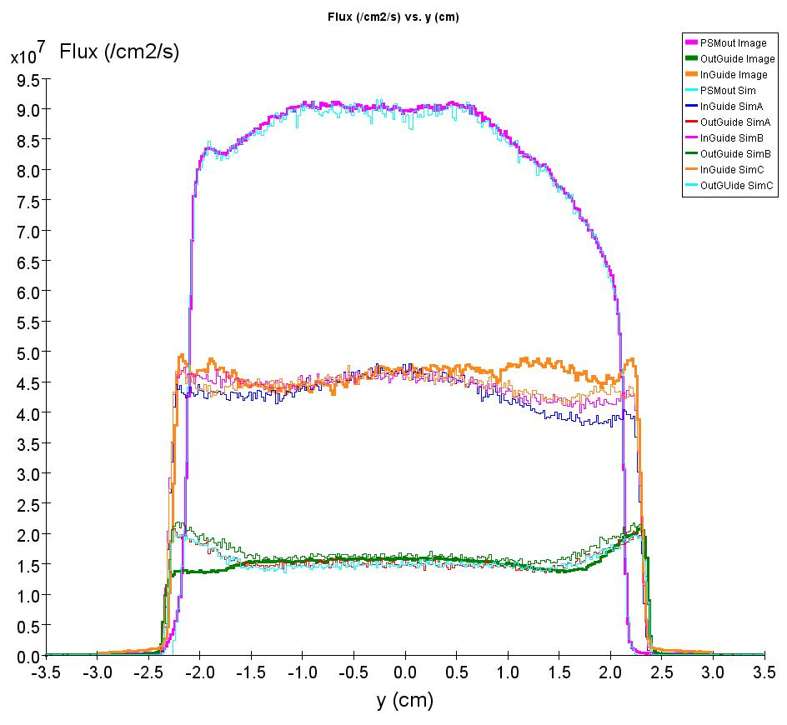
Simulations
Monte-Carlo neutron transport
  Phase space of polarizing super mirror as input
  allow reflections from waveguides, scattering from Al windows, air gaps
  small angle scattering in liquid He target
  calculate PC rotation
  study effect of target position, alignment, B-field gradients, changes in energy and path length

Slide 48
Systematic Effects
Diamagnetism of LHe | ΔB/B ≈ 6E-8 | 2E-9 rad/m
Optical potential of LHe | ~ 10 neV | 3E-9 rad/m
Shift in neutron energy spectrum | Δ L ≈ 0.01 mm | 8E-9 rad/m
Small angle scattering |  | 2E-8 rad/m
Change in neutron paths due to refraction/reflection |  | 3E-10 rad/m
Polarimeter nonuniformity |  | 1E-8 rad/m
B amplification |  | < 4E-8 rad/m
B gradient amplification |  | < 3E-8 rad/m
PA/target nonuniformity |  | < 6E-8 rad/m
TOTAL estimated systematic effect |  | 1.4E-7 rad/m
Calculated
Measured

Slide 49
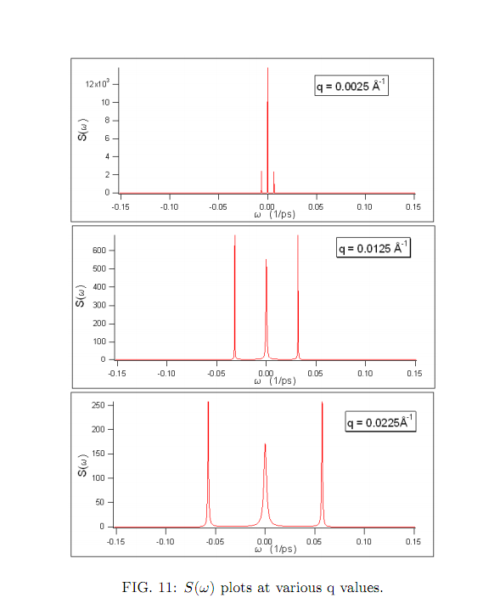
Small Angle Scattering in liquid ⁴He
cross section ~ Dynamic structure factor S(q,ω)
for q<0.1 (1/Å), S(q,ω) found from hydrodynamic properties of liquid
Measured σ(E) used to determine if scattering takes place
Central peak from quasi-elastic scattering from diffusive motion of liquid
side peaks from single phonon scattering

Slide 50
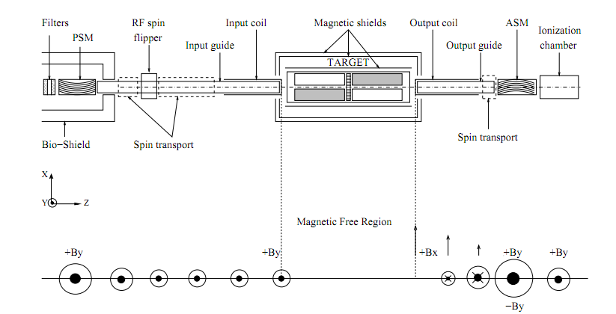

Slide 52
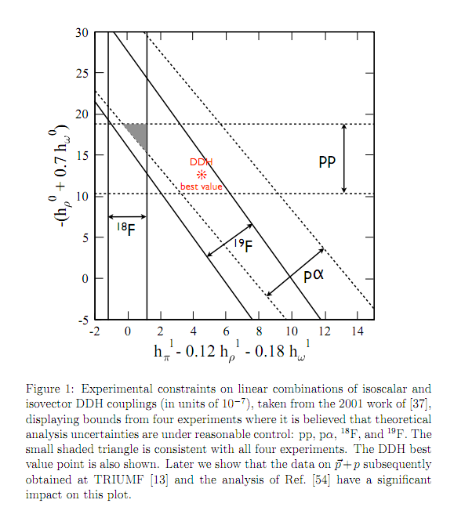
Haxton and Holstein, arXiv:1303.4132v2 [nucl-th] 21 Mar 2013

Slide 53
