Slide 1
NSR Simulations
Bret Crawford
(Murad S., Kangfei G., Ron M., Chris C.)
Collaboration Meeting
August 5-6, 2013

Slide 2
nSpinSim
+y
motion-control
system
room-temperature
magnetic shields
cryogenic
magnetic shield
+x
pi-coil
+z
input coil
output
coil
supermirror
polarizer
input guides
liquid helium targets
output guide
cryostat
Monte-Carlo neutron transport
Study properties of phase space of beam
Study affect of small angle scattering on UP-DOWN / EAST-WEST asymmetry in rotations from longitudinal fields and field gradients

Slide 3
nSpinSim
Input
spatial neutron intensity distribution
wavelength distribution
angular distributions (θ_{x} and θ_{y})
Determined by:
measured outputs of PSM (NSRII)
NGC simulations (J. Cook with mcstas)
NGC+PSM simulations (C. Crawford with mcstas)
Waveguides
θ_{c}=3.52mrad/Å (m=2) R~1 but varies with incident angle
multiple bounces
room T He gas (isotropic scattering, possibility for multiple scattering)
Septum
Air gaps, Al windows (isotropic scattering)
currently same setup as NSRII

Slide 4
nSpinSim
Liquid He target
q<0.1 (1/Ang) with weighting OR Full S(q,ω)
Measured σ_{tot} from Sommers et al.
Multiple scattering allowed
Mirror reflections possible in target region, but turned OFF
ASM treated as another waveguide (not modeled as a SM)
Rotation angle about Bz calculated during path
Bz=0.1mG in target region (0 outside)
Can include measured fields in target region (e.g., gradient field)
NOT modeling spin transport outside target region

Slide 5
nSpinSim
Tallies are done at entrance to ion chamber
θ_{rot}, path length, energy loss, R_{π} etc.
Ion chamber not “Monte-Carlo’ed” but current in each chamber is calculated

Slide 6
Input from NGC simulation from J. Cook

Slide 7
Using PSM simulations

Slide 8
NGC in blue
After PSM in red
Note asymmetry in θ_{x}
θ_{x} θ_{y}

Slide 9
nSpinSim input from NGC+PSM
Cuts in root done on mcstas ntuple (10GB)
9 xy regions (large 8x6cm central region)
Each region has it’s own wavelength distribution
Angular distributions as a function of wavelength taken from entire 10x10cm ntuple

Slide 10
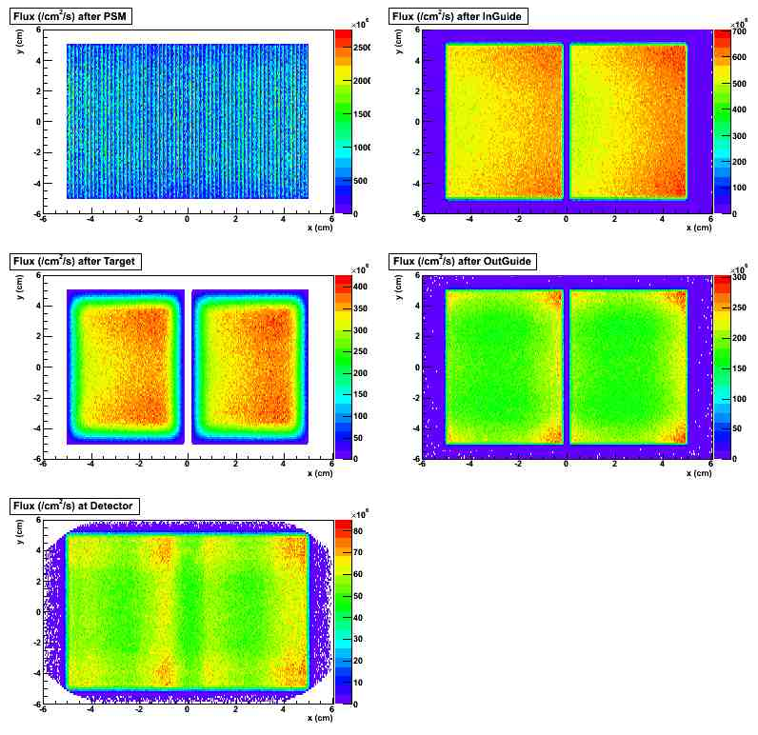
Input from NGC+PSM simulation from C. Crawford
Asymmetry in θ_{x} angles
Flux~5E7/cm²/s at detector

Slide 11
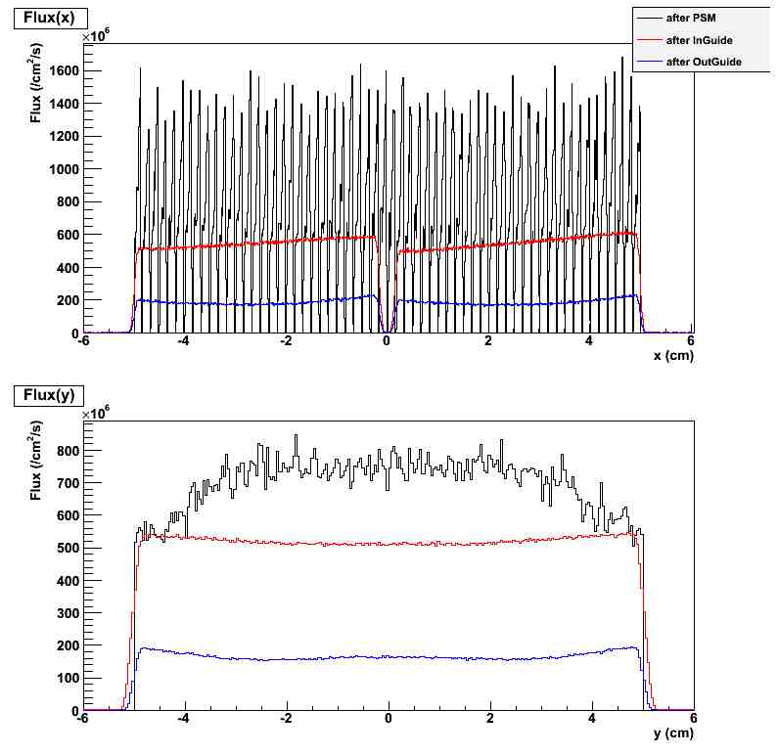
1-cm wide strips
Flux(x) at y=0
Flux(y) at x=-2.5

Slide 12
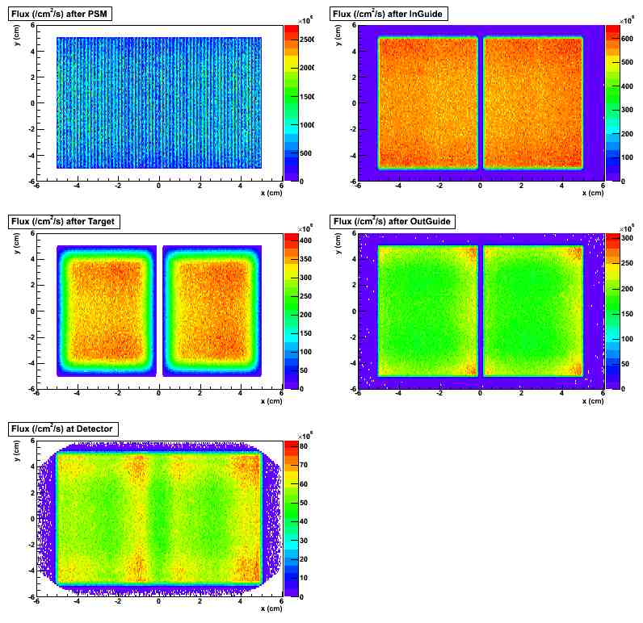
-0.8 mrad rotation of apparatus flattens x-distribution

Slide 13
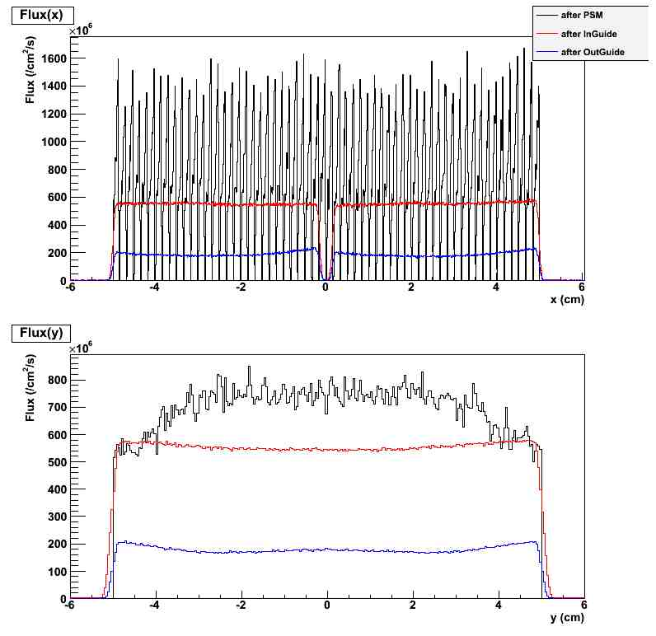
1-cm wide strips
Flux(x) at y=0
Flux(y) at x=-2.5

Slide 14
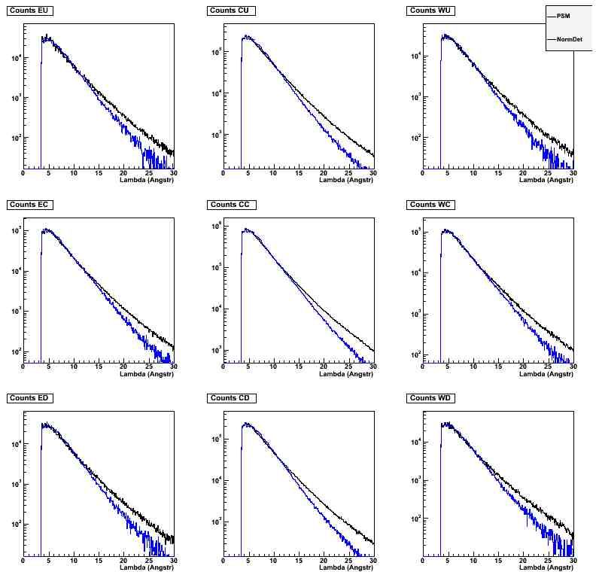
Wavelength distributions in 9 regions

Slide 15
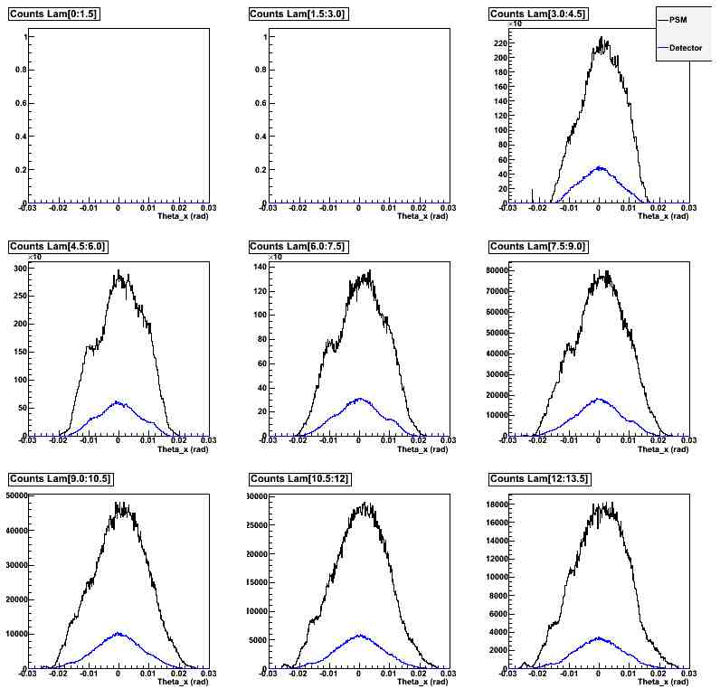
θ_{x} distributions versus wavelength in 1.5Å steps

Slide 16
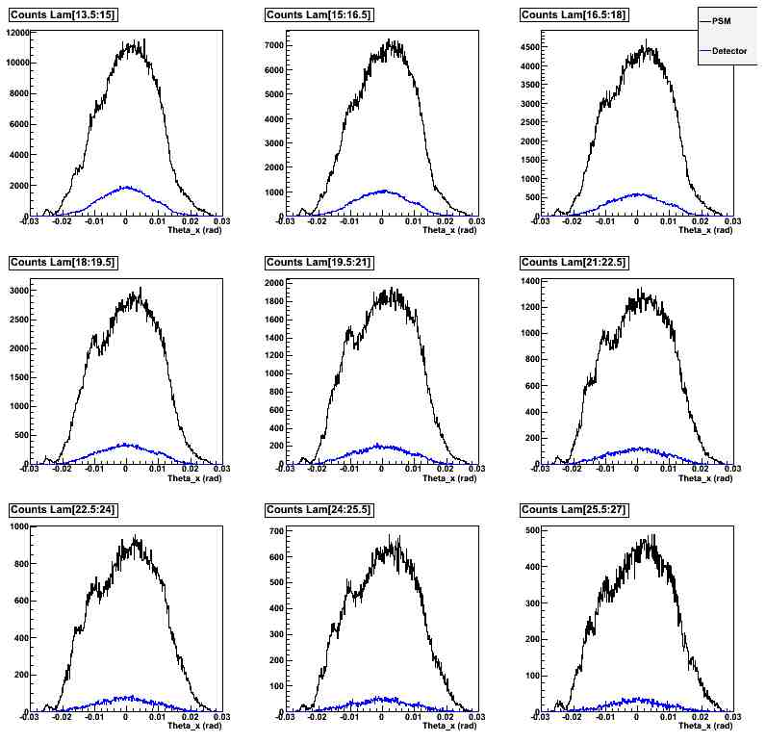
θ_{x} distributions versus wavelength in 1.5Å steps

Slide 17
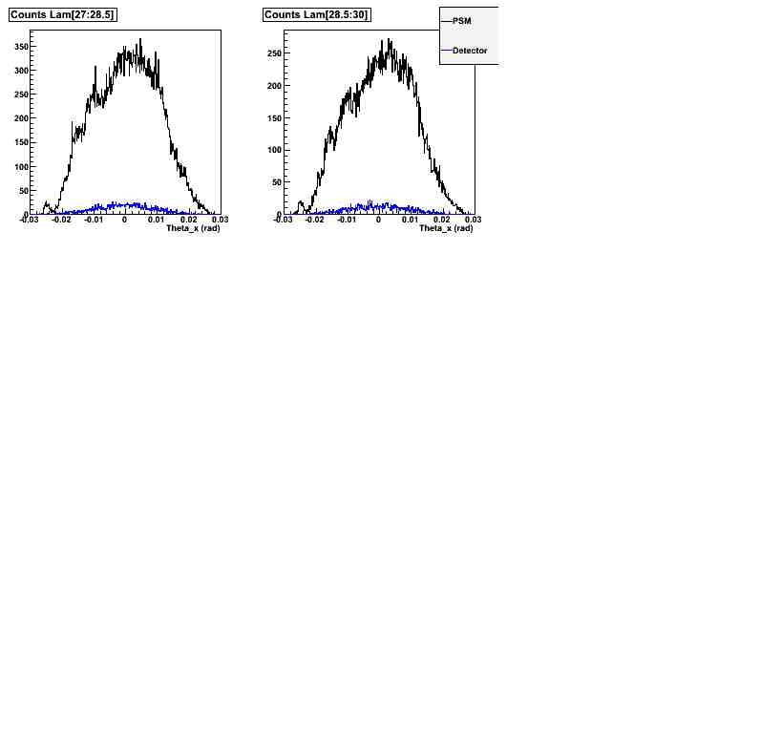
θ_{x} distributions versus wavelength in 1.5Å steps

Slide 18
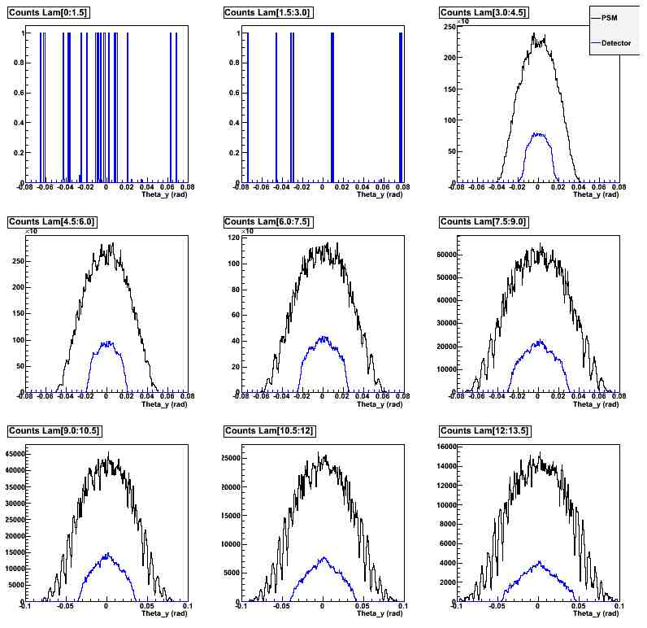
θ_{y} distributions versus wavelength in 1.5Å steps

Slide 19
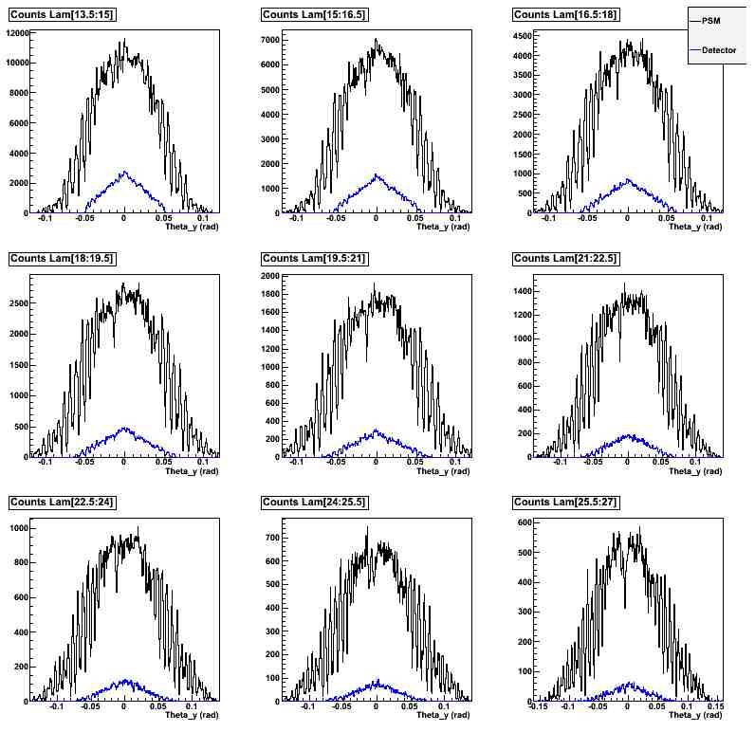
θ_{y} distributions versus wavelength in 1.5Å steps

Slide 20
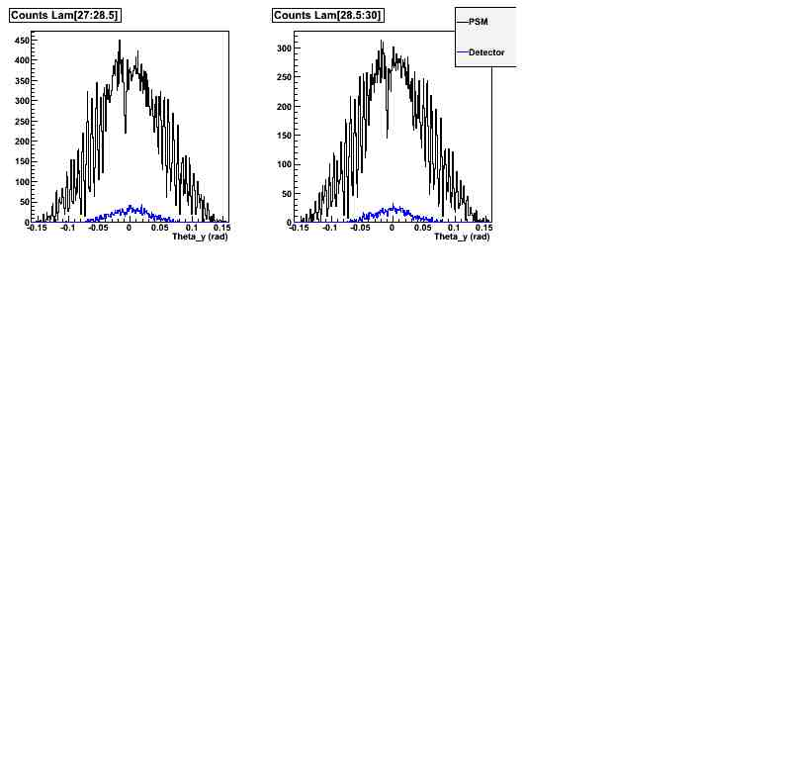
θ_{y} distributions versus wavelength in 1.5Å steps

Slide 21
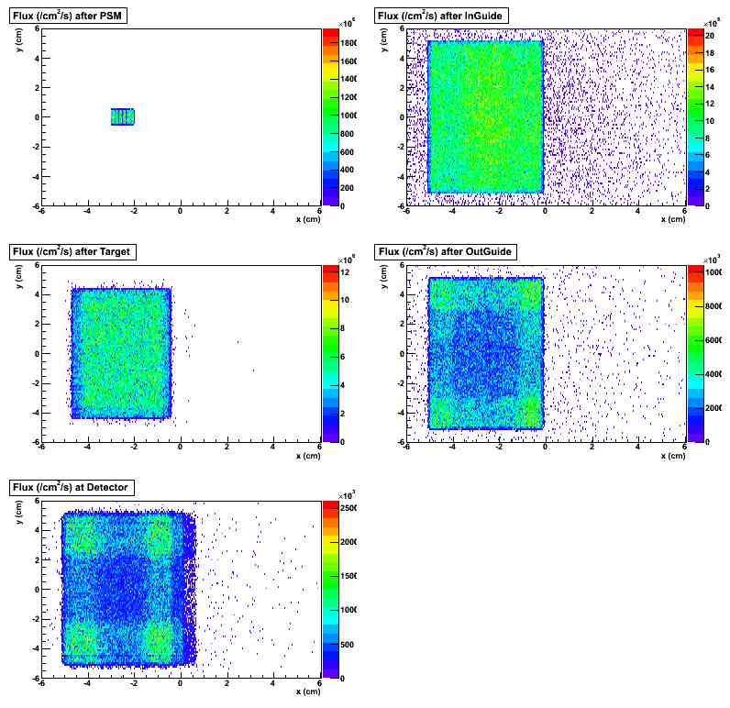
1-cm² aperture at output of PSM, center of East side

Slide 22
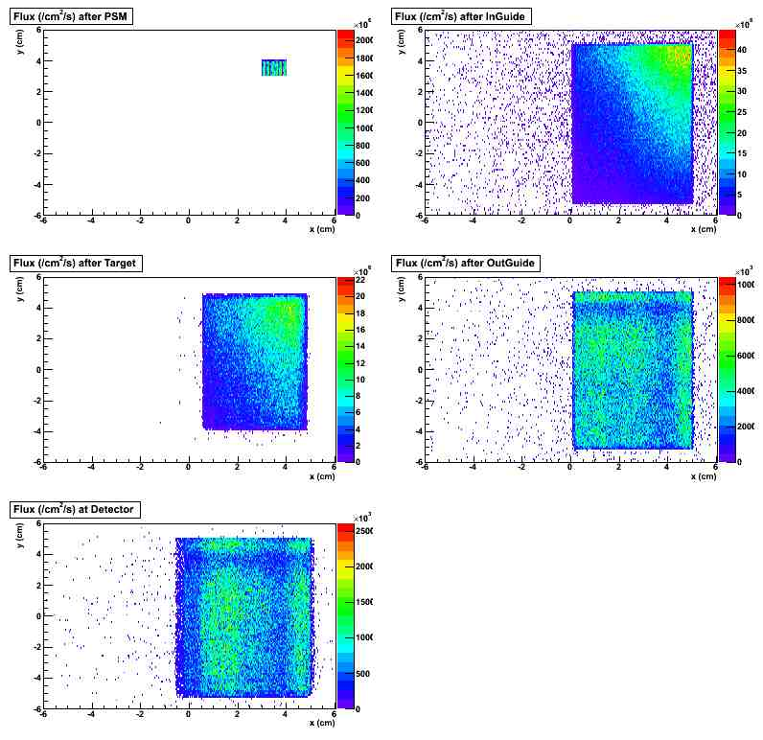
1-cm² aperture at output of PSM, Upper Western corner

Slide 23
Scattering and the dynamic structure factor S(q,ω)
$$\frac{d^{2}σ}{dEdΩ}=b^{2}\frac{k}{k_{o}}S\left(q,ω\right)$$
Limited q (q<0.1)
S(q,ω) from hydrodynamic properties of liquid, S(q)~flat, S(ω) varies with q.
Statistical weighting: $\frac{b^{2}\int_{0}^{0.1}{S\left(q\right)dq}}{σ(E)}$ using Hallock’s S(q) at 4.2K
Full S(q,w) Murad’s blending of models
Currently results of fraction of detector hits from scattered neutrons differ depending on which of above is used

Slide 24
Can we reproduce measured σ(λ)?
S(q) from integrating S(q,ω)dω
2K or 4K?
Multi-phonon effects?

Slide 25
Some Results from Simulations
Mcstas simulation of PSM (60-vane m=2.5 Si) on NGC gives P~98%, T~33%
nSpinSim5.0 shows fairly flat spatial distribution at detector with flux~5x10⁷/cm²/s => Fluence of 5x10⁹/s (NSRII 2.3x10⁷/s)
With R_{π}~54%, effective PA~53% can get to PNC angle to 1E-7rad/m in couple days of data.

Slide 26
Some Results from Simulations
 | fracTS Up | fracTS Dn | Rπ | R_{π} TS
q<0.1 | 7.36E-04 | 7.86E-04 | 54 | 61
full S(q, ω) | 1.70E-03 | 1.80E-03 | 54 | 44
 | frac TSMS Up | frac TSMS Dn
q<0.1 | 5.2% | 3.6%
full S(q, ω) | 0.7% | 0.5%
frac bounce 1 | frac bounce 2 | frac bounce 3 | Xov
67% | 18% | 1.50% | 2.40%

Slide 27
Some Results from Simulations
B_{z} Gradient WUp | θ_{u}-θ_{d} (rad) TS | EST PNC (rad)
q<0.1 | (-1.1±0.2) E-3 | (-8±1) E-7
full S(q,ω) | <3E-3 | <3E-6
B_{z} Gradient EUp | θ_{u}-θ_{d} (rad) TS | EST PNC (rad)
q<0.1 | (+1.0±0.2) E-3 | (+7±1) E-7
full S(q,ω) | <3E-3 | <3E-6
B_{z} Gradient (W+E)/2 | EST PNC WE (rad)
q<0.1 | (-9±8) E-8
full S(q,ω) | <3E-6

Slide 28
Some Results from Simulations
0.1 mG WUp | θ_{u}-θ_{d} (rad) TS | EST PNC (rad)
q<0.1 | (-1.7±0.2) E-6 | (-1.6±0.1) E-8
full S(q,ω) | (-3.2±0.4) E-4 | (-2.7±0.4) E-7
0.1 mG EUp | θ_{u}-θ_{d} (rad) TS | EST PNC (rad)
q<0.1 | (+1.9±0.2) E-5 | (+1.4±0.1) E-8
full S(q,ω) | (+2.7±0.4) E-4 | (+2.2±0.4) E-7
0.1 mG (W+E)/2 | EST PNC WE (rad)
q<0.1 | (-1.0±0.7) E-9
full S(q,ω) | (2.5±2.8) E-8

Slide 29
What’s next?
More study of phase space of PSM output
Other ways to chop up phase space to emphasize variations…?
Resolve S(q,ω) Issues
Include details of ion chamber
Spectra in 4 ion chambers, i.e., Monte-Carlo the ion chamber
Run long enough to see θ_{PNC} in all neutrons
Studies of systematics – lambda variation, waveguide length, with-without septum…
Other targets
Paper!
How can simulations help with the upcoming run?

Slide 32
Estimated Falseθ_{PNC} from B_{z}
$θ_{PNC}^{}=\frac{1}{2}\left[θ_{W}−θ_{E}\right]$ (for given target state)
$$θ_{PNC}^{}=\frac{1}{2}\left[\left(f_{NSW}θ_{NSW}−f_{NSE}θ_{NSE}\right)+\left(f_{TSW}θ_{TSW}−f_{TSE}θ_{TSE}\right)\right]$$
Assume all the non-scattered detected neutrons give zero rotation asymmetry so $θ_{NSW}=θ_{NSW}$=$θ_{NS}$ and $f_{NS}=1−f_{TS}$.
$$θ_{PNC}^{}=\frac{1}{2}\left[\left(f_{TSE}−f_{TSW}\right)θ_{NS}+\left(f_{TSW}θ_{TSW}−f_{TSE}θ_{TSE}\right)\right]$$

Slide 33
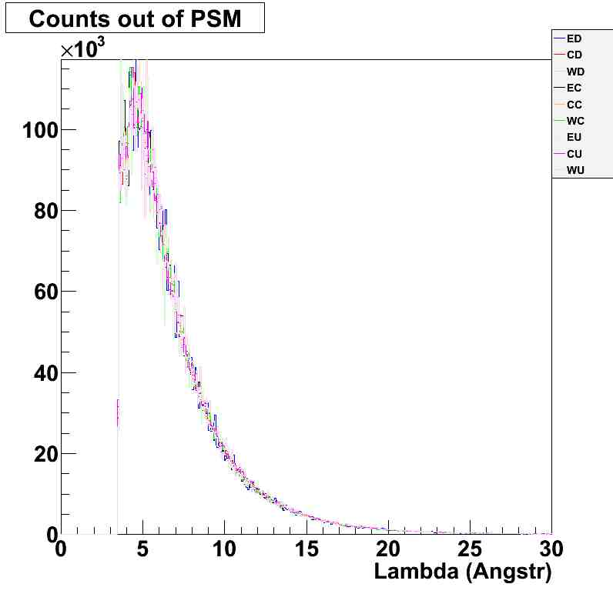

Slide 34
