Slide 1
Resonance: Strings and Guitars
Harmony House and STEM House
November 15, 2021

Slide 2
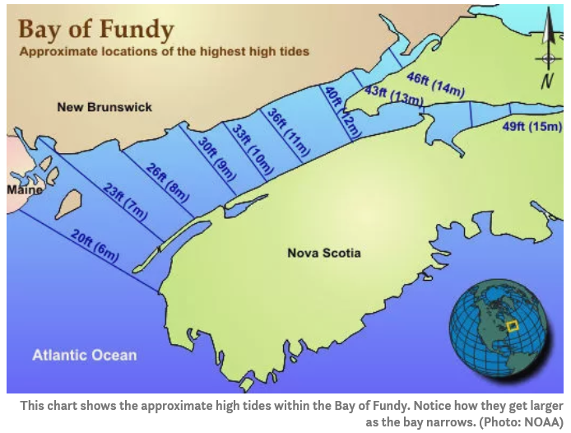
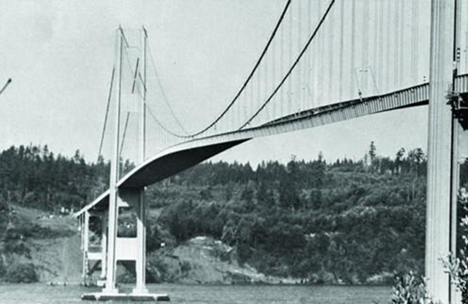
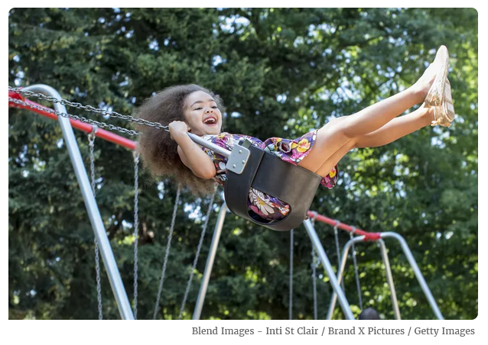
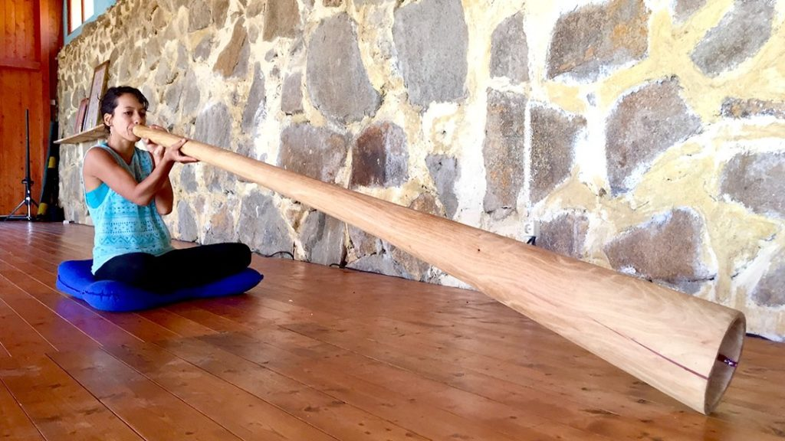
Resonance

Slide 3
Resonance: Force and Response
Repeating motion at a natural frequency
Sympathetic response
  matching input force’s frequency to natural response frequency
Motion and energy both oscillate
Energy can be put in and taken out

Slide 4
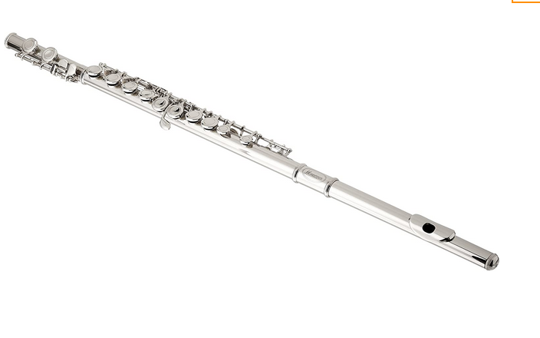

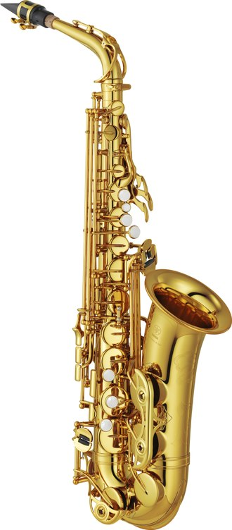
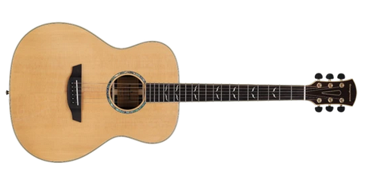
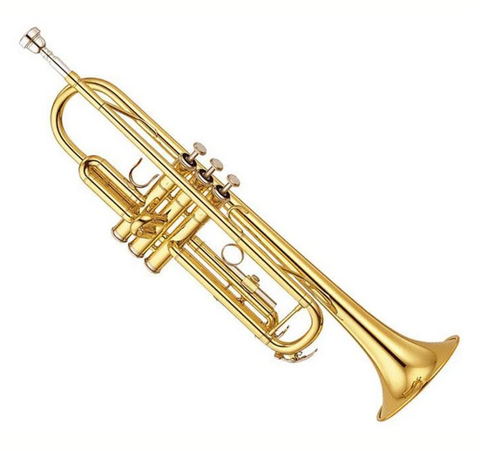
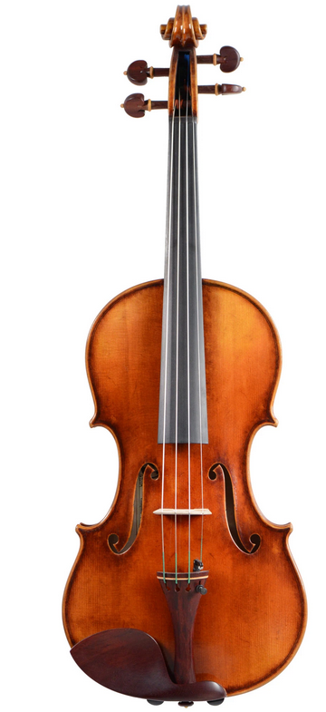
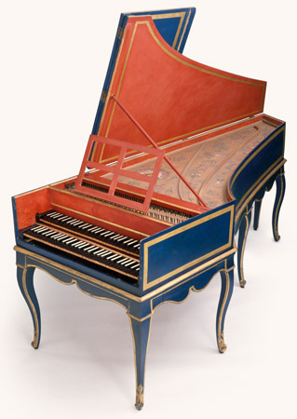
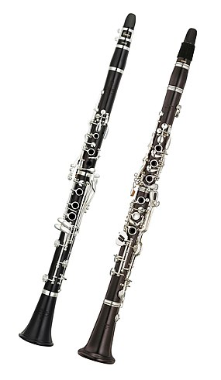

Slide 5
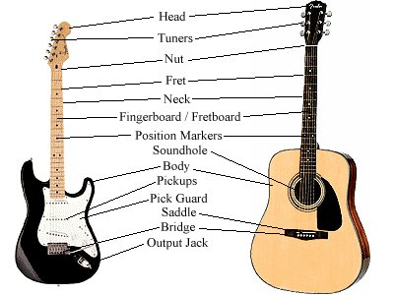
Guitar

Slide 6
Guitar
Strings oscillate after pluck
Energy of strings causes wooden body and air inside to resonate
Strings move very little air
Body and air resonances move lots of air → loudness
Natural frequencies of body and air cavity affect tone

Slide 7
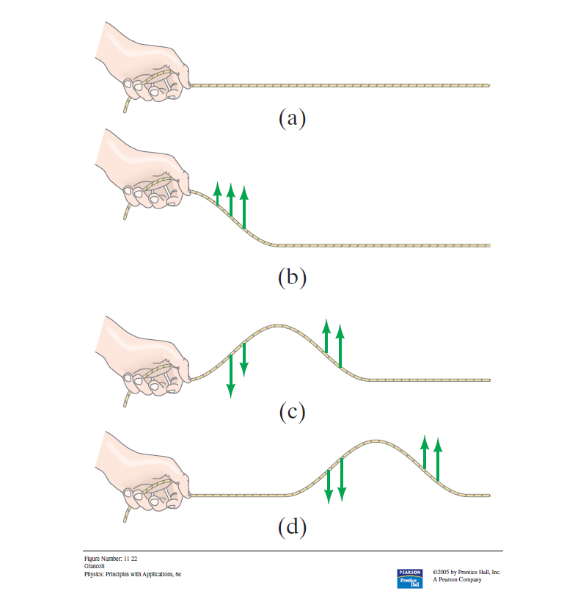
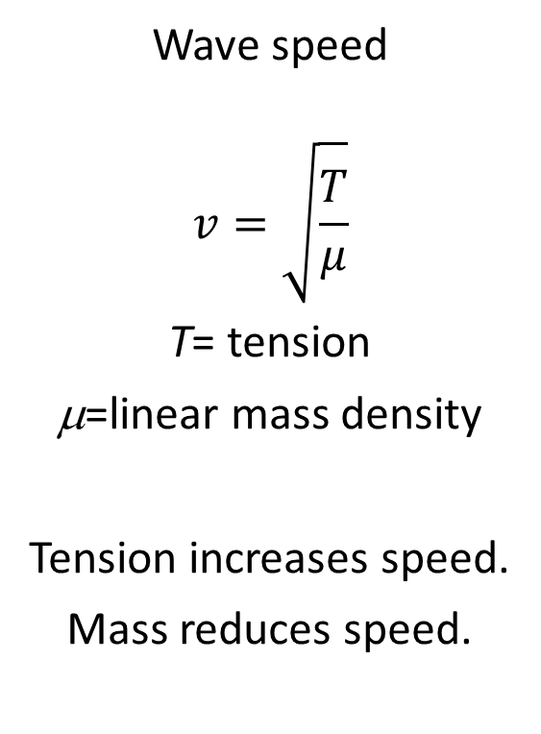
Waves on a String
Wave speed
$$v=\sqrt{\frac{T}{μ}}$$
T= tension
μ=linear mass density
Tension increases speed.
Mass reduces speed.

Slide 8
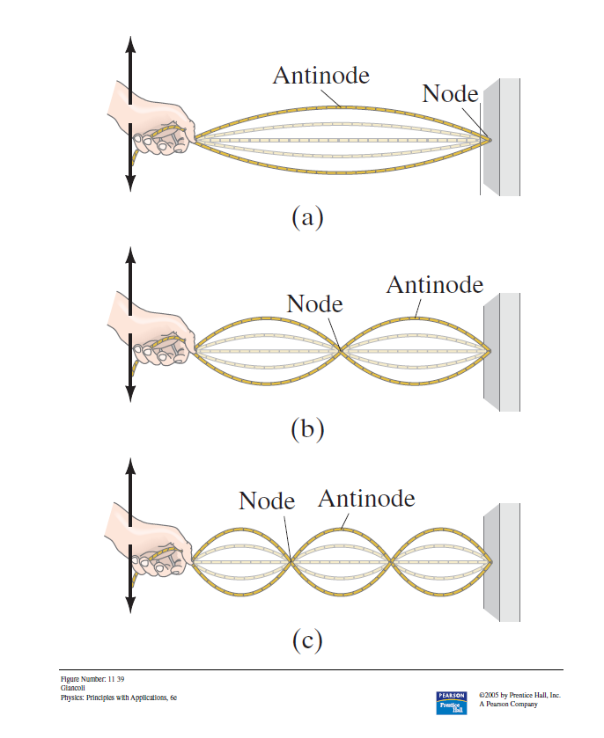
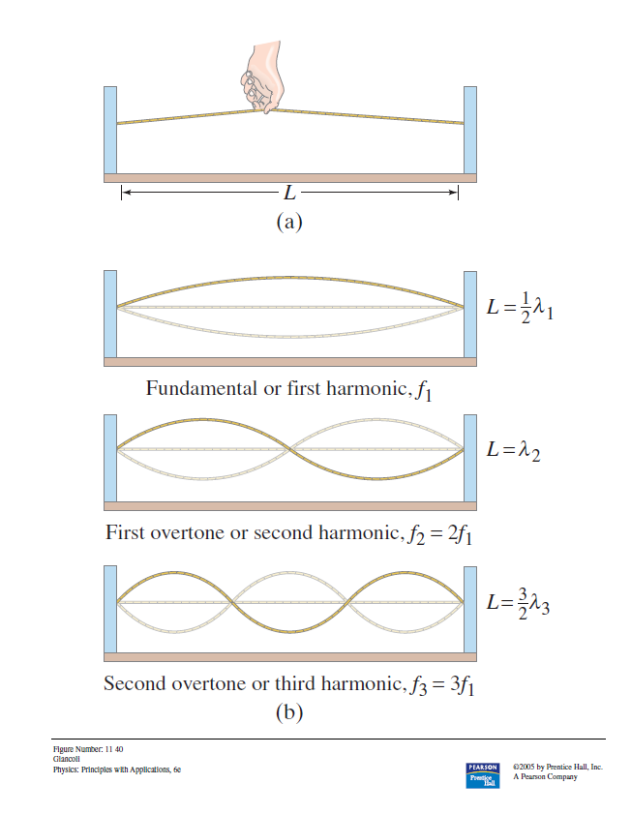
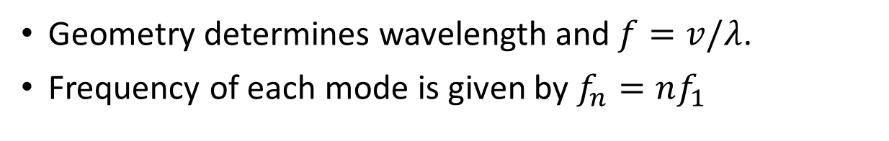
Standing Waves
Geometry determines wavelength and $f=v/λ$.
Frequency of each mode is given by $f_{n}=nf_{1}$

Slide 9
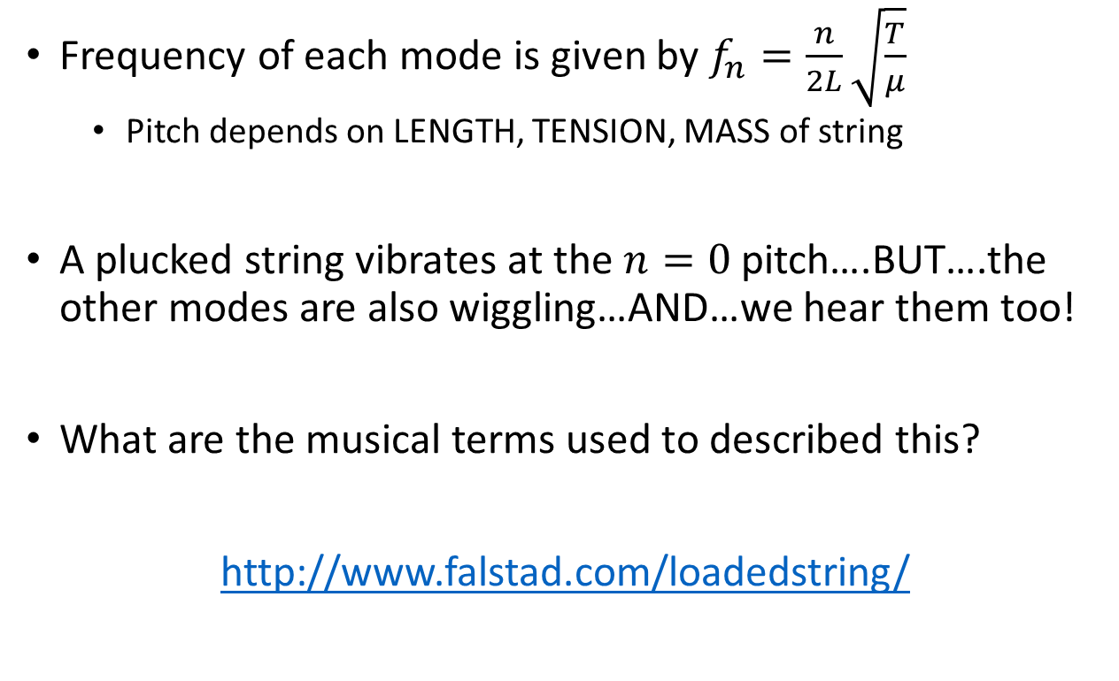



Standing Waves
$$f=v/λ$$
$$v=\sqrt{T/μ}$$
$$λ_{n}=2L/n$$
Frequency of each mode is given by $f_{n}=\frac{n}{2L}\sqrt{\frac{T}{μ}}$
  Pitch depends on LENGTH, TENSION, MASS of string
A plucked string vibrates at the $n=0$ pitch….BUT….the other modes are also wiggling…AND…we hear them too!
What are the musical terms used to described this?
http://www.falstad.com/loadedstring/

Slide 10
Guitar

Slide 11
Circular Surface (drum head) resonances
Two-dimensional surfaces also have different vibration modes
https://www.idrumtune.com/drumhead-vibration-and-the-science-of-sound/
https://www.falstad.com/circosc/

Slide 12
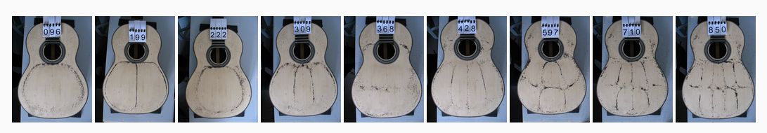
Resonance of Guitar Body
The wooden plates and air cavity have their own modes which respond (or not) to string frequencies.
https://wurth-guitars.com/en/functionality-of-the-guitar/

Slide 13
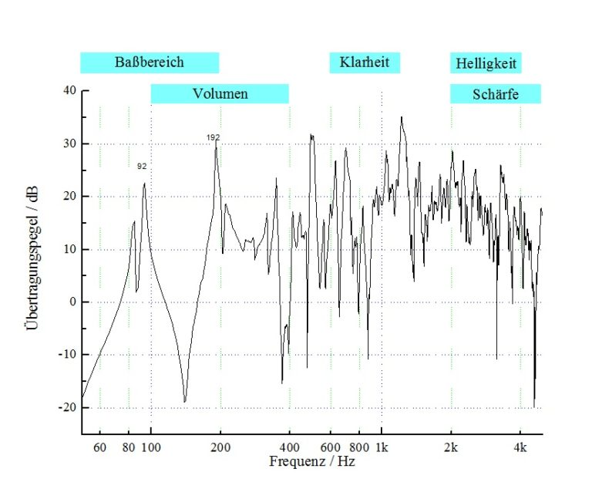
Body and air cavity enhance some frequencies and soften others, which affects the timbre of the instrument.
Plucked string produces a combination of frequencies (fundamental pitch + overtones)
Guitar body (wooden plates, air cavity) responds to input from the strings
In short, the guitar body
  Makes the string’s sound louder
  Makes the string’s sound decay away faster
  Alters the timbre of the string’s vibration
https://wurth-guitars.com/en/functionality-of-the-guitar/

Slide 14
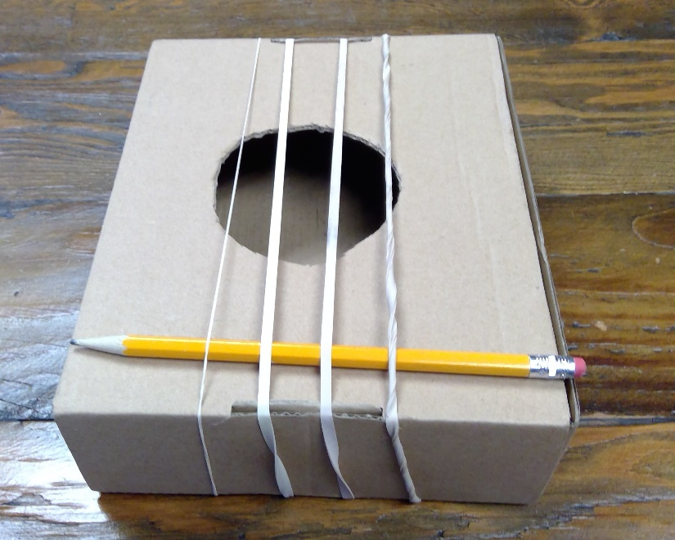
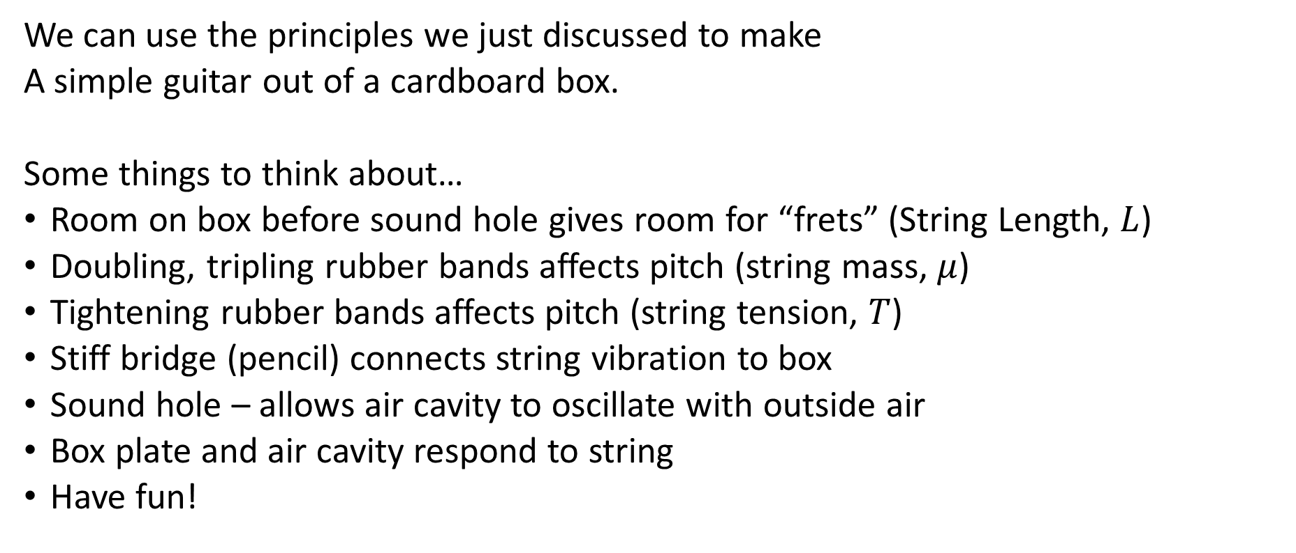
Making a Cardboard Box Guitar
We can use the principles we just discussed to make
A simple guitar out of a cardboard box.
Some things to think about…
Room on box before sound hole gives room for “frets” (String Length, $L$)
Doubling, tripling rubber bands affects pitch (string mass, $μ$)
Tightening rubber bands affects pitch (string tension, $T$)
Stiff bridge (pencil) connects string vibration to box
Sound hole – allows air cavity to oscillate with outside air
Box plate and air cavity respond to string
Have fun!

