Slide 1
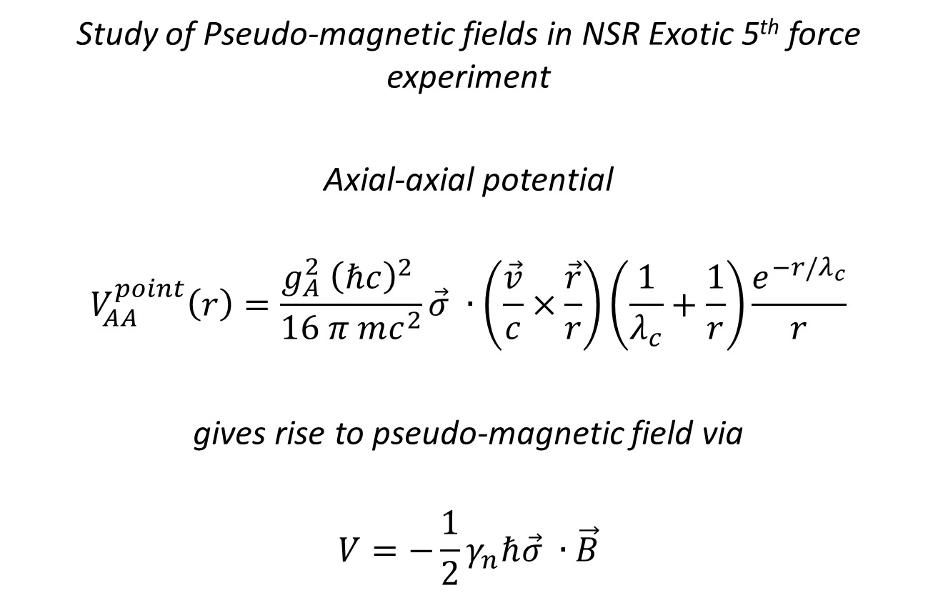
Study of Pseudo-magnetic fields in NSR Exotic 5th force experiment
Axial-axial potential
$$V_{AA}^{point}\left(r\right)=\frac{g_{A}^{2} {\left(ℏc\right)}^{2} }{16 π mc^{2}}\vec{σ} ∙\left(\frac{\vec{v}}{c}×\frac{\vec{r}}{r}\right)\left(\frac{1}{λ_{c}}+\frac{1}{r}\right)\frac{e^{−r/λ_{c}}}{r}$$
gives rise to pseudo-magnetic field via
$$V=−\frac{1}{2}γ_{n}ℏ\vec{σ} ∙\vec{B}$$

Slide 2
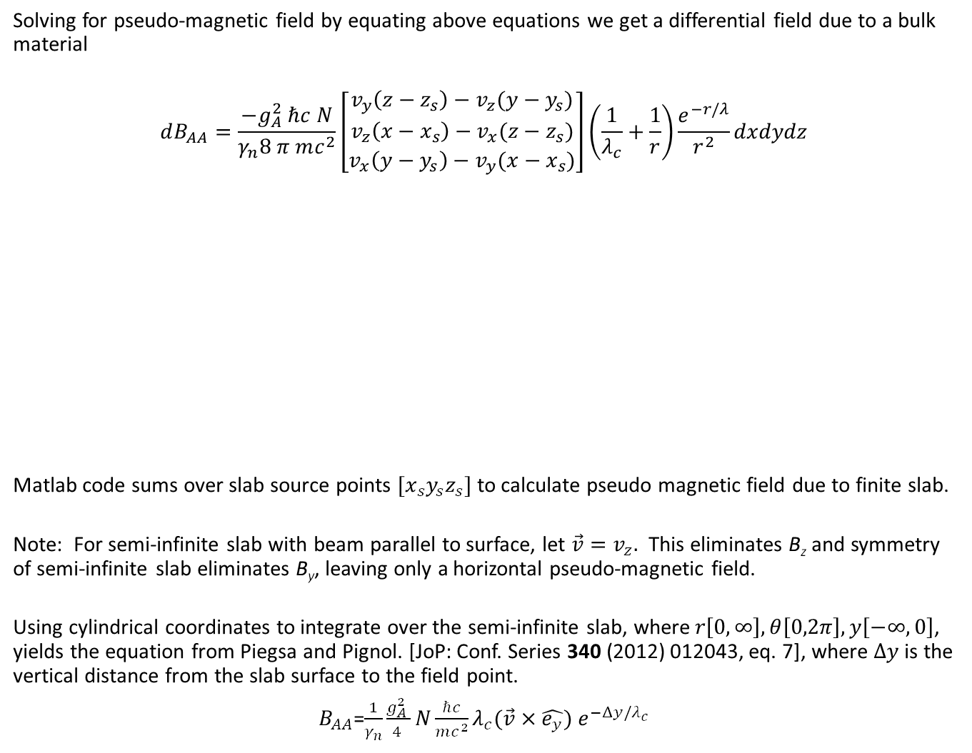
Solving for pseudo-magnetic field by equating above equations we get a differential field due to a bulk material
$$dB_{AA}=\frac{−g_{A}^{2} ℏc N}{γ_{n}8 π mc^{2}}\left[\begin{matrix}v_{y}\left(z−z_{s}\right)−v_{z}(y−y_{s}) \\ v_{z}\left(x−x_{s}\right)−v_{x}(z−z_{s}) \\ v_{x}\left(y−y_{s}\right)−v_{y}(x−x_{s})\end{matrix}\right]\left(\frac{1}{λ_{c}}+\frac{1}{r}\right)\frac{e^{−r/λ}}{r^{2}}dxdydz$$
Matlab code sums over slab source points $[x_{s}y_{s}z_{s}]$ to calculate pseudo magnetic field due to finite slab.
Note: For semi-infinite slab with beam parallel to surface, let $\vec{v}=v_{z}.$ This eliminates B_{z} and symmetry of semi-infinite slab eliminates B_{y}, leaving only a horizontal pseudo-magnetic field.
Using cylindrical coordinates to integrate over the semi-infinite slab, where$r\left[0,∞\right],θ\left[0,2π\right],y\left[−∞,0\right]$, yields the equation from Piegsa and Pignol. [JoP: Conf. Series 340 (2012) 012043, eq. 7], where $Δy$is the vertical distance from the slab surface to the field point.
$B_{AA}$=$\frac{1}{γ_{n}}\frac{g_{A}^{2} }{4 }N{\frac{ℏc}{mc^{2}}λ}_{c}{(\vec{v}×\hat{e_{y}}) e}^{−Δy/λ_{c}}$
z
y
x

Slide 3
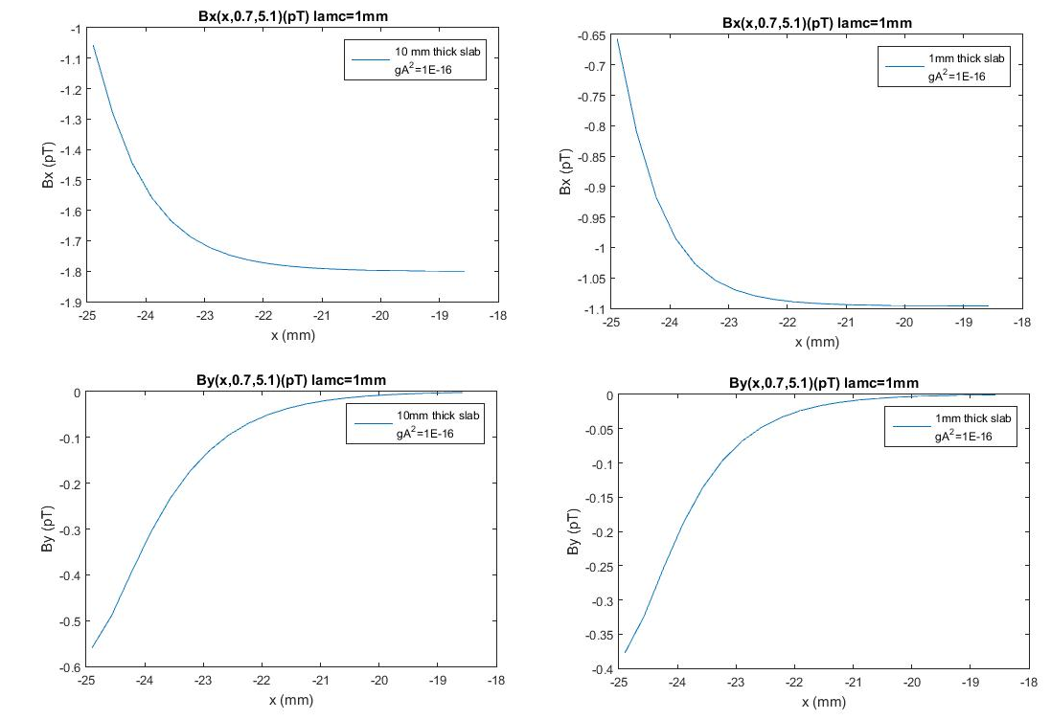
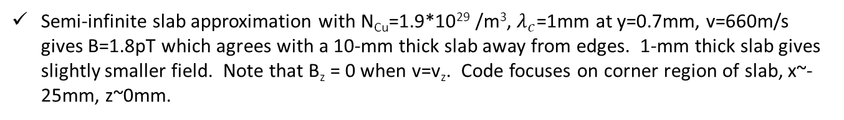
Semi-infinite slab approximation with N_{Cu}=1.9*10²⁹ /m³, $λ_{c}$=1mm at y=0.7mm, v=660m/s gives B=1.8pT which agrees with a 10-mm thick slab away from edges. 1-mm thick slab gives slightly smaller field. Note that B_{z} = 0 when v=v_{z}. Code focuses on corner region of slab, x~-25mm, z~0mm.

Slide 4
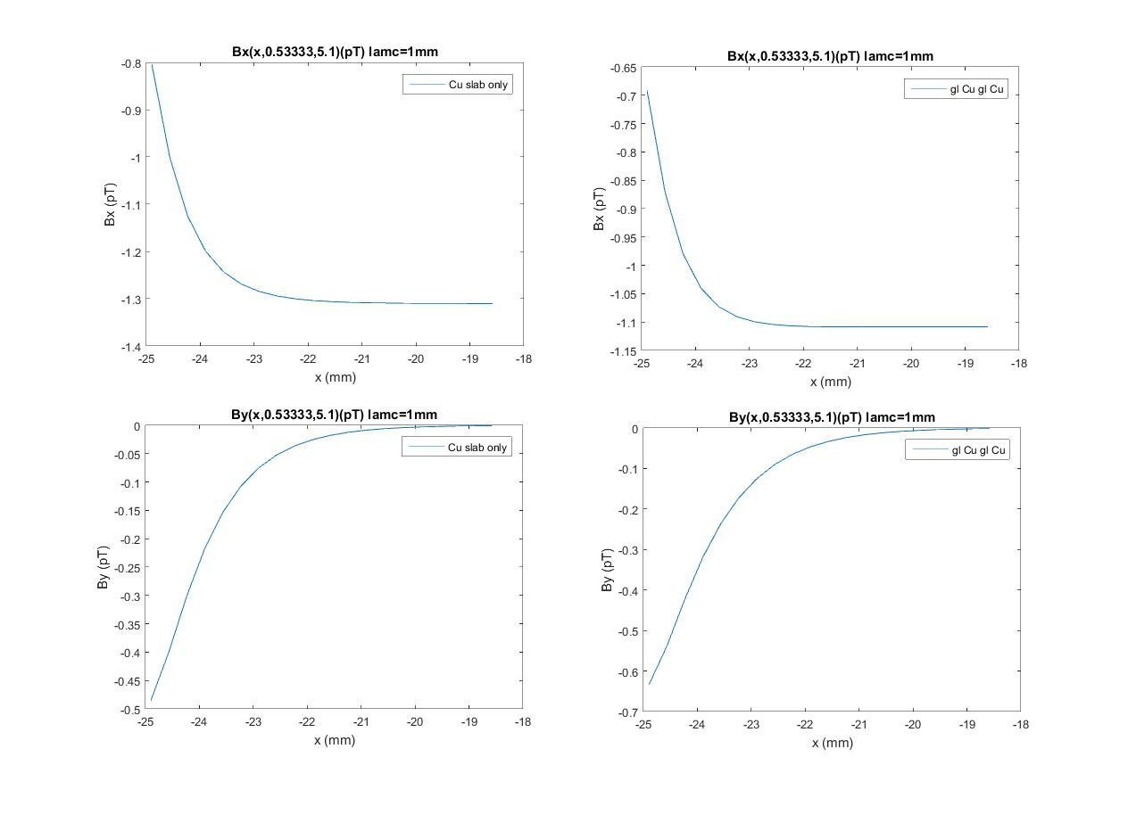
1 slab versus 4
λ_{c}=1mm
Cu (N=1.9E29/m³)
glass (N=0.75E29/m³)

Slide 5
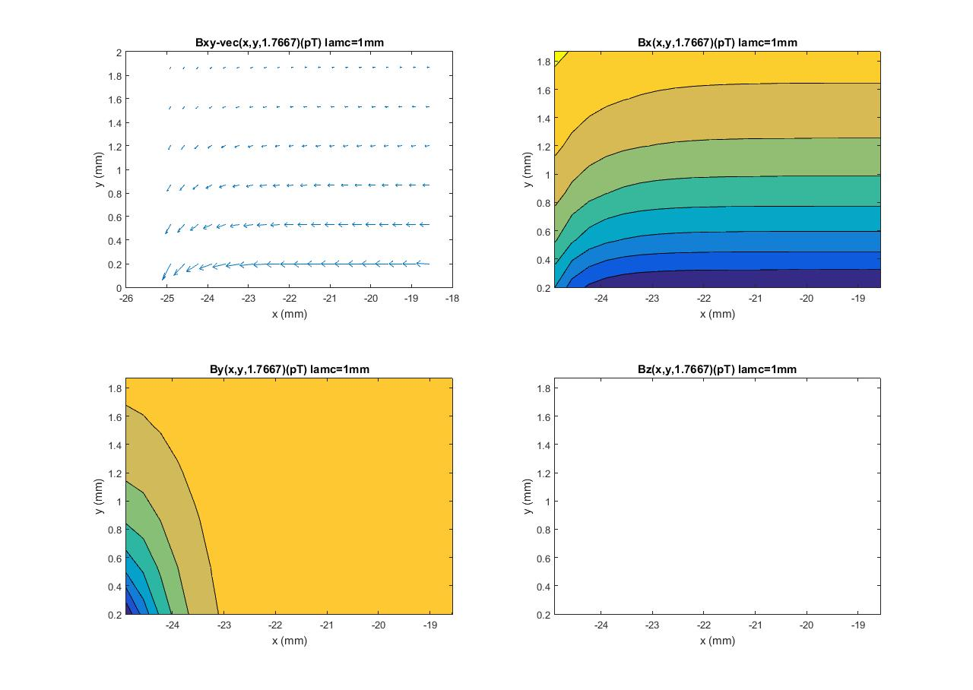
1 slab
λ_{c}=1mm
Cu (N=1.9E29/m³)

Slide 6
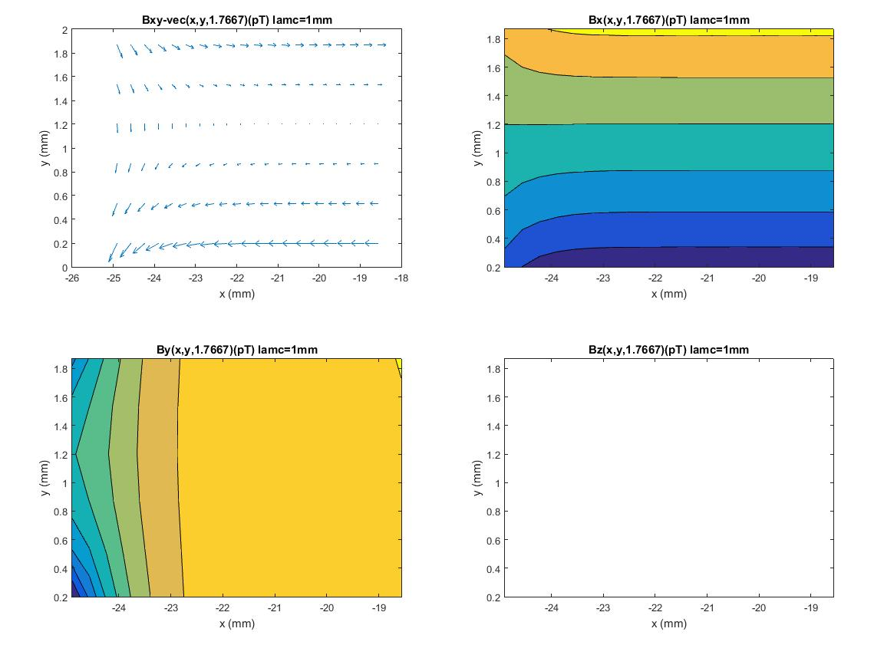
4 slabs
λ_{c}=1mm
glass (N=0.75E29/m³)
+1.1pT
-1.8pT

Slide 7
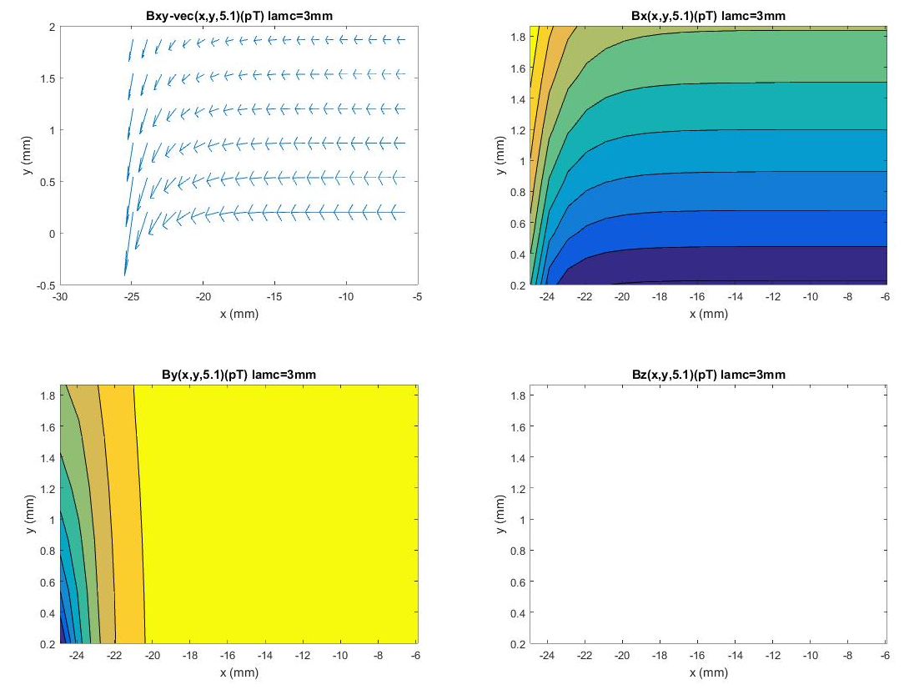
1 slab
λ_{c}=3mm
Cu (N=1.9E29/m³)

Slide 8
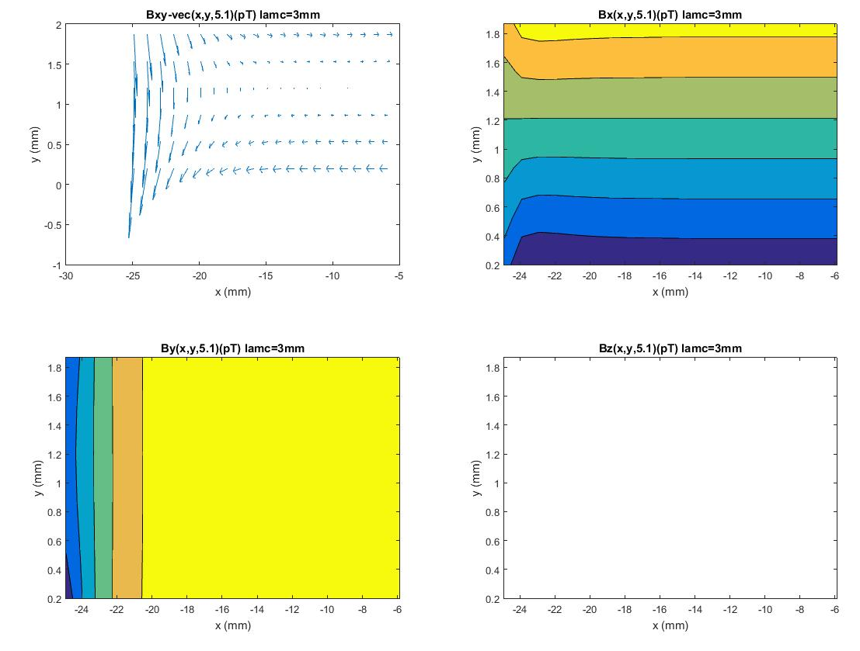
4 slabs
λ_{c}=3mm
glass (N=0.75E29/m³)
+1.2pT
-1.8pT

Slide 9
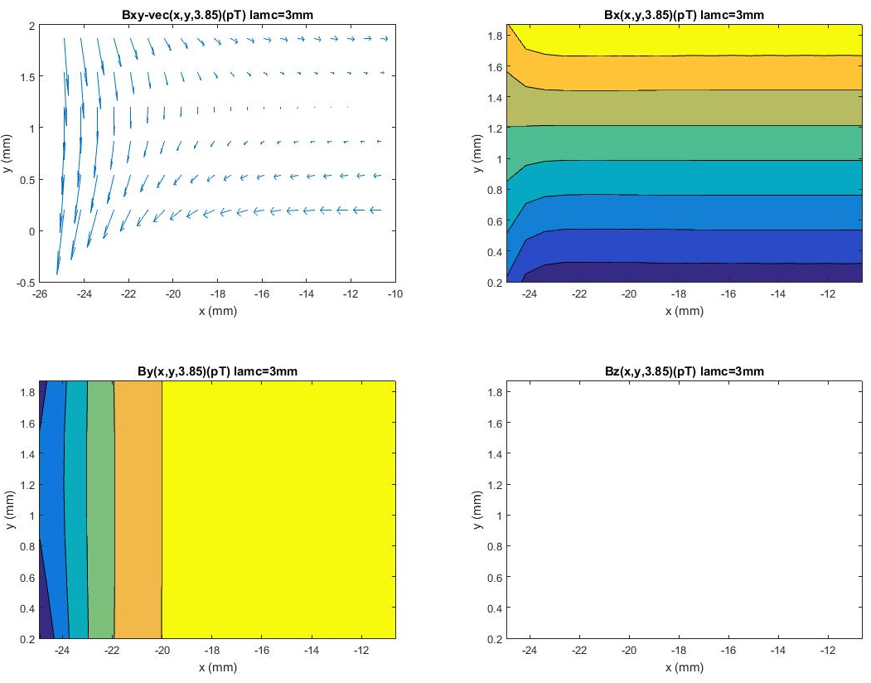
8 slabs
λ_{c}=3.0mm
+1.43pT
-2.25pT

Slide 10
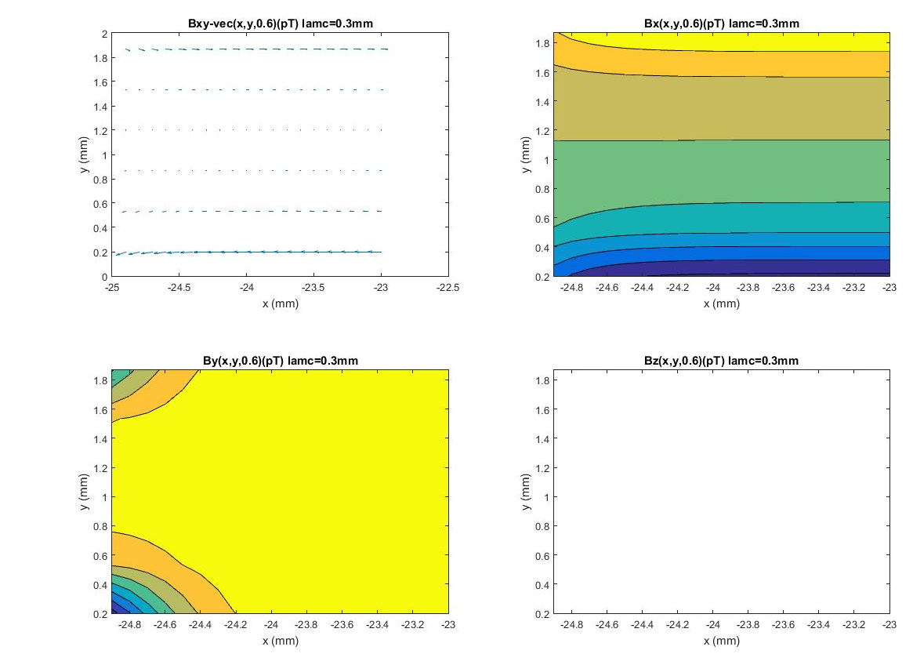
4 slabs
λ_{c}=0.3mm
glass (N=0.75E29/m³)
+0.27pT
-0.51pT

Slide 11
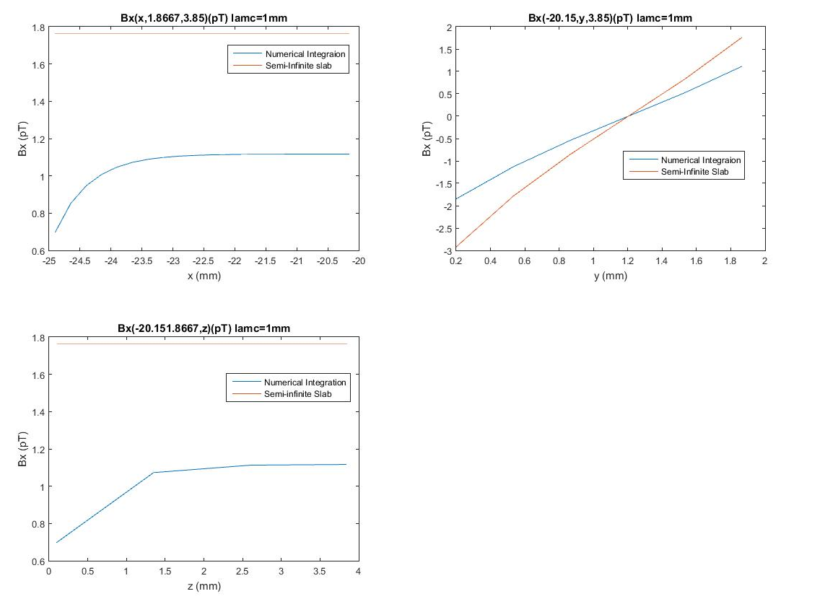
B_{x} versus x, y, z
Eight 1-mm thick slabs with 2-mm vacuum gaps
v=[0,0,660m/s], λ_{c}=1.0mm
Note: Because of slabs above and below the gap, the y-dependence is almost linear rather than exponential.

Slide 12
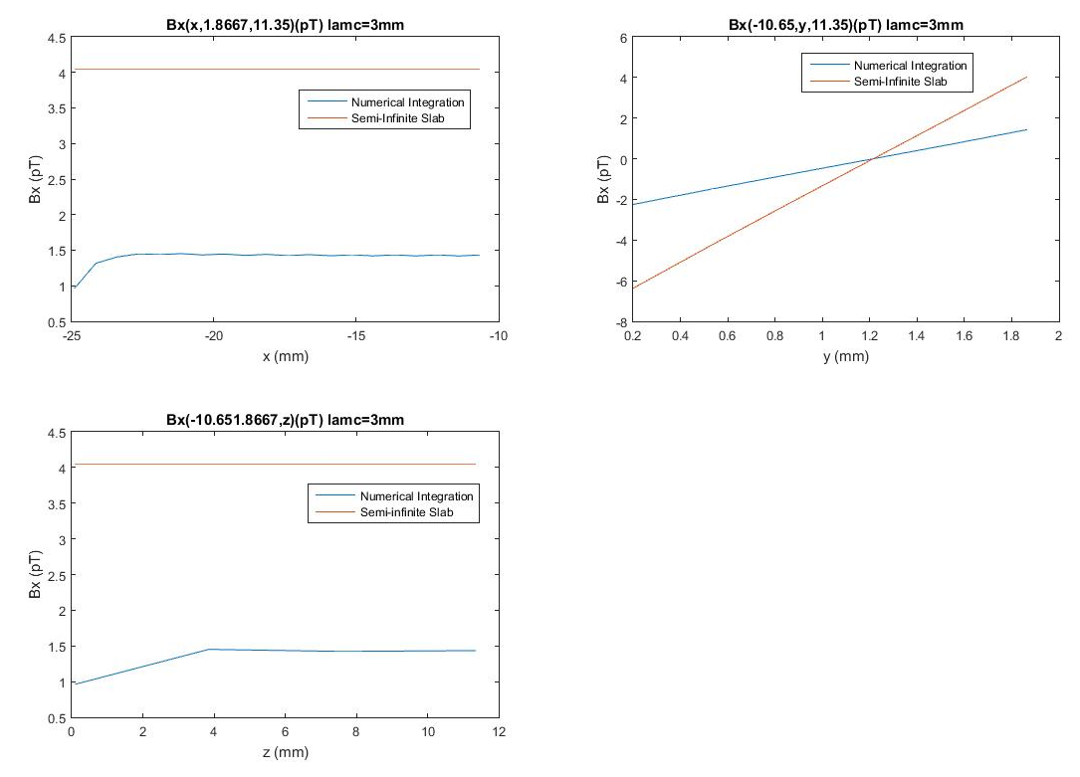
B_{x} versus x, y, z
Eight 1-mm thick slabs with 2-mm vacuum gaps
v=[0,0,660m/s], λ_{c}=3.0mm

Slide 13
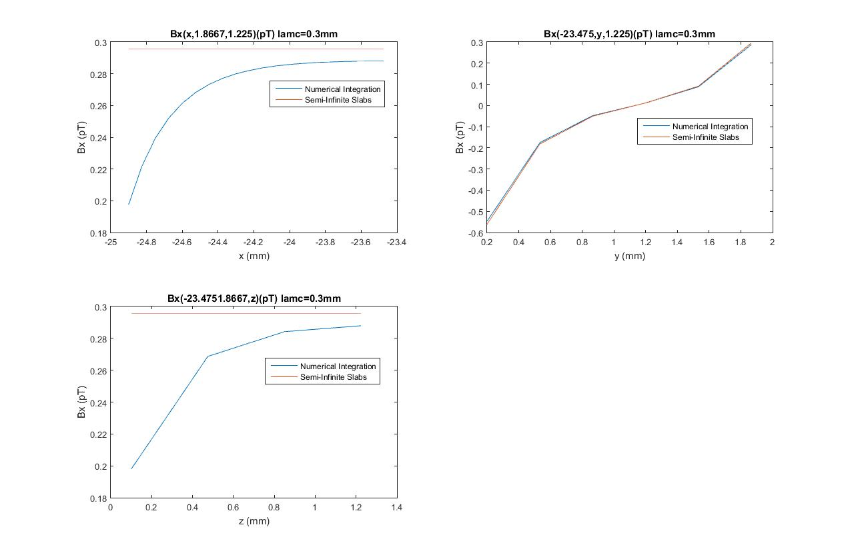

B_{x} versus x, y, z
Eight 1-mm thick slabs with 2-mm vacuum gaps
v=[0,0,660m/s], λ_{c}=0.3 mm
Note: Since $λ_{c}$is 1/3 the thickness of the slab, the slab approximates the semi-infinite slab case in the bulk region away from the edges.

Slide 14
Averaging over volumes in vacuum gap.
These micro-radian rotations, φ, are done separately (φ=-γ_{n}BL/v) for
x- and y- components.
φ_{x} means rotation about B_{x}…
g_{A}=1E-8 v=v_{z}=660m/s | λ_{c}=0.3 mm | λ_{c}=1.0 mm | λ_{c}=3.0 mm
Avg B_{x} (pT) corner* | -0.052 | -0.26 | -0.36
Avg B_{x} (pT) bulk | -0.064 | -0.31 | -0.40
Avg B_{x} (pT) Semi-Inf | -0.066 | -0.49 | -1.14
Avg B_{y} (pT) corner | -0.015 | -0.15 | -0.57
Avg φ_{x} (μrad) bulk | 8.8 | 43 | 56
Avg φ_{x} (μrad) full | 8.6 | 41 | 49
Avg φ_{x} (μrad) Semi-Inf | 9.0 | 69 | 158
Avg φ_{y} (μrad) full | 0.2 | 8.5 | 95
*corner width = 5λ_{c}

Slide 15
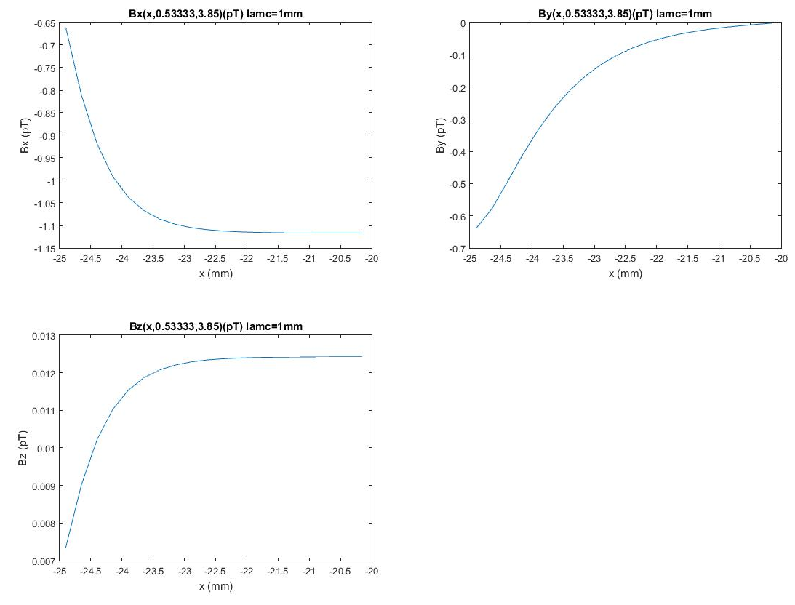
v_{x}=7.3m/s, v_{z}=660m/s (m=0.65 glass), λ_{c}=1.0 mm
Eight 1-mm thick slabs with 2-mm vacuum gaps
v=[2.6,0,660]m/s, λ_{c}=1.0 mm
Note: B_{x} and B_{y} are essentially unchanged. B_{z} is quite small.

Slide 16
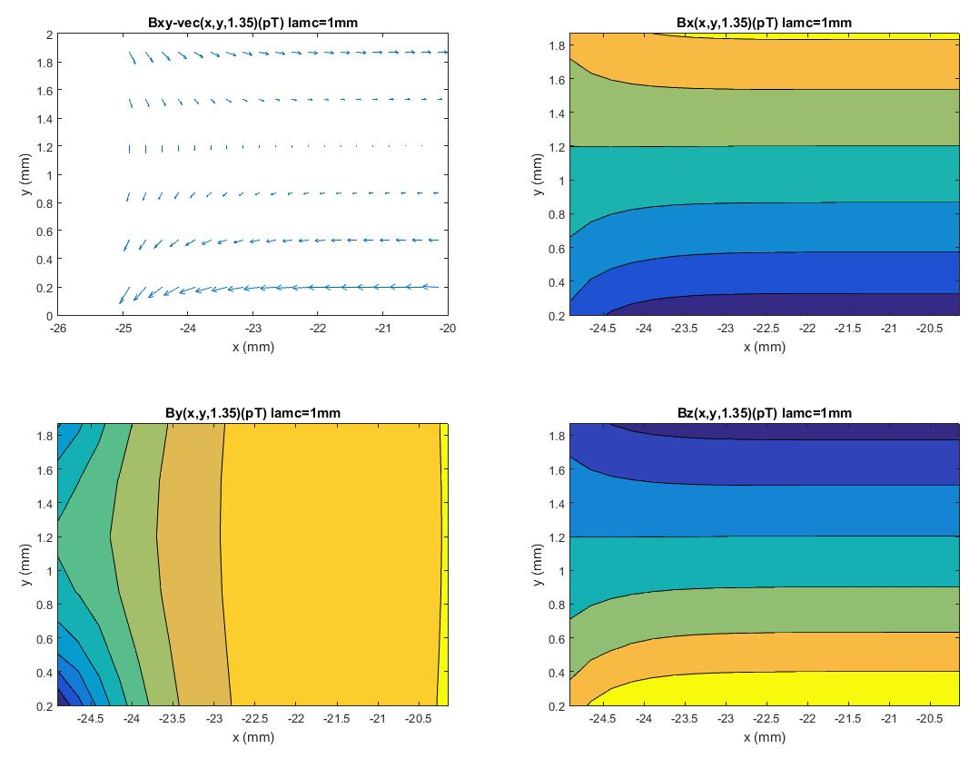
v_{x}=7.3m/s, v_{z}=660m/s (m=0.65 glass), λ_{c}=1.0 mm

Slide 17
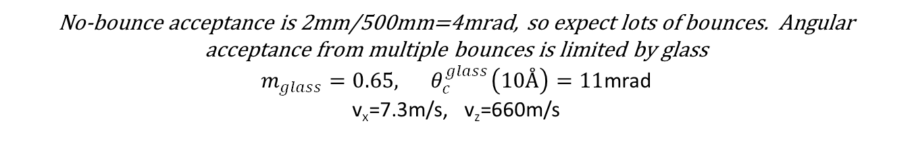
No-bounce acceptance is 2mm/500mm=4mrad, so expect lots of bounces. Angular acceptance from multiple bounces is limited by glass
$m_{glass}=0.65, { θ}_{c}^{glass}\left(10Å\right)=11$mrad v_{x}=7.3m/s, v_{z}=660m/s
g_{A}=1E-8 v_{x}=7.3m/s v_{z}=660m/s |  | λ_{c}=1.0 mm | λ_{c}=3.0 mm
Avg B_{x} (pT) corner* |  | -0.26 | -0.36
Avg B_{x} (pT) bulk |  | -0.31 | -0.40
Avg B_{x} (pT) Semi-Inf |  | -0.49 | -1.13
Avg B_{y} (pT) corner |  | -0.15 | -0.56
Avg B_{z} (pT) bulk |  | 0.003 | 0.004
Avg φ_{x} (μrad) bulk |  | 43 | 55
Avg φ_{x} (μrad) full |  | 40 | 49
Avg φ_{x} (μrad) Semi-Inf |  | 68 | 157
Avg φ_{y} (μrad) full |  | 8.3 | 92
Avg φ_{z} (μrad) full |  | -0.4 | -0.5
So…with maximum divergence, z-rotation component is still quite small.
Y-rotation component is sizable, but beam polarized along y.

Slide 18
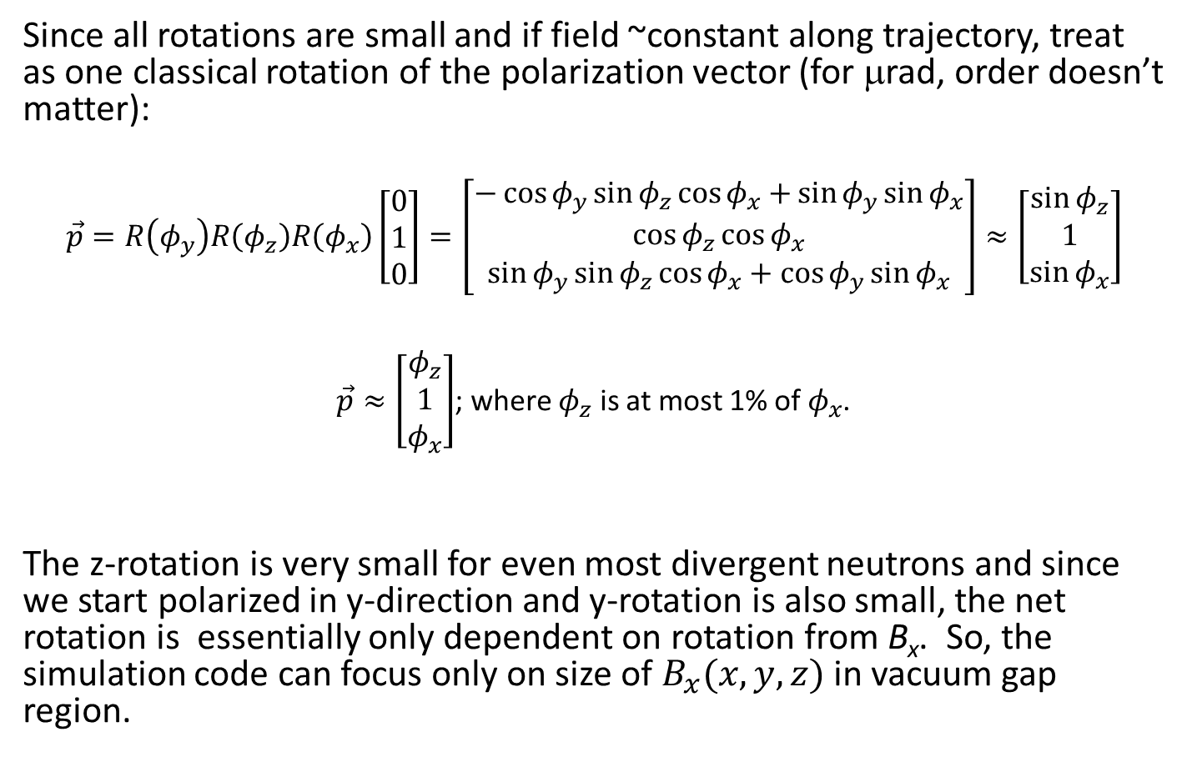
Since all rotations are small and if field ~constant along trajectory, treat as one classical rotation of the polarization vector (for μrad, order doesn’t matter):
$$\vec{p}=R\left(φ_{y}\right)R\left(φ_{z}\right)R\left(φ_{x}\right)\left[\begin{matrix}0 \\ 1 \\ 0\end{matrix}\right]=\left[\begin{matrix}−\cos{φ_{y}}sin{φ_{z}\cos{φ_{x}+}}\sin{φ_{y}}\sin{φ_{x}} \\ \cos{φ_{z}}\cos{φ_{x}} \\ \sin{φ_{y}}\sin{φ_{z}\cos{φ_{x}}}+\cos{φ_{y}}sin{φ_{x}}\end{matrix}\right]≈\left[\begin{matrix}\sin{φ_{z}} \\ 1 \\ \sin{φ_{x}}\end{matrix}\right]$$
$\vec{p}≈\left[\begin{matrix}φ_{z} \\ 1 \\ φ_{x}\end{matrix}\right]$; where $φ_{z}$ is at most 1% of $φ_{x}$.
The z-rotation is very small for even most divergent neutrons and since we start polarized in y-direction and y-rotation is also small, the net rotation is essentially only dependent on rotation from B_{x}. So, the simulation code can focus only on size of $B_{x}(x,y,z)$ in vacuum gap region.

Slide 19
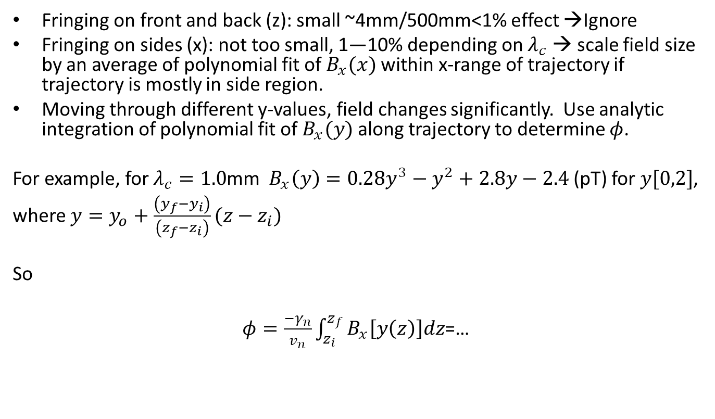
Field is not constant. How to deal with in simulation (nSimDark)…
Fringing on front and back (z): small ~4mm/500mm<1% effect →Ignore
Fringing on sides (x): not too small, 1—10% depending on $λ_{c}$ → scale field size by an average of polynomial fit of $B_{x}(x)$ within x-range of trajectory if trajectory is mostly in side region.
Moving through different y-values, field changes significantly. Use analytic integration of polynomial fit of $B_{x}(y)$ along trajectory to determine $φ$.
For example, for $λ_{c}=1.0$mm $B_{x}\left(y\right)=0.28y^{3}−y^{2}+2.8y−2.4$ (pT) for $y[0,2]$,
where $y=y_{o}+\frac{\left(y_{f}−y_{i}\right)}{\left(z_{f}−z_{i}\right)}(z−z_{i})$
So
$φ=\frac{−γ_{n}}{v_{n}}\int_{z_{i}}^{z_{f}}{B_{x}\left[y\left(z\right)\right]dz}$=…

Slide 21
